Slide 1


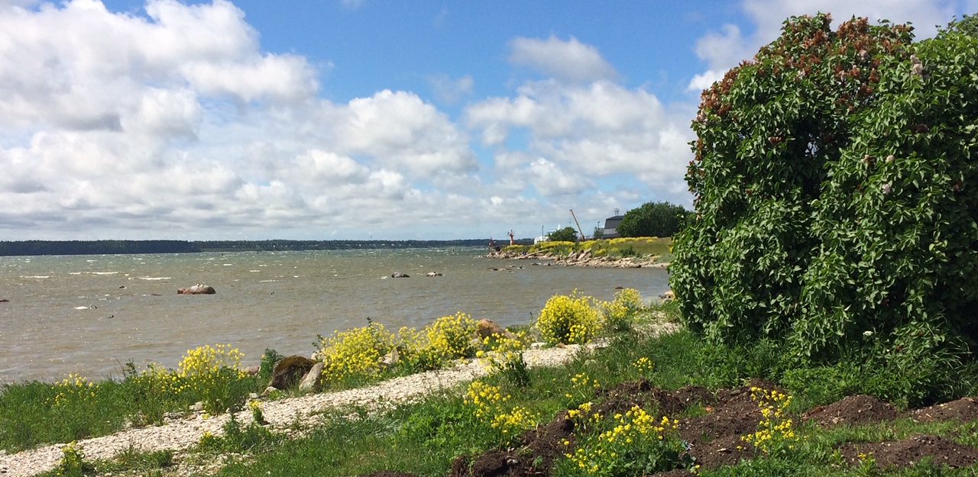
CO-LAND - Inclusive Coastal Landscapes
Activating green and blue infrastructure for sustainable development of the urban-land interface
Tallinn IP 20-27.05.2019

Slide 2
CO-LAND - Inclusive Coastal Landscapes
Tallinn IP 20-27.05.2019
Presentation contents
Character description, values, specific qualities (plans, sketches, descriptions). Also information about intangible values.
Analysis conclusions: Based on the area perception during the course (analysis plans and description)
  what is there?
  what is missing or should be fixed?
  What is the future scenario if everything happens as it happens
Vision for the area: best possible future (plans, descriptions)
  Specific goals for the area
  Role of your area within the peninsula
  Concept for area development
Step-by-step development: what needs to e done to achieve the development vision (plans, illustrations)
Examples of focus areas/topics – detailization of the vision, demonstrating the spatial quality of the proposals (detailed plans, drawings, sections, visualisations etc.)
  e.g. detailed street sections, small scale intervention drawings….
500 words
  *Refer to information, given by the city!
  * Presentation both in PowerPoint and A4 poster report
23.05 analysis presentation
24.05 concept presentation
26.05 CoLand presentation

Slide 3
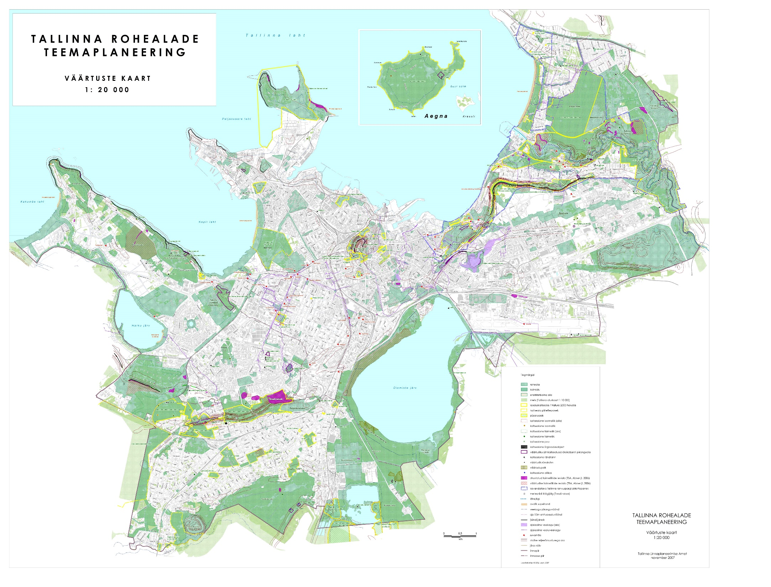
Accessibility and function of public spaces (Tallinn level)

Slide 4
Access to water

Slide 5
Gentrification, densification and possible loss of public (open) spaces

Slide 6
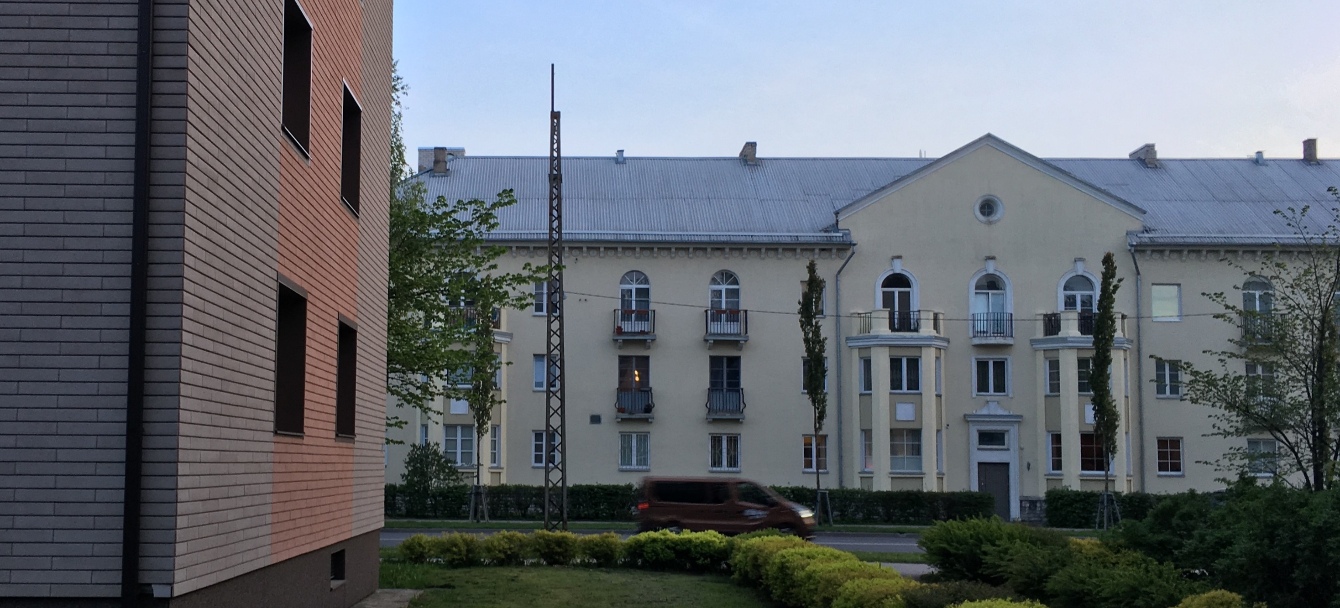
Narratives of the place. What is the valuable history?

Slide 7
Narratives of the place. What is the valuable history?

Slide 8
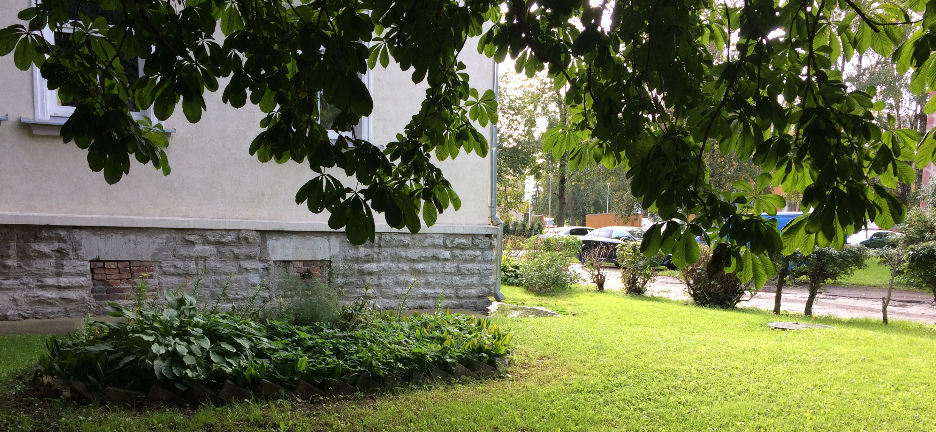
What are the values? What should be kept?

