Slide 1
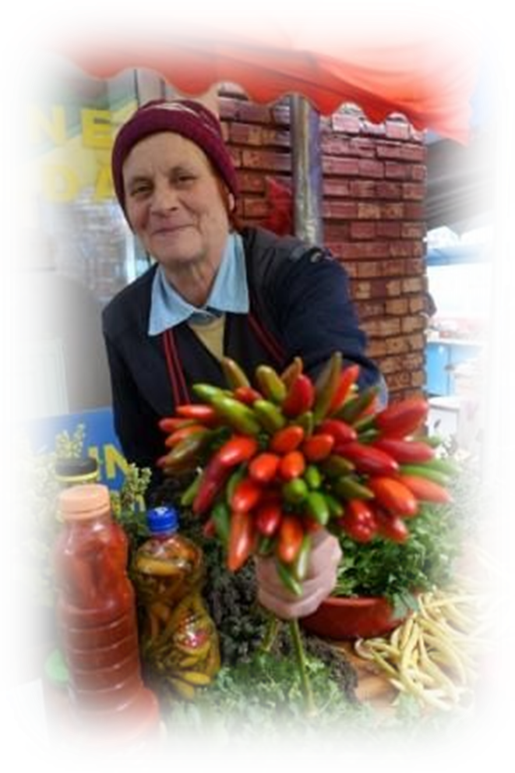
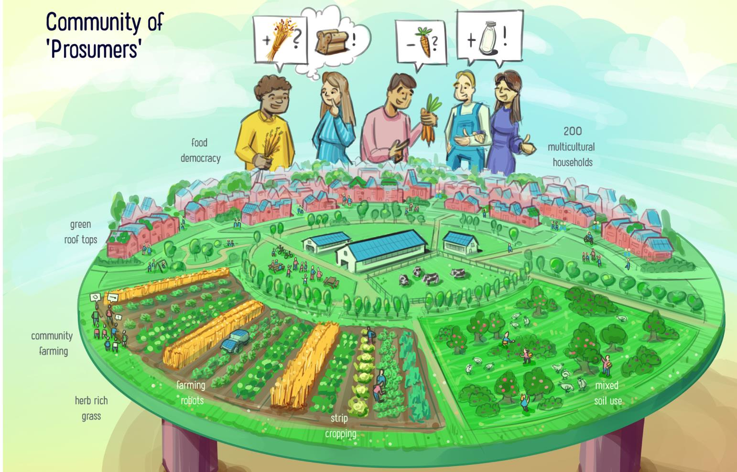
Living Lab Bucharest District 6 (Romania)
Towards a Local Food Strategy
Source De Boer & deOlde et al 2020, Re-rooting the Dutch food system

Slide 2
Outline
Context
Objectives reached
online course
multi-disciplinary team
online and in Bucharest
Tasks
determine objectives: draft an approach/vision for a Living Lab and an agri-food strategy
map local state and non-state actors
inform the draft of the strategy through the analysis of similar examples from other cities
mapped local public, private, and civil society actors
performed the background analysis of similar examples
co-organized a workshop in District 6, Paris
bi-lateral meeting Bergamo
drafted the approach for a Living Lab and an agri-food strategy

Slide 3
“Agroecology demands a complete reorganisation of municipalities.
People from social economy, food production, the environment, health and planning, they all have to work as one multidisciplinary team.”
Raul Terrile (Rosario), September 27, 2019

Slide 4
Expected Outcomes of this course
A detailed map of District 6's food ecosystem, with key players and their interactions.
Defining general objectives aligning with community needs and sustainability ambitions.
A shared vision for District 6's future food system, leading to a strategic plan and scalable pilot projects.

Slide 5
Living Lab Towards a Local Food Strategy
1. Overview of District 6's Food system
2. Creating a Living Lab group.
3. Vision setting and strategic actions.
Objectives for Local Students:
Mapping the local food system.
Establishing comprehensive goals.
Developing a sustainable vision.
Creating an actionable strategy with innovative practices.
Research Questions for Remote Students:
Integration with broader city-region strategies.
Formation of an effective local food council.
Primary goals in a post-socialist context.
Effective resident engagement methods.

Slide 6
Objectives for local students
Mapping the Local Food System: To catalog all participants in District 6's food system, including producers, distributors, retailers, consumers, and waste handlers, thereby identifying product flows, inefficiencies, and opportunities for sustainability.
Establishing General Objectives: To set comprehensive goals like reducing food transportation distances, improving food security, advocating for local and seasonal foods, and cutting down food waste.
Developing a Vision: To formulate a long-term outlook for District 6’s food system that embodies sustainability, community welfare, and economic health.
Creating a Strategy: To devise an actionable plan that includes innovative practices such as urban agriculture, food sharing initiatives, and circular economy principles, detailing both immediate and future steps, potential hurdles, and success indicators

Slide 7
Research questions for remote students
Integration: How can District 6's food strategy integrate with the broader city-region for mutual sustainability benefits?
Formation: What are the necessary steps and key players for establishing an effective local food council at the district level?
Objectives: In a post-socialist capital's context such as District 6, what are the primary goals for a local food strategy?
Engagement: What are the most effective methods for engaging residents in the local food system strategy?

Slide 8
Intermediary presentation
For Local students: mapping the local food system
For remote students : analyse case-study and determine the common element with Bucharest situation

Slide 9
Tasks distribution for local students intermediary presentation
Mapping the local food system
Camelia Bucatariu - identifying relevant stakeholders except institutional. Develop the concept for the multi-stakeholder and multi-disciplinary consultation in Bucharest.
Ioana968211 Elisabeta Enache- spatial mapping of activities or initiatives
Raluca Barbu -mapping the institutional departments related to food system at different level: district/city/metropolitan/GAL/regional
Magda Campeanu – agripark concpet+ Bergamo Food Strategy
Sebastian Cojocaru – Milano Food Strategy
Tudor Brandusoiu

Slide 10
Tasks distribution for remote students intermediary presentation
Case-study evaluation in synergy with Bucharest specific context
Carmen Orduña - Lille Case-Study evaluation + participatory governance methodology
Shashank Yadav - Ghent, Ostende+ Dublin + food hubs approach in metropolitan areas (also study Lille)
Ioanna De Barros
Sofie Patience Mw - Food waste system for a metropolitan area + Milan Food Strategy
María García. Incorporate the peri-urban voids of the city of A Coruña into the green infrastructure o safeguard its agrarian origin.

Slide 11
Tasks distribution for final presentation
mapping local stakeholders (including NGOs, economic actors, festivals, alternative short food chains - ROMO, box schemes, facebook groups) [?Camelia, Ioana]
Stakeholder power map [?Camelia, Ioana]
Timeline: consultation processes, thematic discussions, visits with the producers [?Carmen, Camelia]
Sector 6 green infrastructure workshop conclusions [Roxana, Ioana, Sebastian]
Vision: who are the partners of the Living Lab? (e.g. UAUIM, USAMV, SNSPA…)[?]
timeline [?]
transversal:
capacity building (exchange programme Bergamo, who will visit Bergamo? what can we show them in Sector 6? markets, community gardening in Drumul Taberei, Food Bank, Social Canteen, School with warm meal, festival…)[?]
research (European projects...)[Raluca]
funding (public, private…)[?]
Communication strategy (campaign) - how to communicate with local population and other stakeholders. [Shashank]
Strategy to include vulnerable categories in participatory process [Carmen]
short term actions: Academia de Compost (food waste), Social Food (social project)[Ioana]

Slide 12
Local Food Strategy to be inspired from
Milano https://foodpolicymilano.org/en/objectives-and-priorities/
@Soflet
Dublin https://consultation.dublincity.ie/traffic-and-transport/copy-of-edible-dublin-food-strategy/ or https://www.documentcloud.org/documents/23808541-edible_dublin_draft_250423
@Shashank
Lille https://www.uia-initiative.eu/fr/uia-cities/lille; https://portico.urban-initiative.eu/urban-stories/uia/testing-future-food-court-prototyping-it-real-life-lessons-experience-uia-tastin-fives-lavant-gout
@Carmen

Slide 13
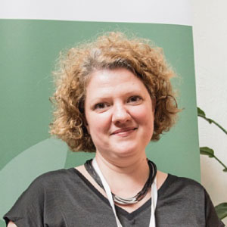
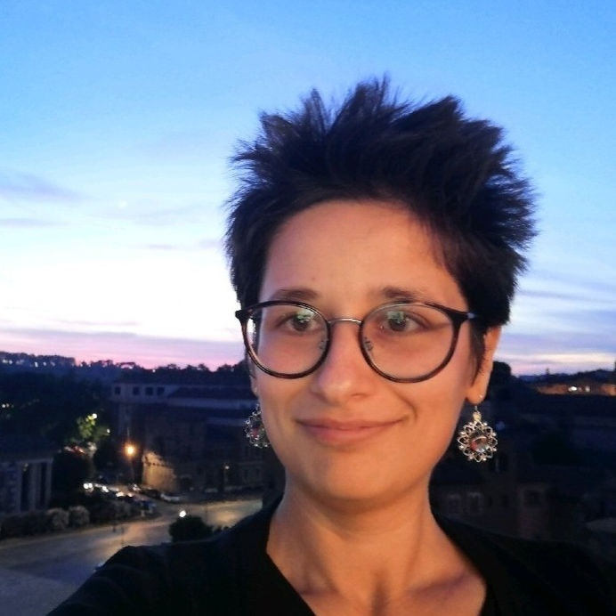
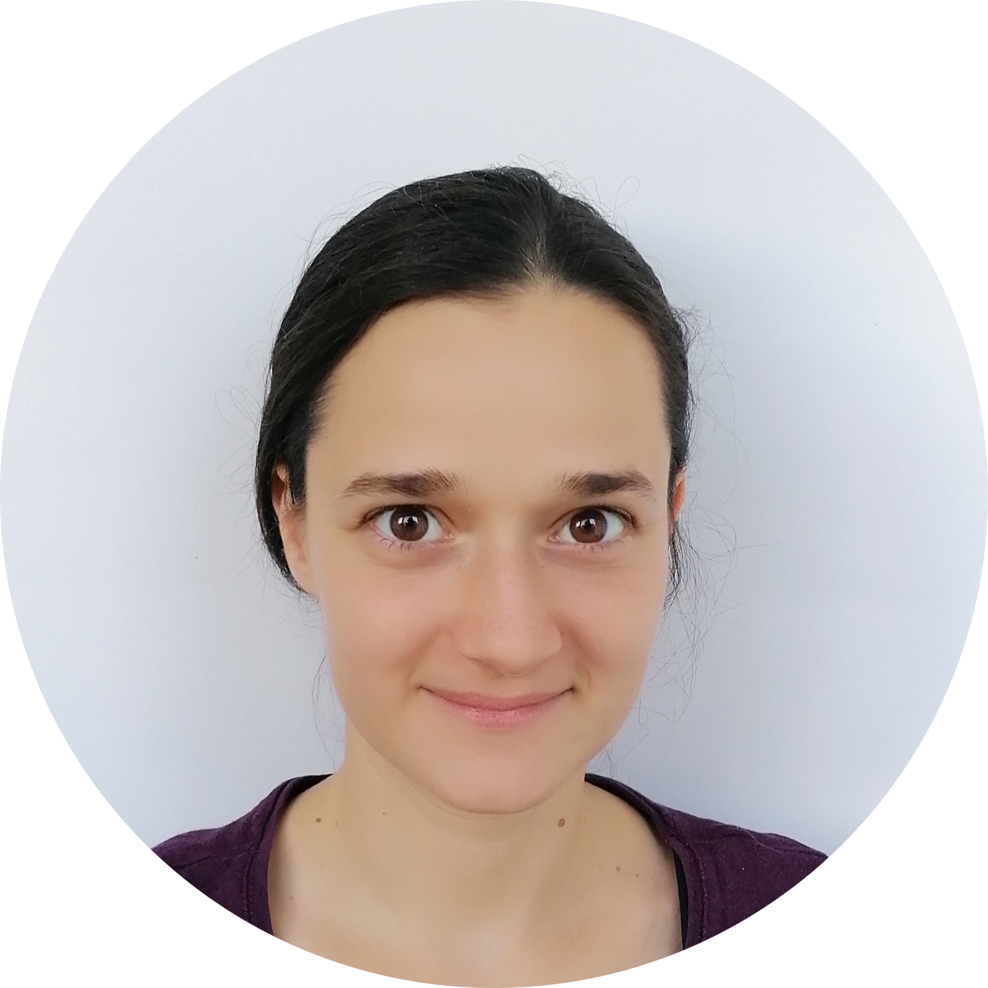
Local students team
Raluca Barbu
PhD student in Food Systems at the University of Agricultural and Veterinary Medicine Sciences, Cluj, Master’s Degree in Communication and Geo-Policy, Bachelor’s Degree in the Economy of Agriculture, Food, and Environment
Professional experience: Agriculture, Rural Development, and Food Policies Consultant, Expertise in Food System Stakeholder Engagement
Camelia Bucătariu
PhD Student University of Bucharest, Political Science
Professional experience in Agri-Food Systems Development, with the FAO
Ioana Enache
PhD Student
UAUIM, Urban Planning, with a thesis on Urban Agriculture with a focus on community practices

Slide 14


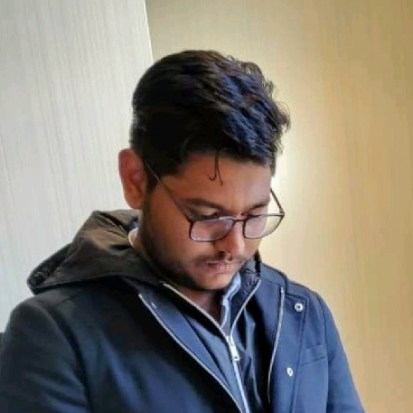
Remote students team
María García
Professor of the master's degree in city and urban planning at the Universitat Oberta de Catalunya.
Doctoral research related to settlement morphology and linked agrarian structures in Galicia in Spain, with a case study on the protection of peri-urban areas of agricultural origin against real estate speculation in the city of A Coruña, Galicia, Spain
Carmen Orduña
Recent graduate from Sciences Po Paris and El Colegio de México Dual masters degree in Comparative Urban Governance. Master’s thesis on Feminism(s) and food activism: the case of feminist prefigurative practices in Mexico City’s alternative food systems.
Contribution: Finding strategies for a participatory governance methodology
Shashank Yadav
Master's student in Landscape Architecture, HfWU-Nürtingen-Geislingen, Germany, studying the intersection of food systems and sustainability, involved in local food strategy development, the Climate task force and Welthaus in Nürtingen, that engages in social, environmental issues and also focuses on forming a future food council in Nürtingen.

Slide 15
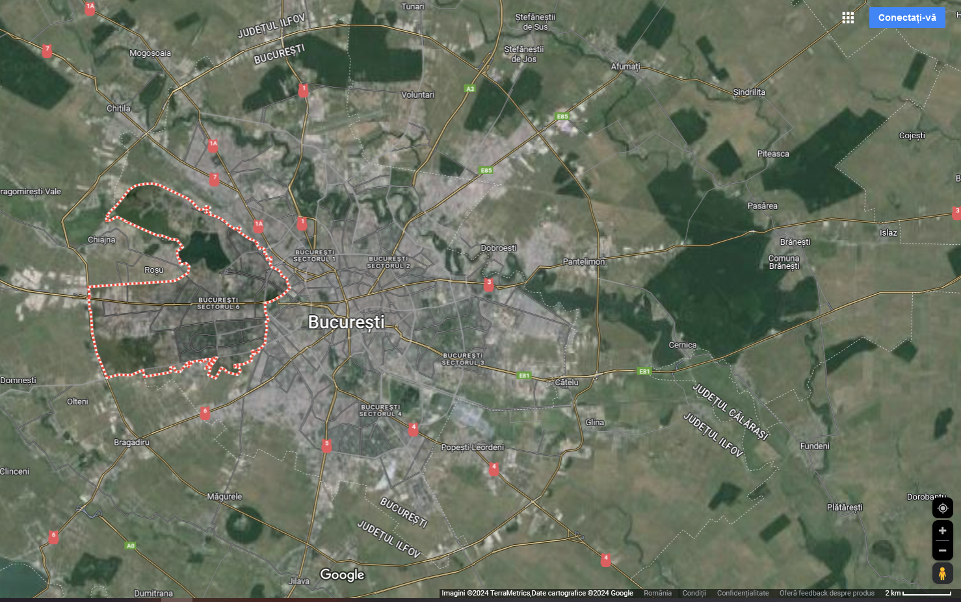
Bucharest District 6 (Romania) - overview
divided into quarters (e.g. Crângași, Drumul Taberei, Ghencea, Giulești, Militari, Regie)
surface: 38 sq km
population: 325,759 (Dec 2021)
it aims to become a smart and green city district
it has a strategic plan for urban development

Slide 16

Integrated urban development program of District 6 of the municipality of Bucharest 2021-2030
Programul integrat de dezvoltare urbană a sectorului 6 al municipiului București 2021 -2030
The document has the following information related to food:
Strategic priority 2 - Efficient and inclusive social development
1. Efficient and inclusive social development
Construction and Equipment Food Bank District 6. Target: 4,000 elderly, 2,000 unemployed, 10,000 disabled people, 1,000 Roma people, 1,500 families with many children, 800 single mothers, 500 children at risk of dropping out of school 30% reduction in the amount of discarded food waste 20% reduction in costs from the local budget regarding the support of poor people and families Reduction by up to 40% of the costs regarding the exceptional financial benefits offered from the local council budget.
Figure Turnover of district 6 retail companies for food and non-food products
4. The inclusive city 4.1. Development of educational infrastructure and services
4.1.2. Improving the primary and secondary/high school education system
Facilitating partnerships to ensure healthy nutrition for children in nurseries, schools, high schools and hospitals
Bucharest City Hall €500,000.00 from local budget and other funding sources
Company name | Object of activity | The country of origin of the capital | Number of employees (2018)
MEGA IMAGE | food and non-food | Belgium / Netherlands | 9741
AUCHAN ROMANIA | food and non-food | France / Netherlands | 10123

Slide 17
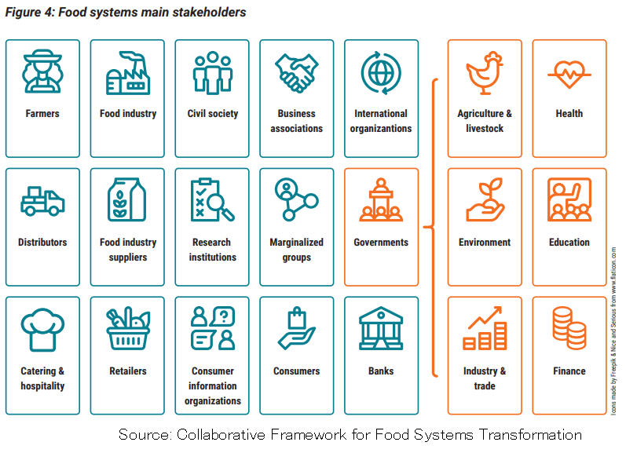
Stakeholder mapping

Slide 18
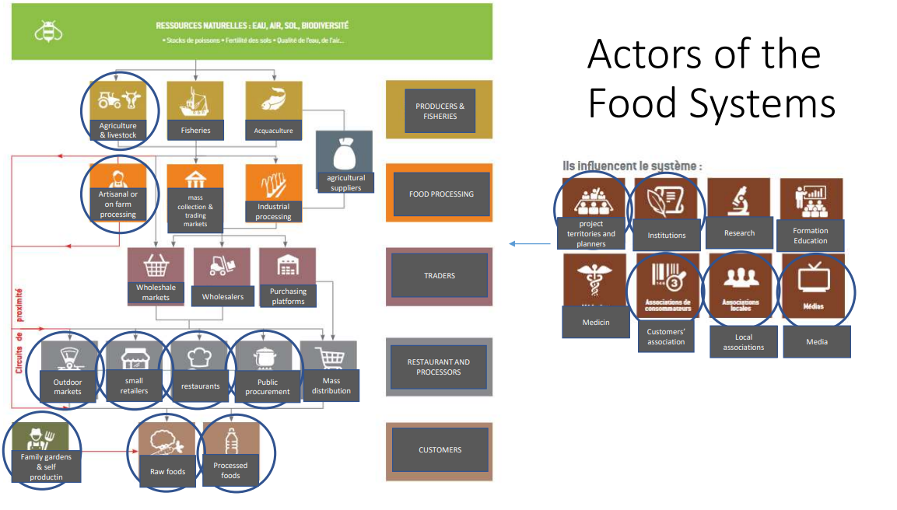

Slide 19
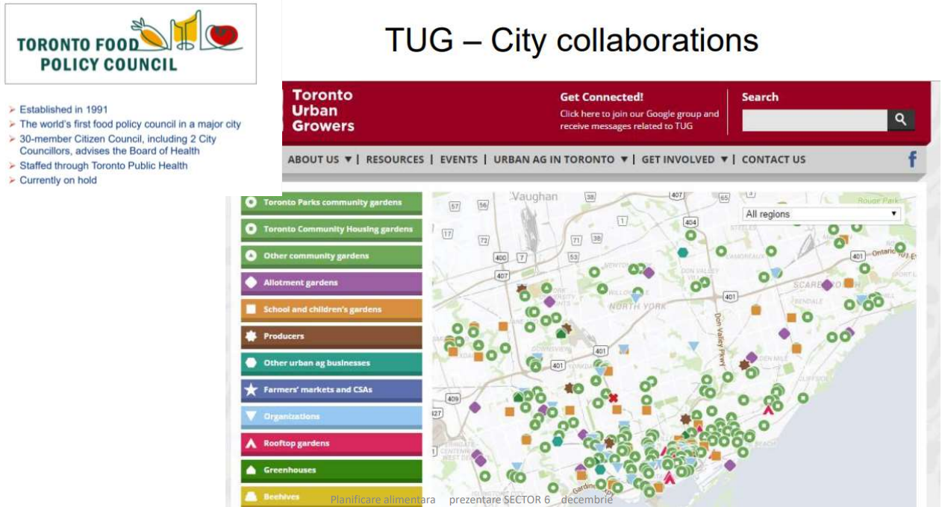

Slide 20
Mapping institutional actors
Production
Agricultural Directorate Bucharest (Direcția pentru Agricultura a Municipiului București)
Sanitary Veterinary and Food Safety Directorate Bucharest (Direcția Sanitar-Veterinară și pentru Siguranța Alimentară București)
Bucharest District 6 City Hall (Primăria Sectorului 6)
Value chain actors
National Trade Register Office (Oficiul Național al Registrul Comerțului)
Sanitary Veterinary and Food Safety Directorate Bucharest (Direcția Sanitar-Veterinară și pentru Siguranță Alimentară București)
Bucharest District 6 City Hall (Administrația Comercială Sector 6)
Social assistance organizations
Social assistance – Bucharest District 6 City Hall (D.G.A.S.P.C Sector 6)
Public catering units (hospitals, creches, schools, military)
Consumption
Consumer Protection (Protecția Consumatorului)
Sanitary Veterinary and Food Safety Directorate Bucharest (Direcția Sanitar-Veterinară și pentru Siguranță Alimentară București)

Slide 21
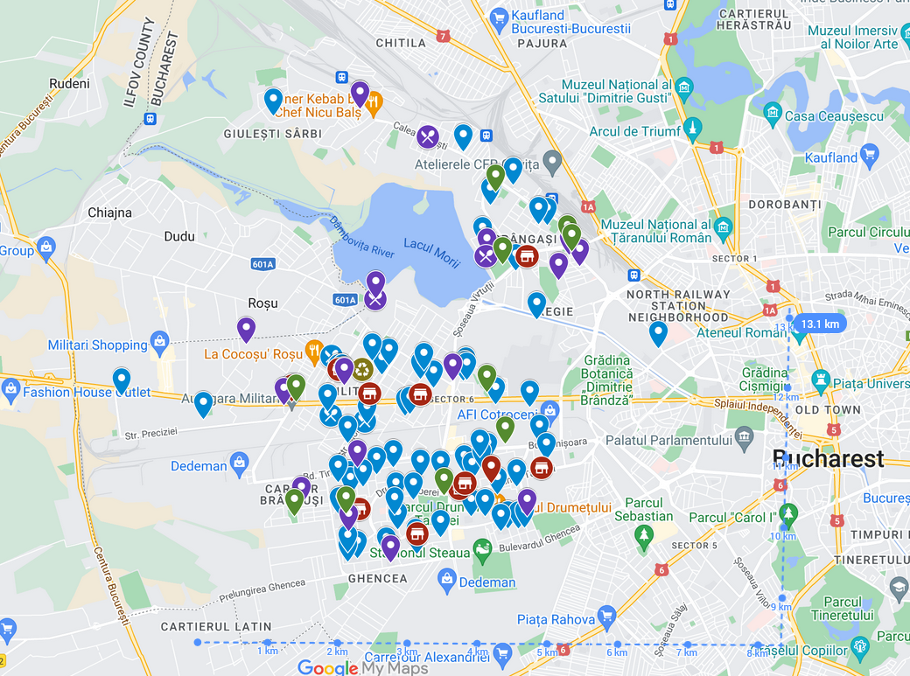
Stakeholder mapping
Instrument: google my maps
+ easy to collaborate, share and integrate on the website of the S6 administration
- difficult to highlight large areas like available plot and green spaces
Link: Sector 6 map

Slide 22
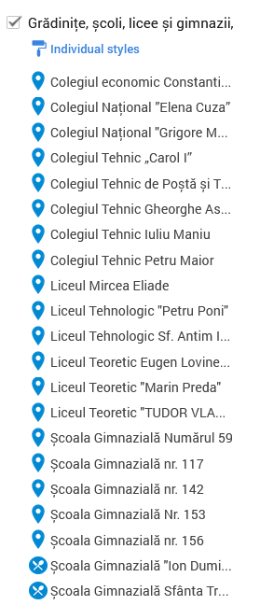
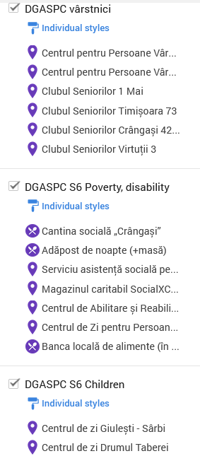
Stakeholder mapping (comprehensive)
Institutions
public administration
schools (3 schools are part of the warm meal programme), preschools, nurseries, universities
social services (care homes, food banks, day centers)
healthcare institutions
waste management
Food producers
ecological producers in periurban area, other producers

Slide 23
Next steps for agri-food in District 6
Target Groups / Stakeholders mapping
  Institutional actors (public, private, civil society)
  Private actors: families, children, elderly, low income/homeless?
Institutional Partnerships
Overall Objective: Improve accessibility and affordability to safe and nutritious food for all income levels in District 6

Slide 24
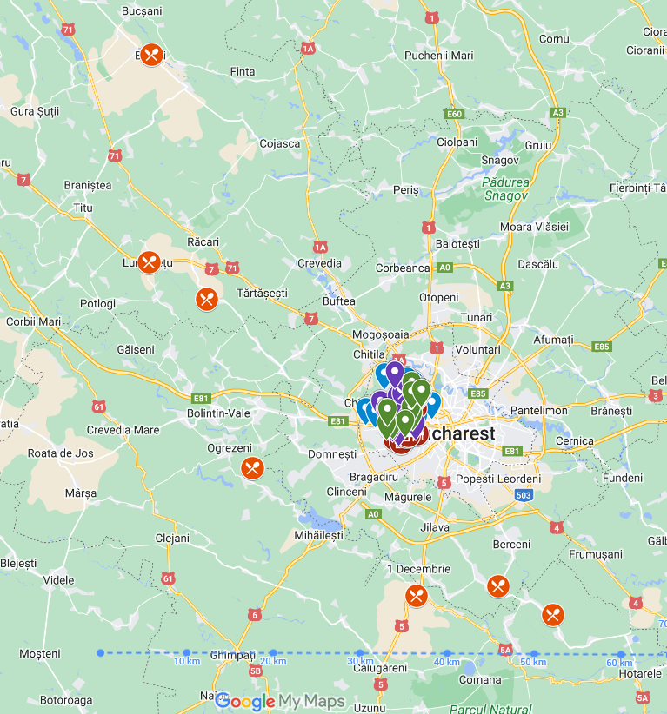
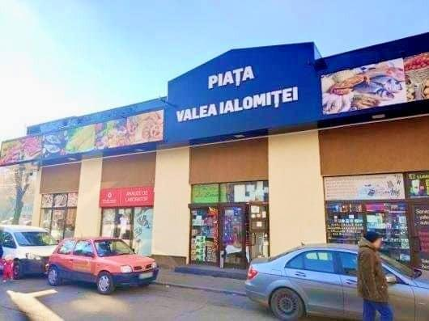
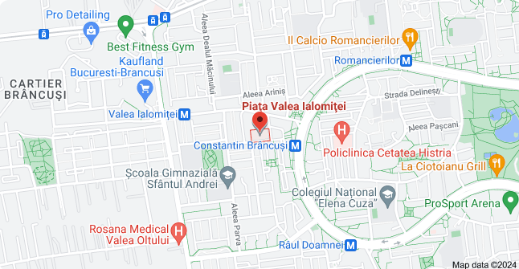
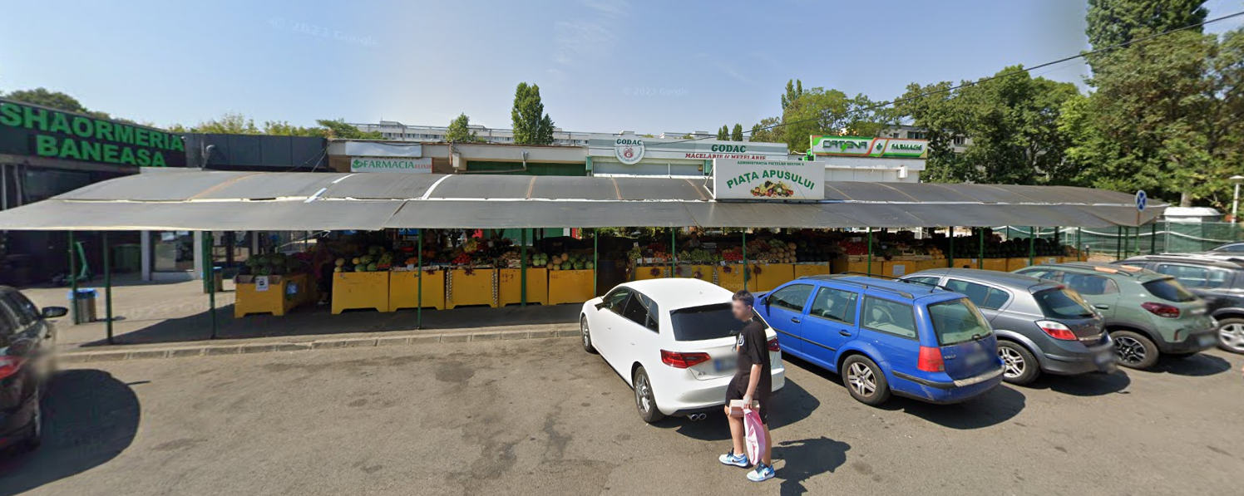
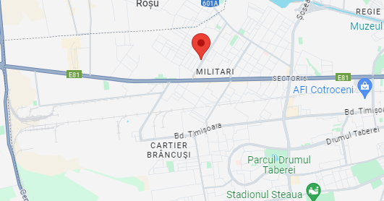
Stakeholder mapping - producers
Piața Apusului

Slide 25
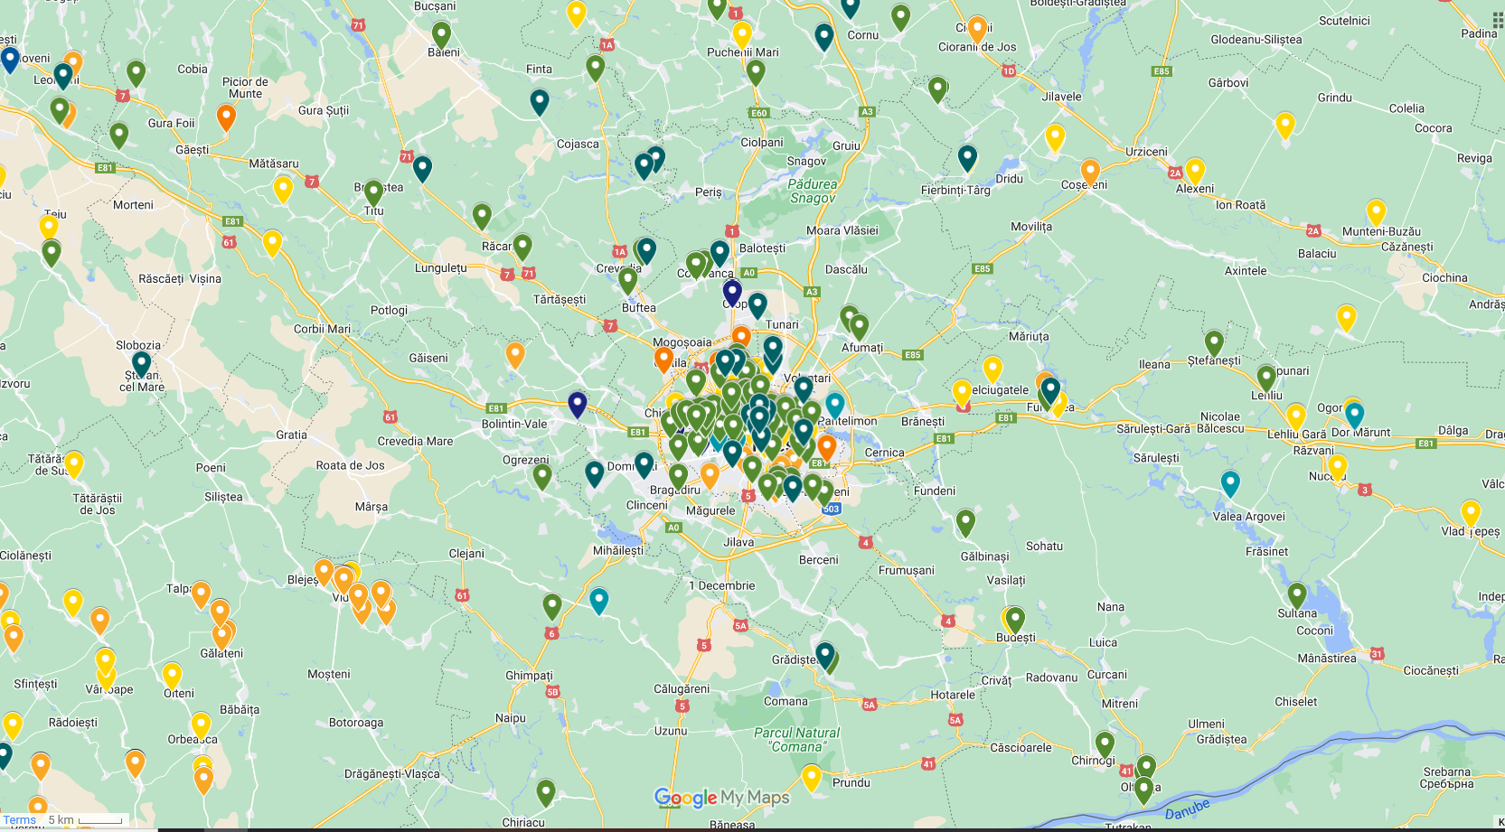
Stakeholder mapping - certified ecological producers
Source: https://www.google.com/maps/d/u/0/viewer?mid=1vjnzHRgaJTwOlmOLmb1fHV-YxqKIjZc&ll=44.46088693531953%2C26.05435294005388&z=10
Agriculture Ministry registry 2023: https://www.madr.ro/agricultura-ecologica/operatorii-certificati-in-agricultura-ecologica-2023.html

Slide 26
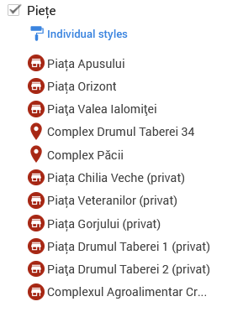
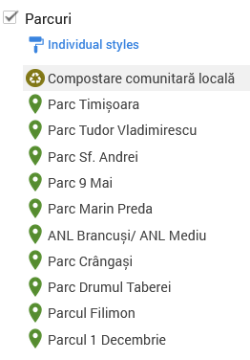
Stakeholder mapping - retail and HoReCa
Retail and Hotels, Restaurants, Catering (HoReCa)
farmers markets, temporary markets, hypermarkets, supermarkets, shopping centers
food service, restaurants
festivals
Available land and green spaces
public parks, available land
public land, abandoned industrial infrastructure
Civil society
NGOs, neighbourhood communities etc.

Slide 27
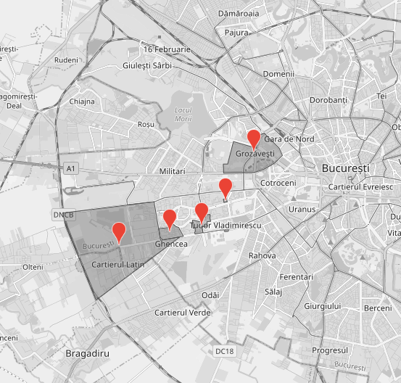
Stakeholder mapping - District 6 neighborhood groups
Grozăvești: green spaces and playgrounds
Favorit: transforming the old cinema into a community cultural center
Tudor Vladimirescu: improving life quality
Callatis: improving the image of the area
Prelungirea Ghencea: improving mobility, public spaces
Source: https://bucuresticivic.ro/sector-6/

Slide 28
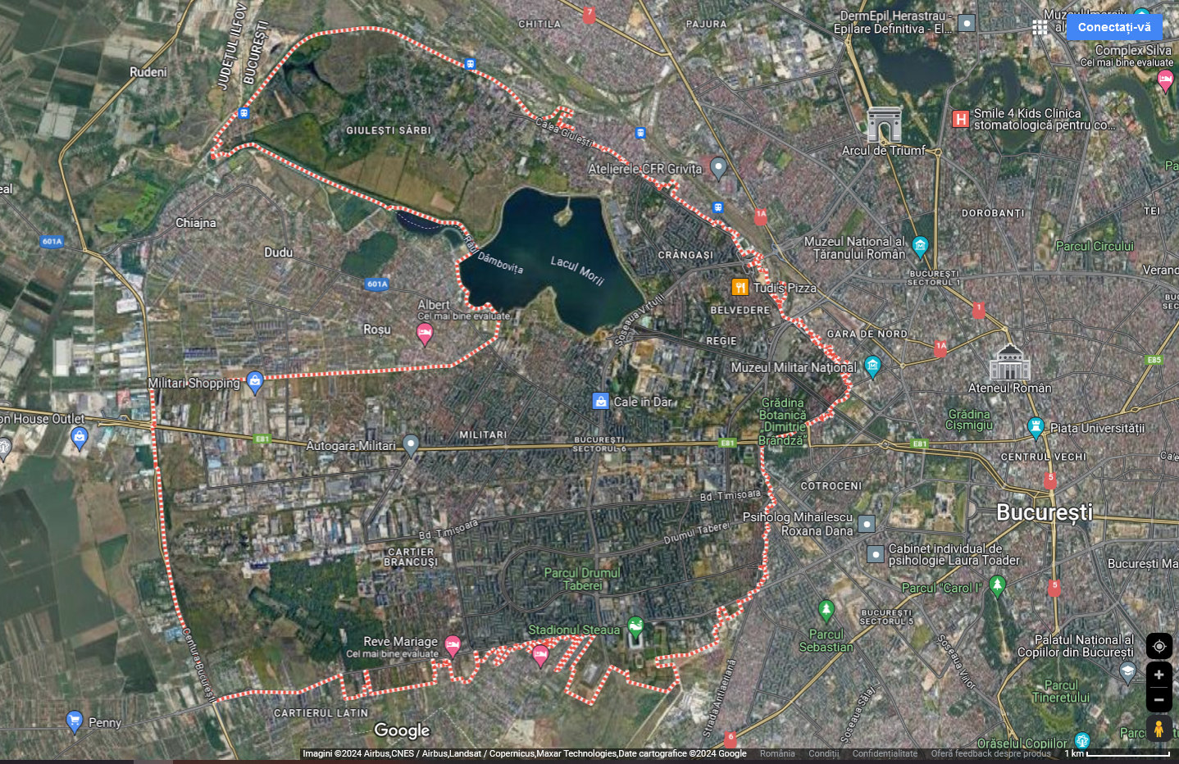
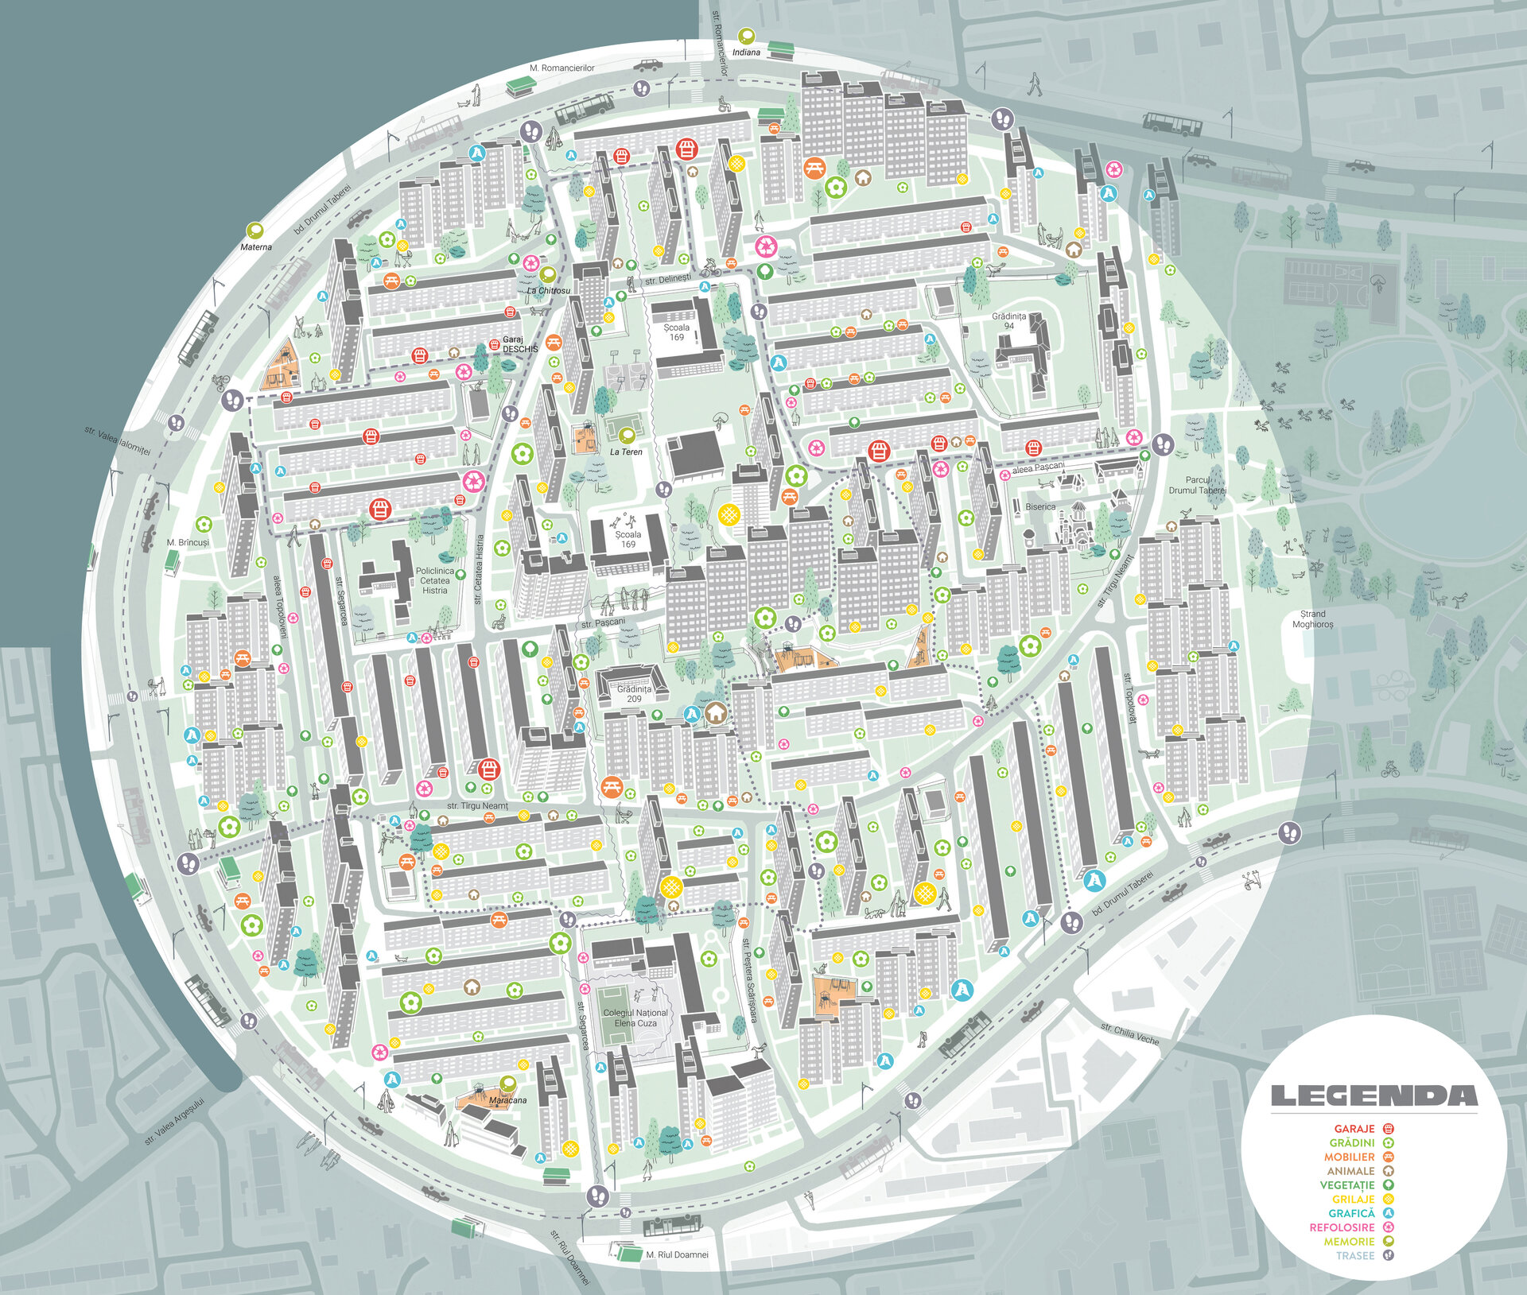
Stakeholder mapping - community gardening practices
Source: arh. Alex Axinte
https://www.anuala.ro/proiecte/2022/199/

Slide 29
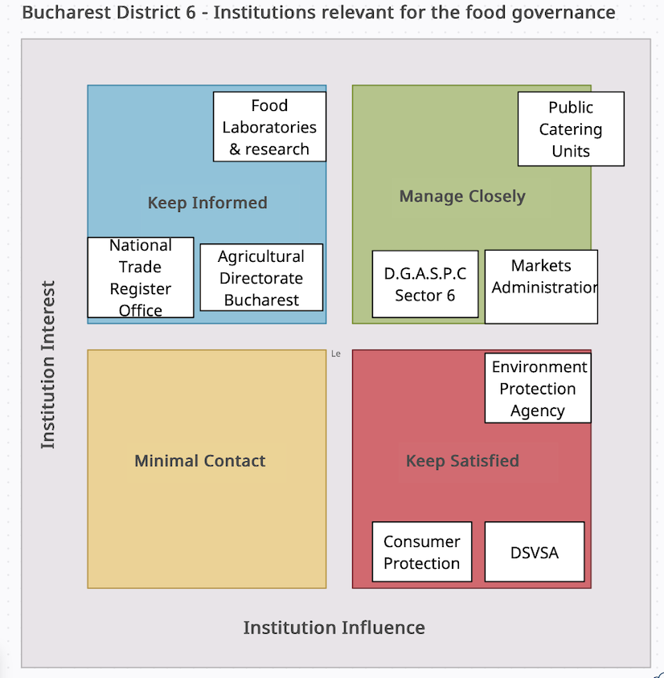

Slide 30




























Stakeholder mapping - civil society
Facilitating community initiatives and participation
Composting advocacy & education
Periurban community garden & seed bank Domnești
Food
Social services
Sustainability
Notes:
https://platformademediu.ro/harta
https://foodwaste.ro/wp-content/uploads/2018/10/FoodWasteRO-Anexa21-CatalogONG.pdf
https://ambasadasustenabilitatii.ro/grupuridelucrucoalitie/risipa-alimentara/#1619188167511-ab9624d2-4a8a

Slide 31
Stakeholder mapping (work in progress Ioana)
NGOs
Name | Activity | website
Fundația Comunitară București | Finding resources for community initiatives in Bucharest | https://fundatiacomunitarabucuresti.ro/
Platforma de mediu pentru București | Platform for collaborating to solve environmental problems | https://www.platformademediu.ro/
CERE: Centru de resurse pentru participare publică | Resource center for public participation | https://cere.ong/
Ambasada sustenabilității în România Sustainability Embassy in Romania | Promoting an economic model that helps companies solve social and environmental problems through partenerships. | https://ambasadasustenabilitatii.ro/
TERRA Millenium III | Developing awareness programs on the causes and effects of climate change and to promote sustainable development solutions, improving public policies. | https://terramileniultrei.ro/en/
Academia de compost
Asociația Pentru Protecția Albinelor și polenizatorilor Sălbatici | Education on importance of bees and pollinators. | https://appaps.org/

Slide 32


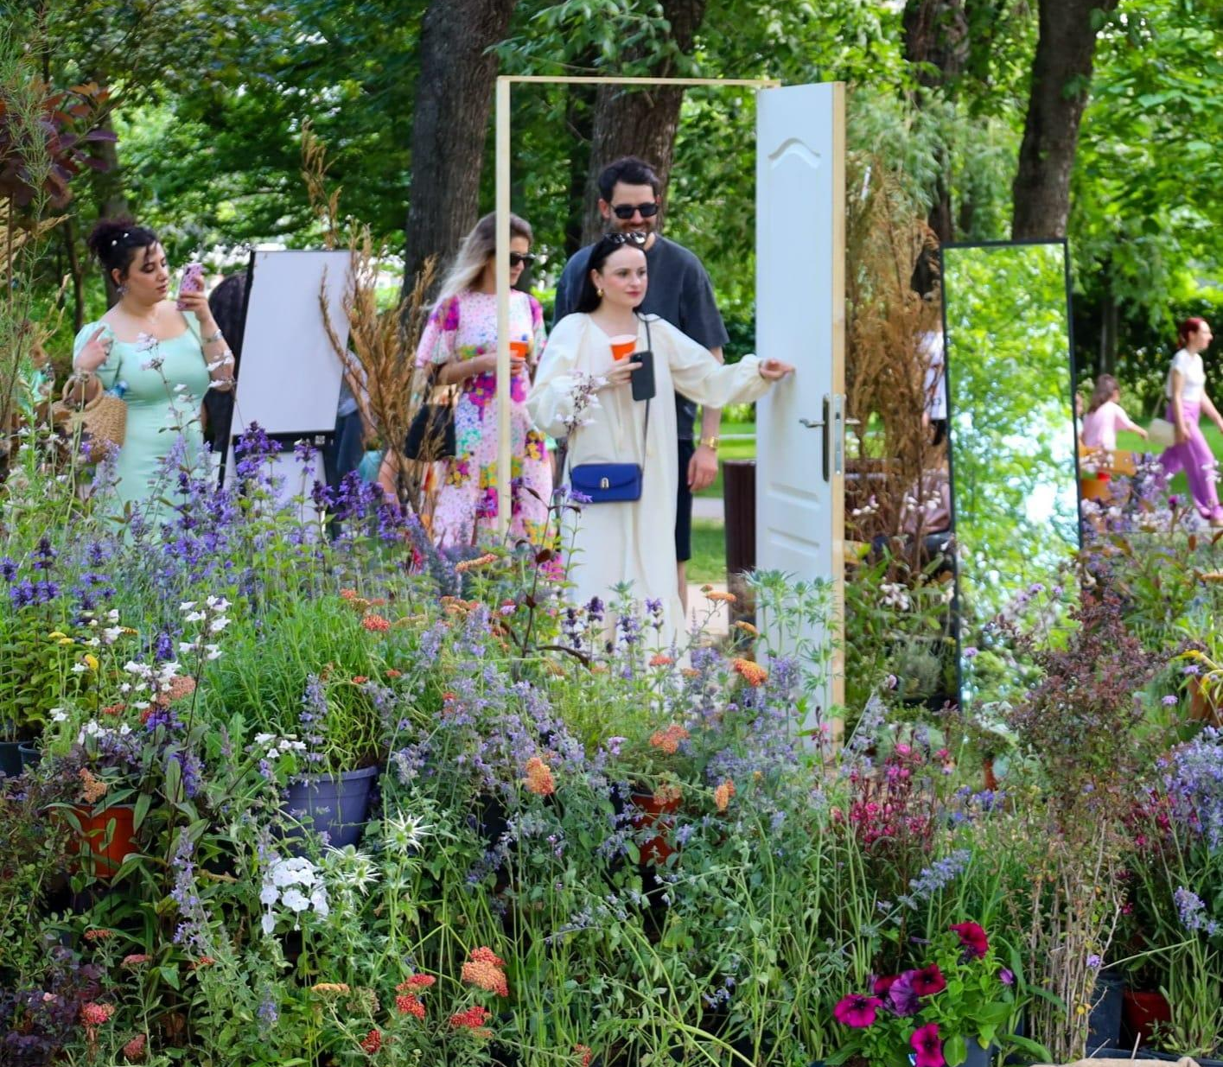
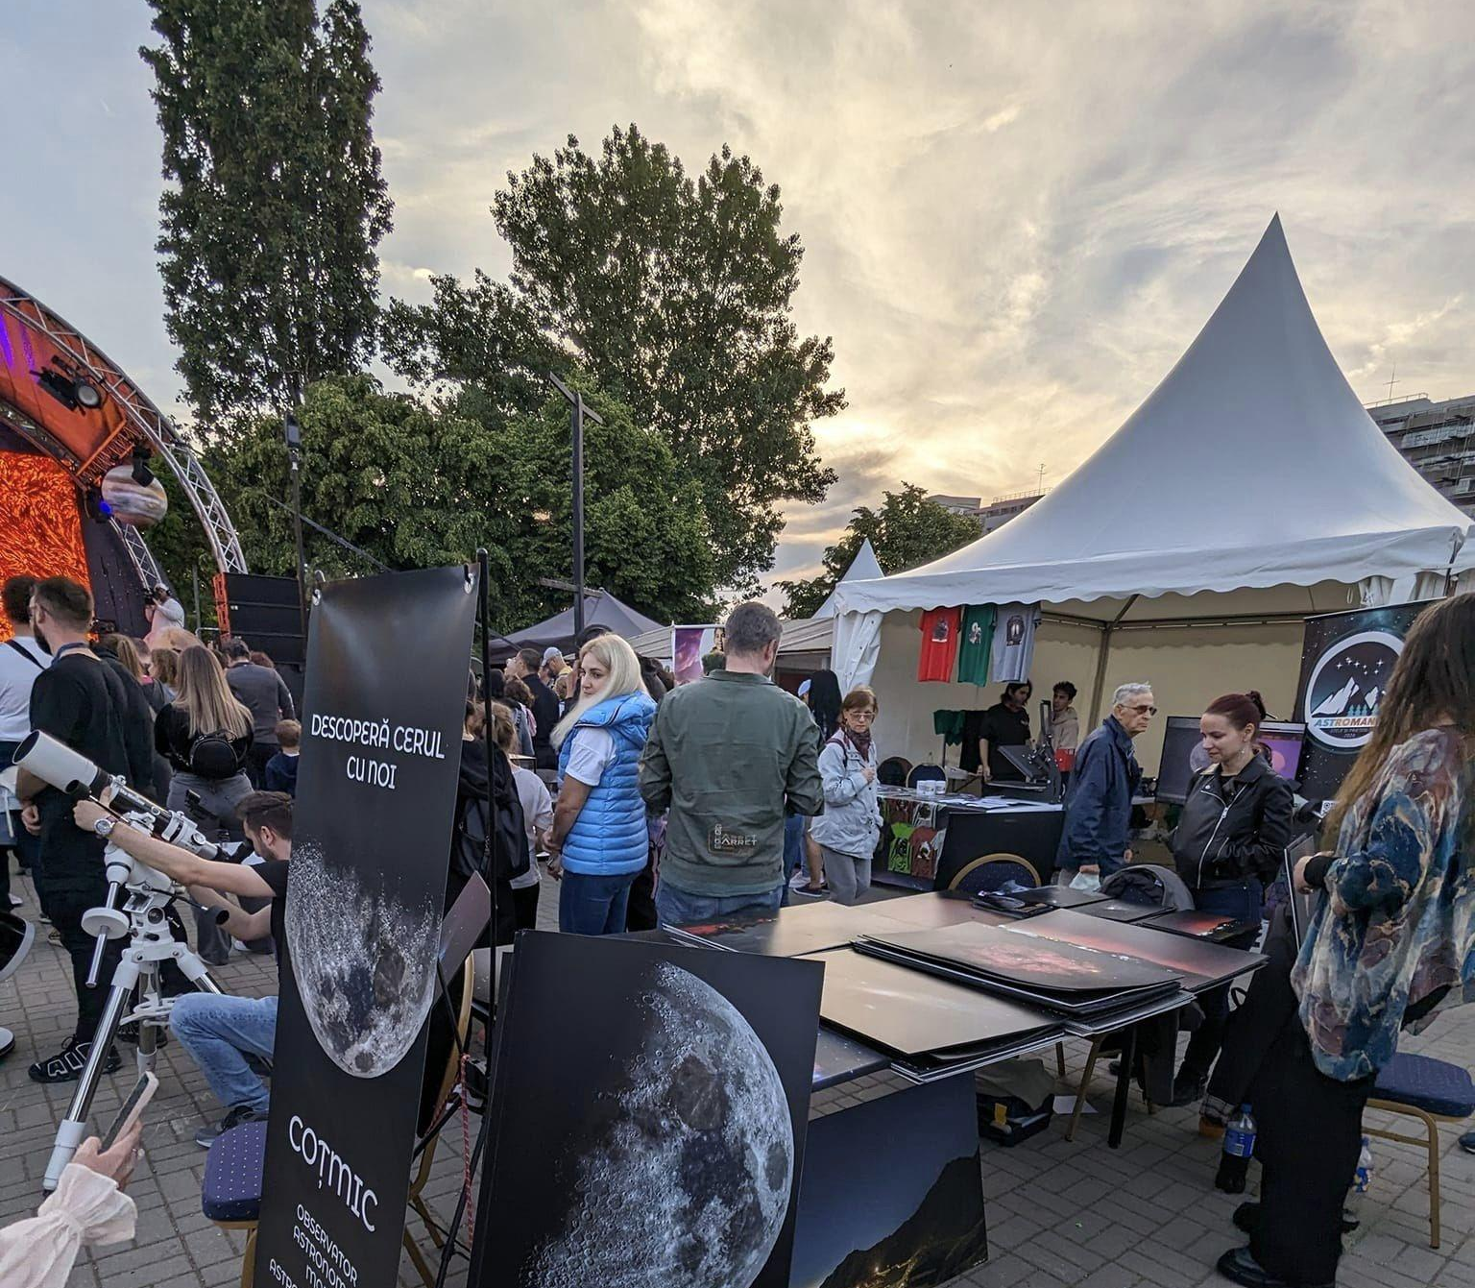
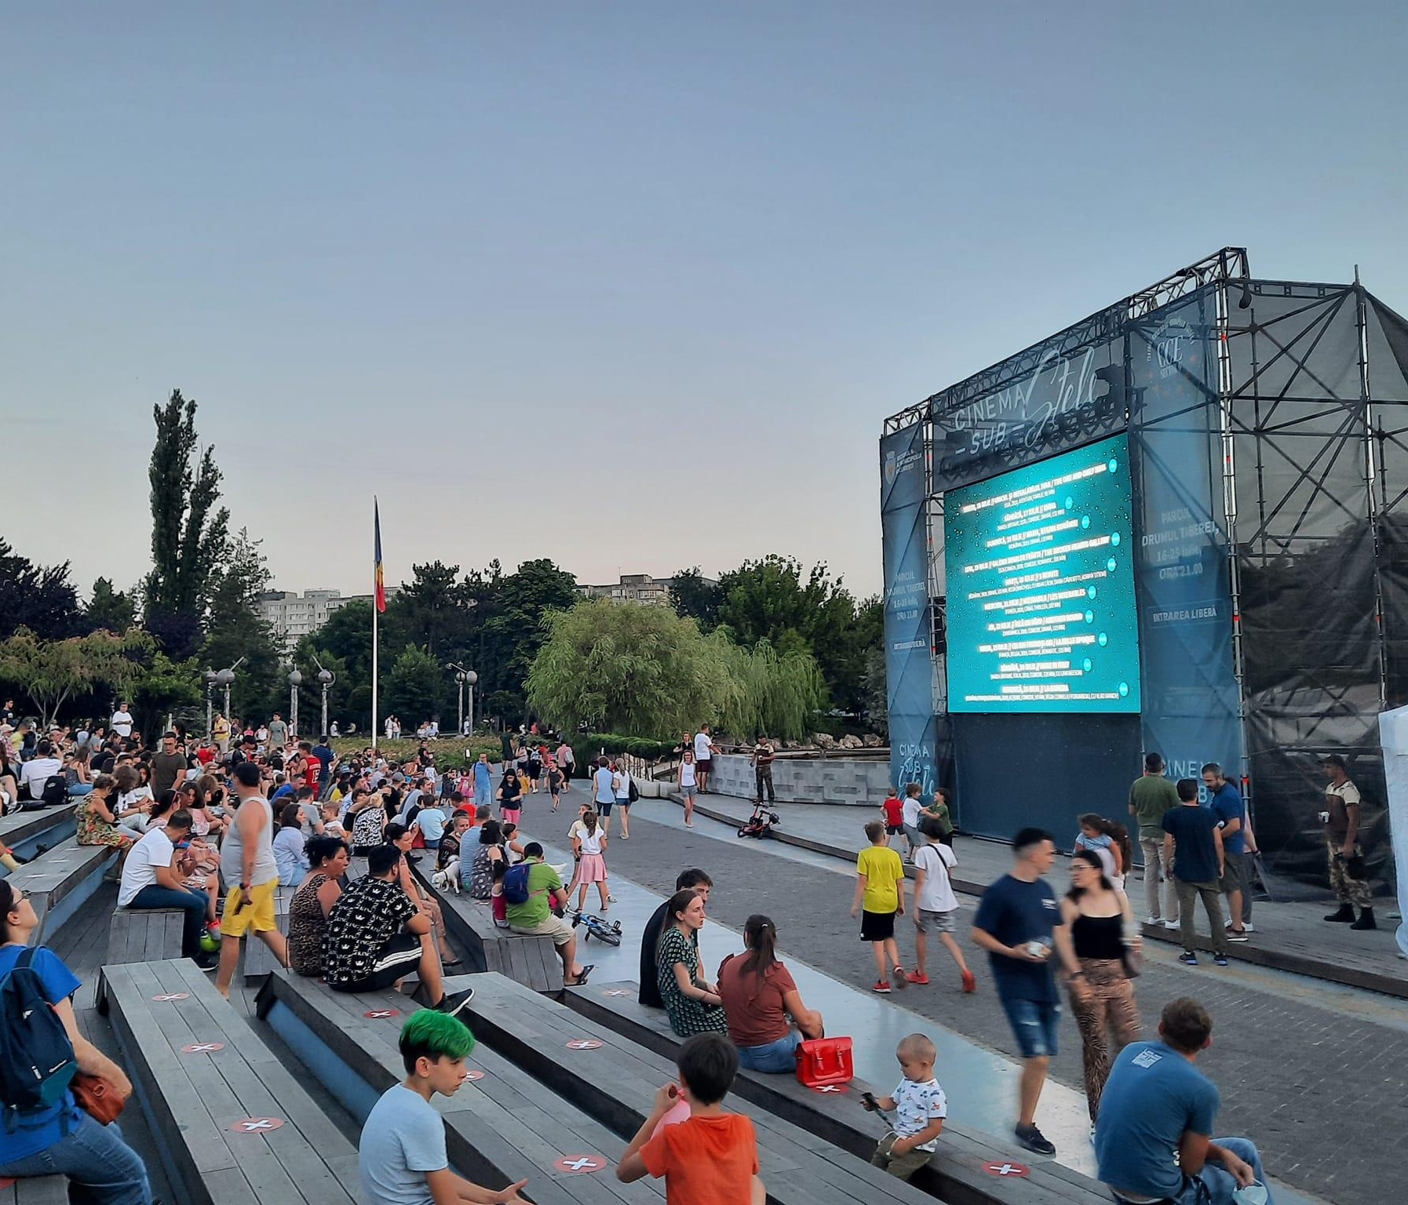
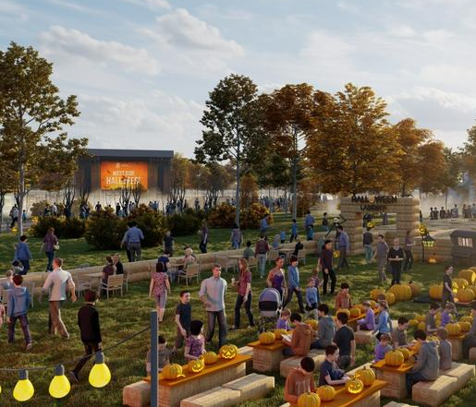
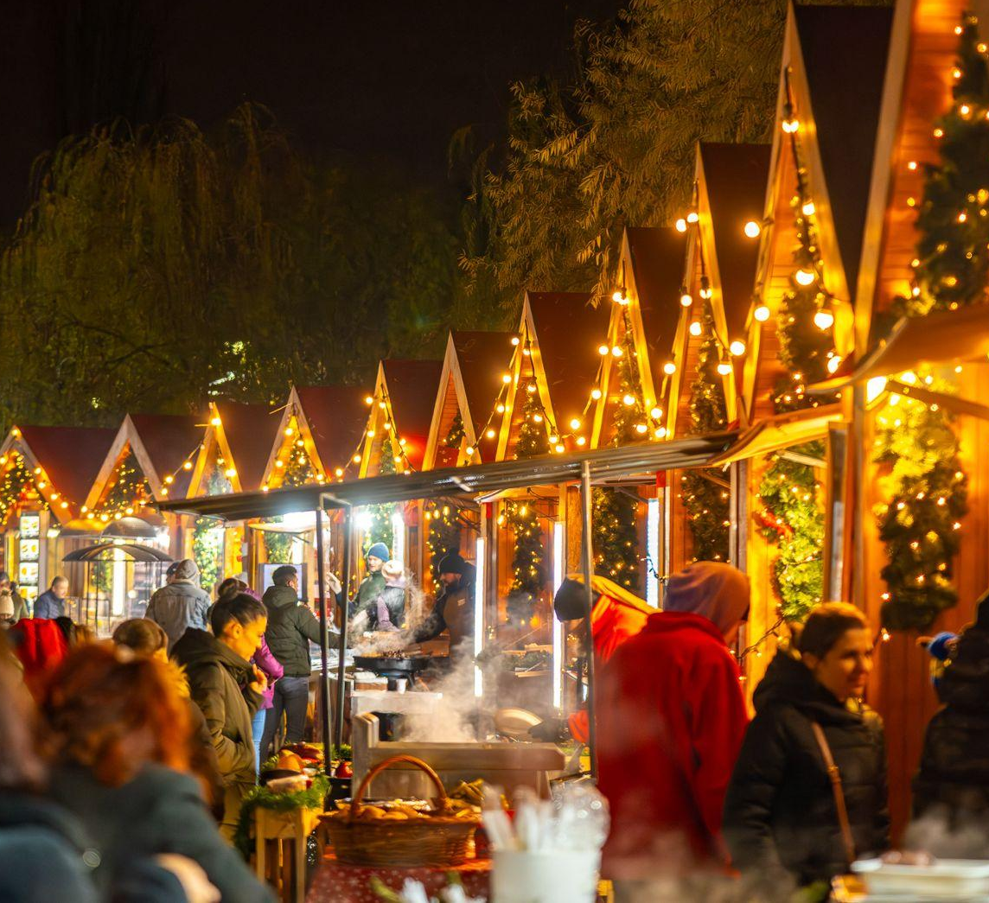
Stakeholder mapping - festivals
Name | Date | Location | Organiser
Astrofest | 17-18 may 2024 | Crângași Park | PS6
West Side Flower Fest | 31 may - 2 june 2024 | Drumul Taberei Park | PS6
Open Streets | 27-28 april 2024 | Drumul Taberei Boulevard | PMB?
Cinema sub stele | august | Drumul Taberei Park, Grângași Park, Line Park, Marin Preda P. | PS6
West Side Hallo Fest | 27-28 october 2023 | Morii Lake Island | PS6
West Side Christmas Market | 29 november - 27 december 2023 | Drumul Taberei Park | PS6
Centrul Cultural European Sector 6
Center for organising events:
https://primarie6.ro/primarie_sector6/lista-evenimente
Notes:
https://www.wall-street.ro/articol/Lifestyle/286732/strazi-deschise-in-sectorul-6-in-acest-weekend-drumul-taberei-va-fi-al-pietonilor.html
https://www.facebook.com/westsideflowerfests6
https://www.facebook.com/esteASTROFEST
https://www.facebook.com/events/lacul-morii/west-side-hallo-fest/1114965949483
https://life.hotnews.ro/stiri-prin_oras-26638171-inceput-west-side-hallo-fest-lacul-morii-surprize-pregatit-organizatorii-care-este-programul-evenimentului.htm
https://www.facebook.com/westsidechristmasmarket
https://www.wall-street.ro/articol/Lifestyle/299822/cinema-sub-stele-in-parcurile-din-sectorul-6-ce-filme-puteti-vedea-din-barca-pe-lacul-din-drumul-taberei.html
https://b365.ro/cinema-sub-stele-ajunge-si-in-giulesti-ce-filme-a-pregatit-ps6-pentru-bucuresteni-512962/

Slide 33
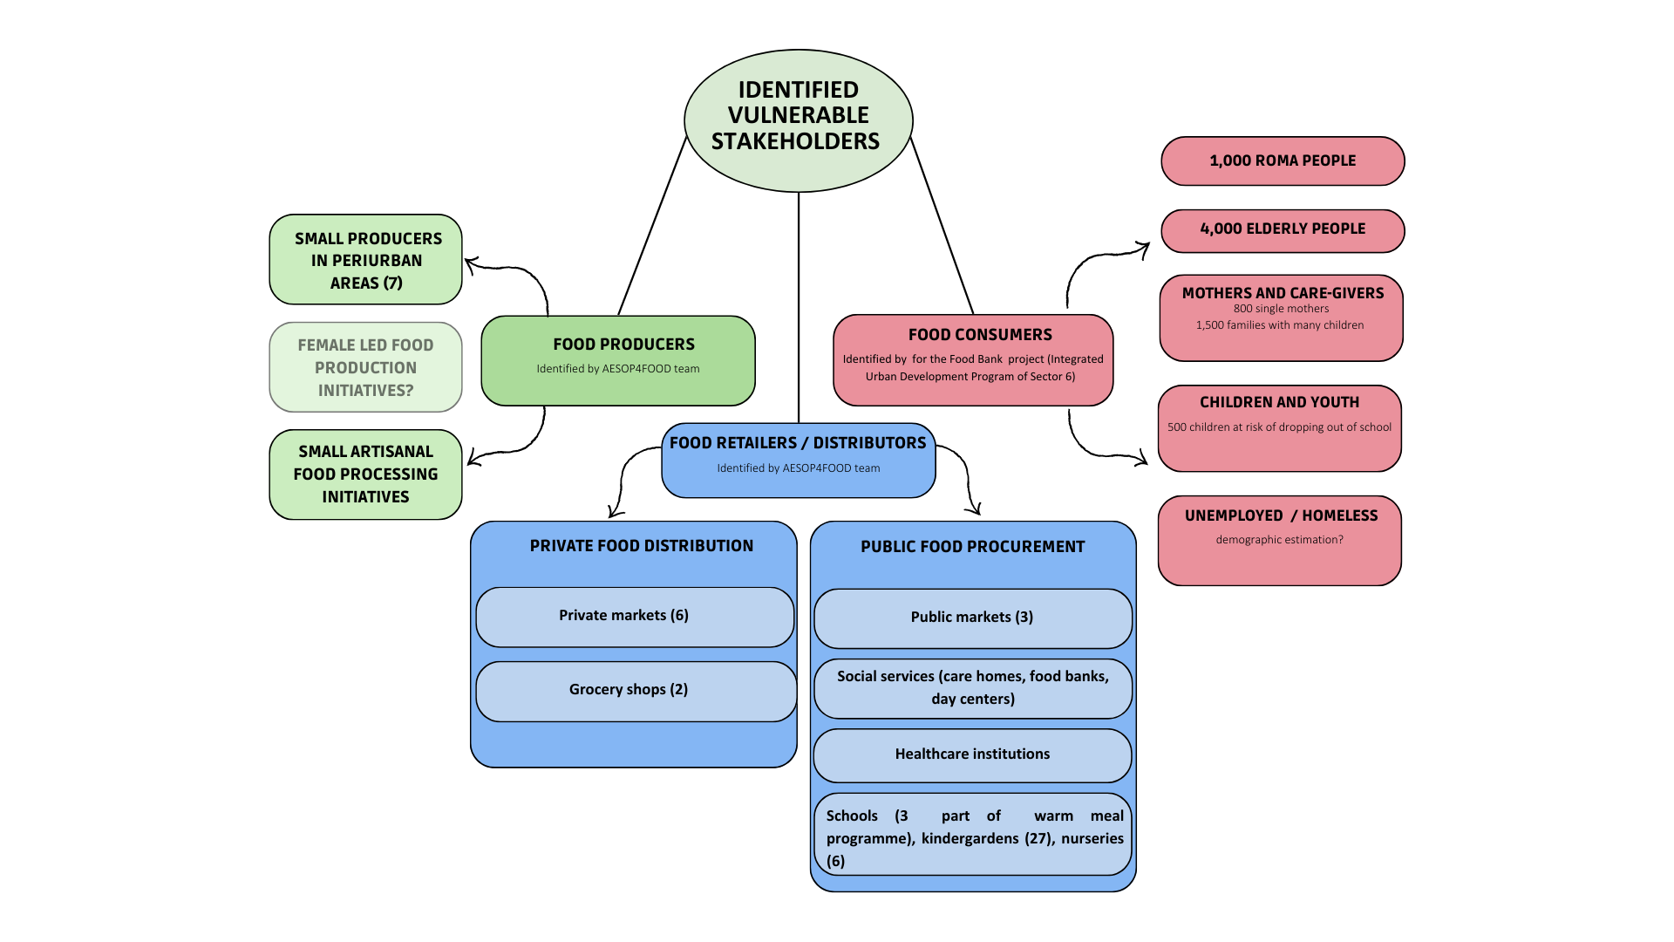
Integrated and participatory food governance in District 6

Slide 34
Integrated and participatory food governance in District 6 - focus on integrating vulnerable actors
Strategic allies
Organize communication strategy for the participation process
Online comm, Posters, flyer distribution in local markets, school and public education institutions, social services and cantines.
Set up a program of meetings with local NGOs facilitating citizen engagement to involve them in the definition of the consultation.
Public consultation on food habits and needs
Preliminary Survey (during workshops and activities, social events, in NGO premises, socio-cultural and social centers, etc.)
Working groups
Consumers : women and caregivers / vulnerable children and youth (Ajungem Mari) / elderly / beneficiaries of social aid services and food parcels (Social Food) / excluded vulnerable groups (Carusel)
Producers : Production surveys to small producers (Romo / Eco Ruralis)
Program of weekly/monthly activities to be deployed:
Producers : Community Mapping (understand production practices, opportunities and barriers)
Consumers: Card visualisation (understand consumers needs and priorities)
Consumers and producers : Monitoring and Evaluation of the Food Strategy: Smiley face / goal prioritization exercise (could use Mural and previous workshop resources)
NGOs facilitating public participation
Social services
Producers’ associations
Notes:
ROMO: grass-root movement started by farmers Cosmina and Șerban Dinu from Ferma de Pajări Pasșunate together with a handful of fellow pioneer producers from Brasov. pre-order group where you can source quality products directly from local producers. Works on a weekly basis
Eco-ruralis : Association of peasants and farmers involved in food production through subsistence and semi-subsistence agriculture, diversified and based on the principles of agroecology. Eco Ruralis is a nationwide association of peasants and farmers with almost 20,000 members in all counties of the country.
ADIZMB: Bucharest-Ilfov Metropolitan Area Intercommunity Development Association (ADIZMB) is the main formal arrangement covering the region for Bucharest and Ilfov County. A partnership between Bucharest Mayor’s Office and the Ilfov County Council, to develop the metropolitan area. The mission of the Association is to contribute to all regional and metropolitan priorities including sustainable mobility, education and inclusion, zero-carbon urban mobility, research and innovation.

Slide 35
Stakeholders power map / Living Lab launch event actors
High power
Bucharest Municipality
District 6 Administration
Public Domain Administration
Planning Center District 6
Bucharest-Ilfov Metropolitan Area Intercommunity Development Association
NGOs facilitating public participation
Social services DGASPC S6
Retail companies
Public catering
Market administrators
Universities
NGOs for environmental education
Producers’ associations
Low interest
other consumers
High interest
Schools, preschools
Local initiative groups
NGOs for social services
Local producers
Vulnerable categories
Social services beneficiaries
Low power
Administration
Research
Food actors
Consumer
NGOs

Slide 36
Wider context analysis
Case studies
Initiatives map
Lille (France)
A Coruña (Spain)
Bergamo (Italy)
Dublin (Ireland)
Milan Urban Food Policy Pact
Toronto Food Policy Council

Slide 37
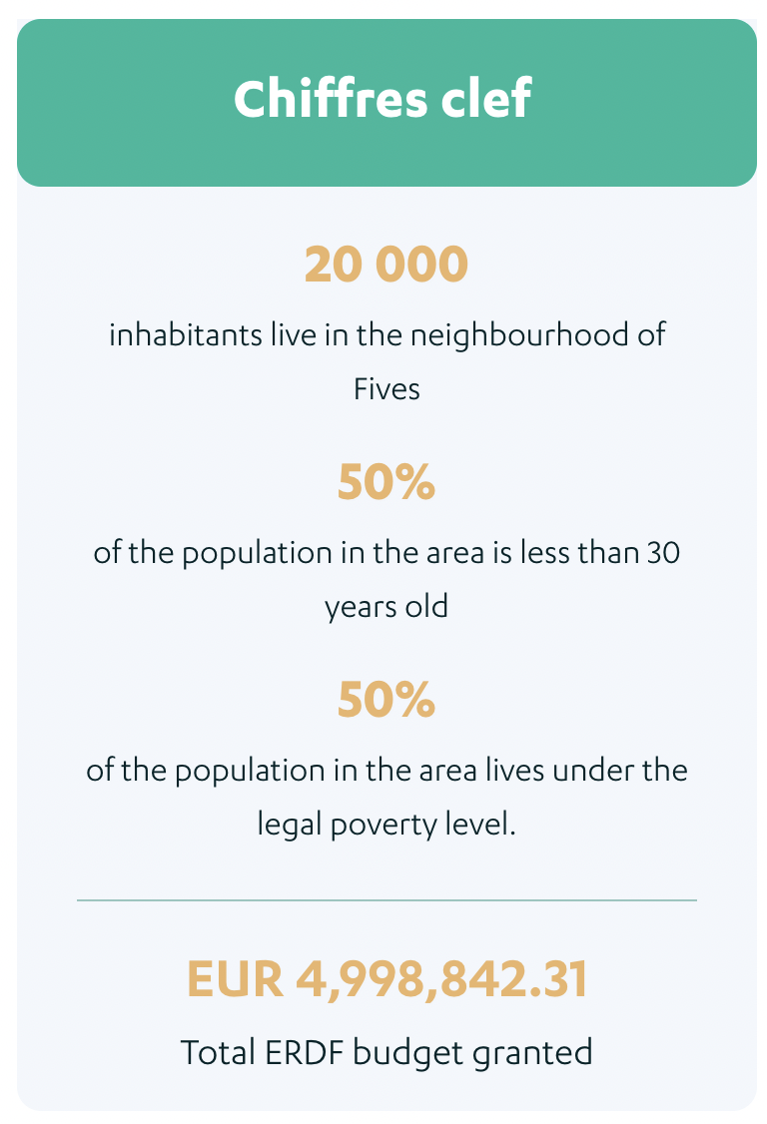
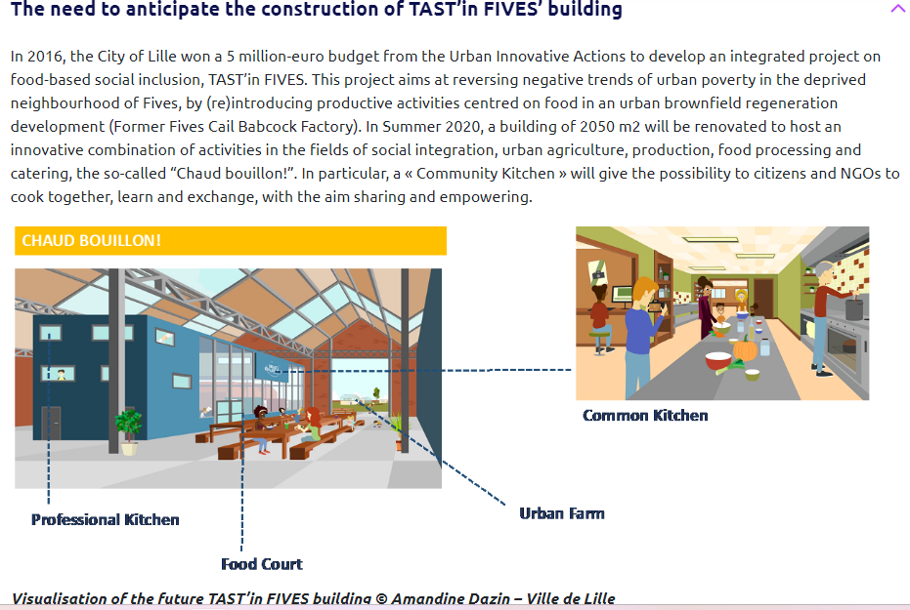
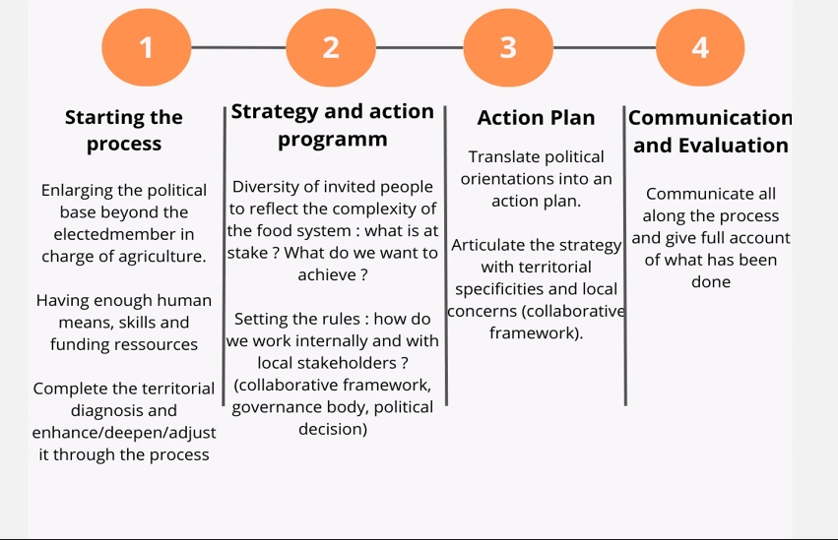
Case Study - Lille
TAST’in FIVES - Transforming Areas with Social Talents: Feed, Include, Value, Educate, Share
Location: Fives Cail brownfield
Duration: 2017-2021
Strategy: part of a larger urban brownfield regeneration development
Objectives:
Combat poverty and social exclusion
Address malnutrition issues and promote healthy diets
(re)introduce productive activities centred on food and empower local residents and stakeholders
2050m2 renovated space to host an urban agriculture, production, educational, food processing, and catering activities
Key numbers
Notes:
Lille’s tast’n five project

Slide 38
Mapping Lille’s Tast’n Food Actors
Institutional |  | NGOs / Civil Society |  | Higher education and research institutes
City of Lille | project coordinator, also responsible for organizing the implementation of the project, communication activities, and supporting the setting up of an innovative model for the collective governance of the Cuisine Commune | Les Sens du Goût | In charge of organizing educational programmes around cooking and tasting, on site and in local schools, and training other stakeholders on delivering educational activities | Yncréa Hauts de France-Institut Supérieur d’Agronomie | in charge of setting up the experimental vertical farming unit that will become a support for training activities
Lille Metropole | In charge of setting up food incubator | The local section of the Secours Populaire | in charge of organizing workshops around waste limitation and cooking; | Maison Européenne des Sciences de l’Homme et de la Société (MESHS), | in charge of supporting the project with evaluation issues and assess the results of implemented actions by means of an action-research programme and research workshops
Soreli | Semi-public urban development and construction company. In charge of the construction works of the kitchen | Les sauvegardes du Nord | in charge of organizing encounters focused on food-related cultural heritage of migrant and Rom populations; | Centre d’Innovation des Technologies sans Contact (CITC) | in charge of developing tech solutions to monitor stocks in fridges and cold rooms and push recipes in relation with goods in storage.
Employment agency | In charge of organizing training activities focused on food-industry, to facilitate access to job opportunities | Les Rencontres Audiovisuelles | in charge of organizing audio-visual creation workshops targeting young people and of setting up a video studio in the community kitchen.
Notes:
Mapping of Lille’s Tast’n Food Actors:
City of Lille was at the center of the project → coordinator and responsible of implementation of project, communication activities…
Coordination with semi-public company (Sorelli) → expertise in urban development projects - easy contracting and project management
Call on local NGOs and Civil Society Organizations to ensure neighborhood ownership - work with vulnerable populations / in charge of surveys and workshops
Higher education and research institutes - experimentation (ie. urban farm), tech solutions, evaluation and assessment - action research to rapidly capitalize from experience

Slide 39
Comparison and lessons learned
Lille’s Taste in FIVES
Bucharest District 6
“Tiers-lieu” in France → temporary socioecological projects (Institutional and socio-cultural framework already there)
Political support and institutional partners at the highest level (IUA, city of Lille, developer Sorelli…)
New concepts in the Romanian post-socialist context
Institutional fragmentation: metropolitan / District Mayor and councils - more difficult to articulate project governance
Political momentum: political interest in the local food strategy
Lessons learned
Adequate recruitment, clear identification of expectations, suitable communication processes are key to reach functional governance (ie. local NGOs and organisations to include vulnerable populations).
Collaboration with higher education and research institutions (ie. research action, design proper monitoring and evaluation strategies for the project .
On-going networking, visibility/communication strategies and regular feedback from users and partners.
Adapt project to local socio-economic context, to ensure economic and social benefits.
Co-constructing with vulnerable populations and ensuring accessibility to the facilities and its activities and build social acceptability (logistics, timing, childcare provision, free activities, creating safe spaces…).
Governance and leadership
Big support from local NGOs and research institutions/universities
Reaching out to socially excluded populations was a significant challenge during first months
Possible partnership with local social and environmental NGOs and research Institutions / universities
Different socio-cultural context : civil society / residents are not as sensitized on sustainable food and nutrition - Need to develop awareness raising and engagement strategies
Public Participation
Part of a larger brownfield rehabilitation strategy
European funding (IUA) secured by the municipality - Financial sustainability built over the project life time
Synergies with the larger ”Integrated Urban Development Program of Sector 6 of the Municipality of Bucharest 2021 - 2030”
EU 2030 Agenda : possibility to apply for EU funds (UIA, etc.)
Financial sustainability
Learning by doing and transfer of the temporary activities developed in L’Avant-Goût to the Cuisine Commune. (2019). Creation of linkages between the facility and the wider ecosystem (food court, etc.), job creation…
Opportunity to create economic opportunities for small local producers, food retail, caterers…
Strengthening food security for vulnerable populations
Access to training and materials for food related activities : city to city exchange and other capacity building strategies
Upscaling
Notes:
We analyzed their strategy and conducted a comparison between the two cases
Even though the settings present some differences, important lessons can be drawn from Lille’s example:
Need for adequate recruitment, clear identification of expectations, suitable communication processes to reach functional governance
Adapt project to local socio-economic context. For that, co-constructing with vulnerable populations and ensuring accessibility to the facilities and its activities will help build social acceptability and ensure economic and social benefits.

Slide 40
Collaborative goals setting and visioning - Project 6 workshop
Challenge:
GOVERNANCE
No programs/strategies at the city level (neither national)
No integration of local products into public food procurement
No school canteens
institutions are regarded as intimidating food initiatives/businesses rather than supporting (advising)
LEGISLATION
public spaces laws
low interaction between food initiatives and culture at city level
no legal status for urban gardening
PLANNING
Public appeal for going back to gardening/community gardening
agricultural land in periurban areas is being displaced
community gardening - public spaces policy, to give/attribute place in the city for that?
PRODUCERS/CONSUMERS SYNERGY
availability of locally produced food
low connectivity between producers and city (producers accessibility)
super/hyper markets preferred by consumers (little space for locally produced food)
fuzzy information regarding traceability of locally produced food (free markets)
food quality
food distribution
CONSUMERS AWARENESS
lack of awareness among citizens on local, nutritious food
consumer education on healthy and sustainable food
food waste
RESEARCH
low involvement of research in food planning
LACK OF AWARENESS AND POLITICAL COMMITMENT ON LOCAL FOOD SYSTEM RESILIENCE
political engagement
food systems mapping
local stakeholder engagement

Slide 41
Collaborative goals setting and visioning - Project 6 workshop
Aims
HOW
territorial framework at regional/country level to handle and implement strategy
legal frame for producers
small grants for initiatives
setting up and training of a distinct team assigned to food within District 6 municipality
develop awareness campaign around food issues
Create a food Living Lab
set up a food council for District 6
develop a food strategy
WHO
involve Universities in the Living Lab process
involve NGOs & Community Initiatives
engage local associations of inhabitants and parents associations in the food council
Ho.Re.Ca., business, canteens - partnerships
stakeholder engagement via festivals
INFRASTRUCTURE
create a Food Hub with local producers
rethink functioning of free markets (food - social hubs)
include food production in green infrastructure
new agricultural zones in periurban areas
urban gardening projects encouraged by municipality
composting included in waste management

Slide 42
GOVERNANCE
  NO PROGRAMS/STRATEGIES AT THE CITY LEVEL (NOTHING FORMAL)
  NO INTEGRATION OF FOOD PROJECTS INTO PUBLIC FOOD PROCUREMENT
  NO SCHOOL CANTEENS
LEGISLATION
  PUBLIC SPACES LAWS
  INSTITUTIONS AND ENTERPRISES AS ADMINISTRATIVE BODIES AND INITIATIVES (ENSURING FUNCTION)
  LOW INTERACTION BETWEEN FOOD INITIATIVES AND CULTURE AT CITY LEVEL
PLANNING
  PUBLIC PRIVATE APPEAL FOR GIVING BACK TO THE PUBLIC (CONTRACTING/CONCESSIONS)
  AGRICULTURAL LAND IN PERIURBAN AREAS IS BEING DISPLACED
  COMMUNITIES CARED (PUBLIC SPACES REGULATED TO ENSURE IMPACT THAT THE COMMUNITY WANTS)
  NO LEGAL STATUS FOR URBAN GARDENING
PRODUCERS/CONSUMERS SYNERGY
  AVAILABILITY OF LOCALLY PRODUCED FOOD
  LOW CONNECTIVITY BETWEEN PRODUCERS AND CITY (MARKET ACCESSIBILITY)
  SUPER/HYPER MARKETS PREFERRED BY CONSUMERS (LITTLE SPACE FOR LOCALLY PRODUCED FOOD)
  FUZZY INFORMATION REGARDING TRACEABILITY OF LOCALLY PRODUCED FOOD
CONSUMERS AWARENESS
  LACK OF AWARENESS AMONG CITIZENS ON LOCAL, NUTRITIOUS FOOD
  CONCRETE EDUCATION ON HEALTHY AND SUSTAINABLE FOOD
RESEARCH
  LOW INVOLVEMENT OF RESEARCH IN FOOD PLANNING
FOOD WASTE
LACK OF AWARENESS AND POLITICAL COMMITMENT ON LOCAL FOOD SYSTEM RESILIENCE
  POLITICAL ENGAGEMENT
  FOOD SYSTEM MAPPING
  LOCAL STAKEHOLDER ENGAGEMENT

Slide 43
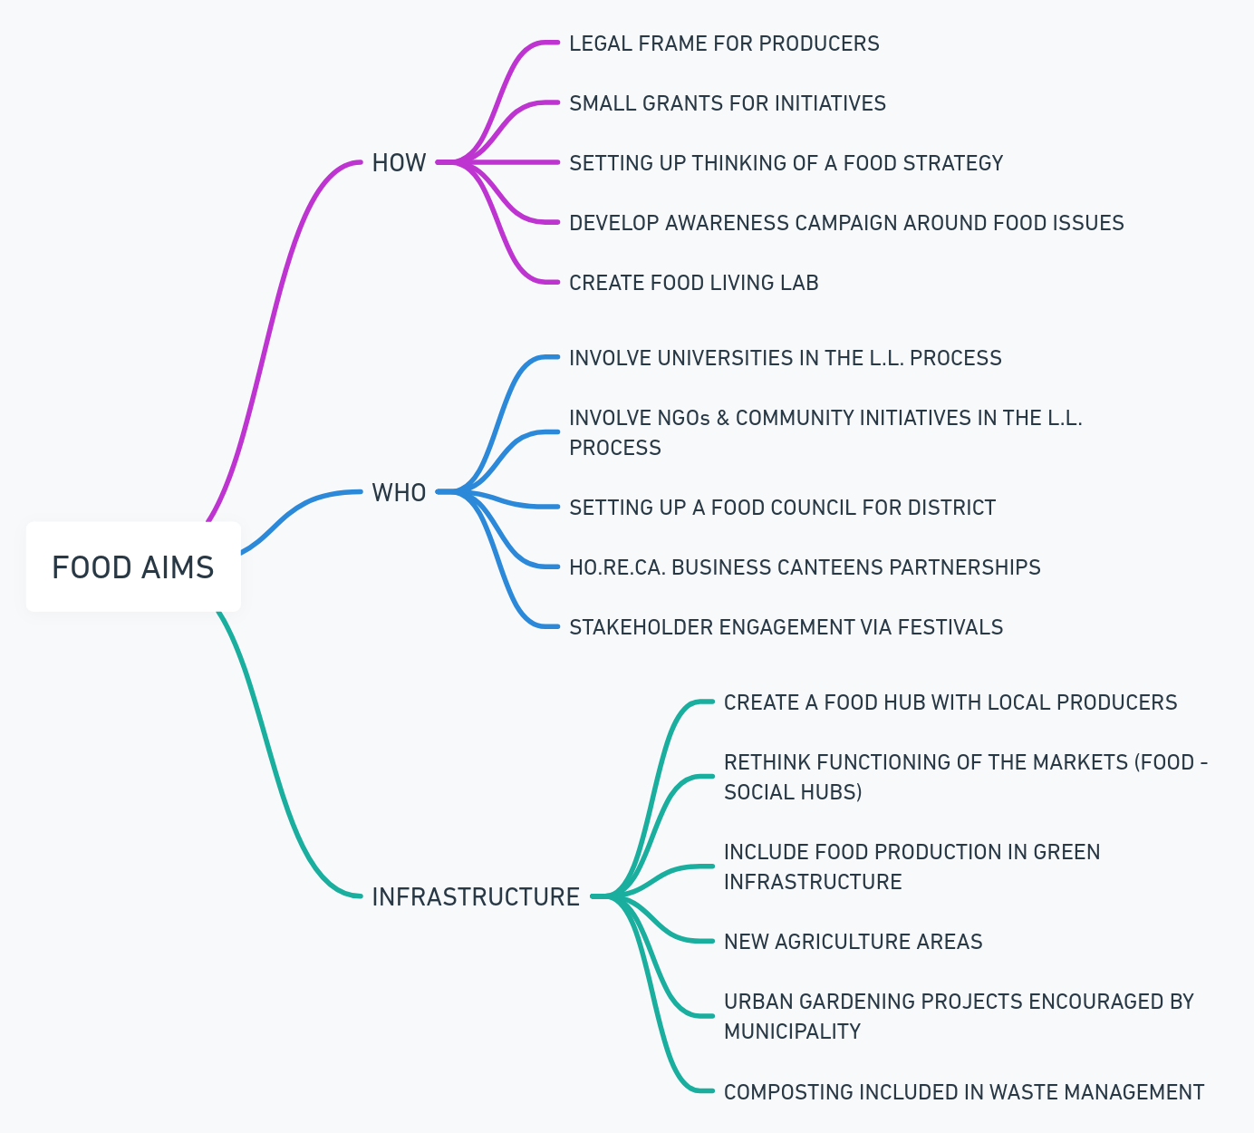
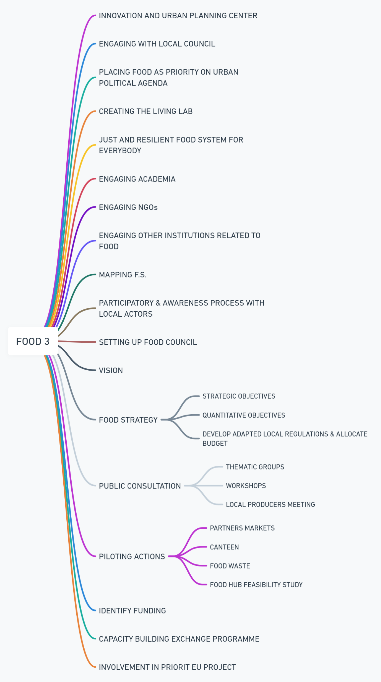
FOOD 3
INNOVATION AND URBAN PLANNING CENTER
ENGAGING WITH LOCAL COUNCIL
PLACING FOOD AS PRIORITY ON URBAN POLITICAL AGENDA
CREATING THE LIVING LAB
JUST AND RESILIENT FOOD SYSTEM FOR EVERYBODY
ENGAGING ACADEMIA
ENGAGING NGOs
ENGAGING OTHER INSTITUTIONS RELATED TO FOOD
MAPPING F.S.
PARTICIPATORY & AWARENESS PROCESS WITH LOCAL ACTORS
SETTING UP FOOD COUNCIL
VISION
FOOD STRATEGY
  STRATEGIC OBJECTIVES
  QUANTITATIVE OBJECTIVES
  DEVELOP ADAPTED LOCAL REGULATIONS & ALLOCATE BUDGET
PUBLIC CONSULTATION
  THEMATIC GROUPS
  WORKSHOPS
  LOCAL PRODUCERS MEETING
PILOTING ACTIONS
  PARTNERS MARKETS
  CANTEEN
  FOOD WASTE
  FOOD HUB FEASIBILITY STUDY
IDENTIFY FUNDING
CAPACITY BUILDING EXCHANGE PROGRAMME
INVOLVEMENT IN PRIORIT EU PROJECT

Slide 44
European Network of New Towns workshop on Just and Inclusive Green Transition
Date: 29 - 31 May 2024
Organizers: International New Town Institute, The Netherlands
Participants: European Network of New Towns
Objective: introduce the work for Bucharest District 6 Living Lab on Food Strategy
Event: Network Lab #2 - Just and Inclusive Green Transition
Visits to Innovative Projects:
Eco-district “Les Docks” in Ris-Orangis
Urban farm “Saint Lazare” in Grigny
Collaborative Workshops: Discussing sustainable food systems, energy efficiency, and green urban planning
Networking Opportunities: connect with Local Food Strategy officer Grand Paris Sud
Goals:
Promote sustainable food practices
Strengthen local food systems
Exchange ideas and best practices for local food initiatives
Notes:
We had the chance to attend the European Network of New Towns workshop on Just and Inclusive Green Transition
which was a great chance to introduce the work for Bucharest District 6 Living Lab on Food Strategy

Slide 45
Capacity building - implemented activities
Actions
European Urban Initiative: City-to-City Exchange Program
Bergamo: first bilateral meeting took place in May, both parties agreed on the exchange visit end of 2024, the administrative steps being taken in the present in order to formalise the collaboration financed and supported by the EUI in the framework of Urban Agenda
Milano (Food Partnership Urban Agenda) even if open at the first discussion, hesitating because the district level approach is not in balanced with their metropolitan city-region framework
Dublin (Food Partnership Urban Agenda) no reaction
Lille (Food Hub infrastructure) no reaction
CLEVERFOOD peer-learning programme October 2024 to December 2025 EUROCITIES
  "Connected Labs for Empowering Versatile Engagement in Radical Food System Transformation," 4 year Horizon Europe project running until end 2026
  Promote sharing experiences in addressing challenges and developing solutions for city region food systems governance
  Engaging online meetings and insightful in-person visits to the mentor’s locality, with financial compensation provided to support organisational costs
Notes:
we also started establishing capacity building partnerships with other cities in the frame of EUI city to city exchange program
Already formalized an exchange program with Bergamo
1st exchange visit end of 2024

Slide 46
Capacity building: city-to-city exchanges - European Urban Initiative (DG REGIO)
Short-term opportunities for peer learning.
Can be as simple as one visit between two cities.
Reciprocal visits are also possible.
When duly justified, an applicant may define up to 3 visits per application if a series of events is most suited to tackling the identified challenge.
A visit may last between 2 to 5 days.
Applicants are expected to implement the visits as soon as possible following approval (i.e., as early as within the first month following).
At the latest, all visits must be completed within 5 months of notification of approval (e.g., for an exchange approved on 10 May consisting of three visits, all must be completed by 10 October).
Notes:
This partnership is built in the frame of EUI city to city exchanges program

Slide 47
Capacity building
Food Policy Bergamo
·creation of the agriculture then food policy council ,
·organization educational activities,
·promotion local products
oevents of awareness raising,
opublic procurement in school canteens,
ogreen menu for bars and restaurants,
ocreation of Food district,
oprocess to become Bergamo Unesco City of Gastronomy fo cheese etc...)

Slide 48
Capacity building
Food Policy Bergamo
Timeline: 2018: Initiative started to improve urban food governance.
  2020-2024: Implementation of the Food Trails project, funded by Horizon 2020.
Strategy & Priorities:
  Enhance food system sustainability.
  Promote local, seasonal, and plant-based diets.
  Foster food innovation.
Governance: Collaborative approach involving local authorities, businesses, and the community.
Key Actions:
  La Buona Mensa: Educational project promoting healthy eating.
  Food Trails: EU Horizon supports policy development and food innovation.
  Food Policy Table: 40 local actors involved in structured dialogue and action planning.
more information on Food Policy Bergamo.

Slide 49
Capacity building
Governance of Food Policy Bergamo
Leadership:
Led by Mayor Giorgio Gori.
Coordinated by Dr. Raoul Tiraboschi.
Support Team:
Food Policy Team:
  Dr. Nadia Tonoli (European Project Office)....our intermediary
  Dr. Francesco Calabrese (Technical Coordination by Secretary General Dr. Pietro San Martino).
Food Policy Table (Tavolo Food Policy):
Established in 2020.
Over 40 local stakeholders including citizens, public institutions, and agro-food system actors.
Promotes structured dialogue and action planning.

Slide 50
Capacity building: analysis of the Urban Food System - Bergamo
Report:"The Bergamo Food System: Issues, Policies, Projects, and Actors", Conducted with EStà – Economia e Sostenibilità
Year:
Author:
Objective:
Analyzes how food intersects with city life, focusing on production, transportation, consumption, and waste management.
Active consultation with over 30 local stakeholders.
Highlights the environmental impact of food production and distribution.
over 100 current experiences and policies, and over 60 active stakeholders in the city.
Key Components:
Production
Transformation
Logistics
Distribution
Consumption
Food waste and recovery
Waste management
Demography, ethnic communities, and poverty
Obesity and eating disorders
Greenhouse gas emissions
Agricultural land evolution and soil consumption
Water resource usage and status

Slide 51
Capacity building
Actions Food Policy Bergamo
Key Actions:
La Buona Mensa: Educational project promoting healthy eating.
Food Trails: A 4-year European project funded by Horizon 2020.
  Aims to foster food innovation and support urban food policy development.
Food Policy Table: Over 40 local stakeholders involved in structured dialogue and action planning.
Other projects and Actions:
Urban Food System Analysis: Comprehensive analysis of Bergamo's food system, covering production, transformation, logistics, distribution, consumption, food waste, and socio-economic and environmental contexts.
AgriCultura: Promotes sustainable agricultural practices and strengthens the connection between urban and rural areas.
Education and Awareness Campaigns: Focus on reducing food waste and promoting sustainable diets.
Policy Integration: Ensures that all food-related projects, plans, and programs align with a unified framework to address various dimensions like education, environment, culture, economy, and health.

Slide 52
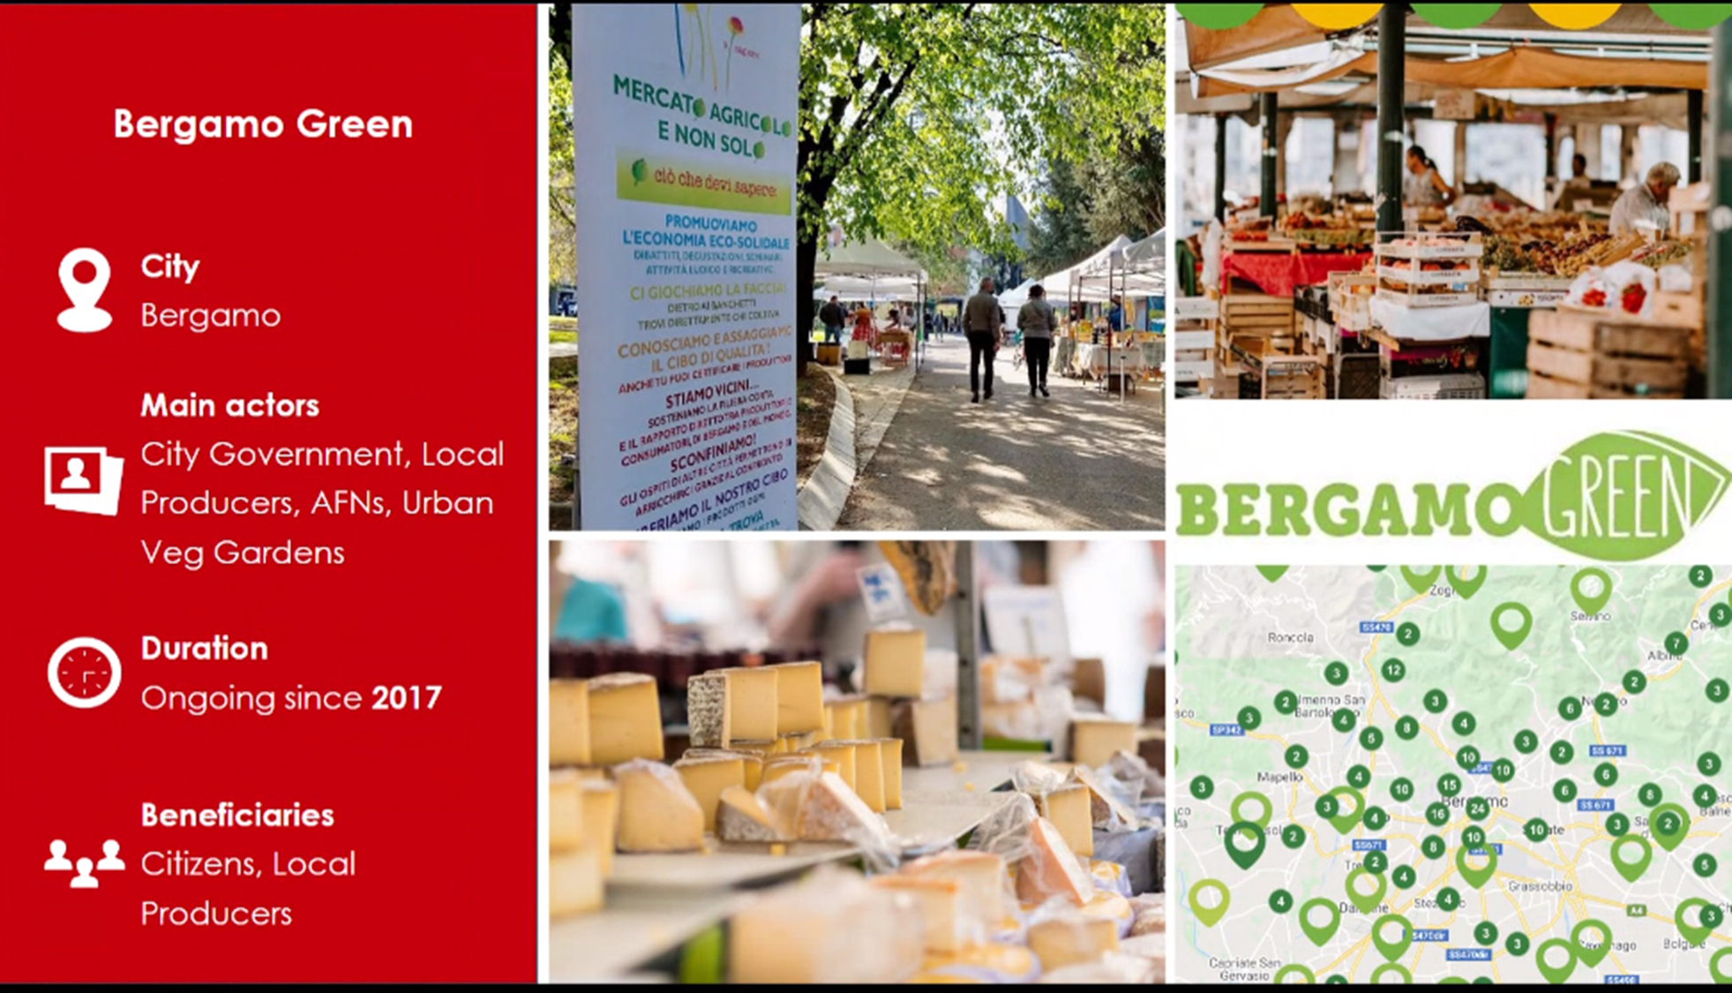
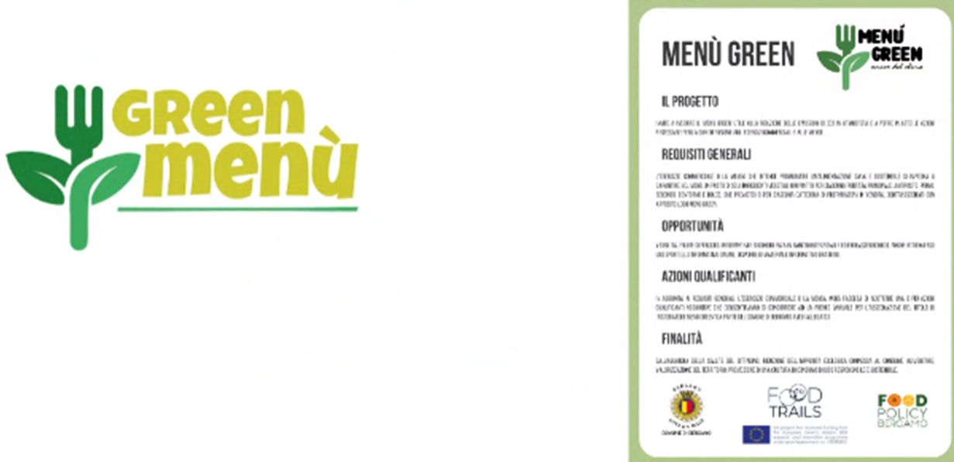
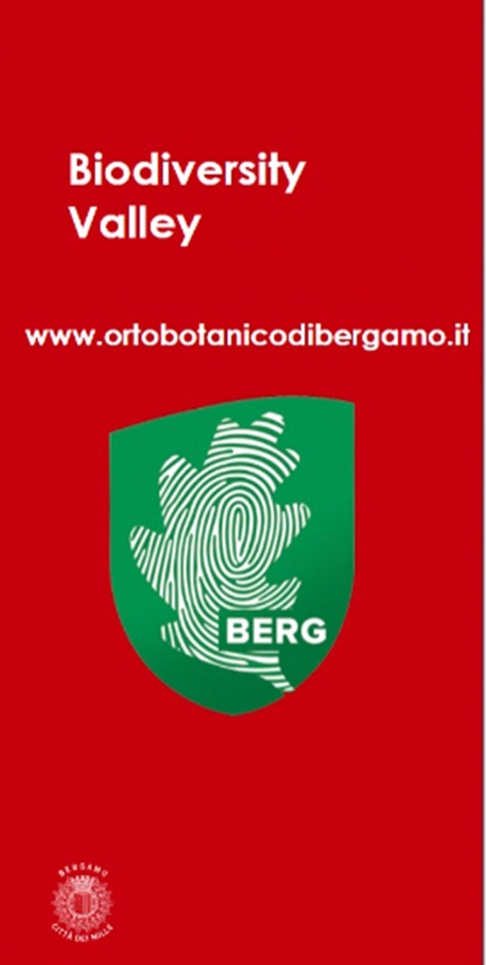
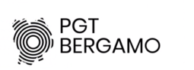
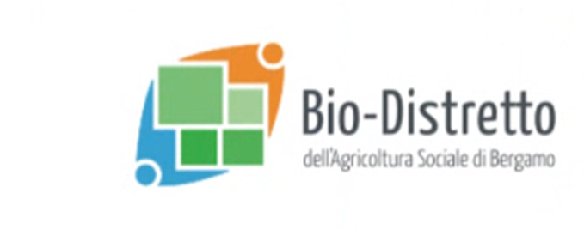
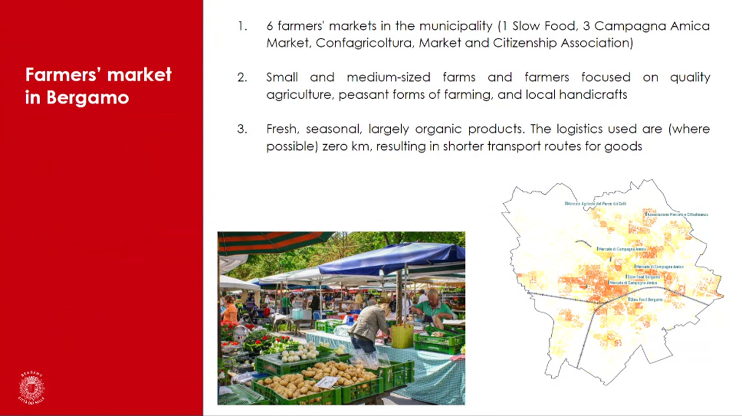

Slide 53
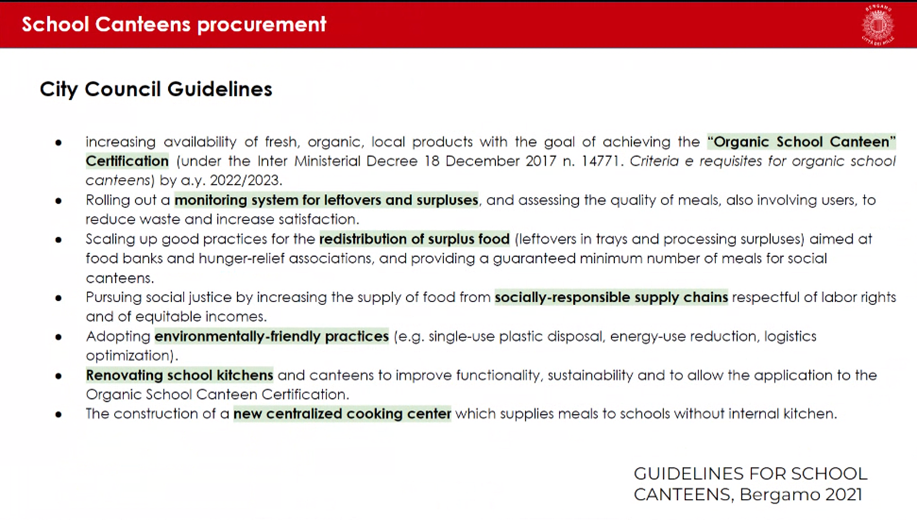
Notes:
One of their accomplishments was to transform school cantines procurement, with actions such as increasing the supply food from socially-responsbile supply chains in schools.

Slide 54
Capacity building
What to explore Food Policy Bergamo
Suggestions:
public procurement strategy
canteens
food hub
food district
farmers market
Who are the 4 members representing Bucharest:
City-hall political representative (local councillor, vice-maire, maire)
City-hall Technical department (public canteens unit, public farmers market)
Food policy officer

Slide 55
Capacity building
What to show Food Policy Bergamo
social canteen
kindergarten or elderly home canteen
local organic food store (bacanie, romo…)
local producer
farmers market
local festival/event
compost facility
urban gardening in Drumul Taberei by Alex Axinte
urban gardens elsewhere
maybe organise at same time as New town narrative workshop in Bucharest in October

Slide 56
Dublin food strategy development
Dublin is building a food strategy to improve access to healthy, sustainable food.
January 2022: public consultation to gather data on food habits and experiences.
  Data shapes policies for food production, consumption, waste management.
2023: Eat the Street festival - to raise public awareness and engagement.
Collaboration with local stakeholders and EU-funded projects like Cultivate

Slide 57
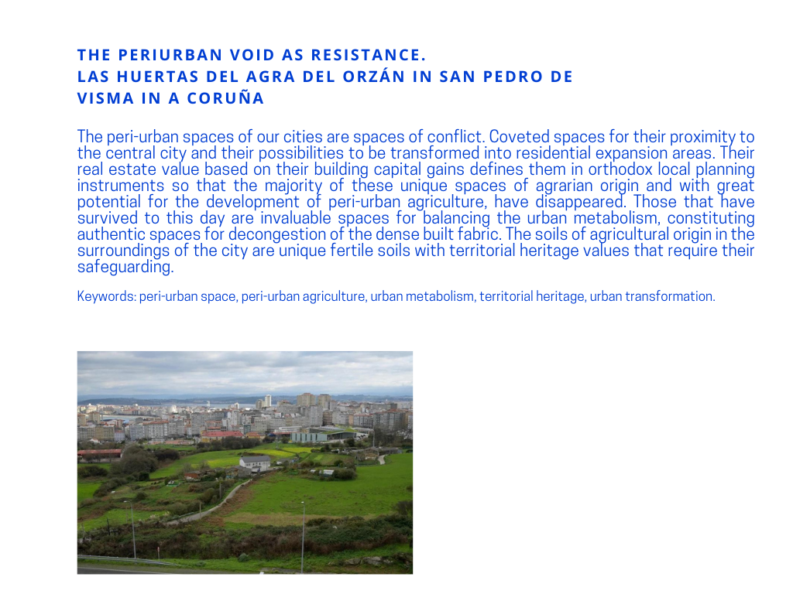
Case Study - safeguarding peri-urban voids A Coruña

Slide 58
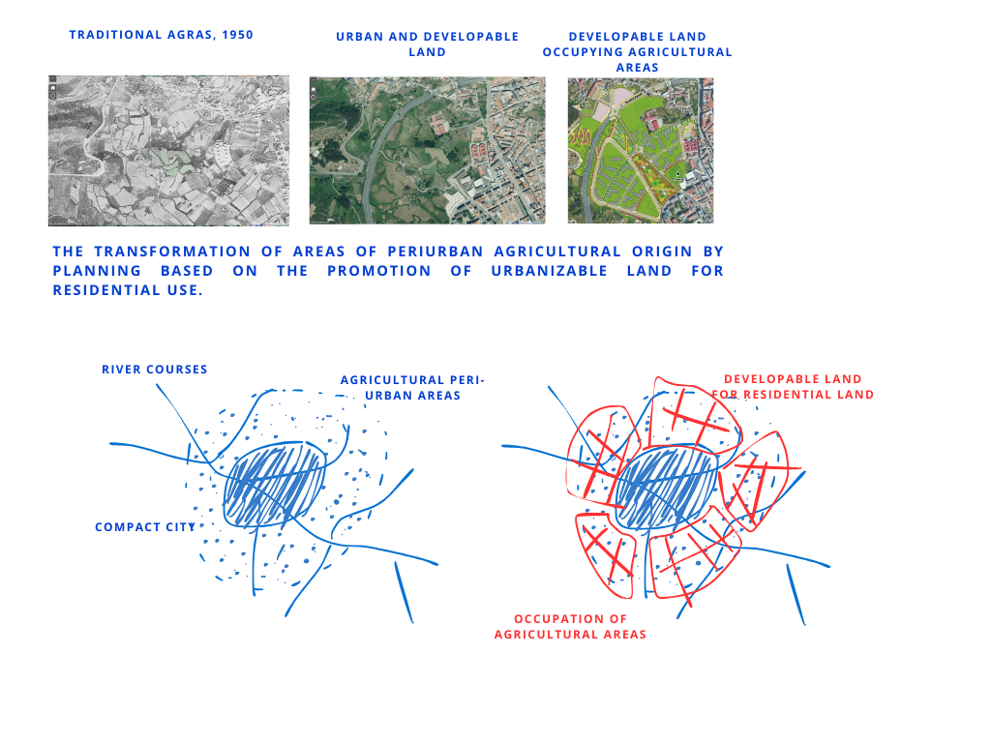
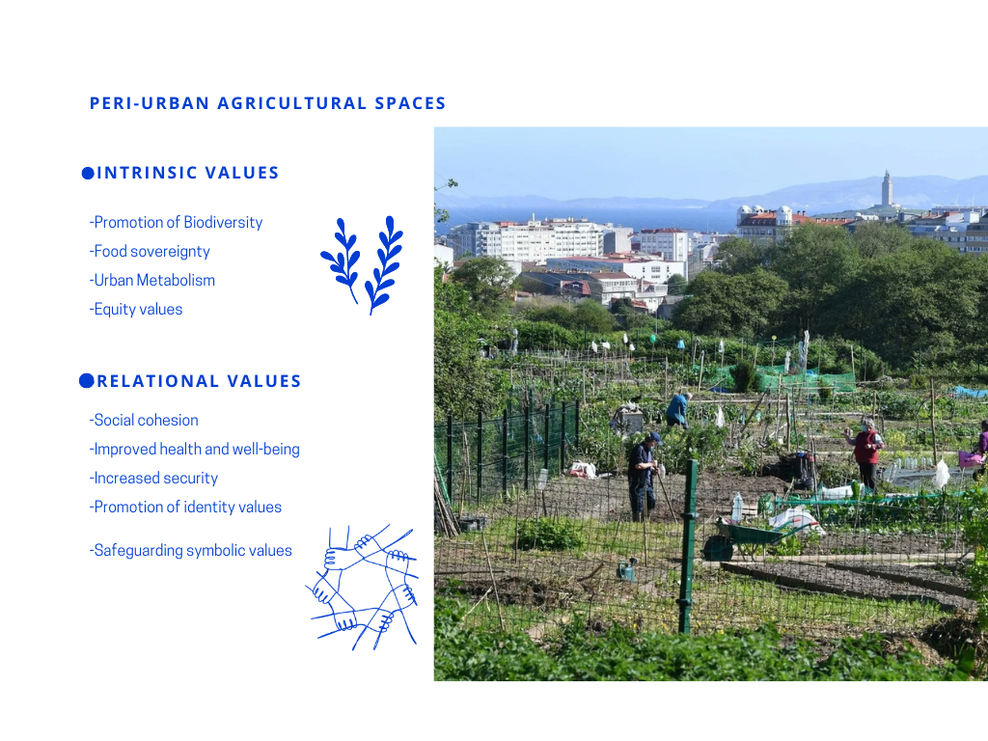
Case Study - safeguarding peri-urban voids A Coruña

Slide 59
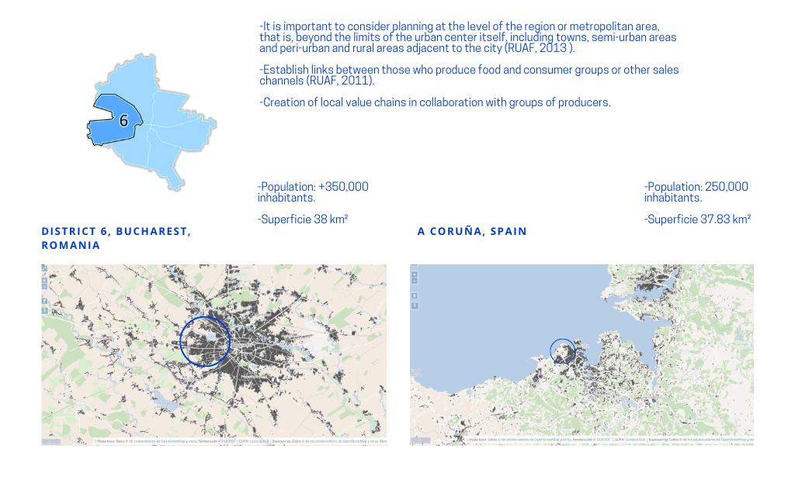
Case Study - safeguarding peri-urban voids A Coruña

Slide 60
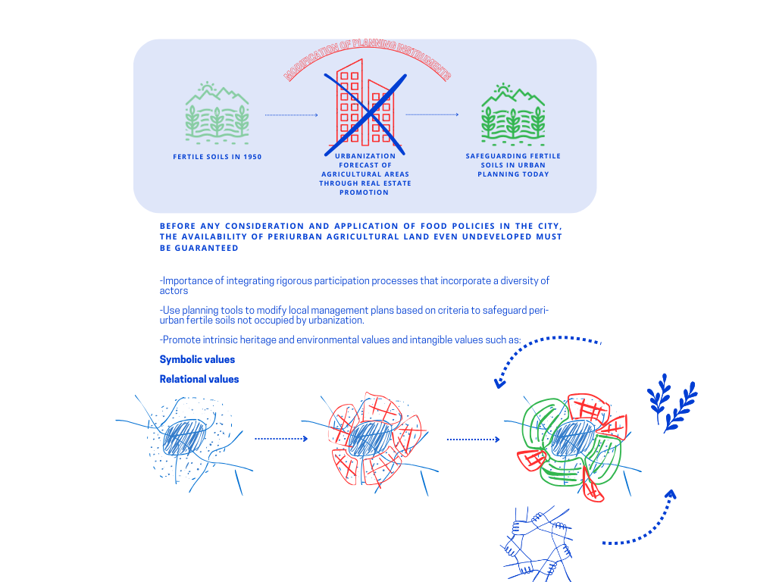
Case Study - safeguarding peri-urban voids A Coruña

Slide 61
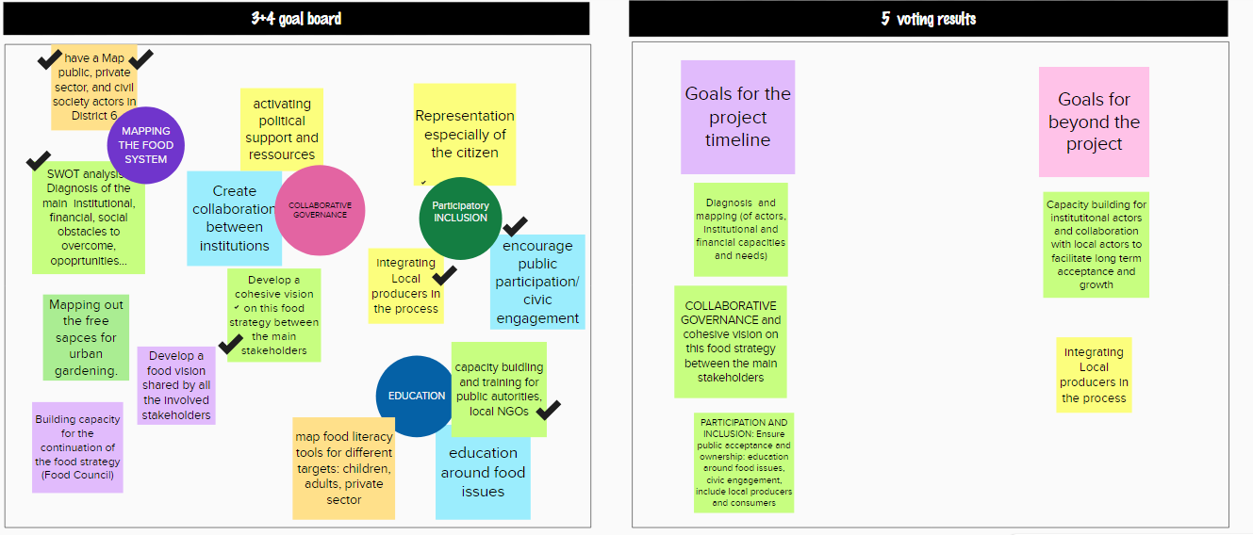
On-line: collaborative goals setting and visioning

Slide 62
Collaborative goals setting and visioning
Vision: building solidarity and synergies between local producers and consumers
From goals to actions:
Identifying local producers
Festival organisation for local producers with round table discussion
Prosumers approach: CSA…

Slide 63
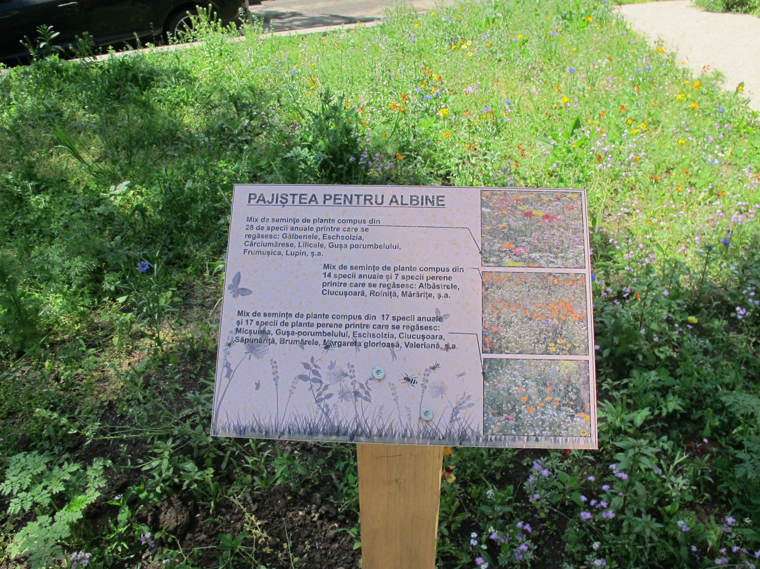






Actions already taken - Sector 6 Green Infrastructure Workshop Food Strategy thematic group (April 2024)
Community composting workshop (May 2024) Sector 6 process plan
Source: https://academiadecompost.ro/
URBOTECA Fellowship participatory diagnostic for Masca theatre as community hub (February - June 2024)
Source: https://urboteca.ro/urboteca-fellowship-2024/

Slide 64

Case Study - safeguarding peri-urban voids A Coruña

Slide 65
In Bucharest: collaborative goals setting and visioning - workshop output
Project 6
engaging with
local council
placing food as priority on urban political agenda
identify funding
capacity building: exchange programme
creating the
Living Lab
Just and Resilient Food System for Everybody
involvement in Horizon EU project
engaging Academia
engaging NGOs
engaging other institutions related to food
understanding and organising the local food system
mapping FS
participatory & awareness raising process with local actors
setting up a food council
vision
food strategy
public consultation
- plenary session
- thematic groups session
- workshops
- local producers meeting
strategic objectives
quantitative objectives
- setting up food policy department
- initiate collaboration with city, metro, regional
- awareness and educational
programmes
- public procurement
- underused infrastructure
- urban agriculture
develop adapted local regulations and allocate budget
- farmers market
- canteen
- food waste
- food hub feasibility study
- local traceability and labeling
Piloting actions

Slide 66
Next steps

Slide 67


Producers’ working groups methodology
Source: Unicef
Notes:
ROMO: grass-root movement started by farmers Cosmina and Șerban Dinu from Ferma de Pajări Pasșunate together with a handful of fellow pioneer producers from Brasov. pre-order group where you can source quality products directly from local producers. Works on a weekly basis
Eco-ruralis : Association of peasants and farmers involved in food production through subsistence and semi-subsistence agriculture, diversified and based on the principles of agroecology. Eco Ruralis is a nationwide association of peasants and farmers with almost 20,000 members in all counties of the country.
ADIZMB: Bucharest-Ilfov Metropolitan Area Intercommunity Development Association (ADIZMB) is the main formal arrangement covering the region for Bucharest and Ilfov County. A partnership between Bucharest Mayor’s Office and the Ilfov County Council, to develop the metropolitan area. The mission of the Association is to contribute to all regional and metropolitan priorities including sustainable mobility, education and inclusion, zero-carbon urban mobility, research and innovation.

Slide 68



Consumers working groups methodology
Similar to the first participatory workshop, but focusing on consumers priorities and needs.
Source: Unicef
Notes:
ROMO: grass-root movement started by farmers Cosmina and Șerban Dinu from Ferma de Pajări Pasșunate together with a handful of fellow pioneer producers from Brasov. pre-order group where you can source quality products directly from local producers. Works on a weekly basis
Eco-ruralis : Association of peasants and farmers involved in food production through subsistence and semi-subsistence agriculture, diversified and based on the principles of agroecology. Eco Ruralis is a nationwide association of peasants and farmers with almost 20,000 members in all counties of the country.
ADIZMB: Bucharest-Ilfov Metropolitan Area Intercommunity Development Association (ADIZMB) is the main formal arrangement covering the region for Bucharest and Ilfov County. A partnership between Bucharest Mayor’s Office and the Ilfov County Council, to develop the metropolitan area. The mission of the Association is to contribute to all regional and metropolitan priorities including sustainable mobility, education and inclusion, zero-carbon urban mobility, research and innovation.

Slide 69

Public consultation methodology
To collect stakeholders feedback during the public consultation phase (March - April 2025)
Source: Unicef
Notes:
ROMO: grass-root movement started by farmers Cosmina and Șerban Dinu from Ferma de Pajări Pasșunate together with a handful of fellow pioneer producers from Brasov. pre-order group where you can source quality products directly from local producers. Works on a weekly basis
Eco-ruralis : Association of peasants and farmers involved in food production through subsistence and semi-subsistence agriculture, diversified and based on the principles of agroecology. Eco Ruralis is a nationwide association of peasants and farmers with almost 20,000 members in all counties of the country.
ADIZMB: Bucharest-Ilfov Metropolitan Area Intercommunity Development Association (ADIZMB) is the main formal arrangement covering the region for Bucharest and Ilfov County. A partnership between Bucharest Mayor’s Office and the Ilfov County Council, to develop the metropolitan area. The mission of the Association is to contribute to all regional and metropolitan priorities including sustainable mobility, education and inclusion, zero-carbon urban mobility, research and innovation.

Slide 70
Vision
timeline [?]
research (European projects...)[Raluca]
funding (public, private…)[?]

Slide 71

Proposal - Structure of the Living Lab
UAUIM
Urban
planning
USAMV
Agronomy
University of Bucharest
Political science
Local residents groups
MAIRE/
COUNCILLOR
PROJECT 6
PUBLIC MARKETS
PUBLIC CANTEENS UNIT

Slide 72
Timeline for Food and Healthy Diets Strategy in District 6, Bucharest
1. Initial Assessment (September - October 2024)
- Survey dietary habits and food availability.
- Identify stakeholders and gather baseline health data, urban and peri-urban spatial analysis.
2. Stakeholder Engagement (November - December 2024)
- Awareness raising workshops
- Working groups launched.
- Set coordinated objectives and priorities.
3. Strategy Development (January - February 2025)
- Draft strategy focusing on food access, food literacy, and local production.
- Coordinate with local initiatives like school programs and community gardens.
- Workshops with local state and non-state actors.
4. Public Consultation (March - April 2025)
- Present draft to the public and collect feedback
- Adjust strategy based on input.
5. Finalization and Approval (May 2025)
- Finalize strategy and M&E plan.
- Submit for local government approval
- Secure funding for the following 24 to 48 months.
6. Implementation Planning (June - July 2025)
- Create detailed implementation plan.
- Train personnel and launch pilot projects.
7. Implementation and Monitoring (August 2025 - )
- Implement strategy and monitor progress.
- Report each 12 months to the set Food Council for District 6 and adjust as needed, based on review.
8. Evaluation and Adjustment (Ongoing)
- Conduct annual reviews and make necessary adjustments.

Slide 73



Communication strategy (campaign) - how to communicate with local population and other stakeholders
Social media channels provide a good reach to communicate and distribute information in public. The social media platforms are pretty popular among the young as well as mid age population which can help spreading awareness about the policies, initiatives and events among the public.
Public events explaining local and regional food systems to people to give them insights on the local foodscapes, and raising public awareness through active engagement.
Interactive online mapping with open access to users asking about their favorite restaurants, or if they have any idea for food generating open spaces, to build an online library of the food system. Padlet mapping can be used for example. Also, QR codes at public places can be used for easy public access.
IMAGE SOURCE: 1. fREEPIK
2. FREEPIK AI IMAGE GENERATOR
3. OPEN ART AI

Slide 74
Multi-stakeholder and multi-disciplinary consultation - Concept
Potential title “District 6 foodscapes: join our table!” - Launch of the Bucharest District 6 Living Lab
- 1st day: focus on knowledge exchange (RO, EU institutions, maybe non-EU local authorities), academia, civil society, private sector - 4 to 5 sessions of 1 h each
evening: Masca Theater may be interested for community activities
- 2nd day: workshop to facilitate capacity development on food systems thinking, including the reflection on what tools (technical, social, governance, etc) are most adequate in the RO context for Sector 6
e.g. a strategy OR an Action Plan under the current “Integrated urban development program of sector 6 of the municipality of Bucharest 2021-2030”; what could be a food council for Sector 6?
Who: AESOP4Food; University of Bucharest - Faculty of Political Sciences; Sector 6 (Bucharest); civil society; private sector; EU institutions (?)

Slide 75
Integrated and participatory food governance in District 6
BARRIERS TO BE CONSIDERED
Most impacted by the project are sometimes the most marginalized
Ensure accessibility (timing, cover transport fees, food, childcare provision, etc…)
Danger of replicating power dynamics, not everyone feels as confident to speak
Foster Inclusive and empowering environments (good facilitation, separate working groups, preliminary meetings with some groups, etc)
Complex socio-political context : Reluctance due to post socialist context and lack of inclusion of food in political agendas
Establish network with local NGOs and civil society organizations to provide support in the participatory strategy.
Map of local actors (consumers, producers, focus on vulnerable groups who could benefit from initiative)
Establish appropriate participation strategies for local vulnerable groups (ie. mediation through local NGOs, separate working groups, etc…)
STEPS
Develop intuitive communication strategies (open discussions, poster dissemination, participatory activities such as workshops in schools or community centers, public consultations, etc…)
Interviews and surveys among populations targeted by the project
Include local populations in working groups that will potentially be created for the project.

Slide 76
References
https://www.milanurbanfoodpolicypact.org/the-milan-urban-food-policy-pact-monitoring-framework-handbook-and-resource-pack/
https://www.fao.org/fileadmin/user_upload/faoweb/ffc/docs/Tool_-_CRFS_Resilience_Indicator_Framework.pdf
https://www.uia-initiative.eu/en/news/last-uia-tastin-fives-journal-urban-labs-new-way-creating-and-living-city
https://www.sustainablefoodplaces.org/resources/sfp_toolkit/
https://www.rockefellerfoundation.org/wp-content/uploads/2022/02/Food-Systems-Analysis-Toolkit.pdf
https://www.rit.edu/affiliate/nysp2i/sites/rit.edu.affiliate.nysp2i/files/docs/resources/Municipal_Food_Waste_Toolkit_Part_1-Defining_Your_Goals.pdf

Slide 77
Evaluation of this course
Ioana: I appreciate working in a Living Lab setting, knowing students with different backgrounds, exchanging knowledge and applying what we have learnt on a concrete project than will continue after the finalisation of the course.
Camelia: Excellent lectures and great conversations on how to work on the strategy for District 6. Informative to know the other groups work too.
Raluca:
Maria: Being able to share similar experiences in different contexts has been really enriching. The living lab of district 6 in Bucharest has been very well organized and has achieved very good results in such a diverse international context.
Carmen: The lectures were really enriching and working in the living lab allowed to apply what we learned in a concrete setting. Working in a local/remote students basis was interesting, as we could combine our theoretical desk research with the findings on the ground.
Shashank: AESOP4FOOD is a really nice course to learn about how to get involved in the foodscapes, the lectures are very insightful on how to start forming policies, and also give opportunities to learn about active initiatives in other parts of the world which can later be combined in new food policies. Also, the living labs provide opportunities to meet other people curious about foodscapes and knowledge sharing, which is also good for networking and future collaboration. Overall, the course is nicely designed to to learn and apply the knowledge during the duration of the course.

Slide 78
Questions
Festivaluri
Piețe volante
Certificate de producători
stakeholders power map

Slide 79
Resources for stakeholder mapping
Ecological production:
News article about an independent mapping of ecological producers in Romania (romanian) and interactive map: https://www.agriculturaecologica.ro/harta-producatorilor/
Development Strategy 2021-2030: https://primarie6.ro/primarie_sector6/sites/default/files/2022-05/Programul-integrat-de-dezvoltare-urbana-a-Sectorului-6-al-Municipiului-Bucuresti-2021-2030.pdf (romanian)
List of markets from S6 website, green areas, parks, playgrounds can also be found: https://administratiacomerciala6.ro/comercial_primariesector6/serviciul-administrare-piete
Mapped schools, highschools, kindergardens, nurseries: https://administratiascolilor6.ro/admin_scoli_primariesector6/
Projects of the Social Services S6: https://www.asistentasociala6.ro/proiecte-fonduri-externe including https://www.foodbank6.ro/
Programme for introducing warm meals in schools: https://www.edupedu.ro/programul-national-masa-sanatoasa-incepe-pe-1-ianuarie-2024-masa-calda-sau-pachet-alimentar-de-15-lei-pe-zi-de-elev-inspectoratele-scolare-vor-alege-scolile-care-intra-in-program/ including 3 schools in Sector 6 (Ion Dumitriu, Sfânta Treime, Nr. 309) https://www.edupedu.ro/oficial-lista-scolilor-incluse-in-programul-masa-sanatoasa-in-2024-publicata-dupa-doua-luni-de-cand-a-inceput-noul-an-calendaristic/
Local community composting stations project: https://www.climatosfera.org/academia-de-compost 1 station in sector 6
Urban Agriculture Heritage: Pasteur Institute Boja Farms, Farms for animals raised for veterinary vaccines experiments: http://wikimapia.org/8857998/ro/Ferma-Boja-Institutul-Pasteur
Morii Lake project: https://www.dropbox.com/s/ynqdeq36msle1i2/prezentare%20lacul%20morii.pdf?dl=0&fbclid=IwAR1o1U0dCNaKQQoxH7tuCrs8A-rnY2FGlWo7i6S6G3a9GFlEQT-m0yYmlMQ
Drumul Taberei community practices mapping: https://www.anuala.ro/proiecte/2022/199/

