Slide 1
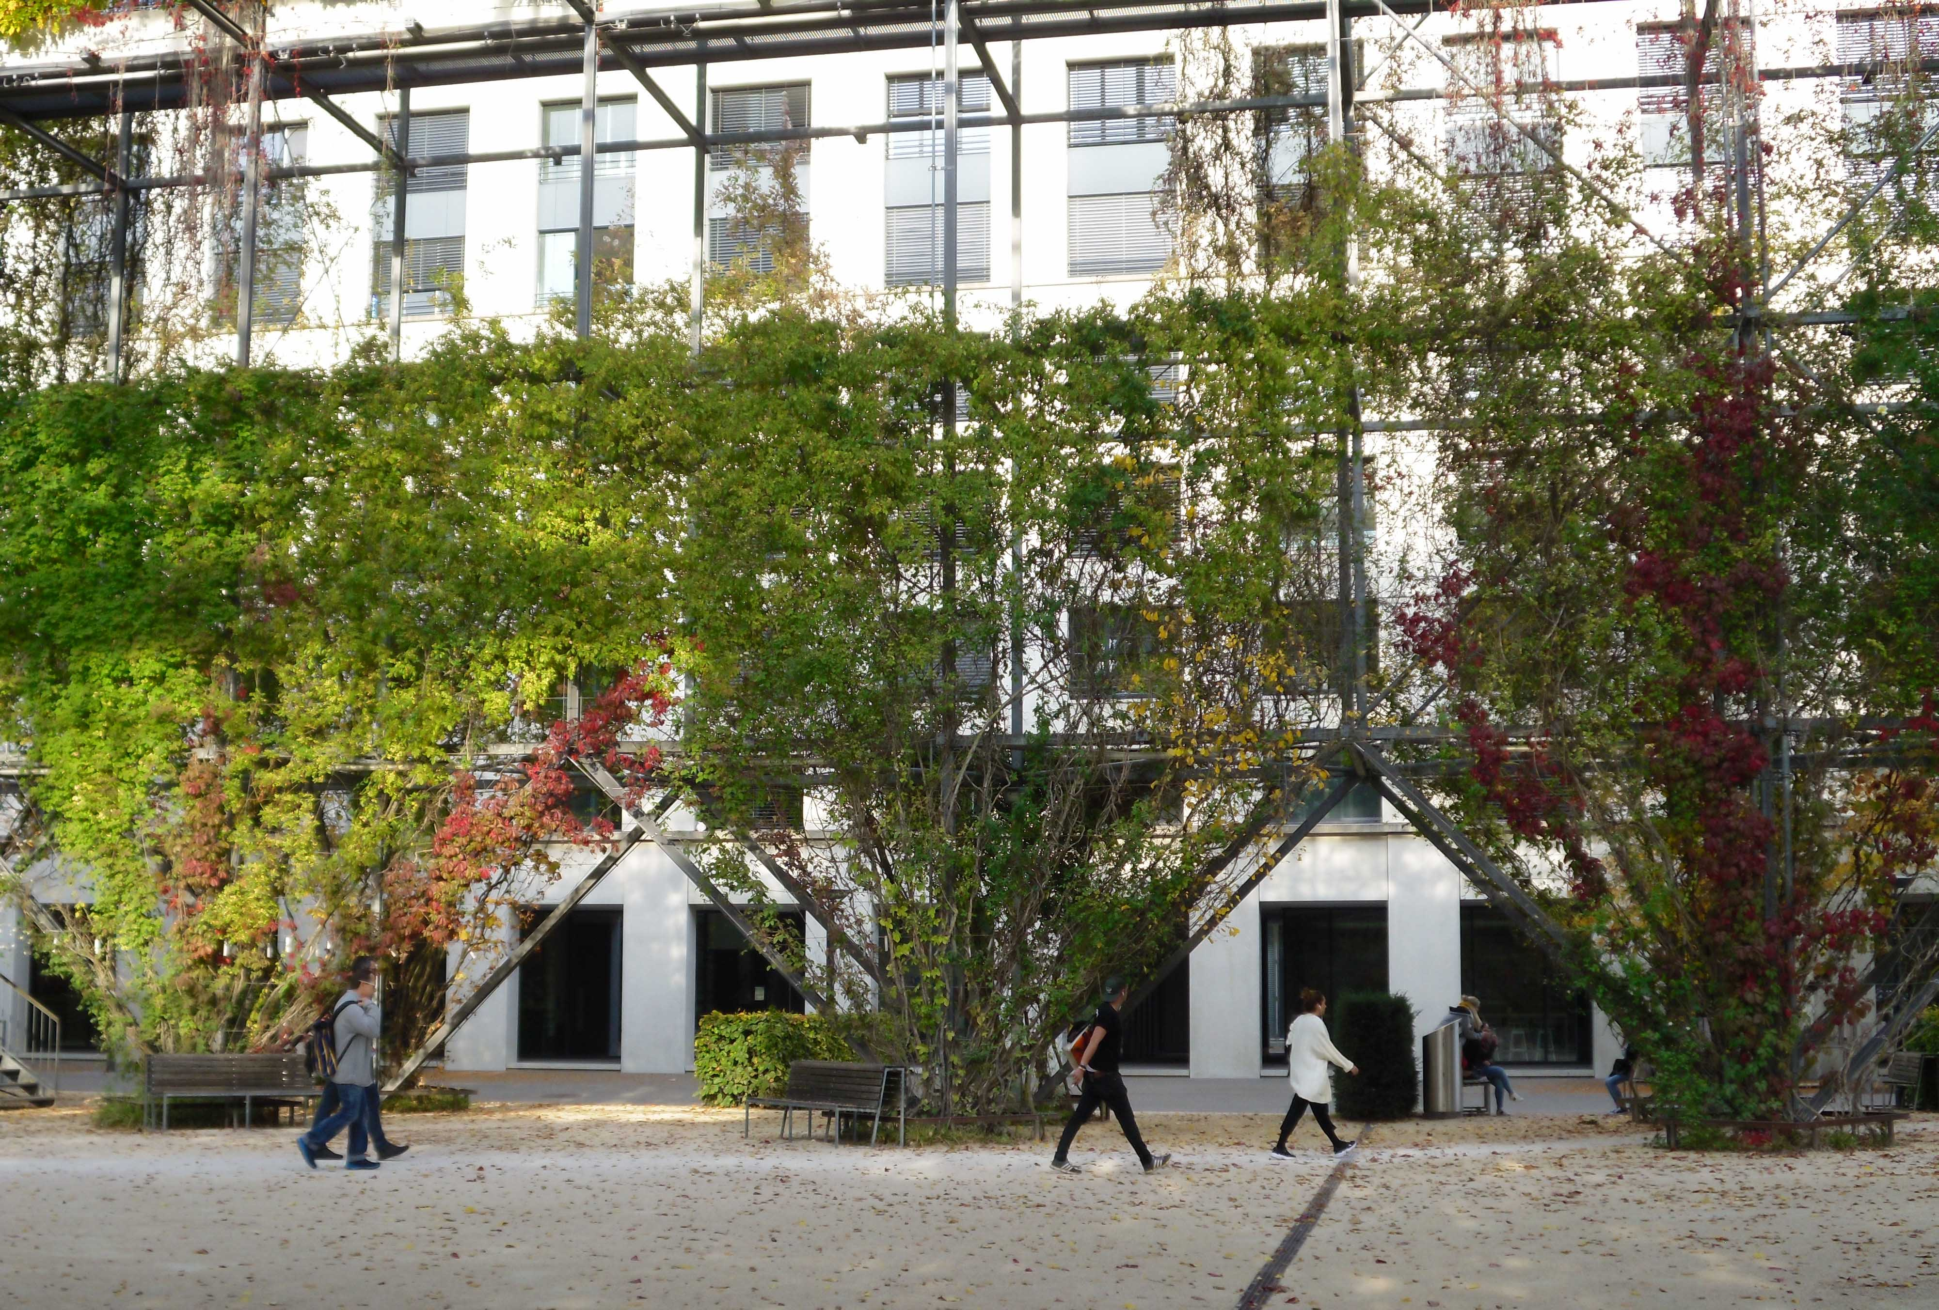



Design with Nature
Final Presentation
International Master of Landscape Architecture
Student: Tatiana Nascimento

Slide 2
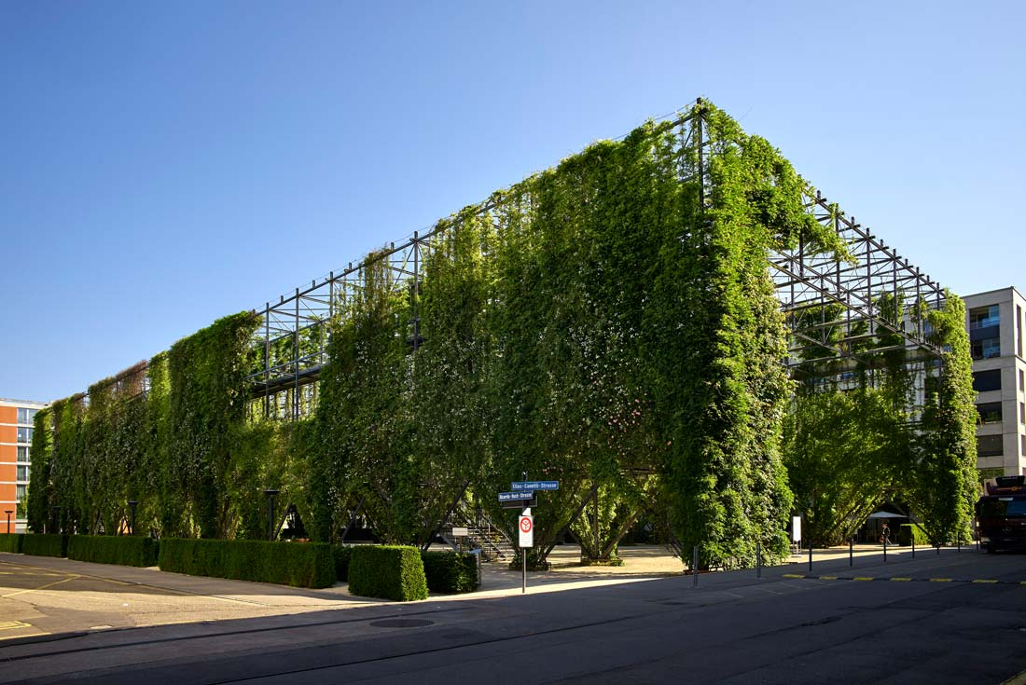




What are the challenges for the park?
So far the park has as main use the stay and be visiting card of Oerlikon.
What has been observed during the last month is:
People use the park for crossing between the neighborhood and the station.
Sound pollution is constantly disturbing when using the park.
There are some vestiges of vandalism like graffiti and destruction of furniture.

Slide 3
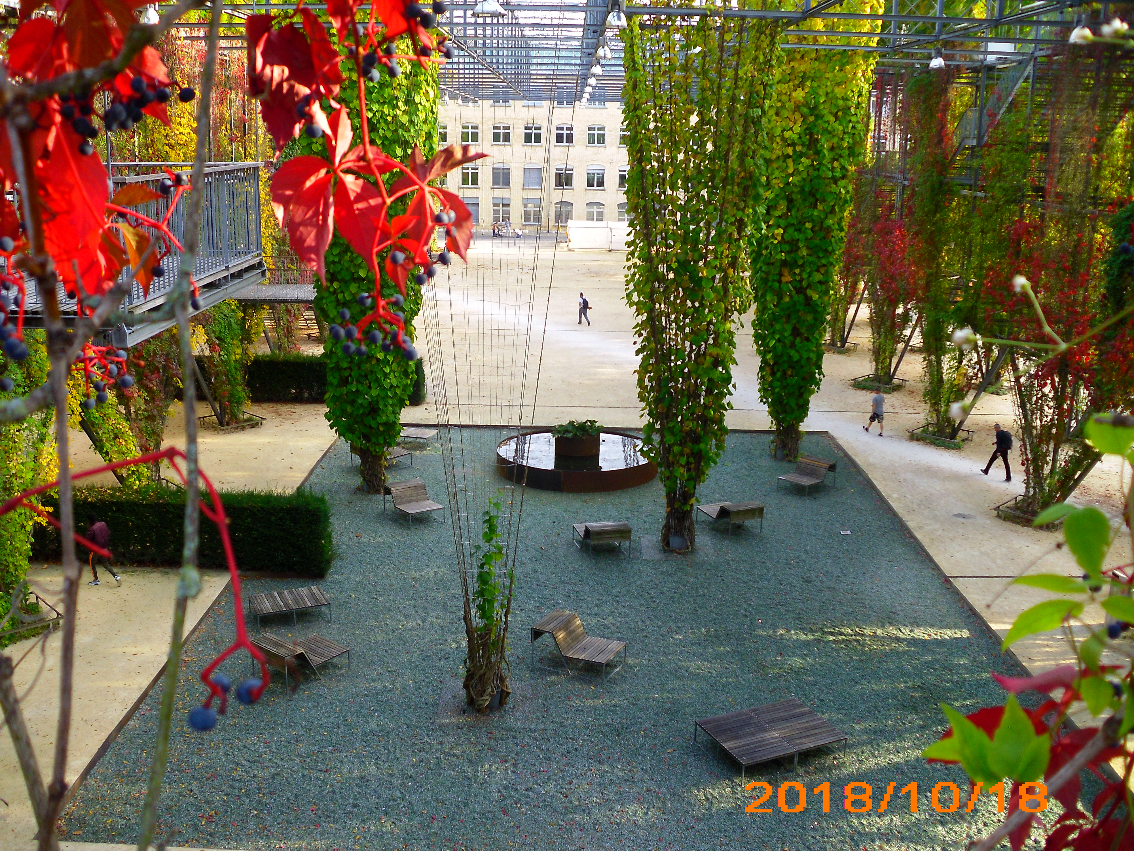


Which idea of ‘design with nature’ guides the design concept of this site?

Slide 4
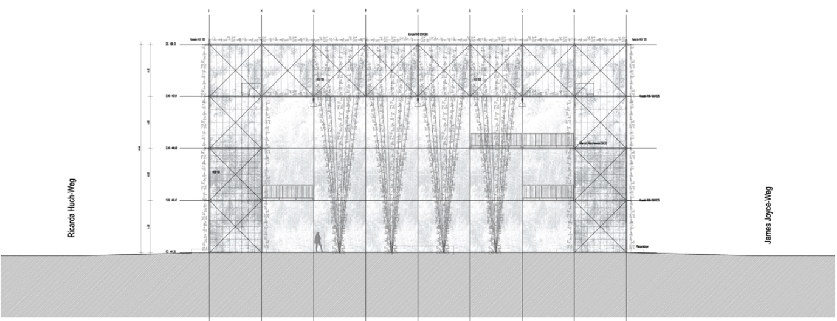




Put new furniture to eat, maybe zones of tables and benches for lunch, as some of the users spend their lunch hour in the park.
Replant the plants that have already died and replace the degraded pavement.
To make tradeshows and traditional markets, with products of the region, for integration of the neighborhood, and also so that people begin to have the sensation of use of the park.
Begin to bring fast food trucks or other traveling trades that can evolve in this area (there is already one ,less than 500m, with roasted chestnuts and another one on the other side of the season with kebabs and donners)...

Slide 5
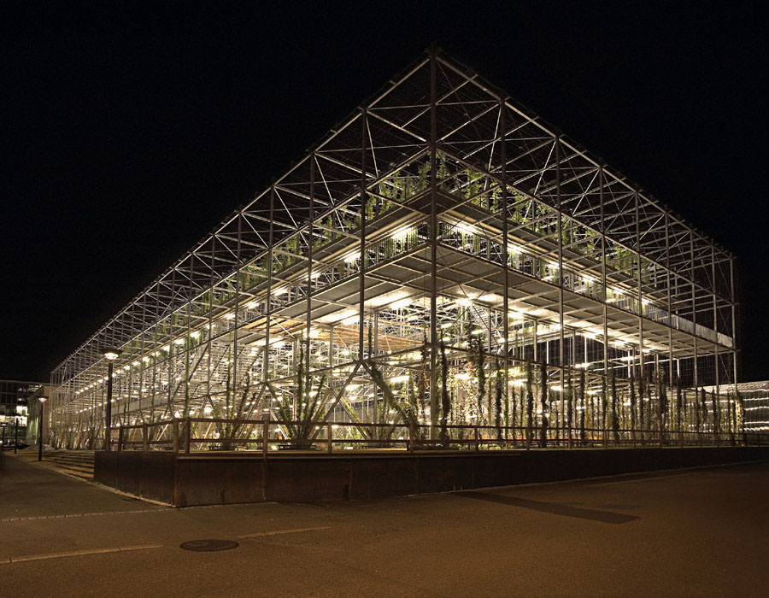


Use the space for open-air cinema and concerts or theaters, since its design was inspired by the old theater rooms with cabins.

Slide 6
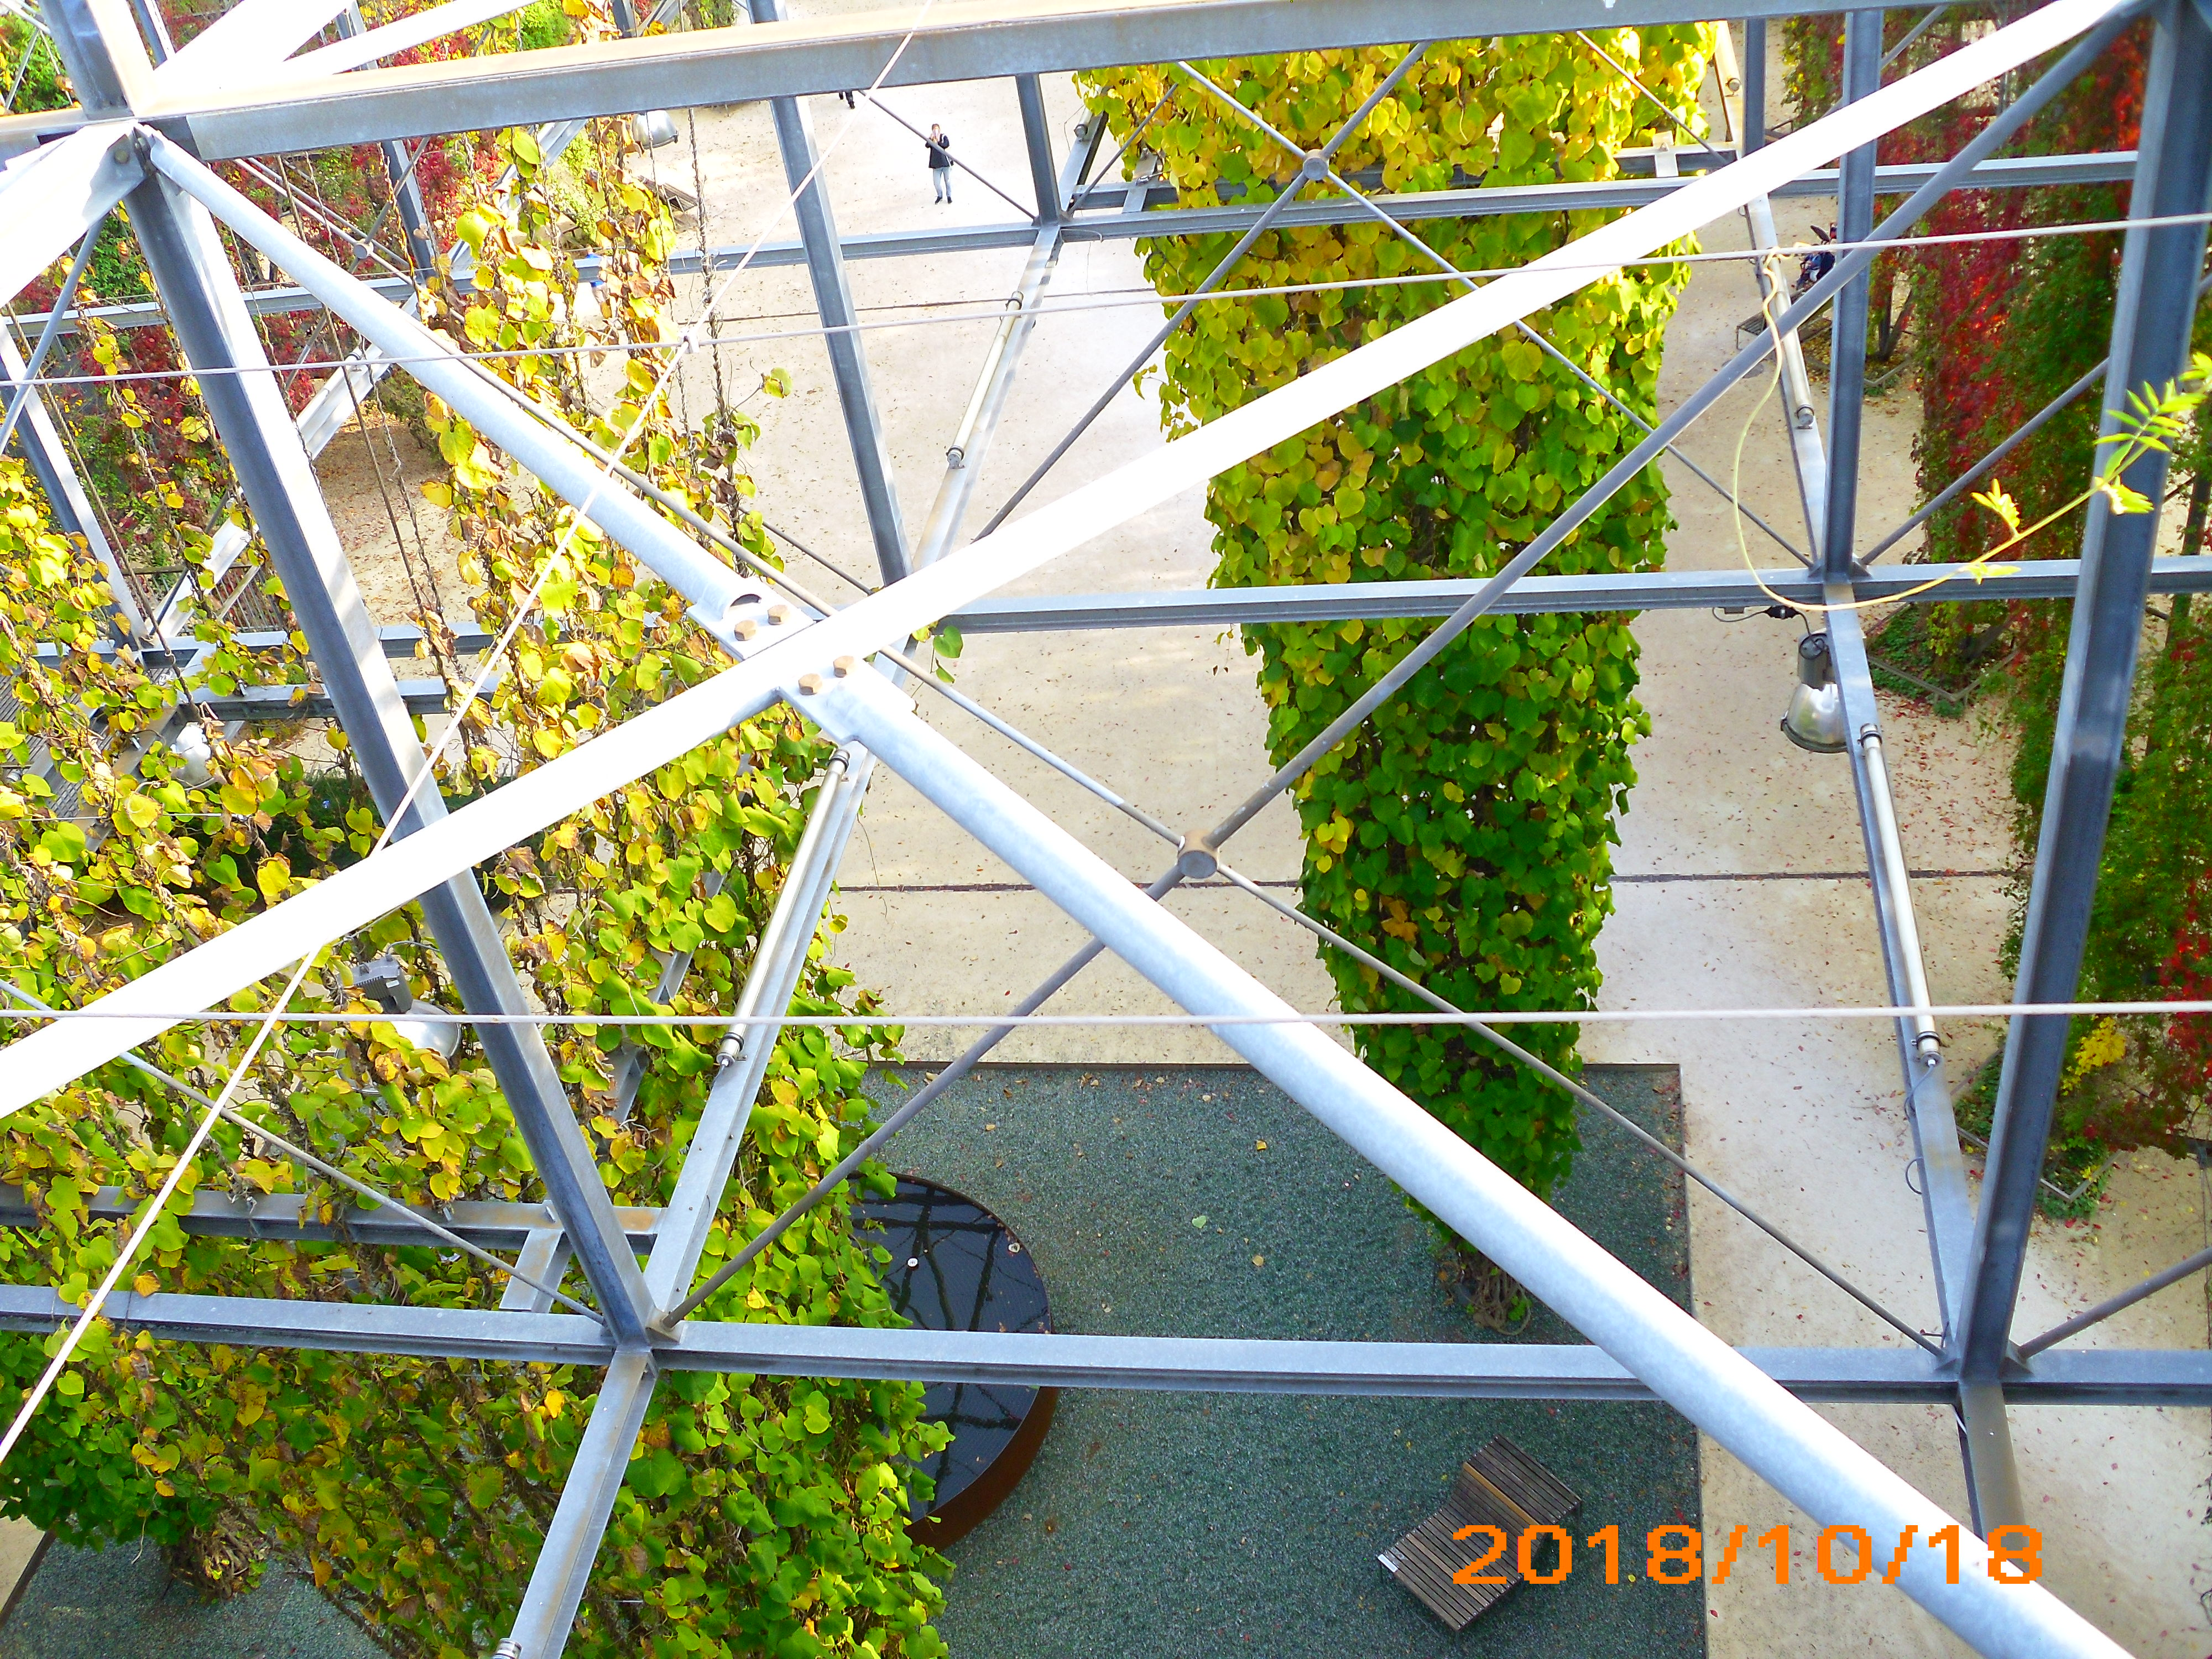
Thank you for your attention!
If you have a question,
I might have the answer…
So ask me now!!

