Slide 1

The Villa Almeida’s Garden
Starnberg Germany
An old neglected English garden

Slide 2
I- What are the challenges ?

Slide 3
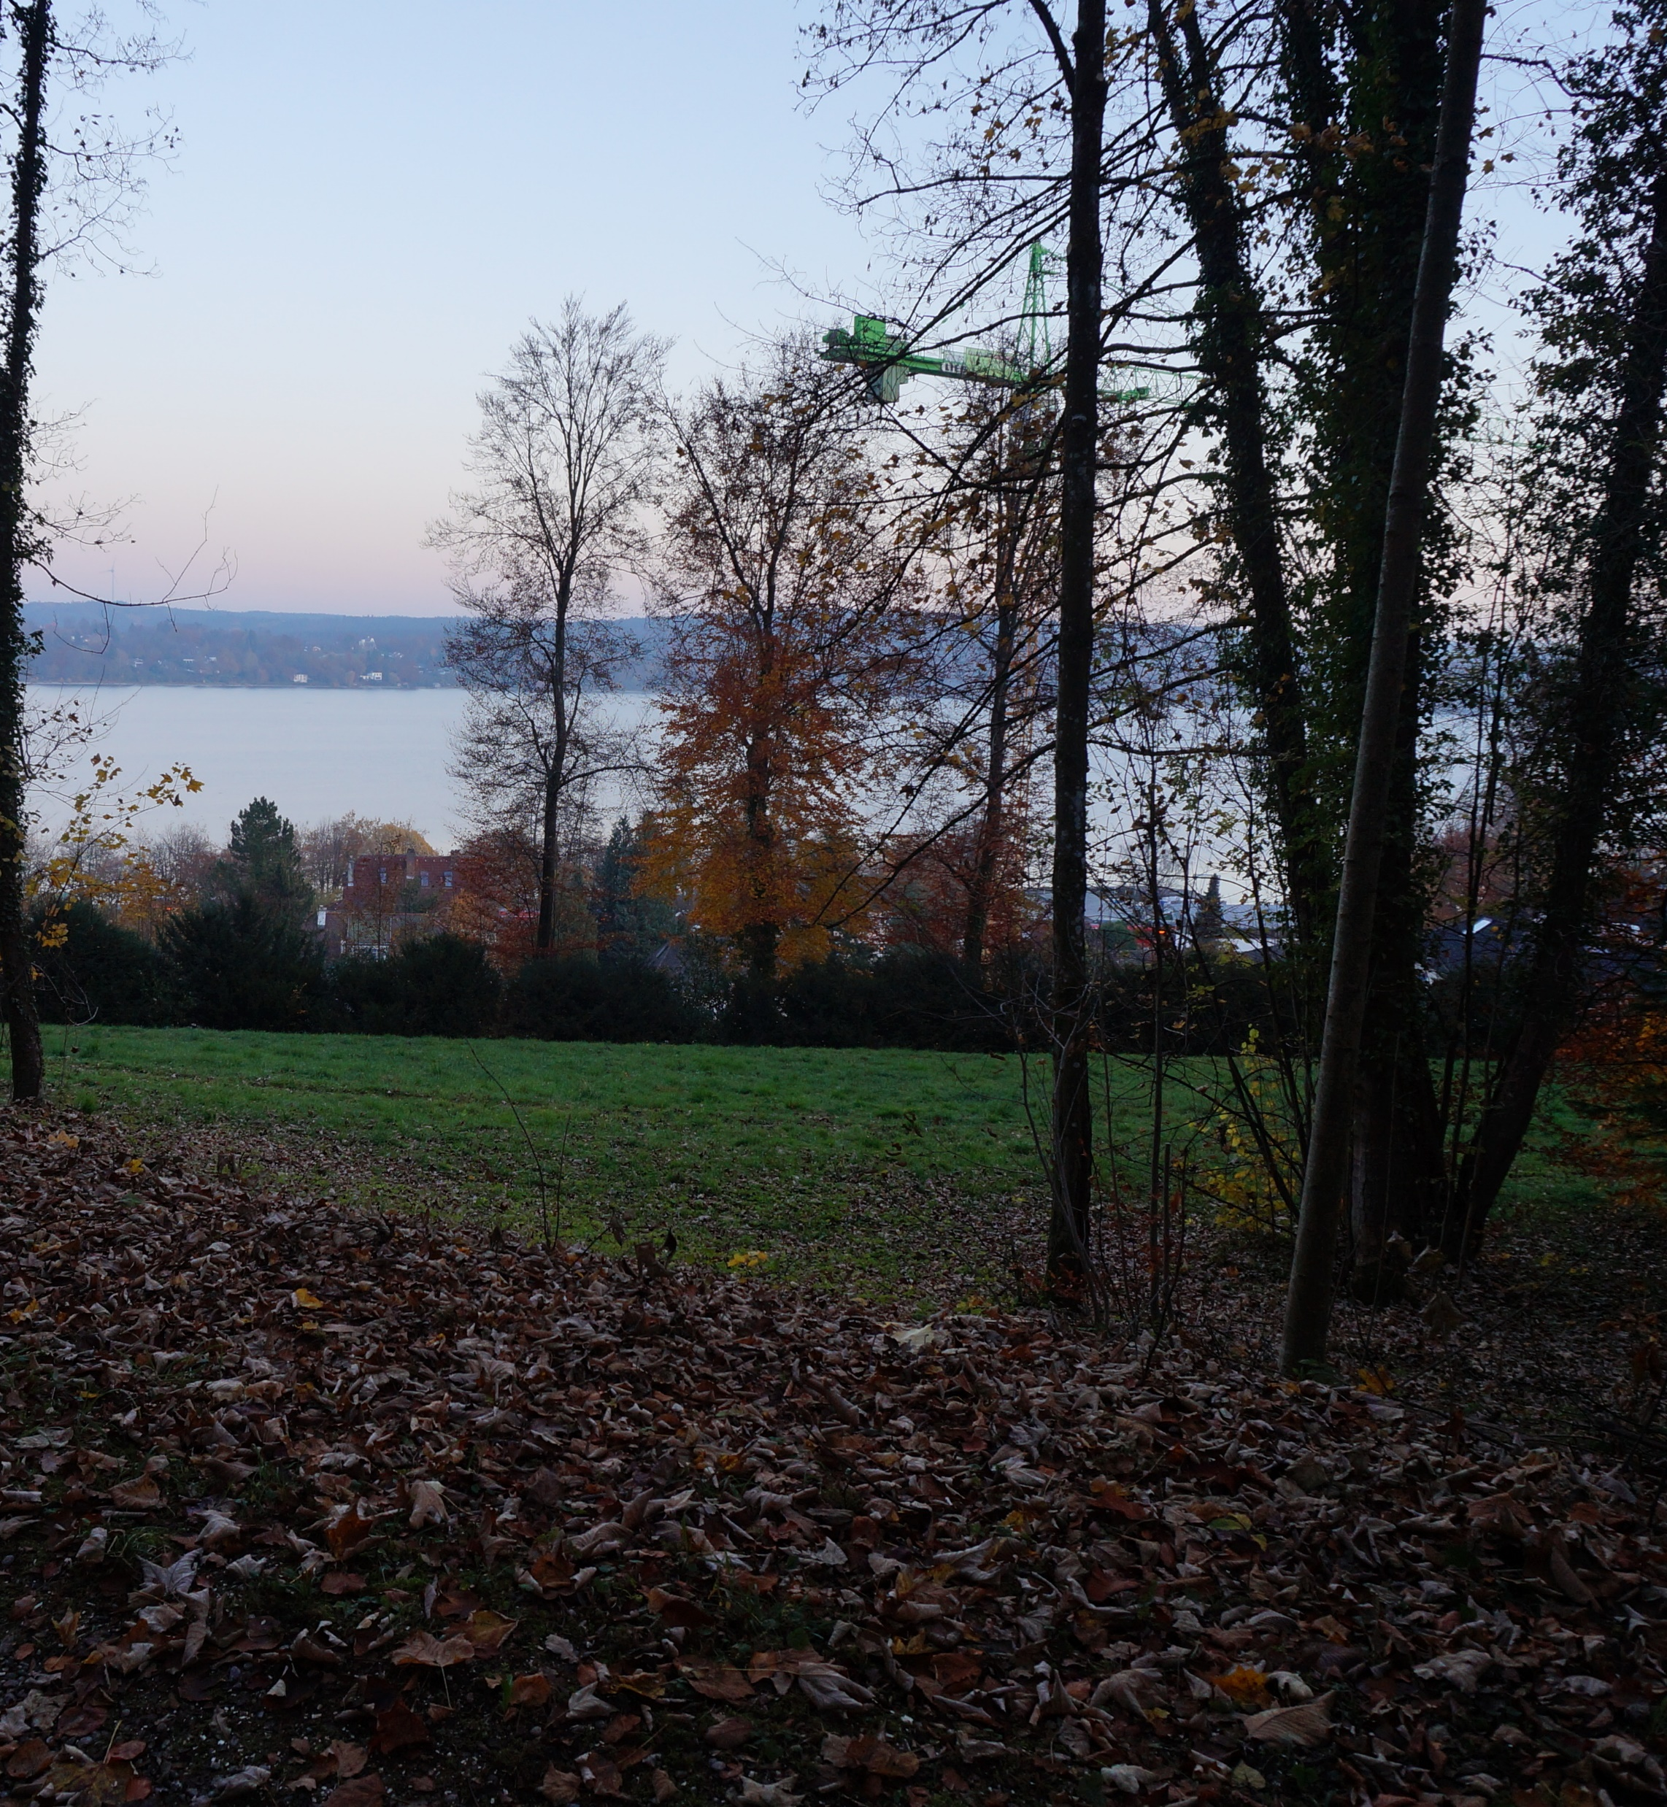
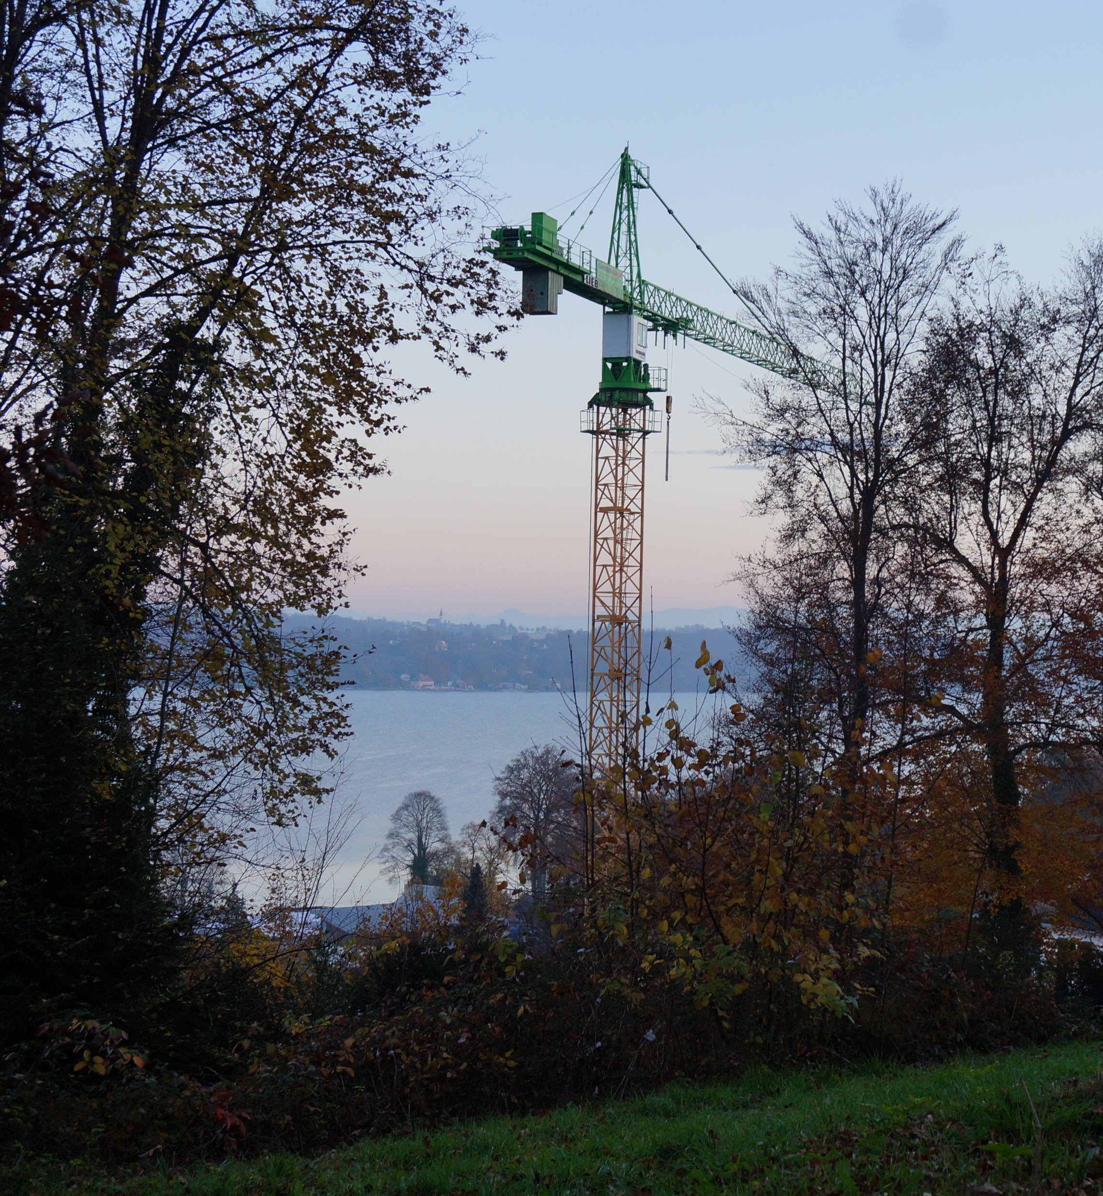

Slide 4
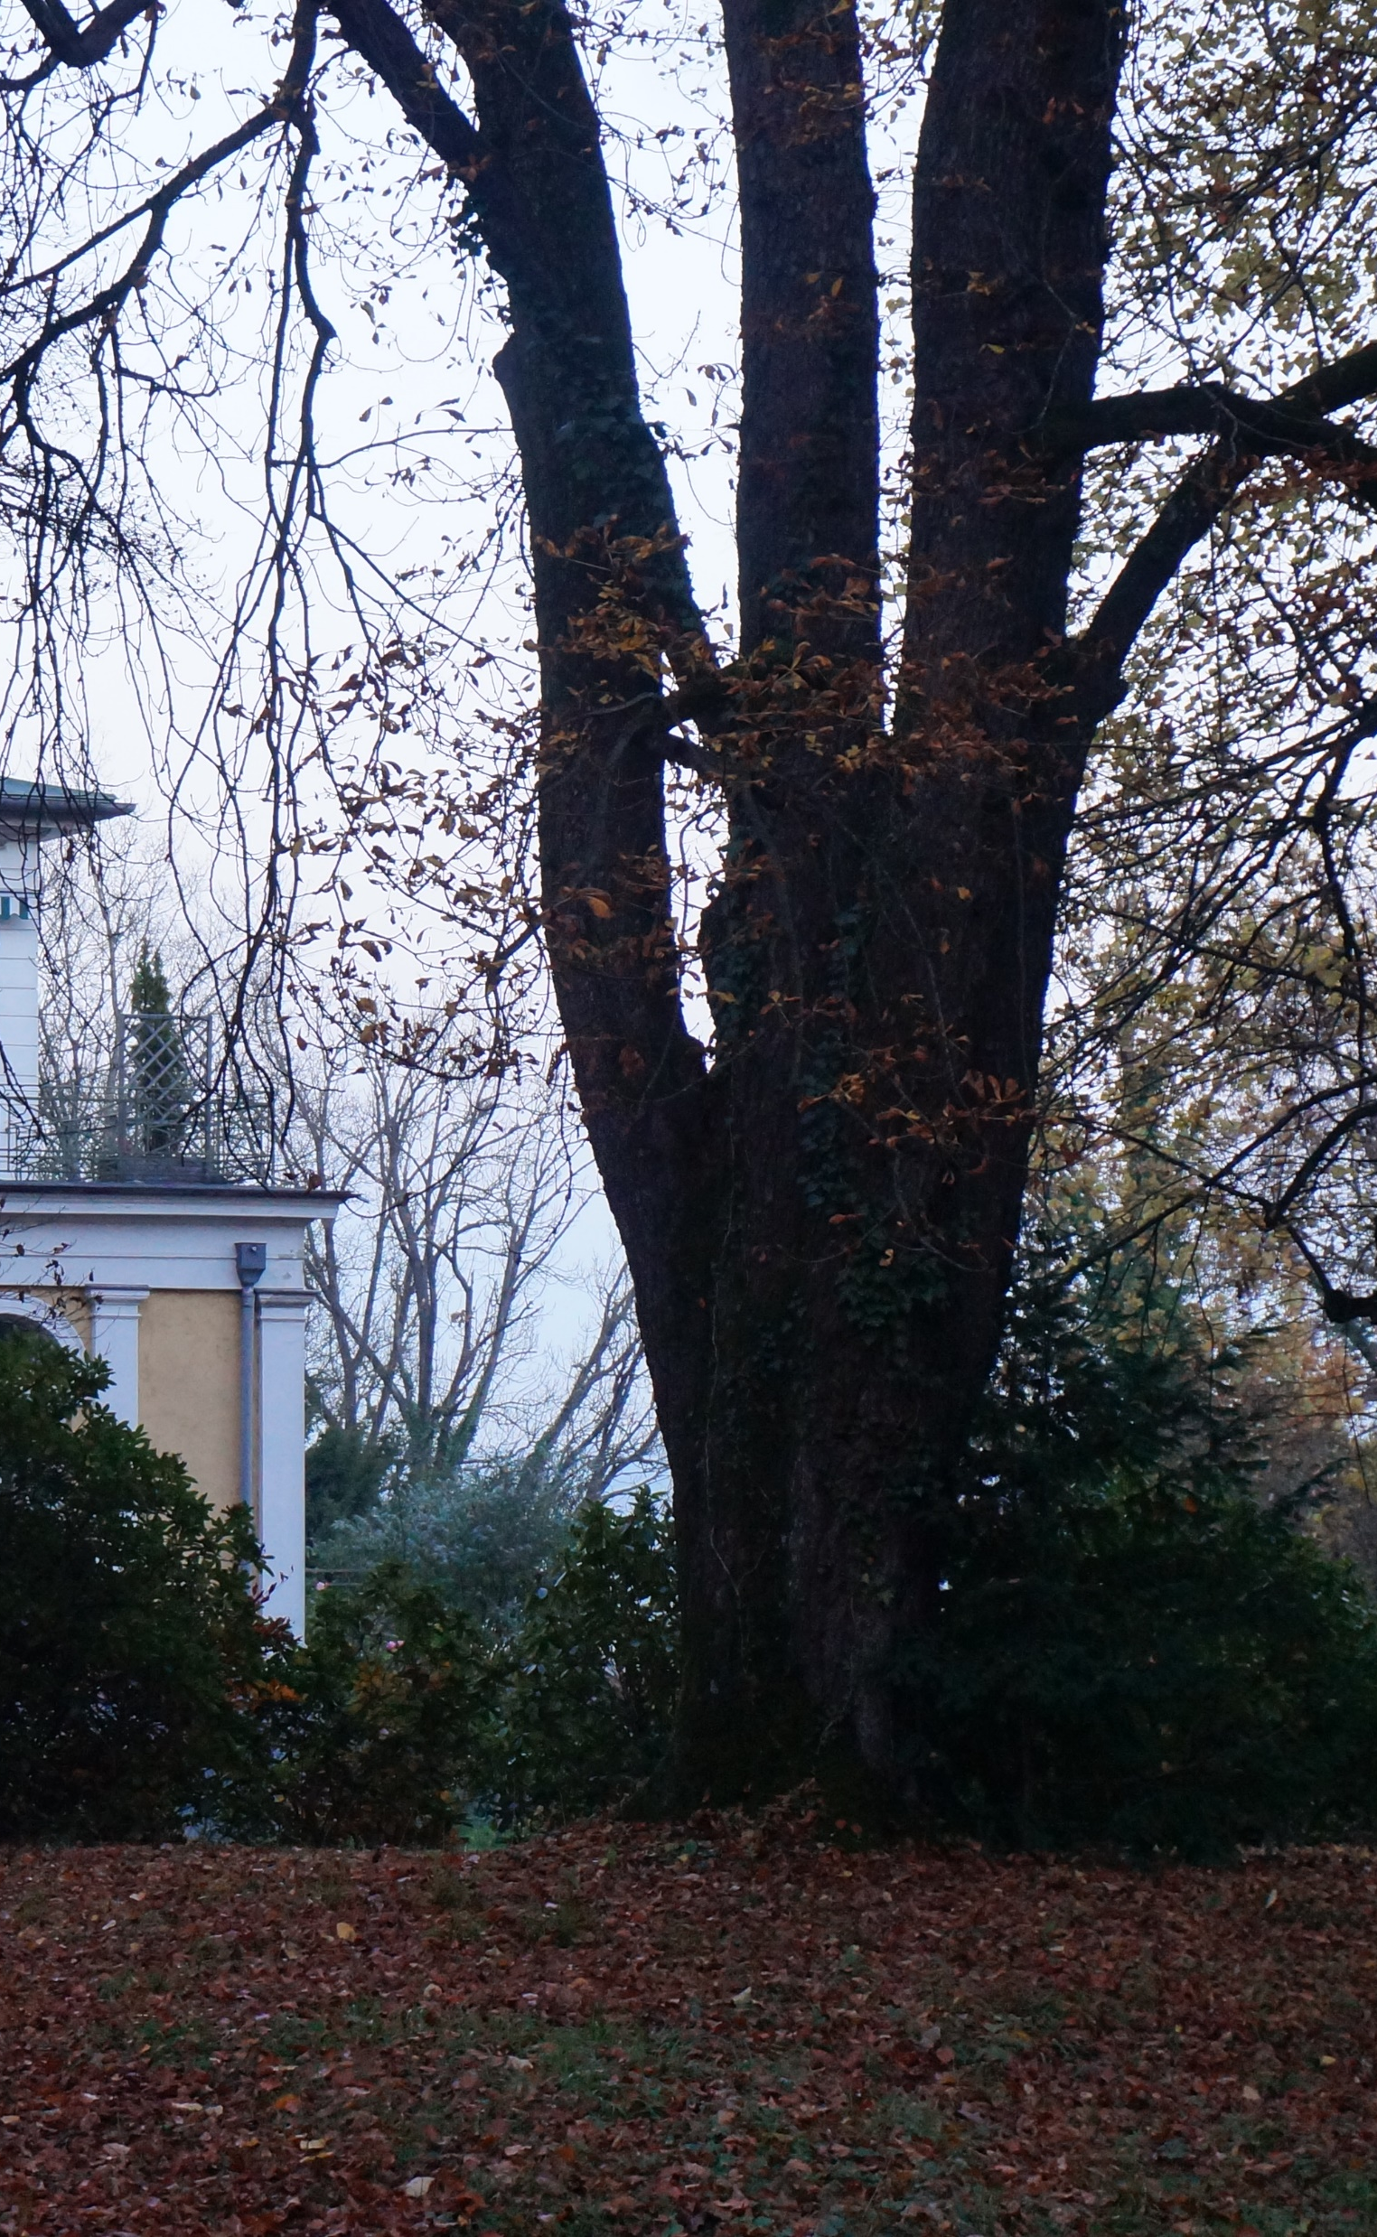
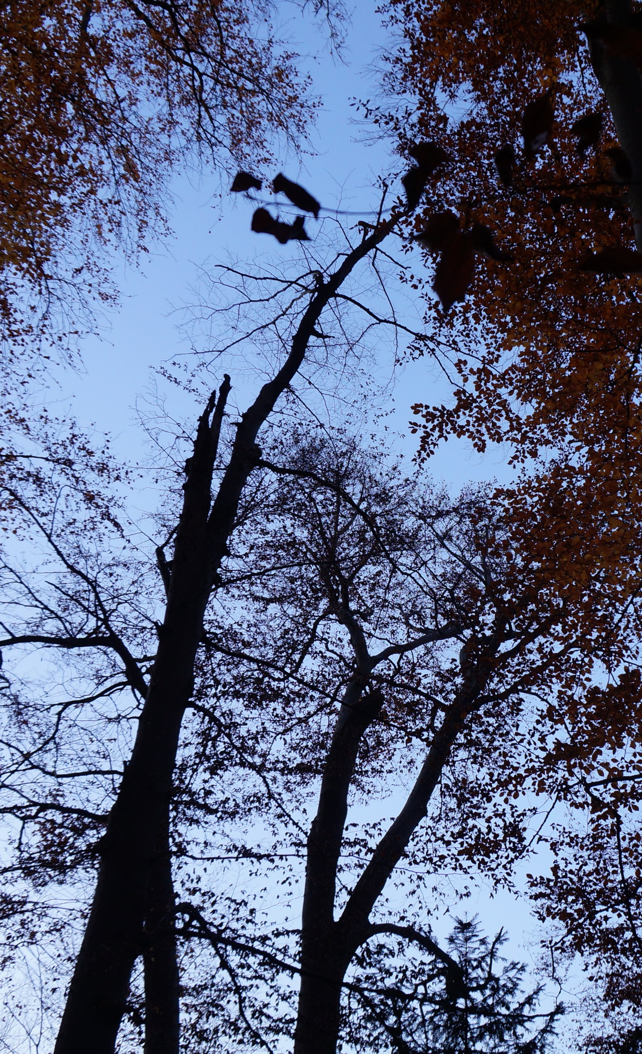
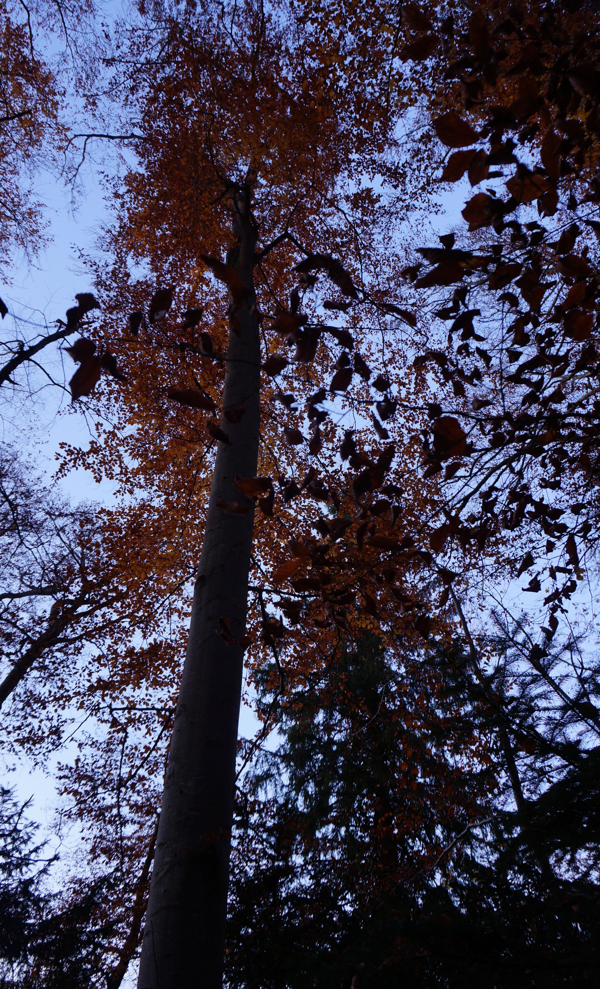

Slide 5
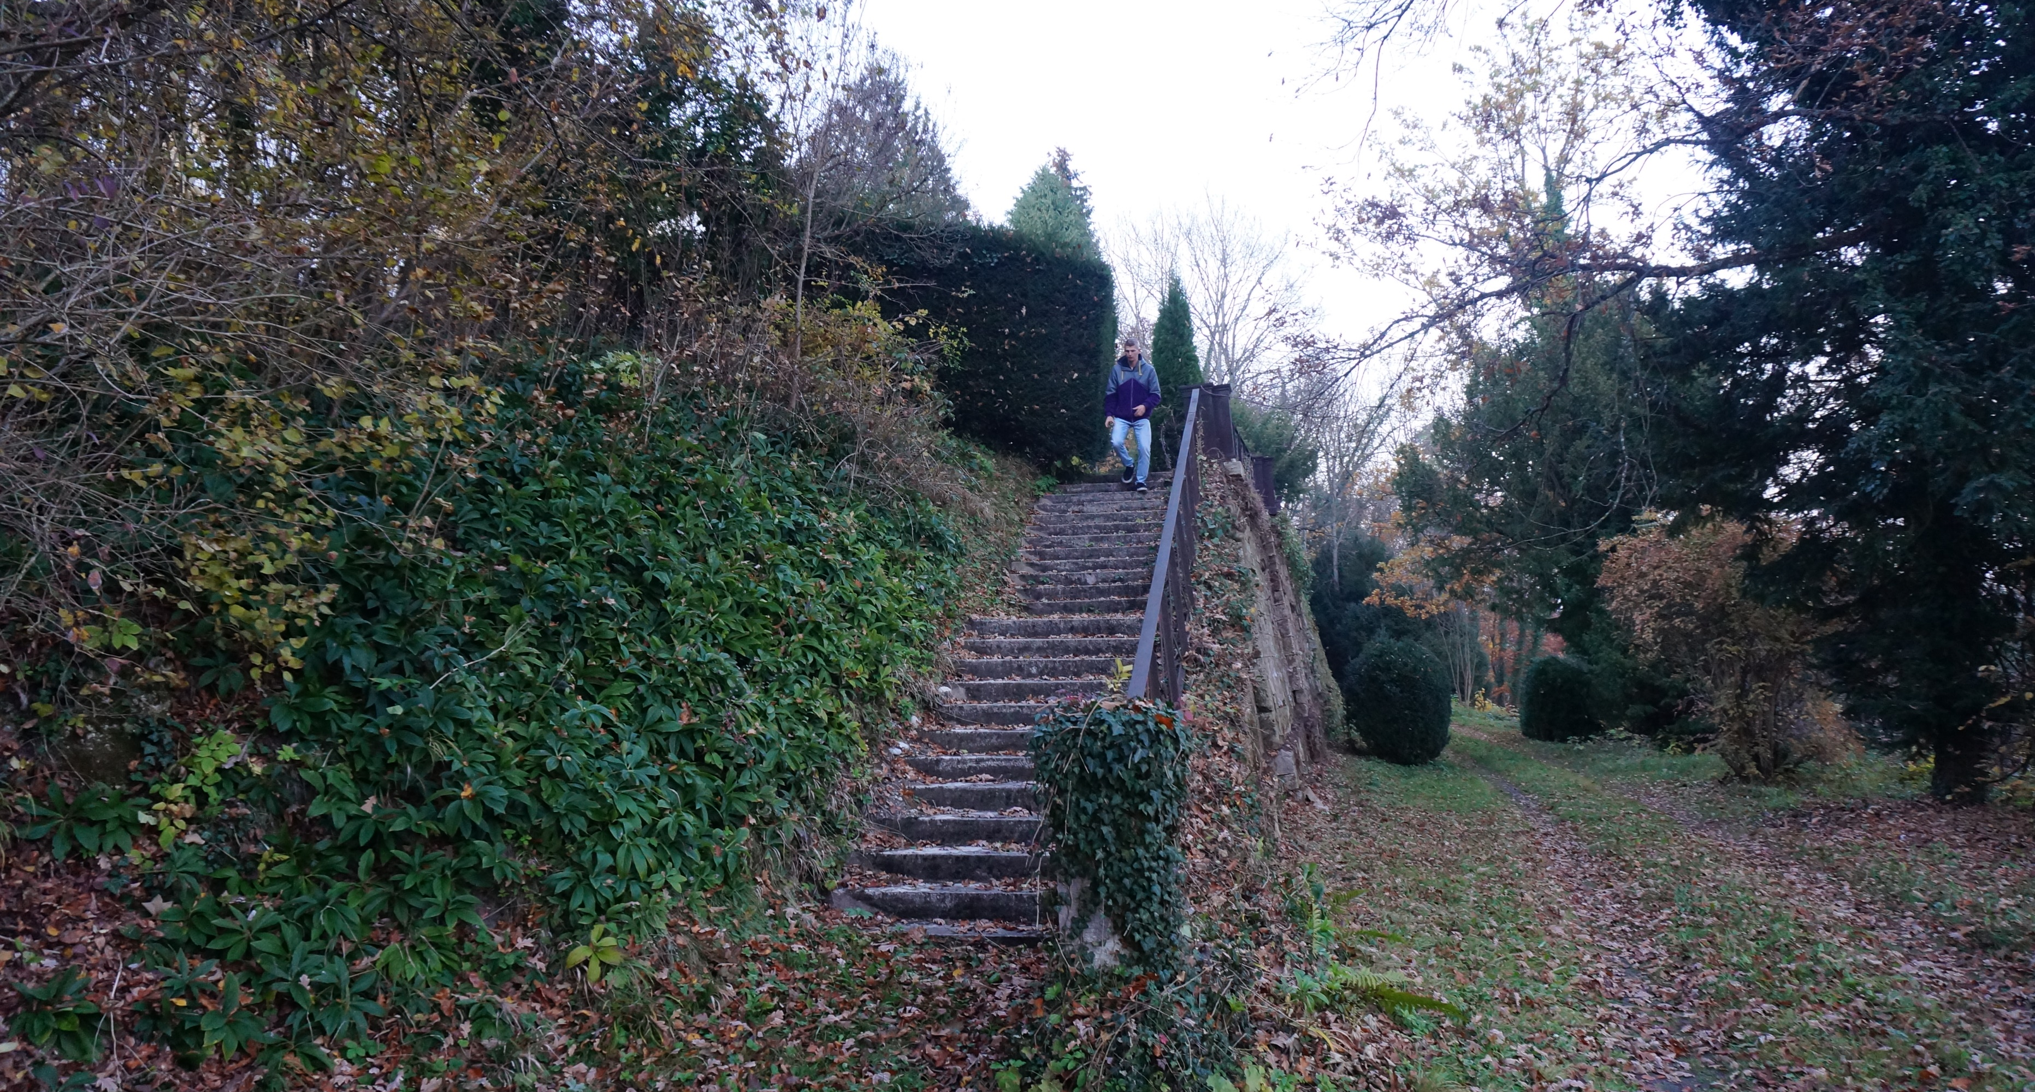
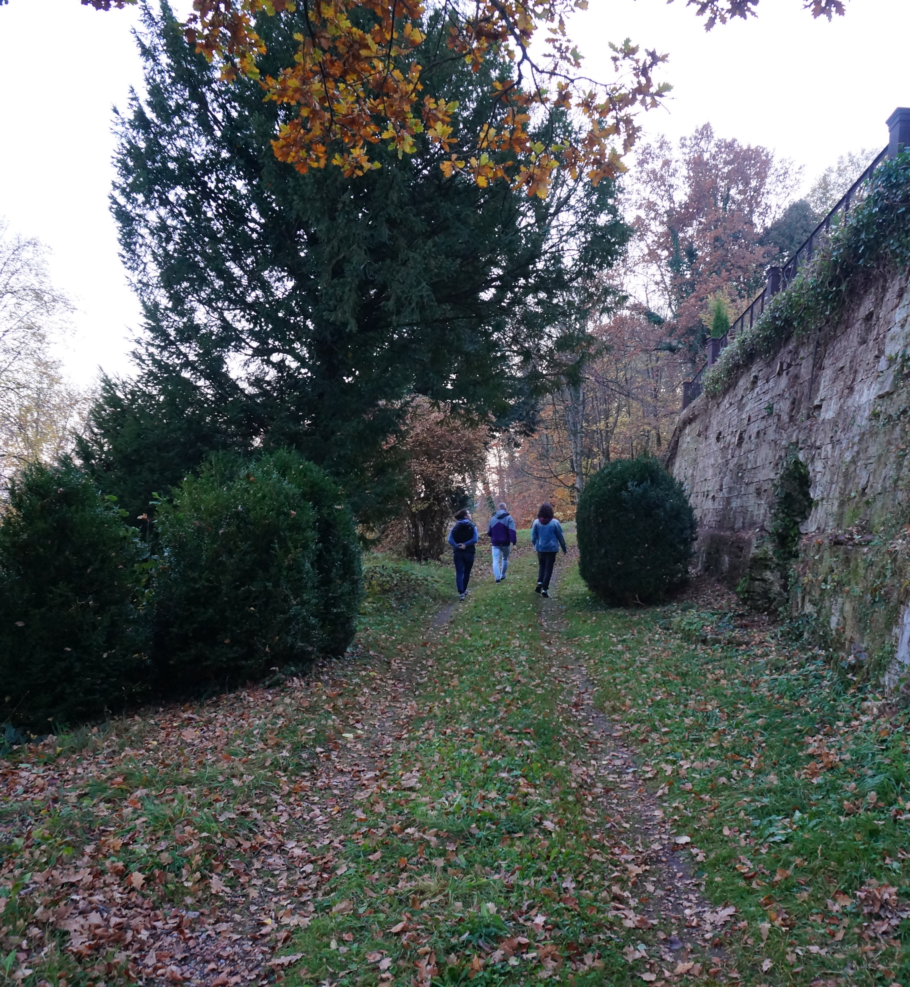
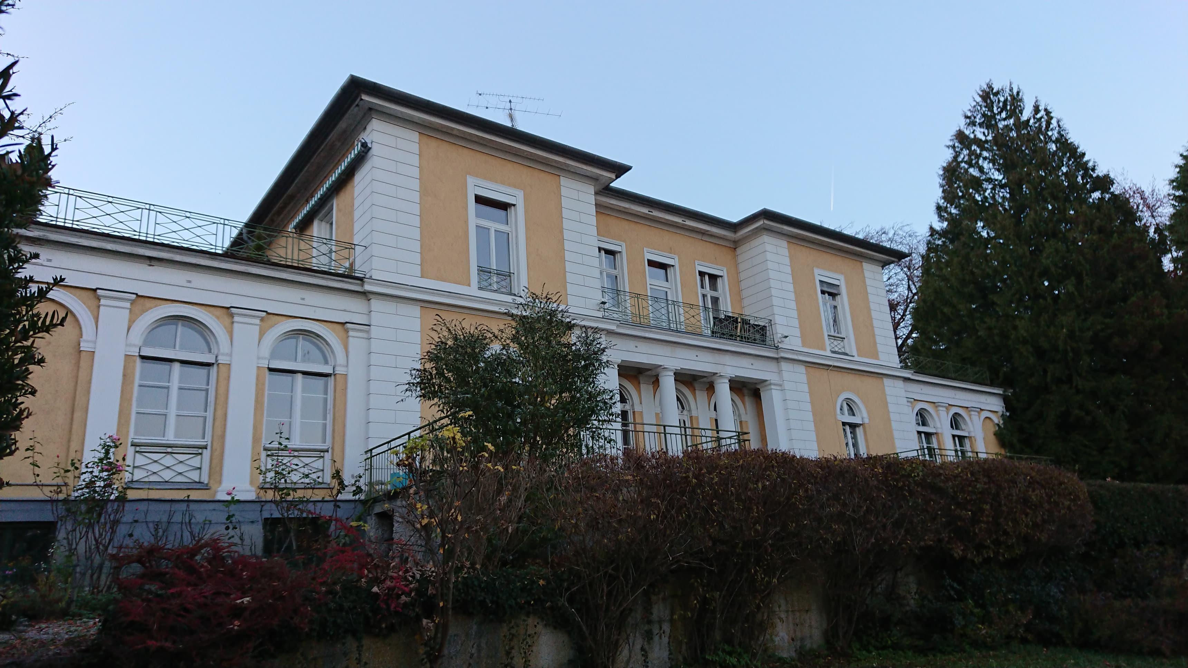

Slide 6
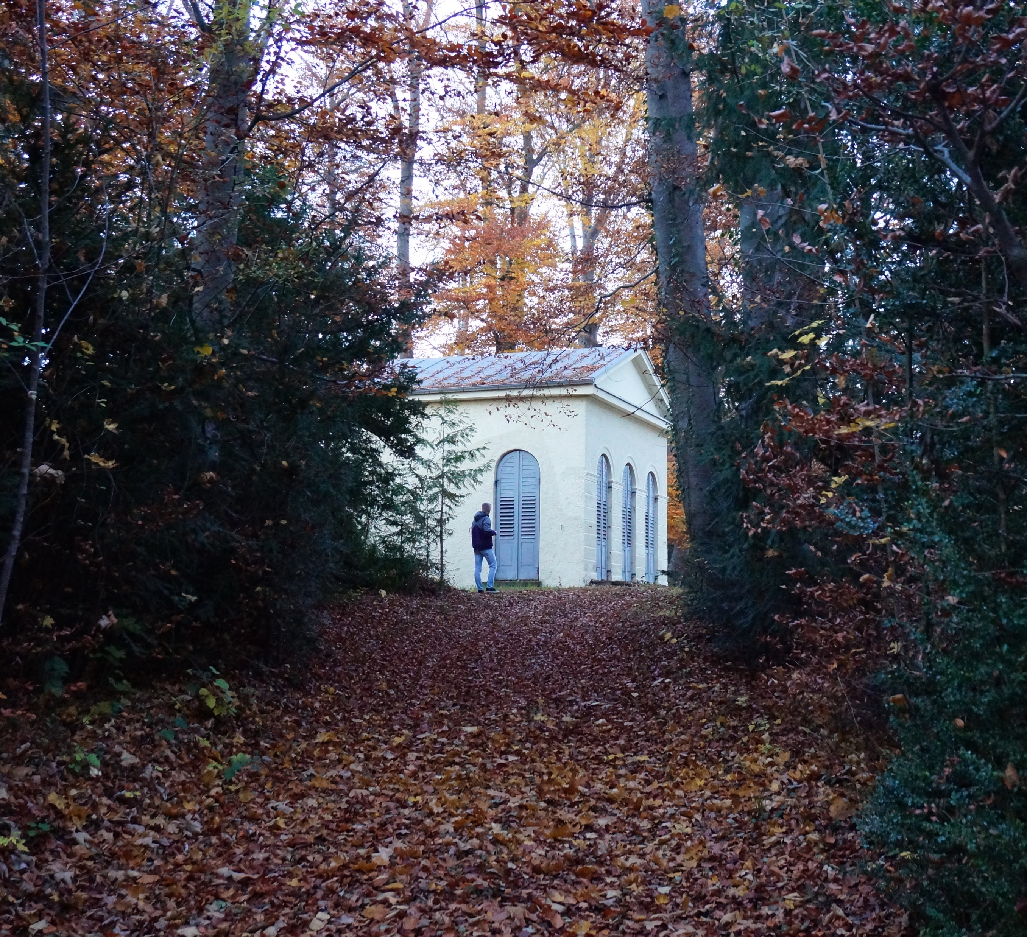
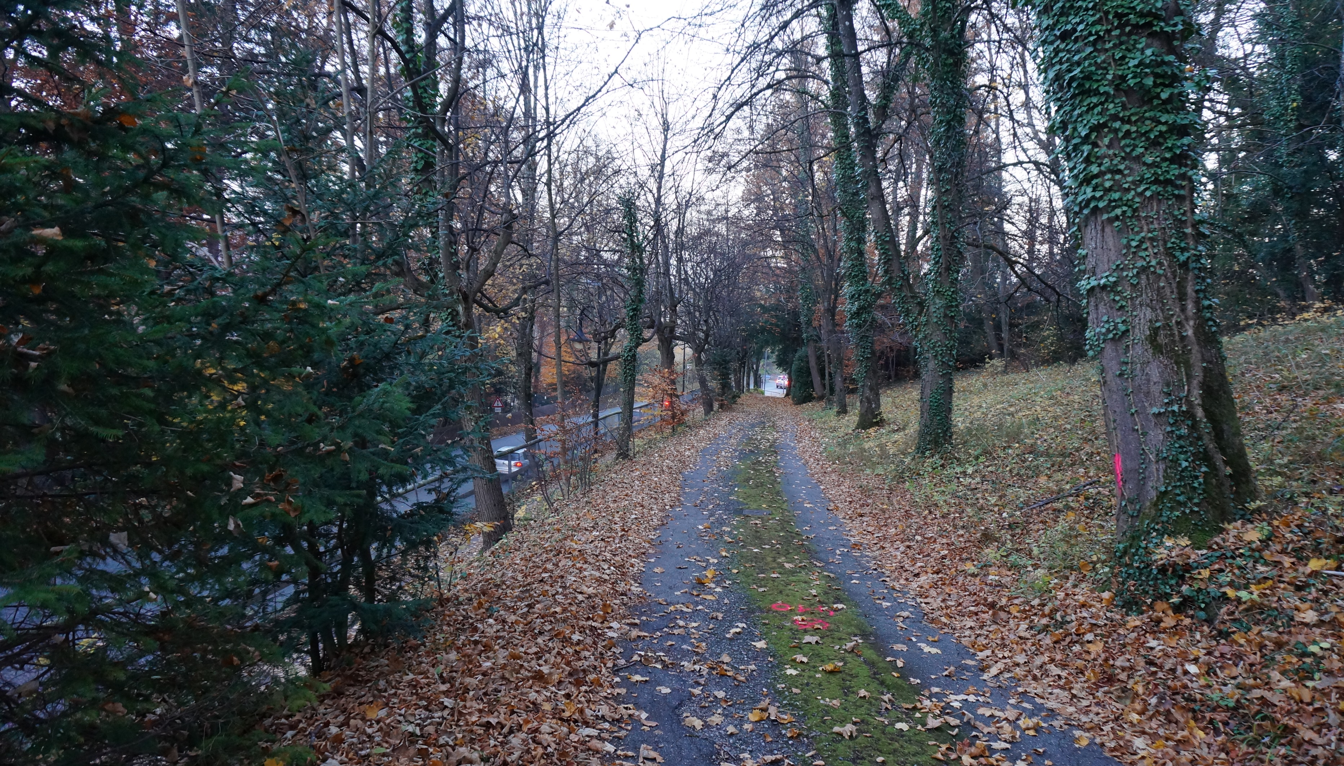
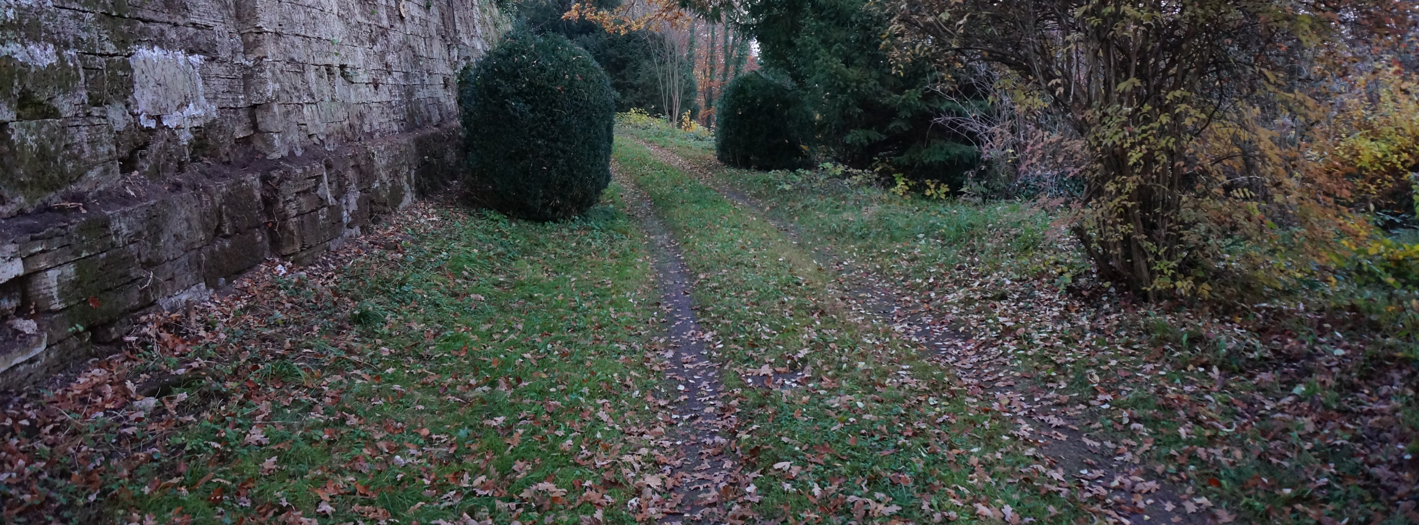

Slide 7
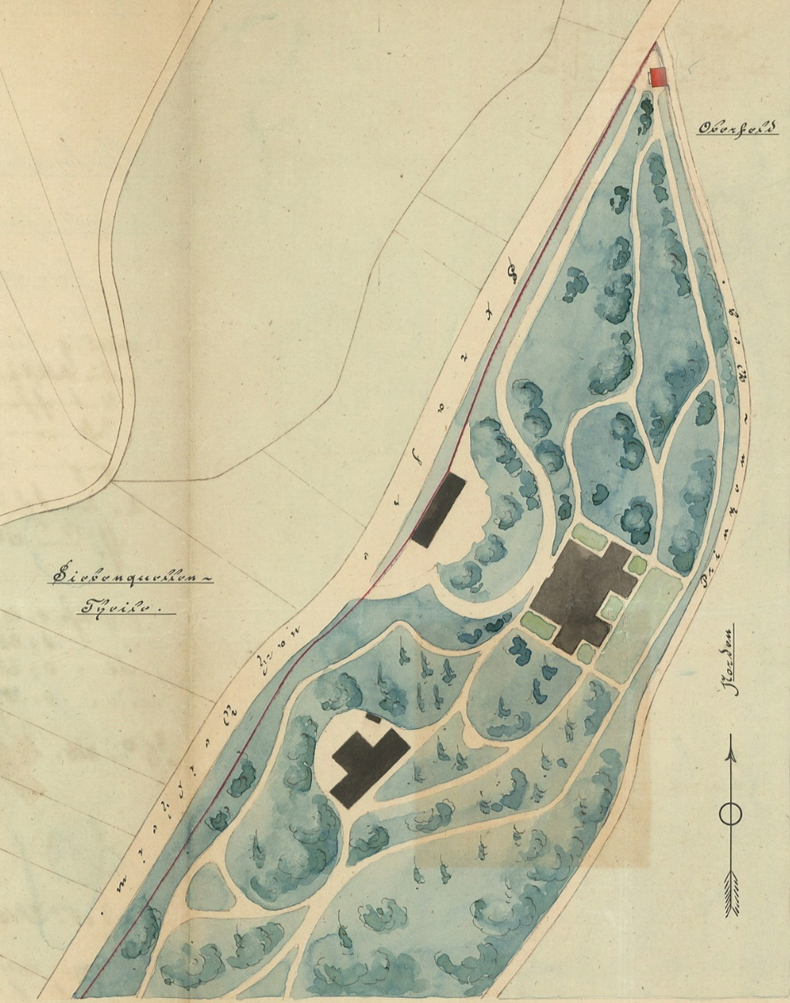
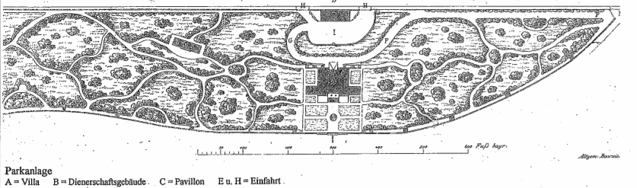
Ideal plan vs Real plan
1832
1896

Slide 8
Summary of the identified challenges
The view on the lake is obstructed by the height of the trees
The view from the lake is obstructed by the newly constructed villas
Some paths disappeared and most of the others are in poor conditions
Here and there trees and shrubs appeared and broke the coherence of the garden
There are a lot of great old trees which lack maintenance
Some important elements of the garden are no longer to be seen :
The wall fountain
The french garden
→ The different entities of the garden can not be appreciated anymore

Slide 9
What is our strategy of improvement ?

Slide 10
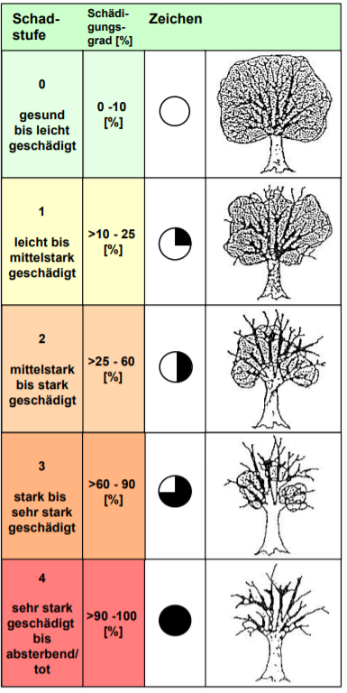
State of play

Slide 11
Purpose
Restructuration of the space through the delimitation of the landscape entities

Slide 12
Solutions
Cutting of the trees blocking the view
Triming of old trees and shrubs
Delimitation and creation of paths
Fix the fountain
Recreate the french garden
Add a vegetable garden

Slide 13
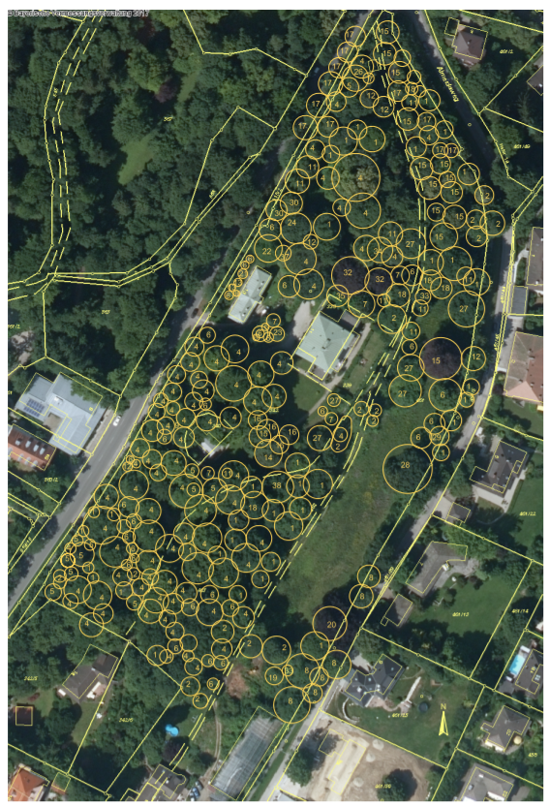
Cutting of the trees blocking the view
Triming of old trees and shrubs

Slide 14
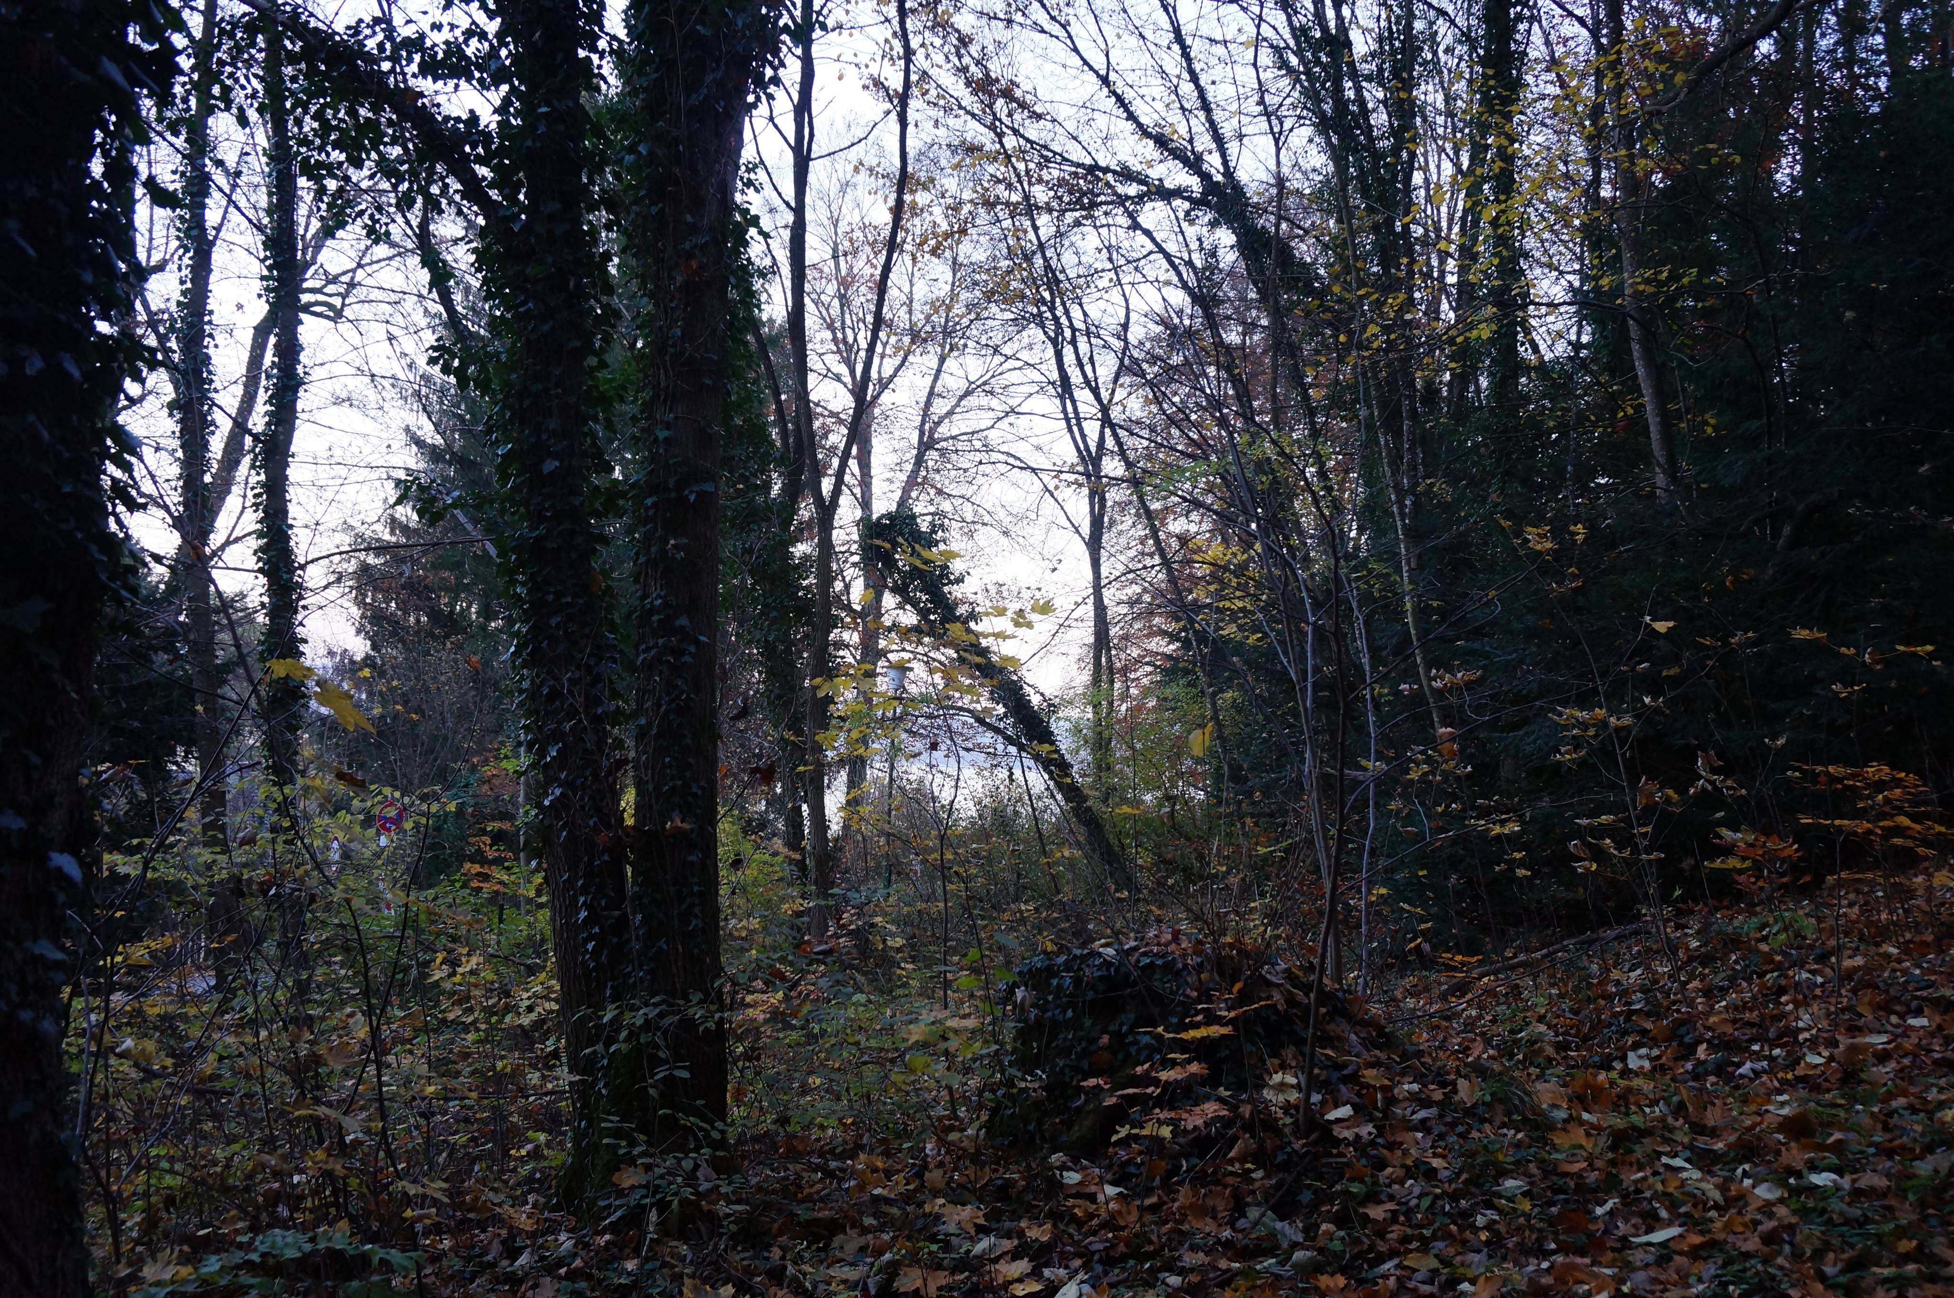
Triming of old trees and shrubs

Slide 15
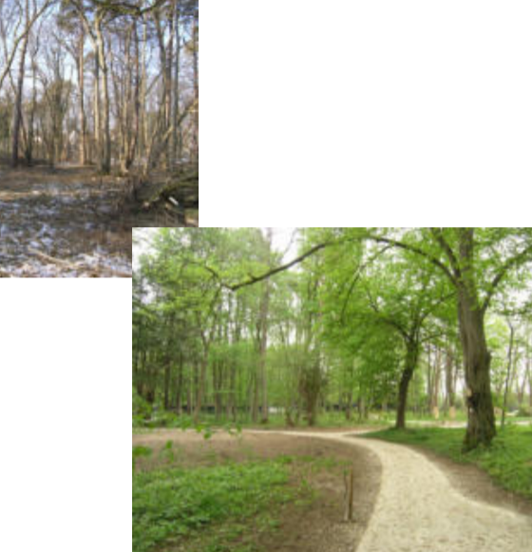
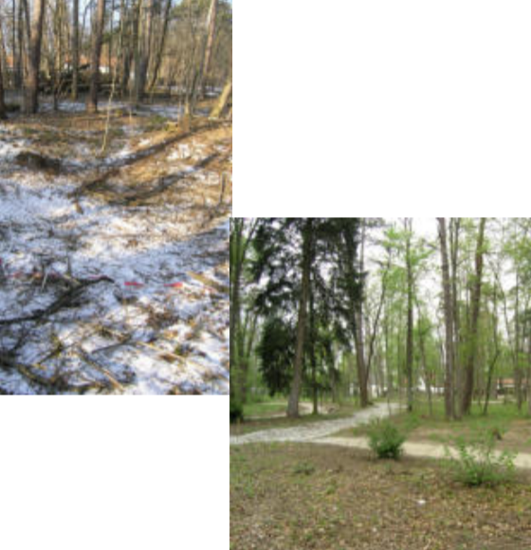
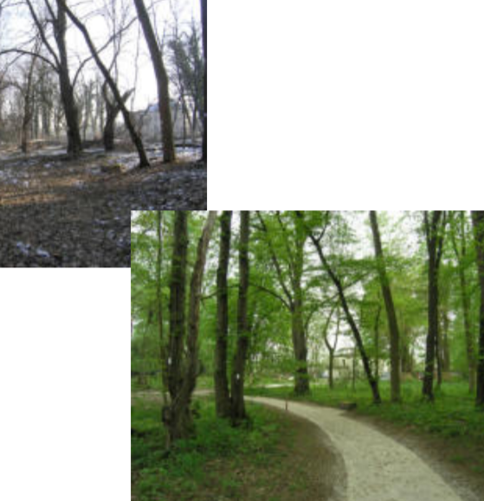
Delimitation and creation of paths

Slide 16
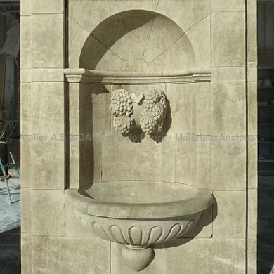
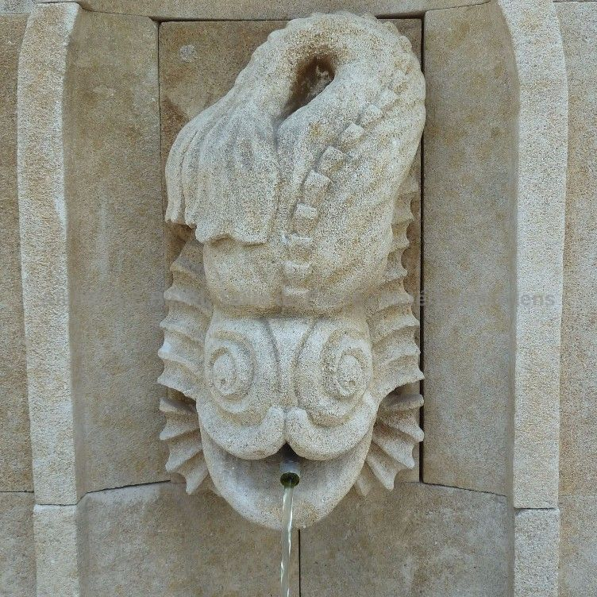
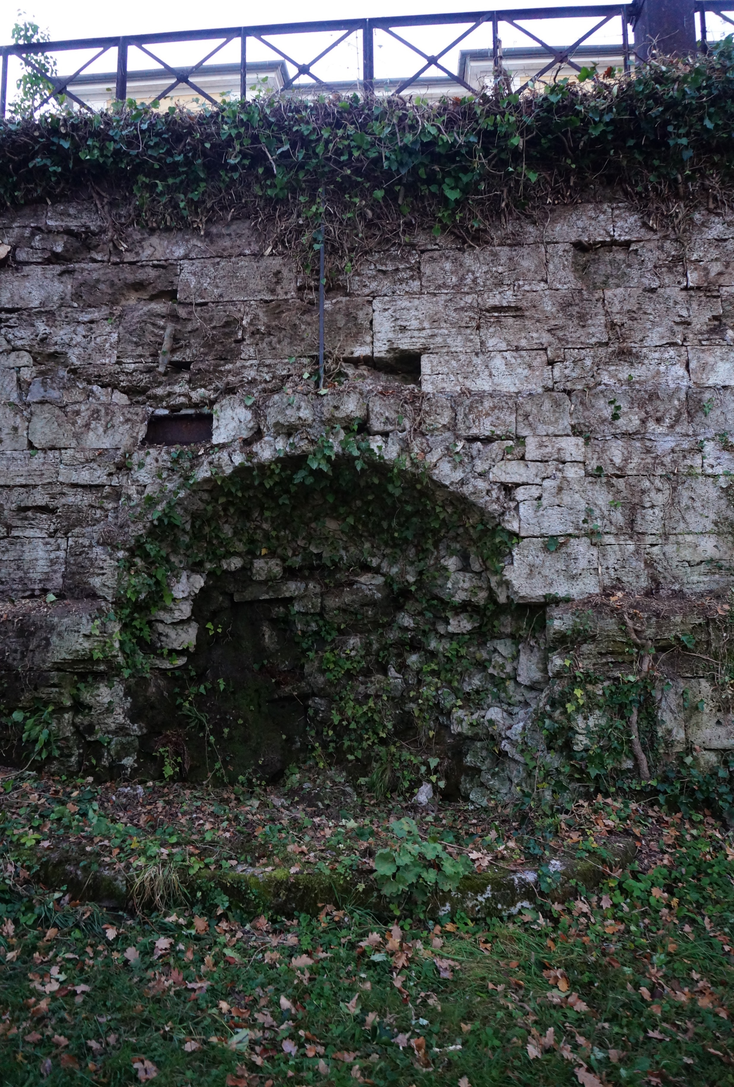
Fix the fountain

Slide 17
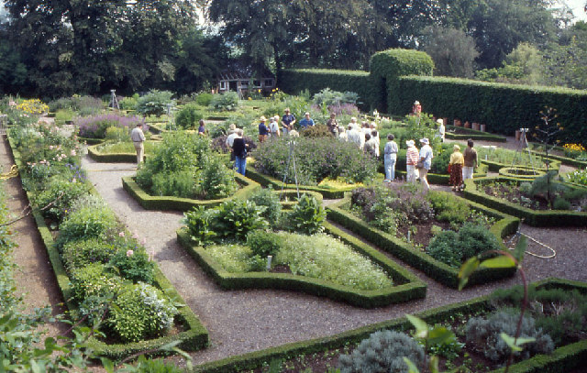
Recreate the french garden
Add a vegetable garden

Slide 18
Thank you for your unfailing attention

