Slide 1
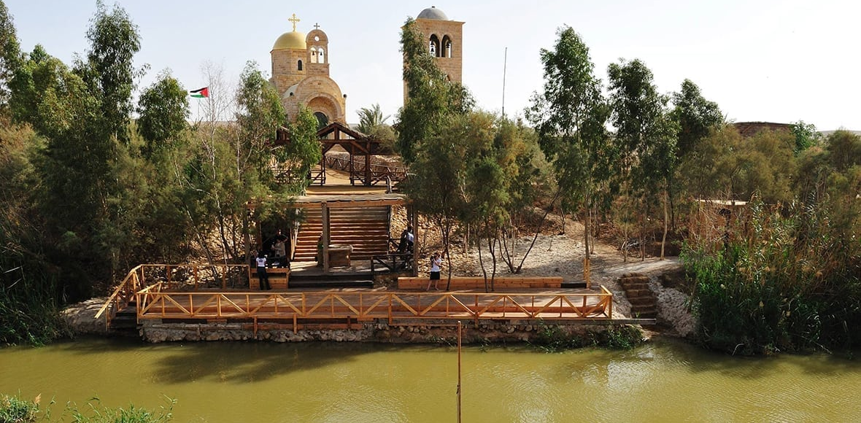
The Baptism Site of Jesus Christ
(Al-Maghtas)
Nawar H.Sabeeleish
Design with Nature
14.11.2018
https://www.deadsea.com/explore/historical-sites/biblical-sites/qasr-al-yahud-site/

Slide 2

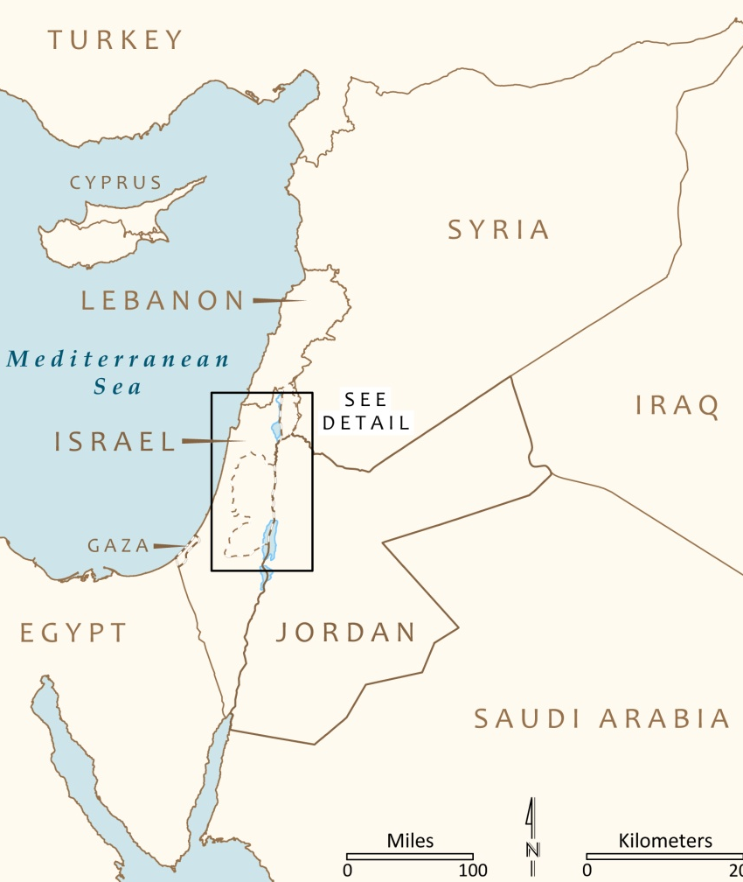

Case Study Location and Relevance
Modified from: https://www.sapiens.org/archaeology/yardenit-baptismal/
An archaeological park that represents an evidence of what a society considers a “Holy place” and has been venerated as such since the Byzantine period, at least. It represents an example on how the geography, and Roman and Byzantine epochs have influenced the context of the area.

Slide 3



Site Values and Significance
Values
Religious
The location where Jesus was baptized by John the Baptist
Cultural
The site embraces two archaeological areas:
1. The remnants of a monastery on a mound known as Tell Mar-Elias
2. An area near the river with roman and byzantine remains of ponds, churches and caves used by hermits and pilgrims as dwellings.

Slide 4
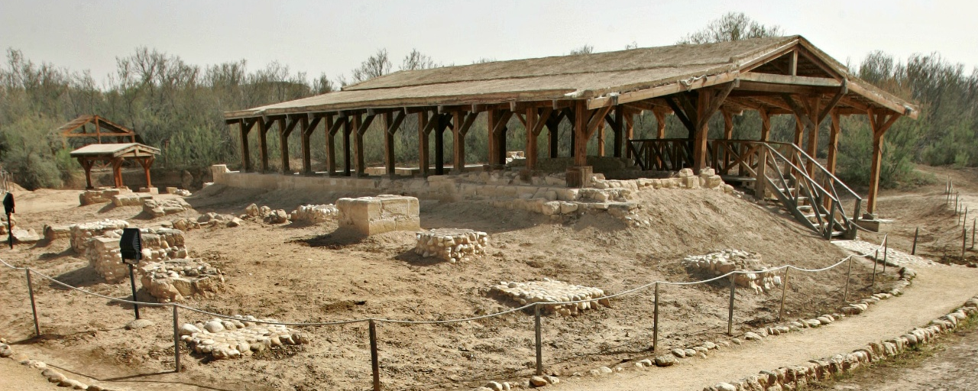
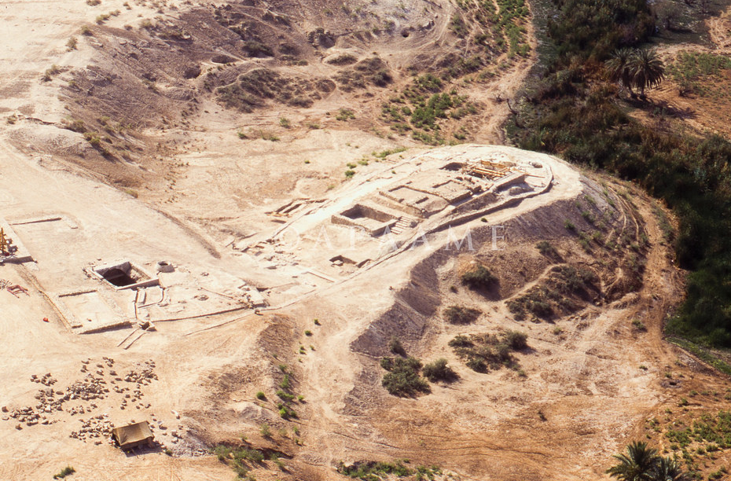
http://www.baptismsite.com/the-place-where-jesus-was-baptized/
In 2015, the site was listed as a cultural property, according to the UNESCO selection criteria:
III. The site bears a unique or at least exceptional testimony to a cultural tradition or to a civilization which is living or which has disappeared.
VI. The site directly or tangibly associated with events or living traditions, with ideas, or with beliefs, with artistic and literary works of outstanding universal significance.
https://www.flickr.com/photos/apaame/14847268809

Slide 5

Site Management and Maintenance
The area is said to be highly maintained, since it was classified as a Jordanian archaeological site by the Ministry of Tourism and Antiquities after the completion of excavations that began in 1996.
The management plan set is adequate; The site and its buffer zone is protected under the Jordan Valley Authority Laws, and on the site level it is managed under the laws of the Baptism Site Commission.
The archaeological remains in the site have been conserved in their original materials, and some have been restored using similar materials, to preserve the authenticity of the area.
If maintenance and management strategies are missing, the site is expected to lose its religious, cultural and archaeological significance. Decay, Rot, and collapses are also expected, especially of those structures that are exposed to water directly, and the different weather conditions

