Slide 1
River red gums in agricultural landscapes in Victoria, Australia
Stephen Flack, IMLA
HfWU, Nürtingen

Slide 2
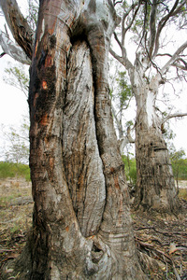
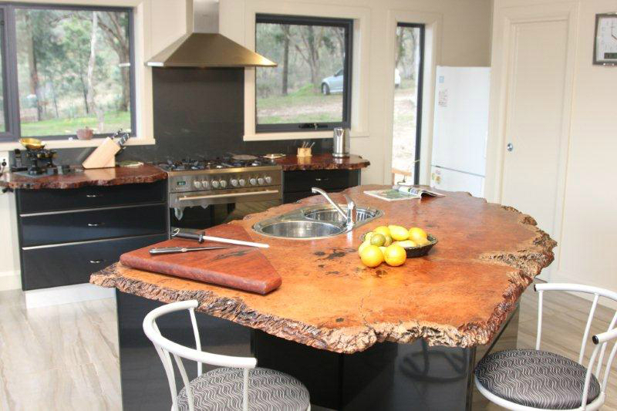
Eucalyptus camaldulensis
Up to 500 years old and 30m high
Scattered throughout floodplains where cattle grazing the dominant land use
Important for Aborigines and early European settlers

Slide 3
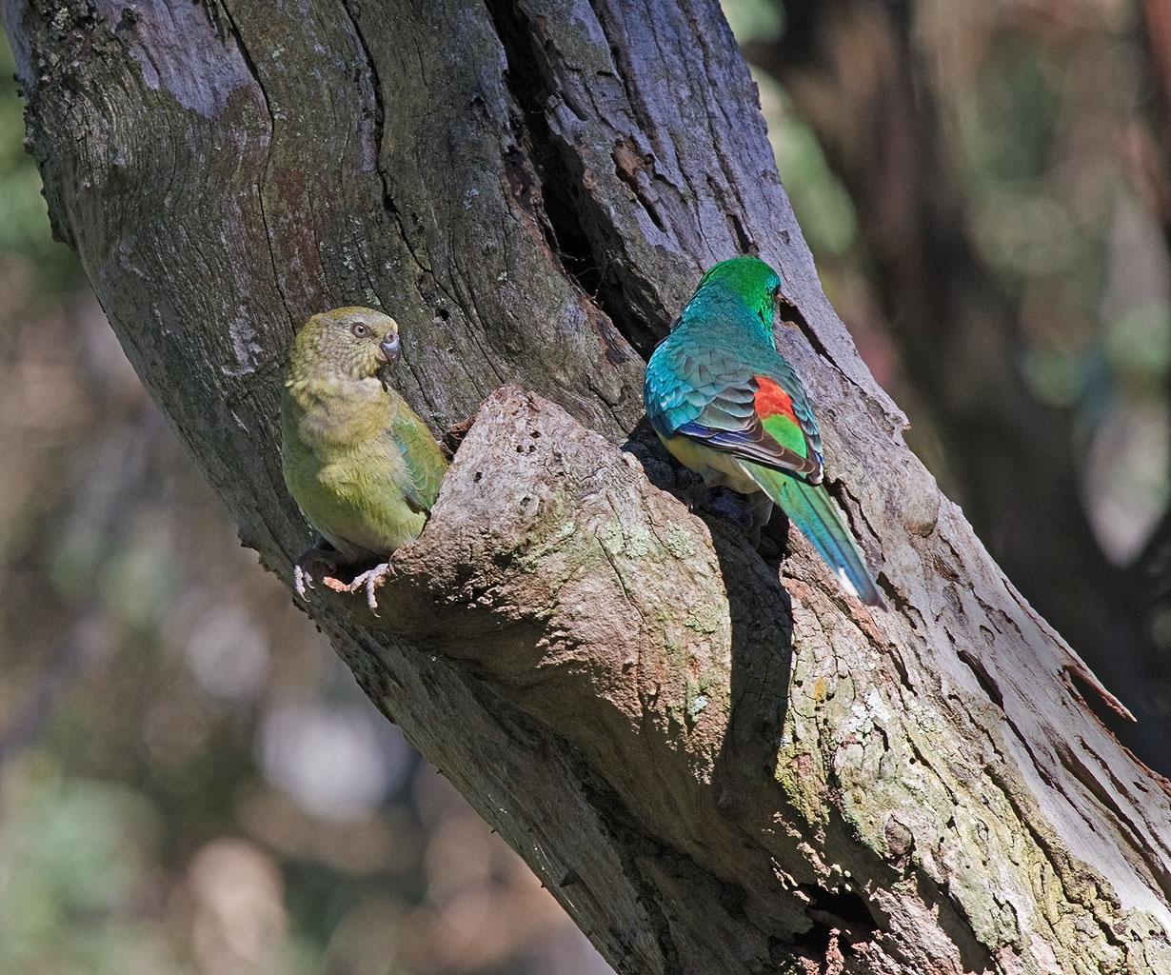
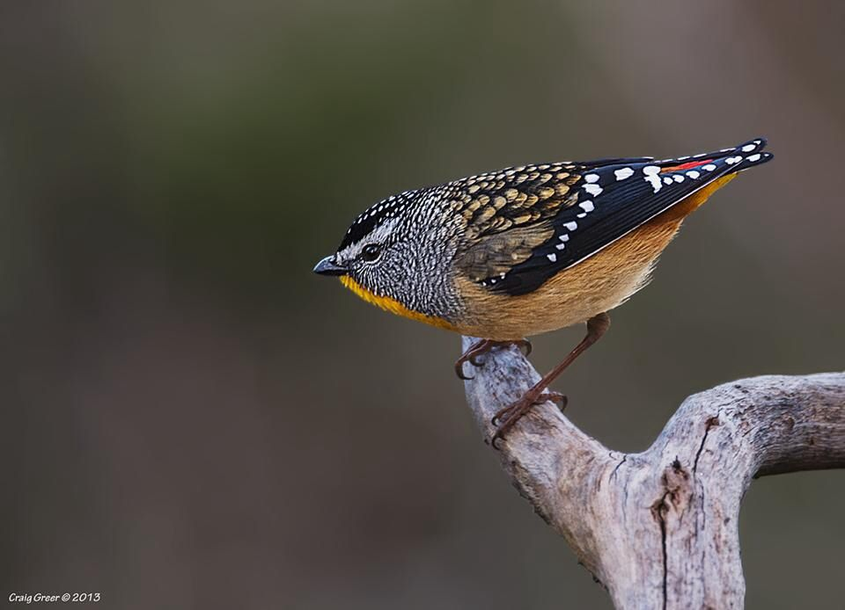
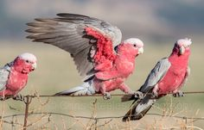
Why relevant?
Beautiful!
Distinct visual link to past human and ecological history
Supports many other species which are iconic and place-defining eg parrots

Slide 4
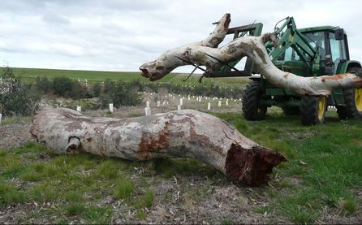
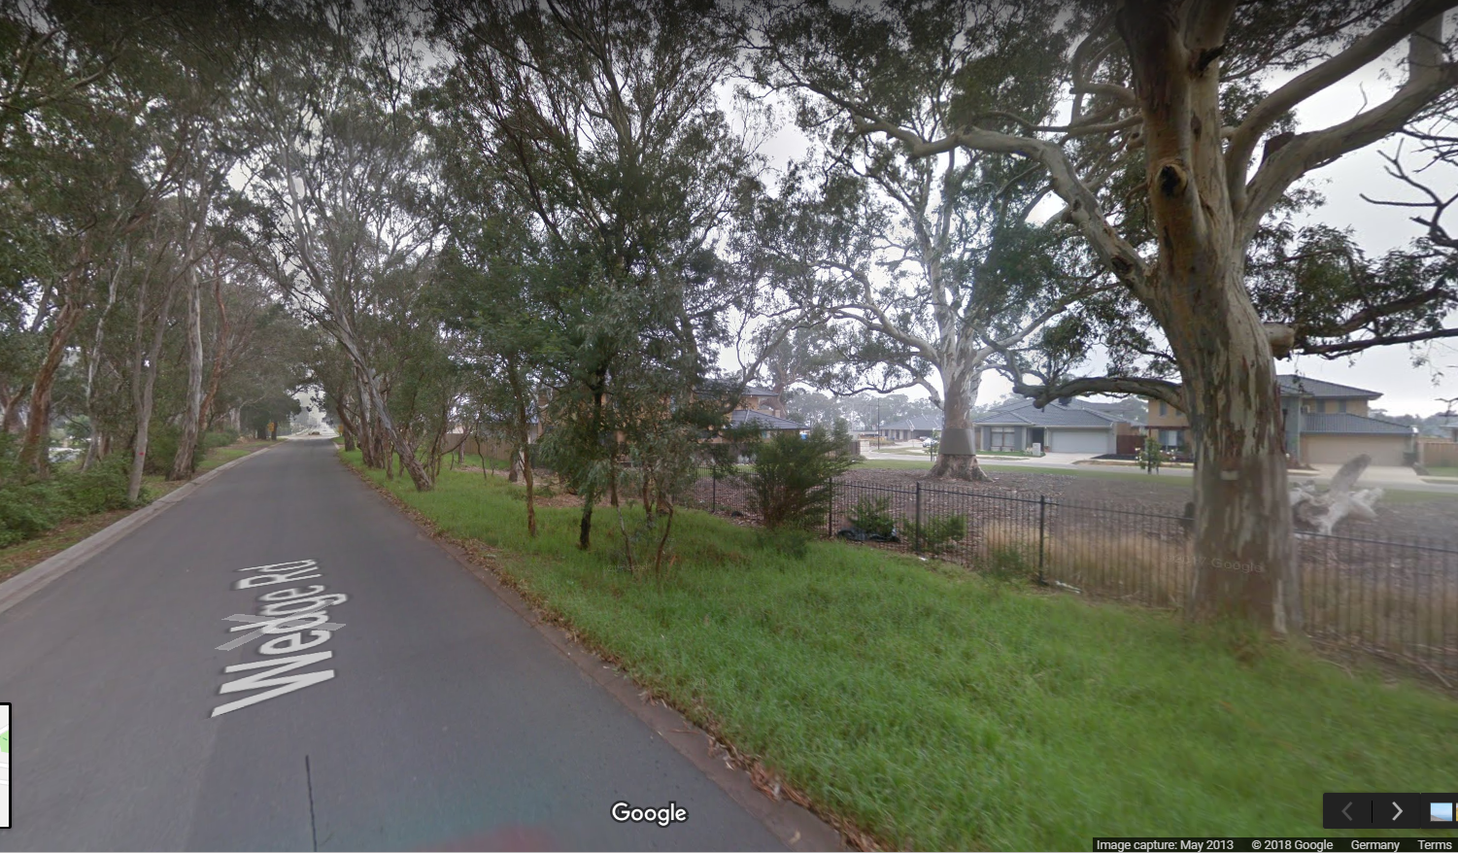
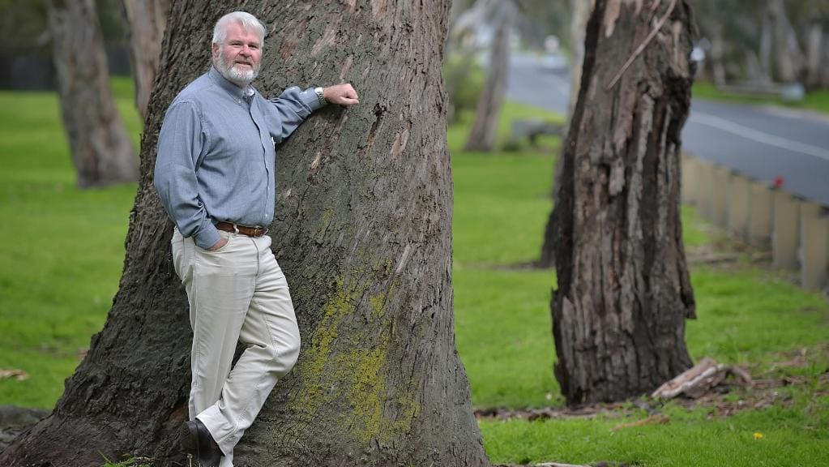
Which idea of ‘design with nature’ guides the design concept of this site?
Restoration in agricultural areas often includes large pieces of timber, plantings of smaller native shrubs that once were commonly associated
New residential development often incorporates old trees into the identity of the area
Roadside trees are maintained where possible

