Slide 1
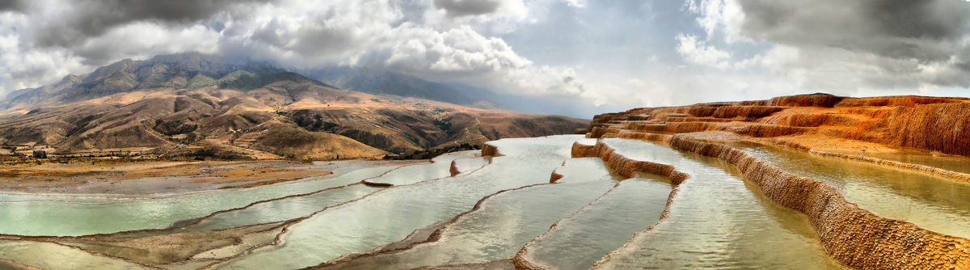
Badab-e Surt, Mazandaran Province, Iran design with nature
Resource: https://www.atlasobscura.com/places/badab-e-surt
Presentors:
Haniyeh Golzardi
Negar Rezaei
Amirhossein Fard
14.11.2018

Slide 2
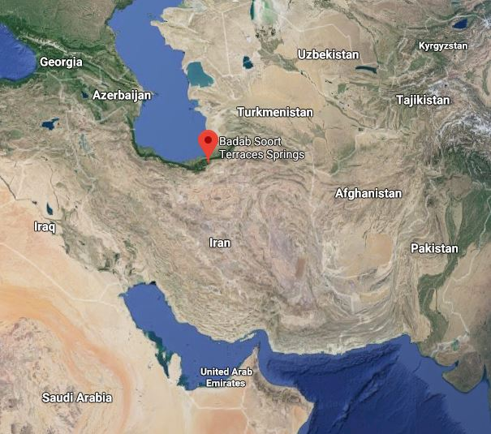
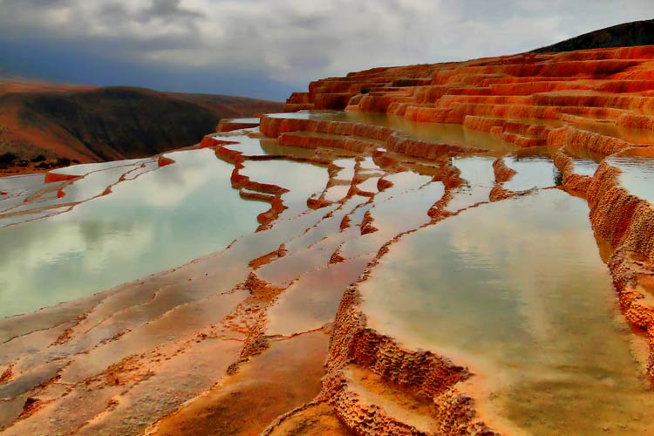
General information
Bād "gas" + āb "water"
Name (English): Badab Surt
Name (Persian): باداب سورت
Old name: Arest wao
Country: Iran
State: Mazandaran Province
City: Sari
Geographic point : N362119 E535123
Natural Geography: 1841 above sea level
The Badab Surt Springs was recorded as the second national natural work of Iran in 2008.
Cool and dry area
Coldest Temperature: 7 ° C
Warmest temperature: 35 ° C
Similar case studies in : Turkey, United State, China
Resource: Google map 11.11.18
Resource: https://www.kojaro.com/2016/2/3/117036/badab-e-surt-travel-guide/
Notes:
Badab is a Persian compound of Bād "gas" + āb "water", translating to "gassed water", referring to the springs' waters being carbonated mineral waters. Soort is an old name for the Orost village and a Persian word meaning intensity.[2]
The region's temperature in the coldest month is 7 ° C, and in the warmest state is 35 ° C. The average annual precipitation is 350-400 mm, which creates a cool and dry area with steppe vegetation. The relative humidity of the air is at least 50% and up to 85%, and the water evaporates to 850 mm. The maximum wind speed is 50 km / h.

Slide 3
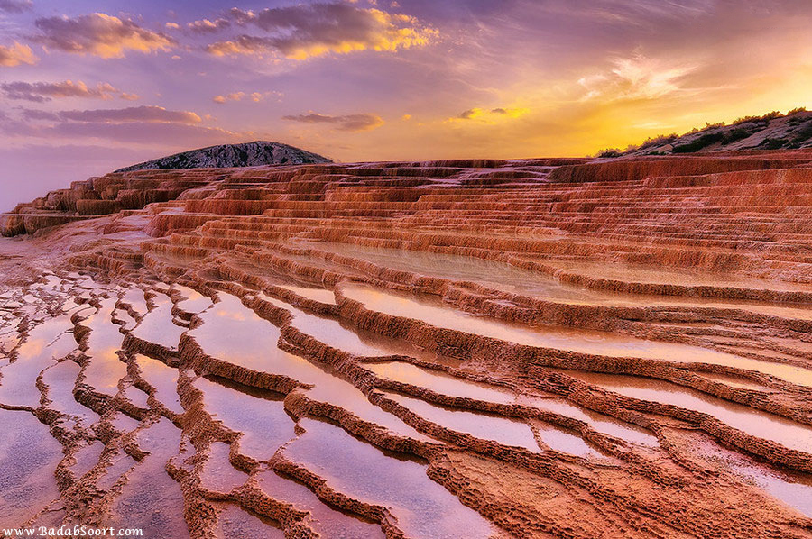
why is this case relevant…
Resource: https://www.atlasobscura.com/places/badab-e-surt
Natural heritage
From more than thousands of year ago
Second important saline water
Second significant natural heritage
Unique place with valuable characteristics
Notes:
Because of the importance of that among all natural heritages which we have in Iran.
It has been formed over the last thousand of years.
Second important saline water spring after Pamukkale in Turkey.
Second significant natural heritage after Damavand mountains in Iran in 2008.
There are only five countries around the world with this valuable character.

Slide 4
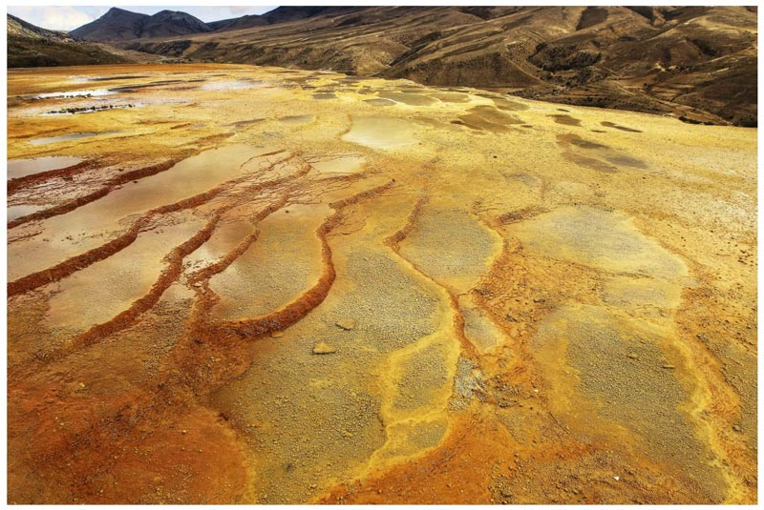
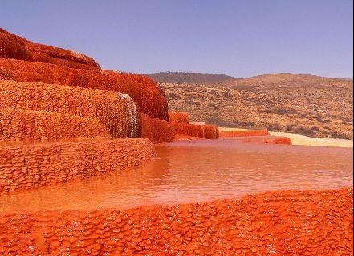
Which idea of ‘design with nature’ guides the design concept of this site?
Not man-made
stepped travertine terrace formations
Used for medical and healthy reasons
http://ar.farsnews.com/entertainment/news/13960724001382
http://www.al-vefagh.com/News/75910.html?catid=5&title=
Notes:
This landscape heritage is not man-made so that the concept of this area is completely natural.
It comprises a range of stepped travertine terrace formations.
The first spring contains very salty water that is useful as a care for rheumatism and some types of skin diseases.

Slide 5
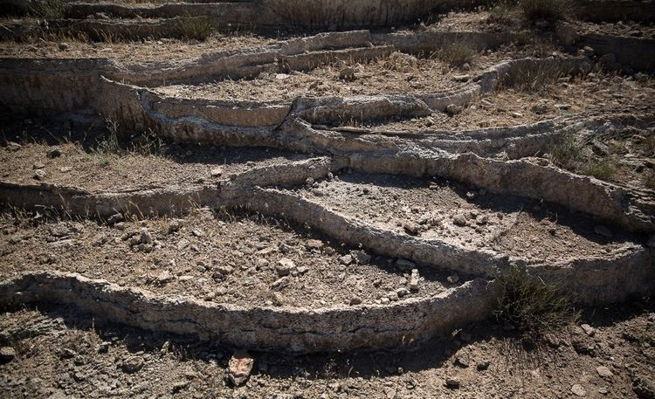
Which idea of ‘design with nature’ guides the design
concept of this site?
Resource: https://www.shutterstock.com/image-photo/badabe-surt-travertine-pool-unesco-world-409637077
The second spring has a sour taste due to the iron oxide sediment.
They emanating from the mountain have combined and resulted in a number of orange, red and yellow colored pools shaped as a forms stair case
Some parts of Badab-e Surt many years ago were damaged.

Slide 6

Video
https://www.youtube.com/

Slide 7
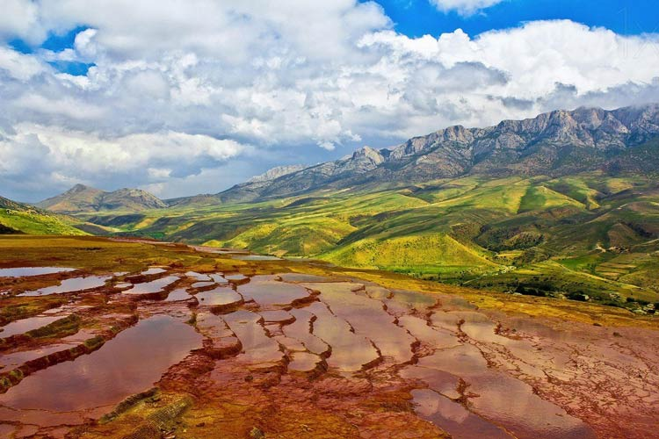
Thank you!
Resources:
https://www.eghtesadonline.com/%D8%A8%D8%AE%D8%B4-%DA%AF%D8%B1%D8%AF%D8%B4%DA%AF%D8%B1%DB%8C-87/285423-%D8%A8%D8%A7%D8%AF%D8%A7%D8%A8-%D8%B3%D9%88%D8%B1%D8%AA-%D9%87%D9%85-%D8%AE%D8%B4%DA%A9-%D8%B4%D8%AF-%D8%AA%D8%B5%D8%A7%D9%88%DB%8C%D8%B1
https://en.wikipedia.org/wiki/Badab-e_Surt
https://www.kojaro.com/2016/2/3/117036/badab-e-surt-travel-guide/
http://www.badabsoort.com/
Resource: https://www.atlasobscura.com/places/badab-e-surt
Google map 11.11.18
https://www.kojaro.com/2016/2/3/117036/badab-e-surt-travel-guide/
https://www.atlasobscura.com/places/badab-e-surt

