Slide 1
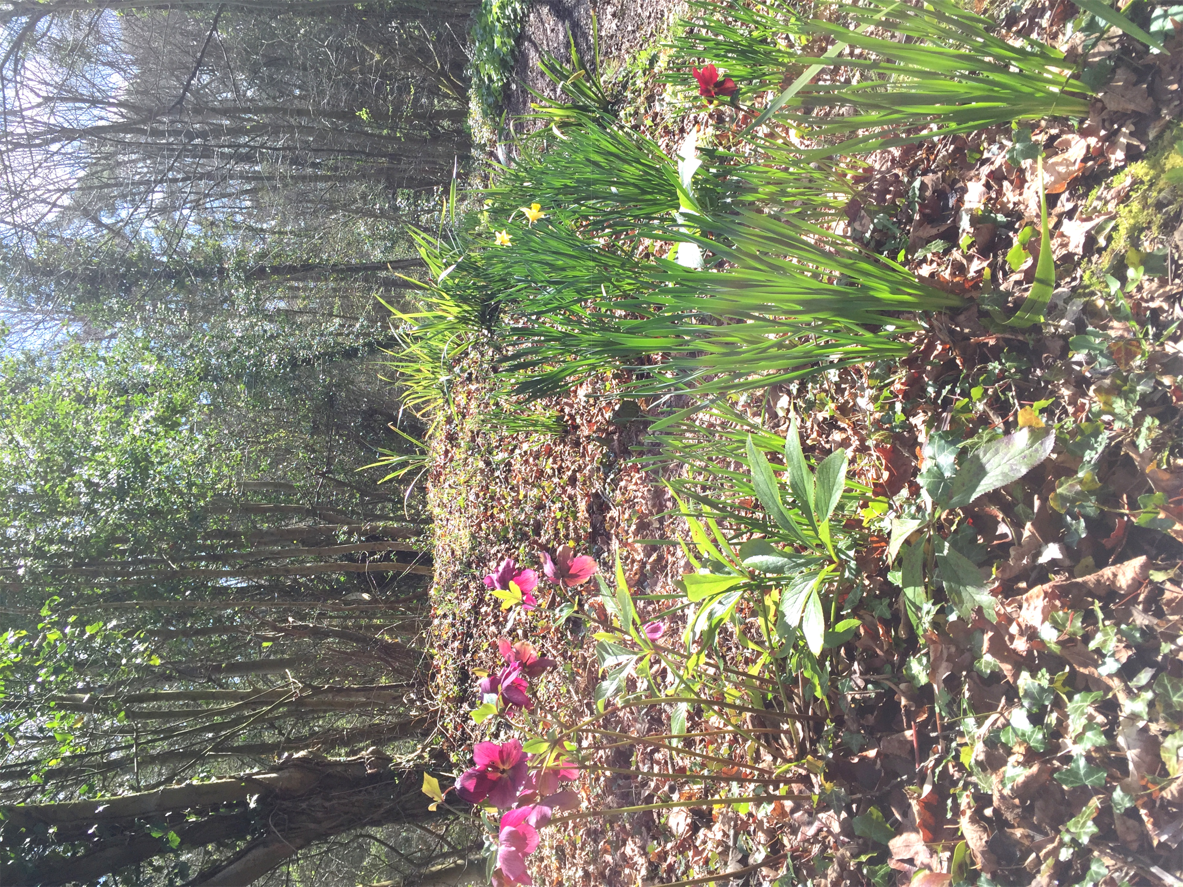
Jarn Mound and Wild Garden, England
Sophia Clarke

Slide 2
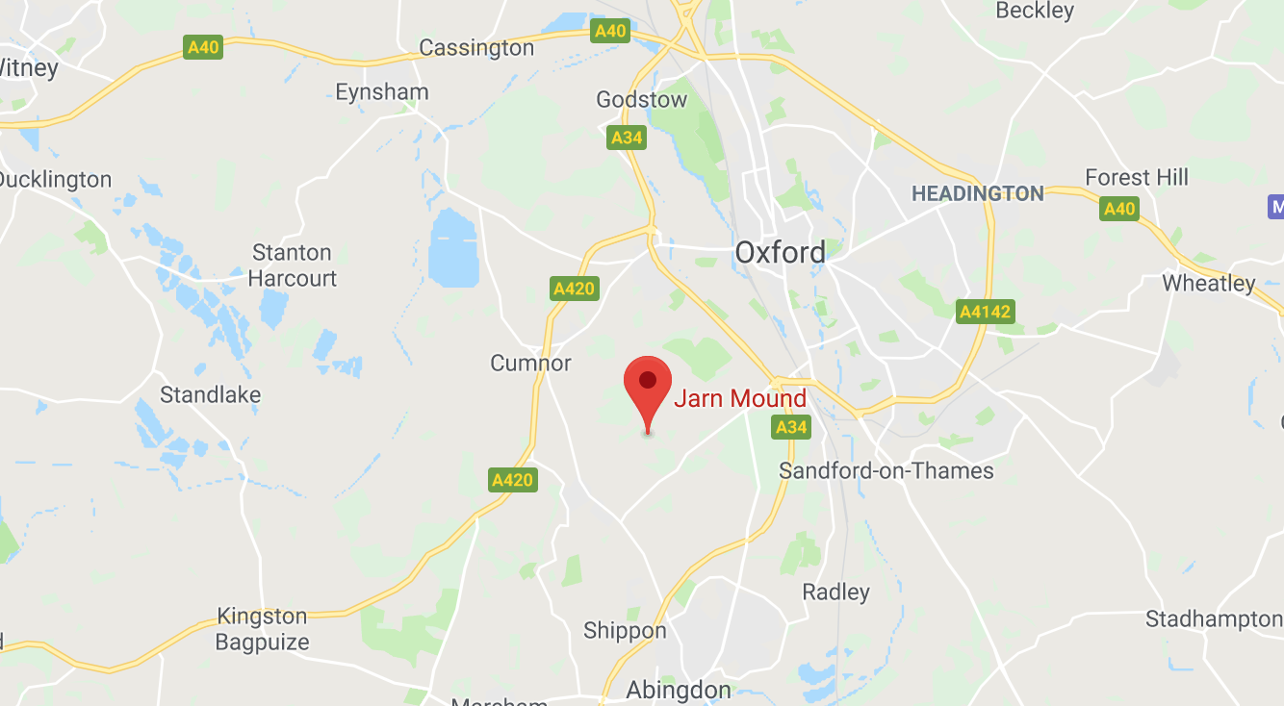

Slide 3
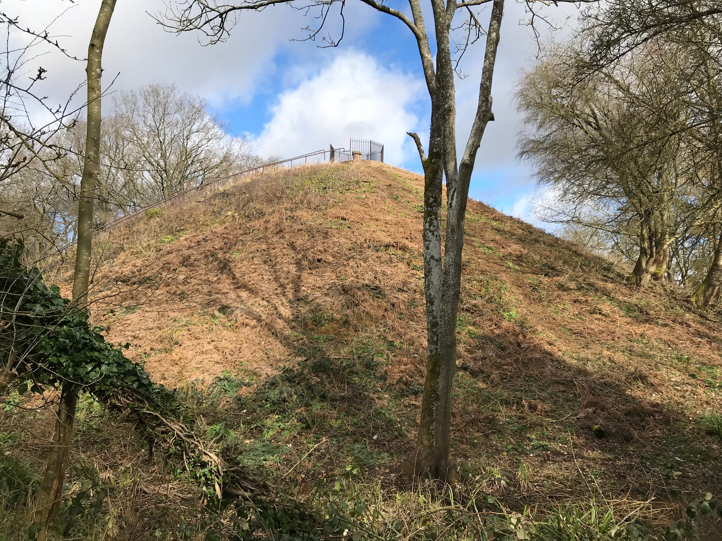
Why is this Case Relevant?
50ft viewpoint 3 miles South West of Oxford
Built in 1932 by Sir Arthur Evans, a local resident
He wanted to preserve the natural beauty and views from the area.
Important piece of the
area’s history
Wild Garden contains
British species from all
over the country

Slide 4
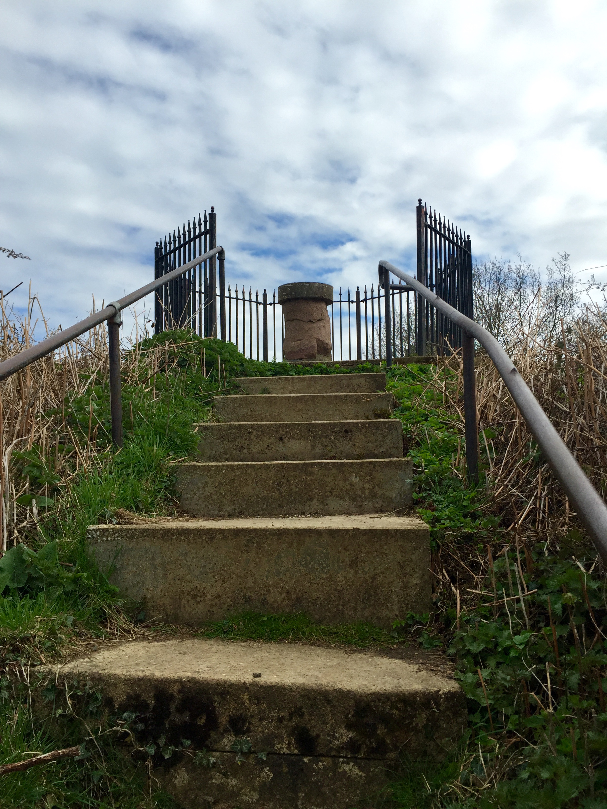
Plinth at the top shows a map of the local area
Allows visitors to view the famous ‘Dreaming Spires’ of Oxford
Wild Garden supports a large biodiversity of plants and animals

Slide 5
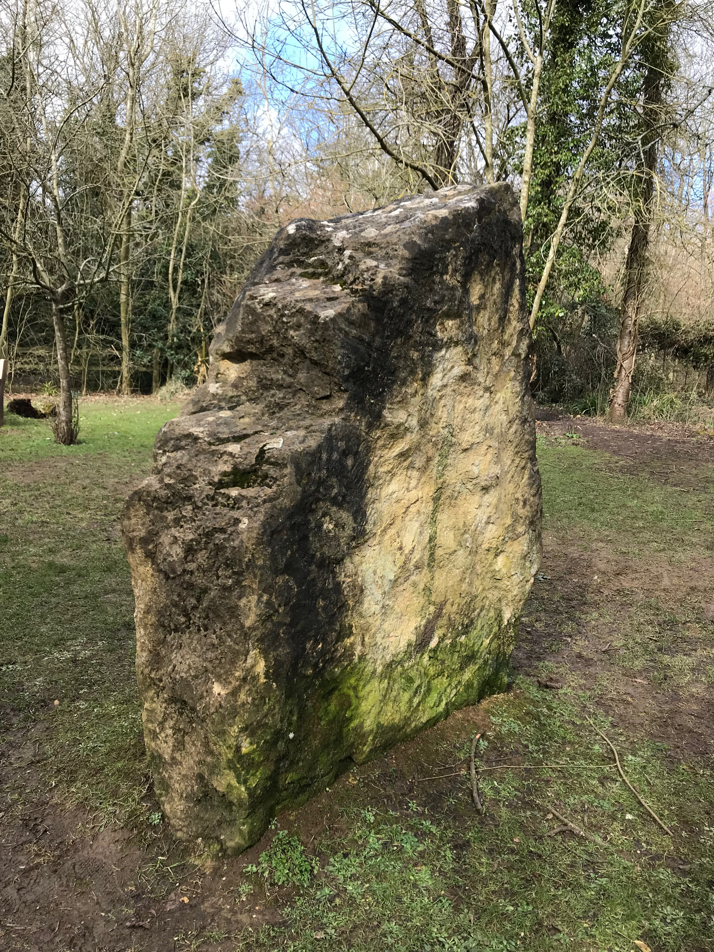
Which Idea of ‘Design With Nature’ Guides the Design Concept of this Site?
Concept was to showcase views of Oxford and a range of different British species
Maintenance is carried out annually by the owning charity ‘Oxford Preservation Trust’
Volunteer groups provide more regular maintenance

Slide 6
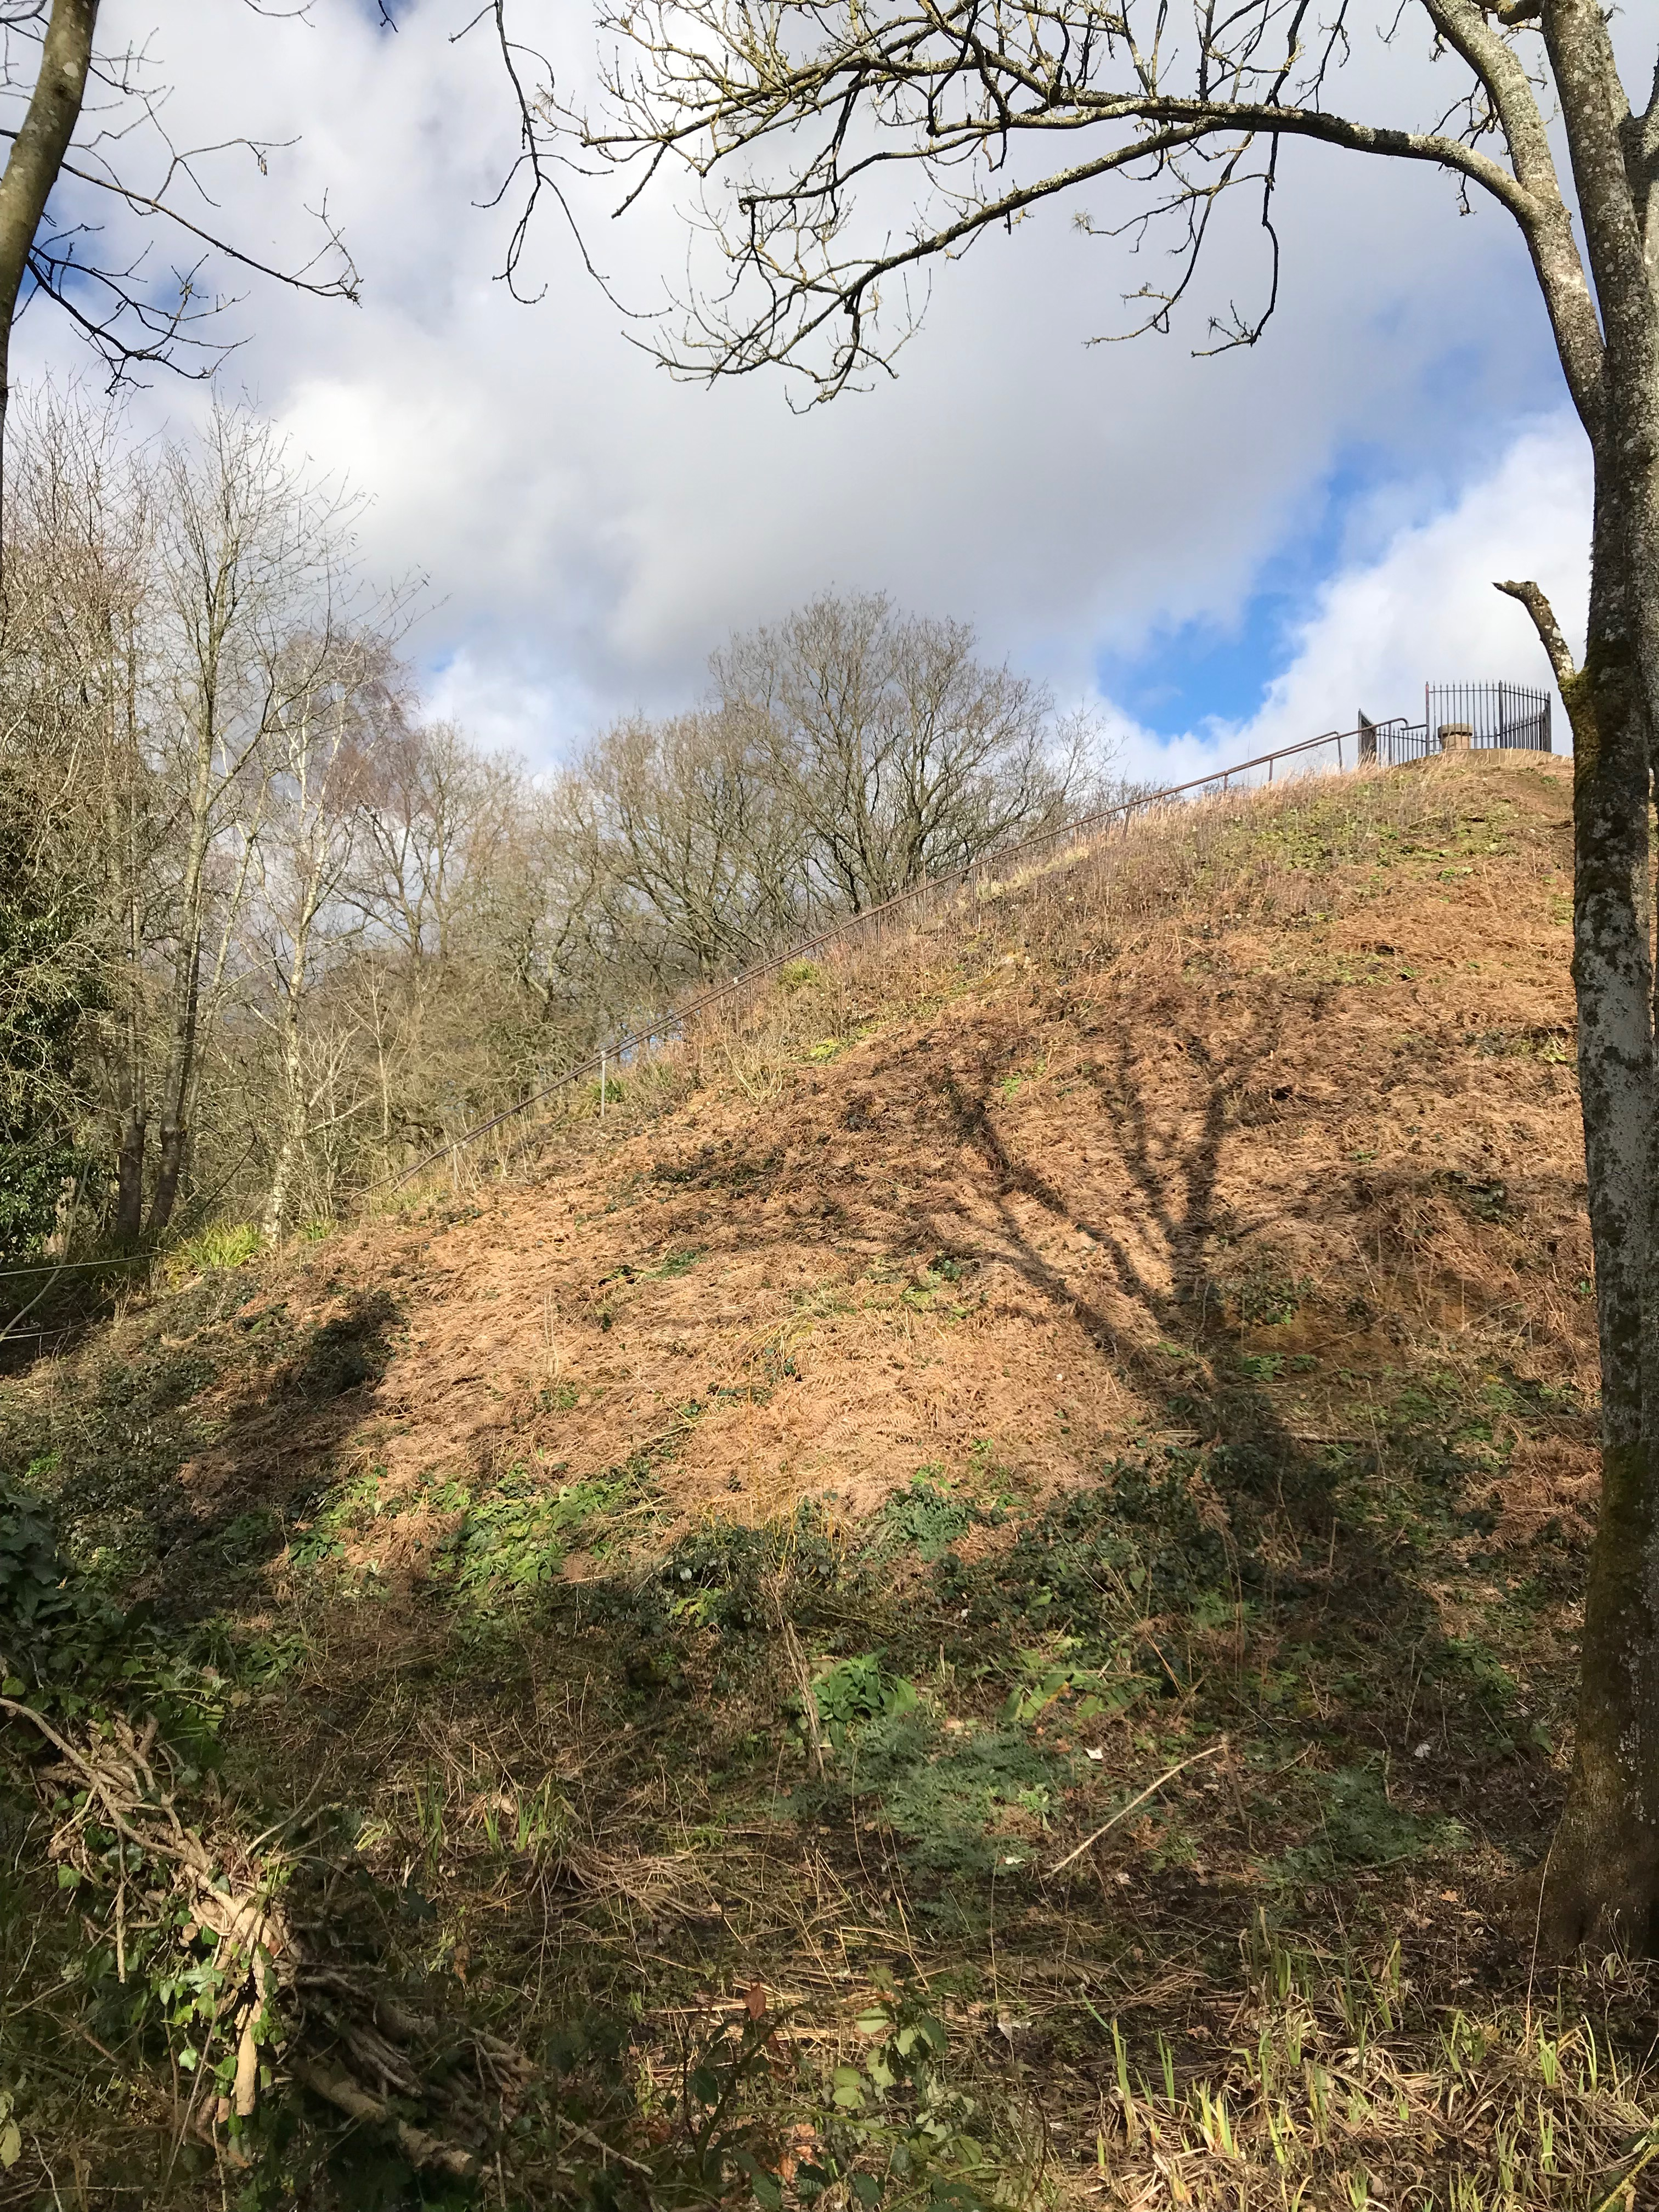
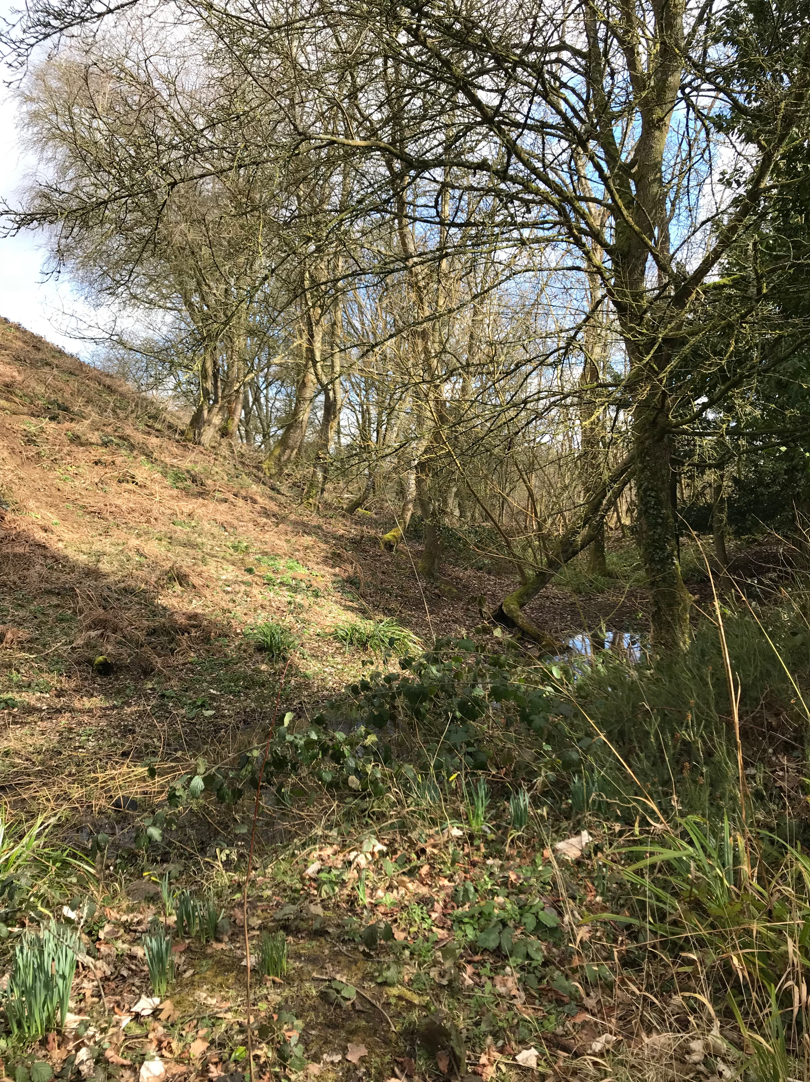

Slide 7
