Slide 1
The Villa Almeida’s Garden
Starnberg Germany
An old neglected ENGLISH GARTEN

Slide 2
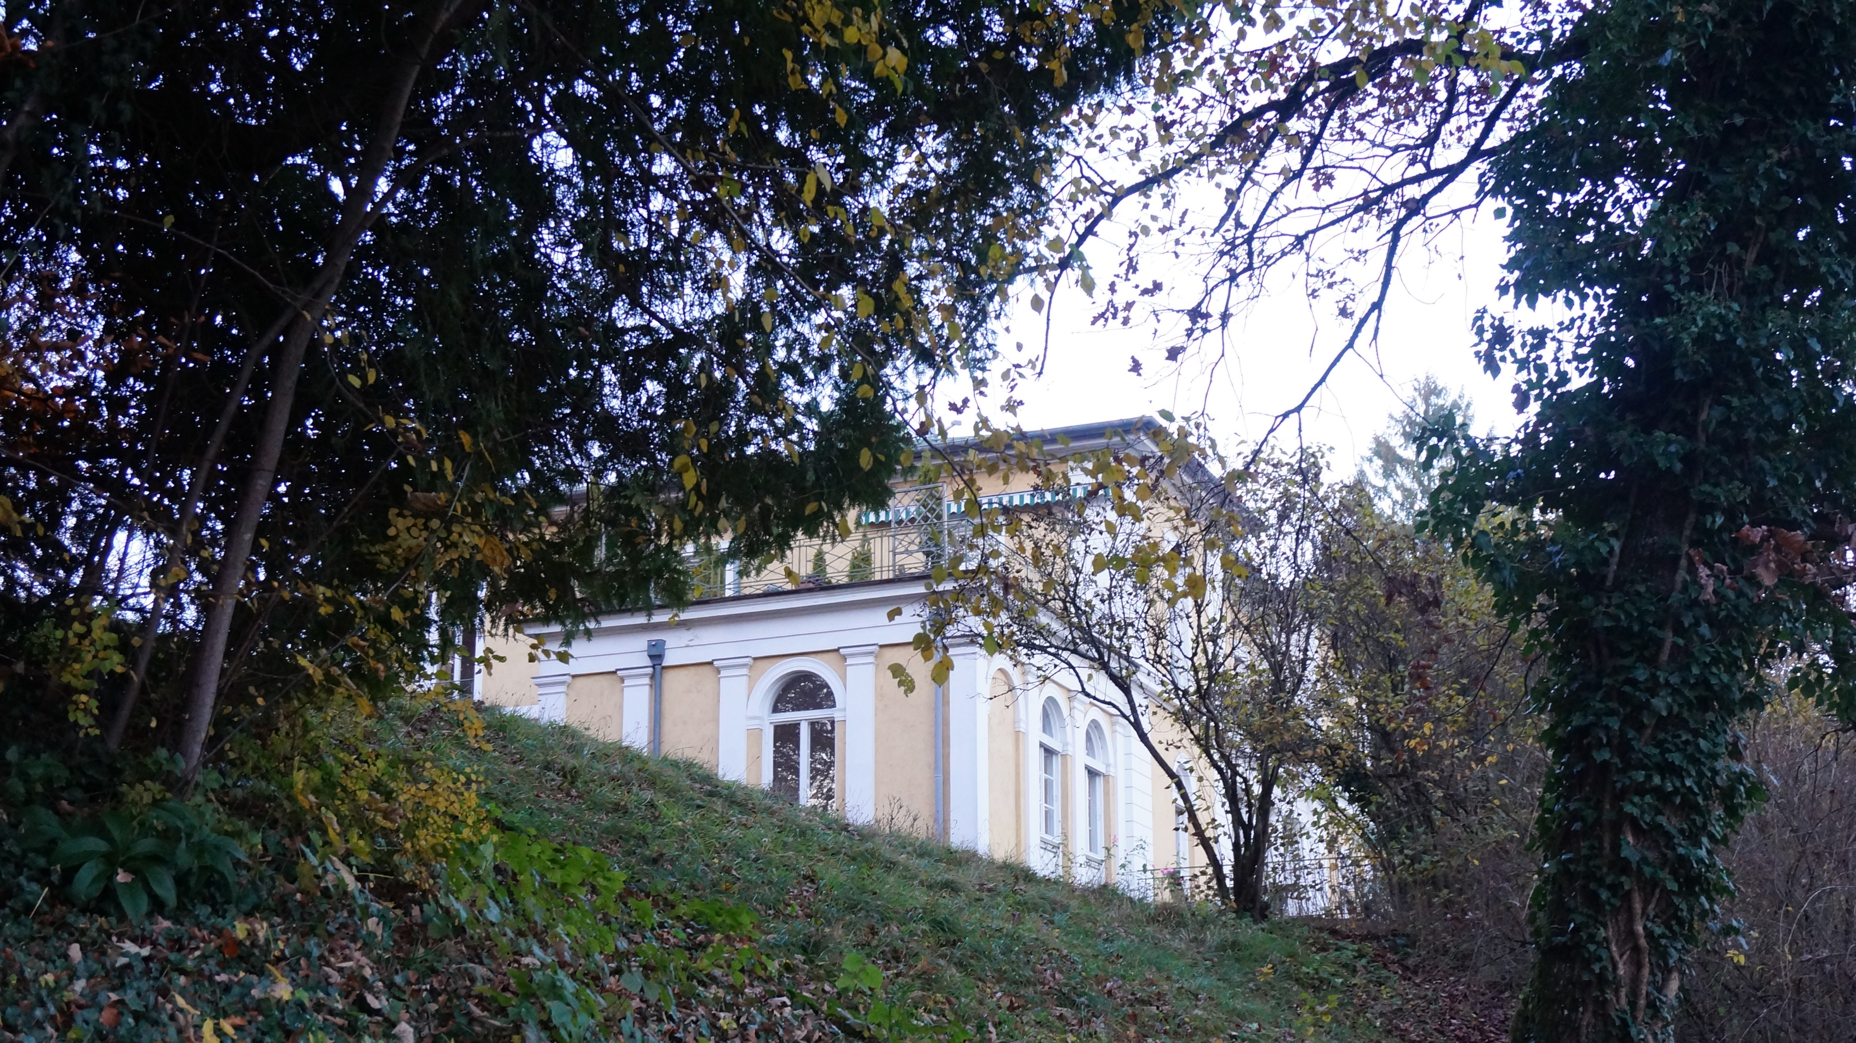
i- Context

Slide 3
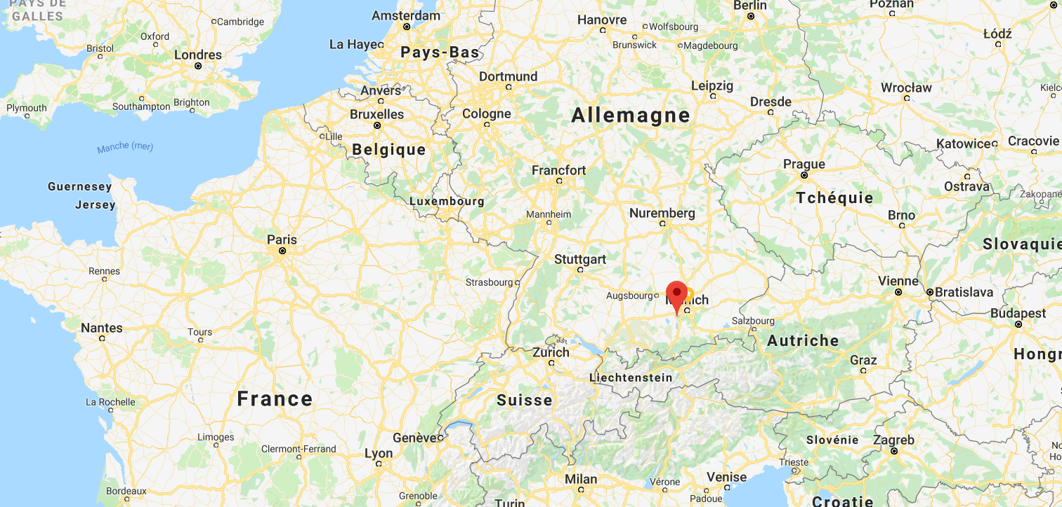
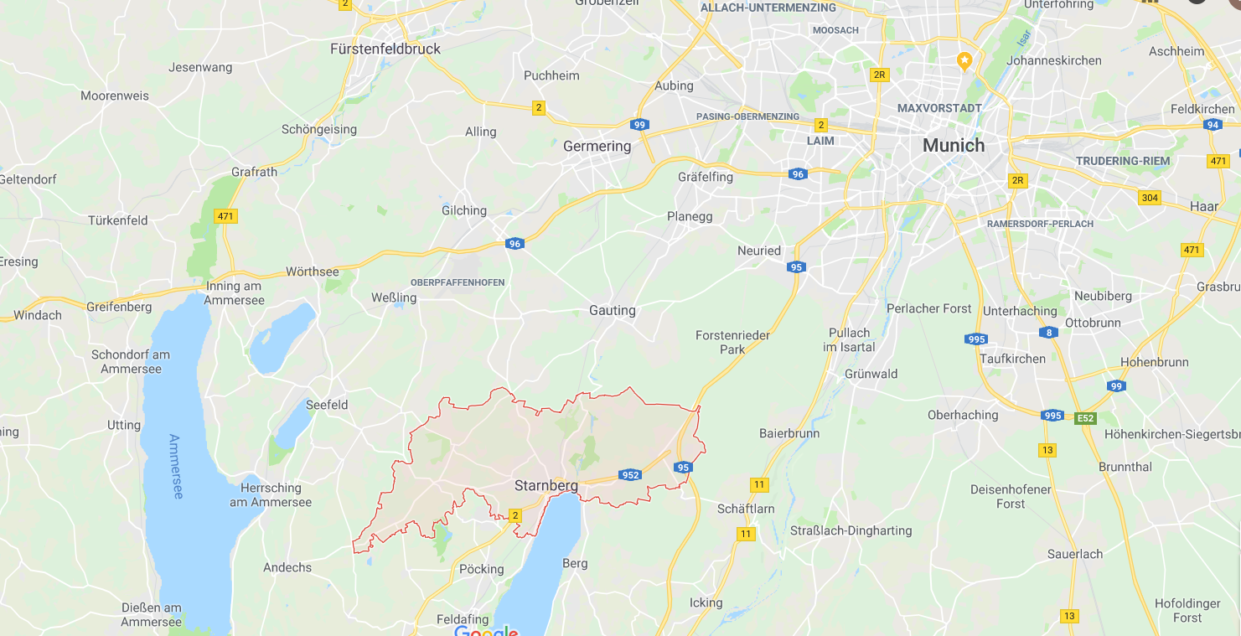

Slide 4
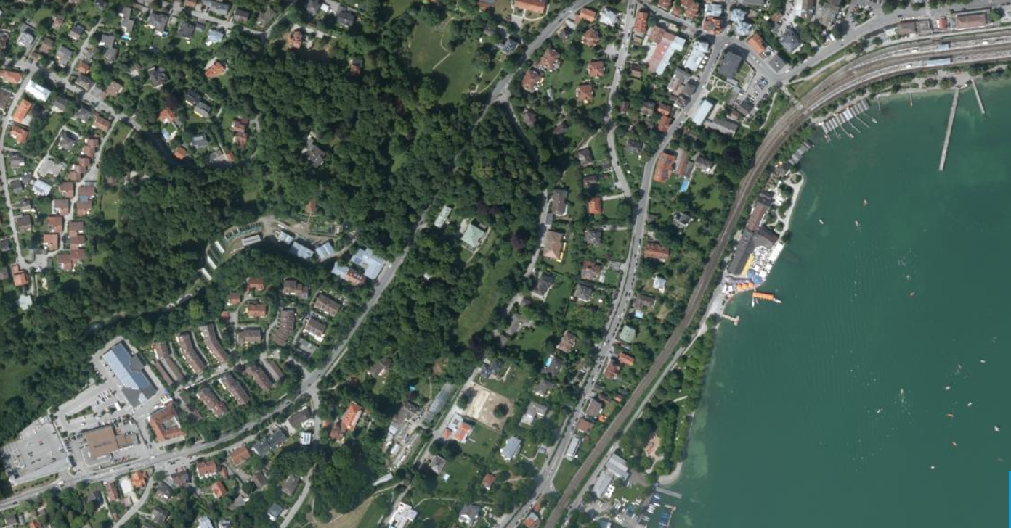

Slide 5
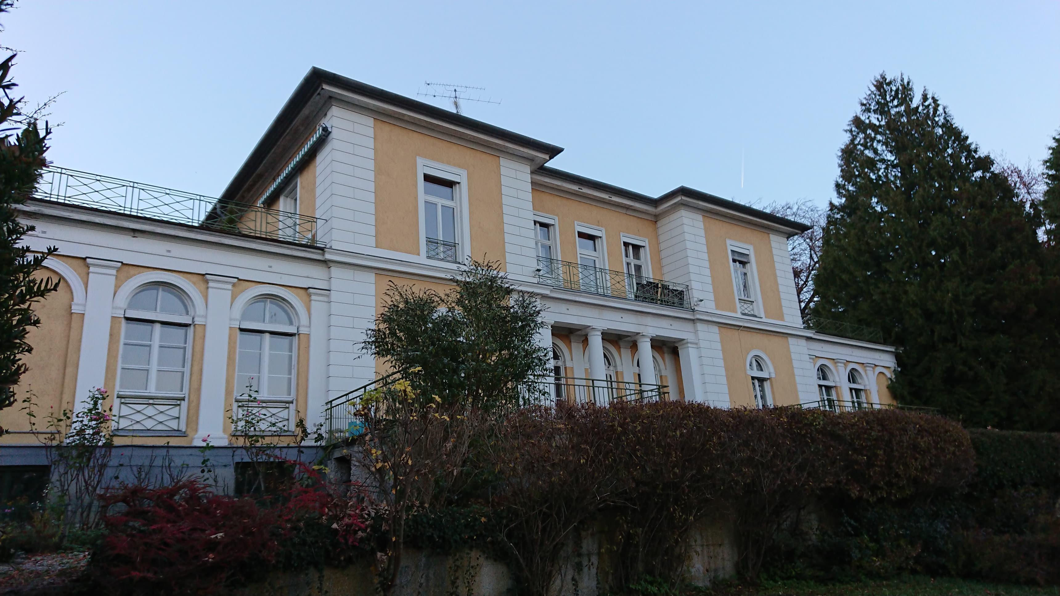
iI- Why is it relevant ?

Slide 6
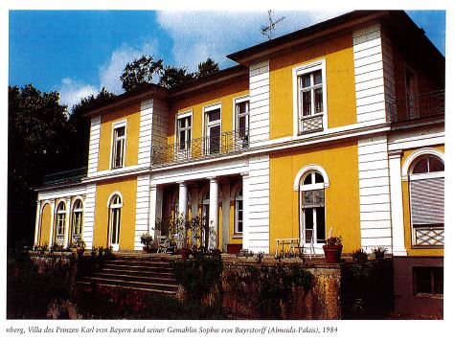
The Villa Almeida : a historical site
The villa is registered as monument in the Bavarian list of building with historic importance (bayerisches Baudenkmals).

Slide 7
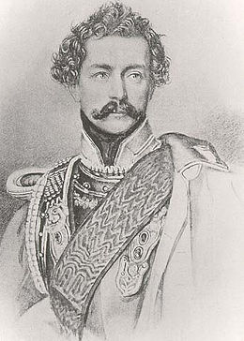
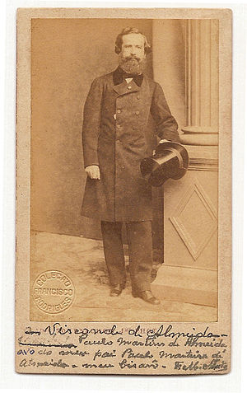
The domain was built in 1832 on order of the Prince Karl of Bavaria, for him and his wife.
Prince Karl von Bayern (1795-1875)
Paulo Visconde d’Almeida (1807-1874)

Slide 8
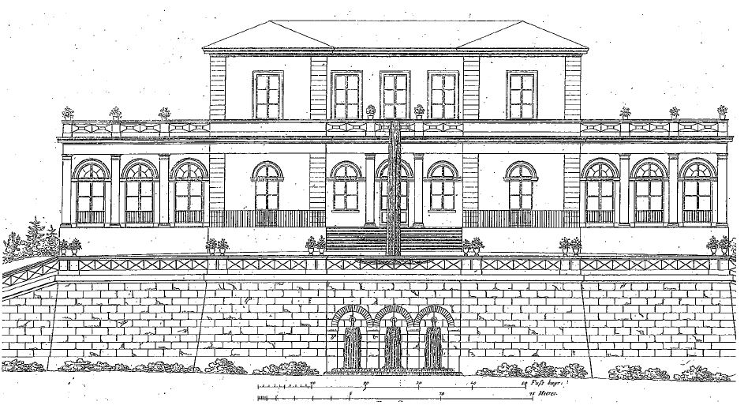
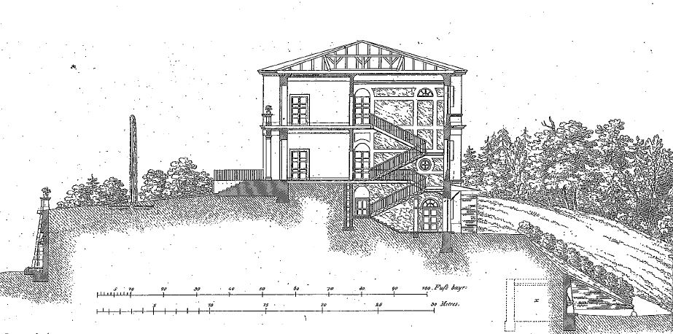
A discreet and noble classical villa

Slide 9
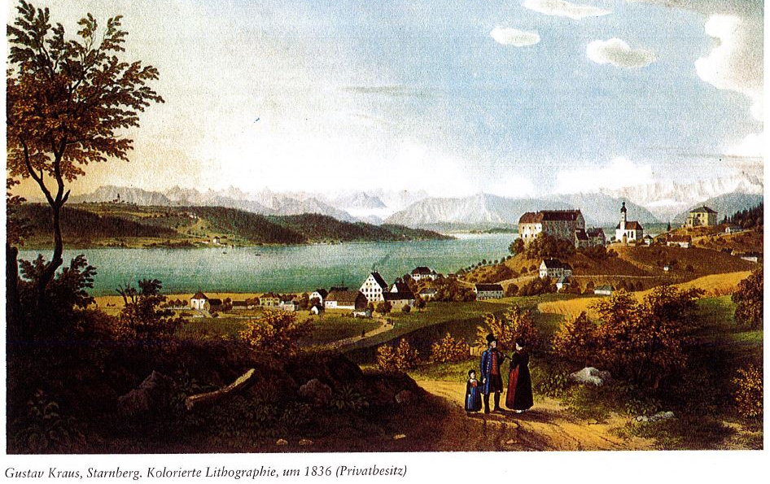

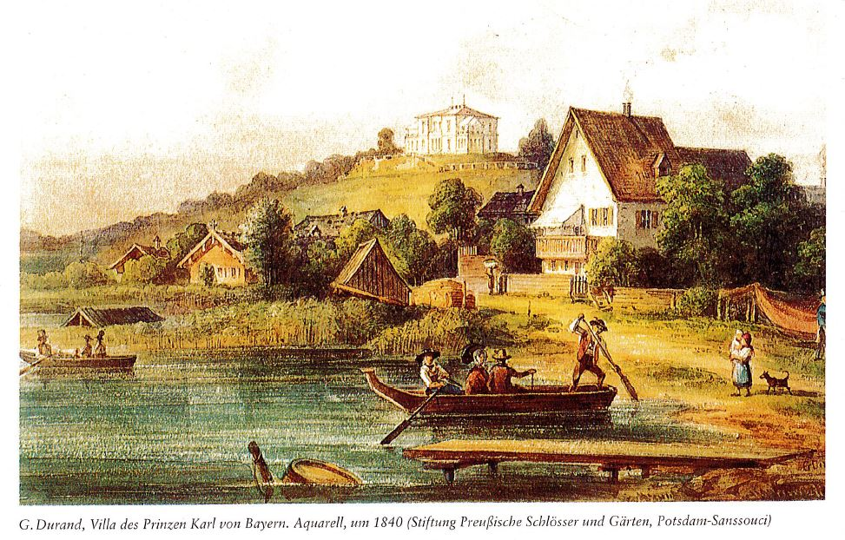
At the time of its construction, the villa was quite isolated from the rest of the village of Starnberg, surrounded by fields, up on a hill, at a higher altitude than the Starnberg village, with a nice view on Starnberg’s lake and the Alpes.

Slide 10

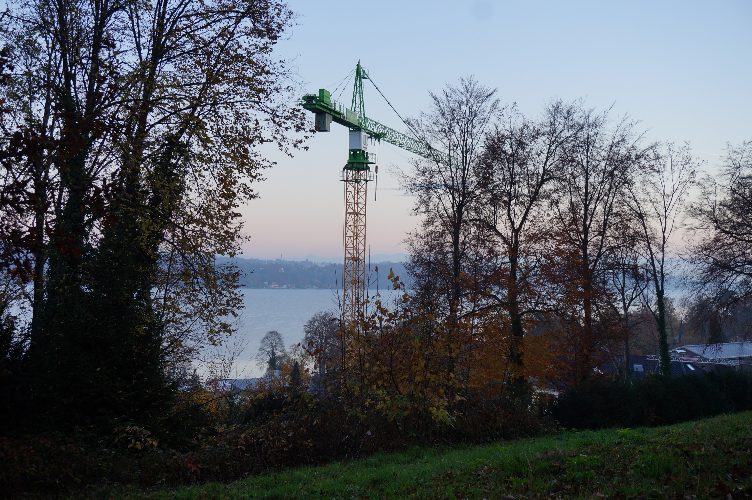
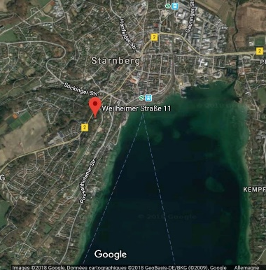
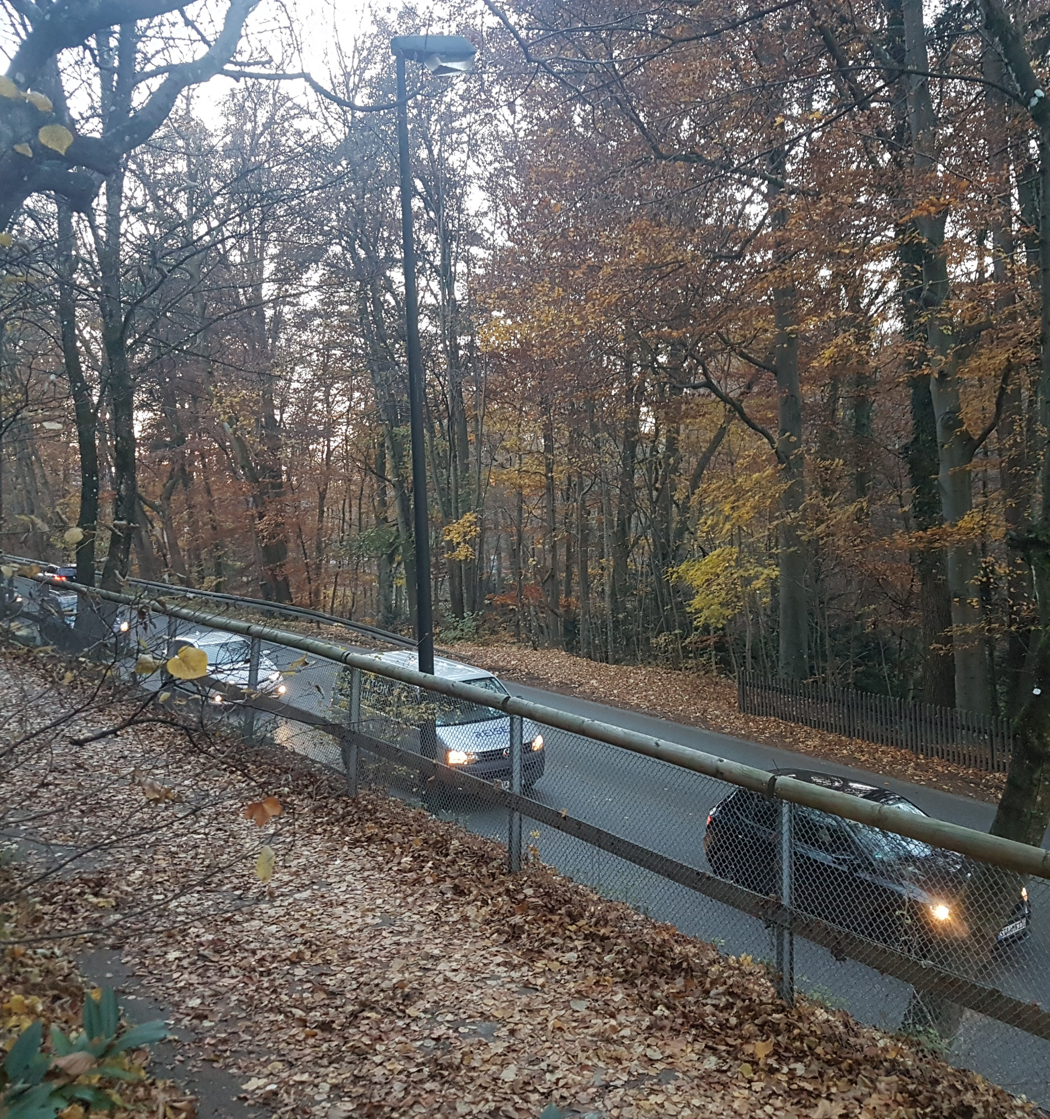
Nowadays, Starnberg has become a bigger city and the villa Almeida is now surrounded by other villas, in a very wealthy neighbourhood.
Also, a road is now passing by, down the hill.

Slide 11
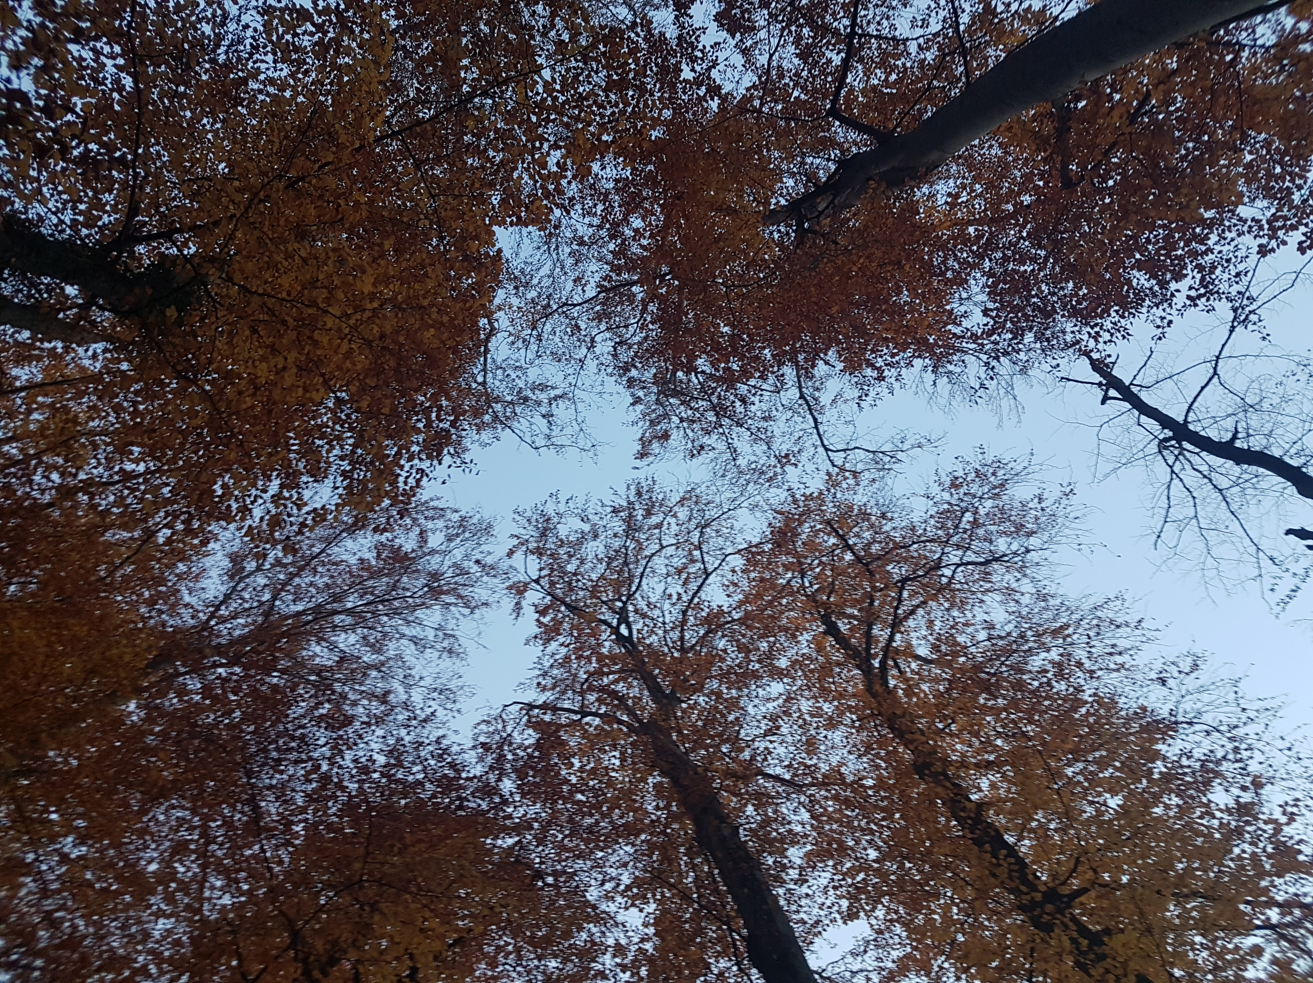
Remarkable elements
The view
The old trees
The paths
The terrace
The relief

Slide 12
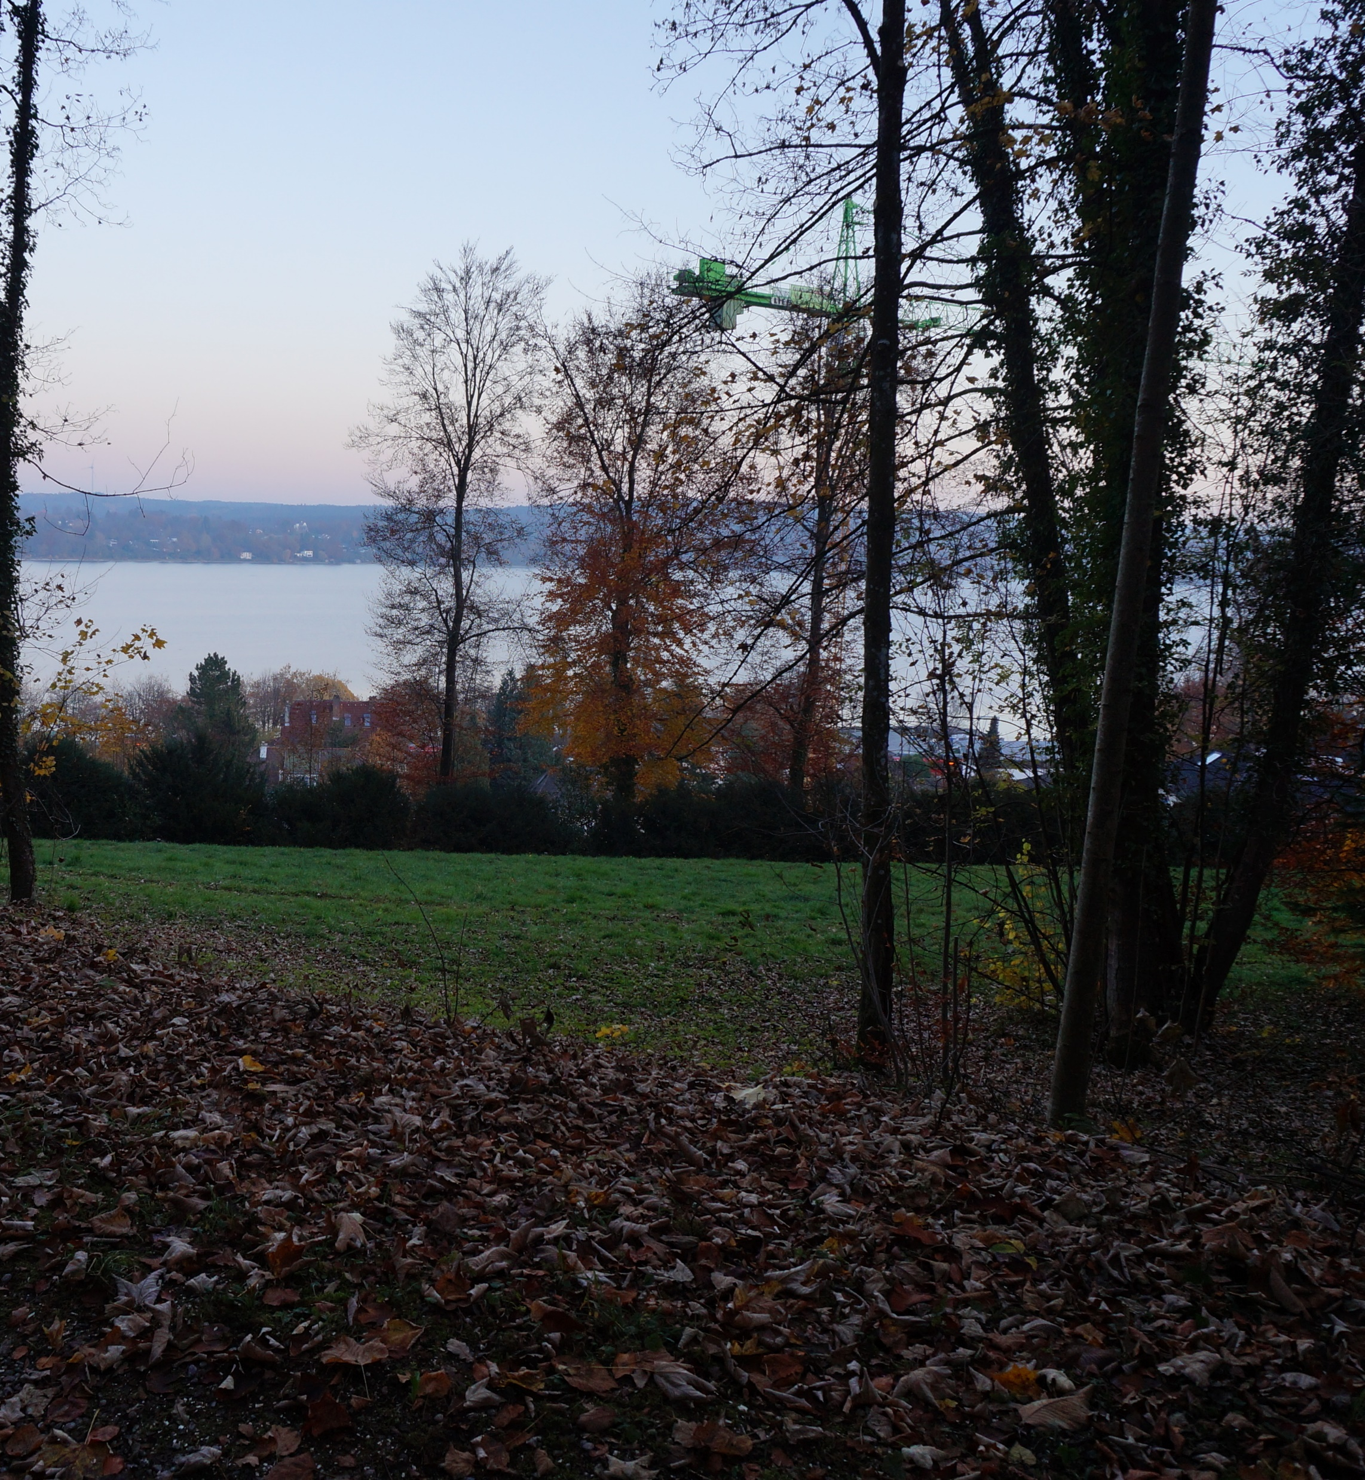

Slide 13
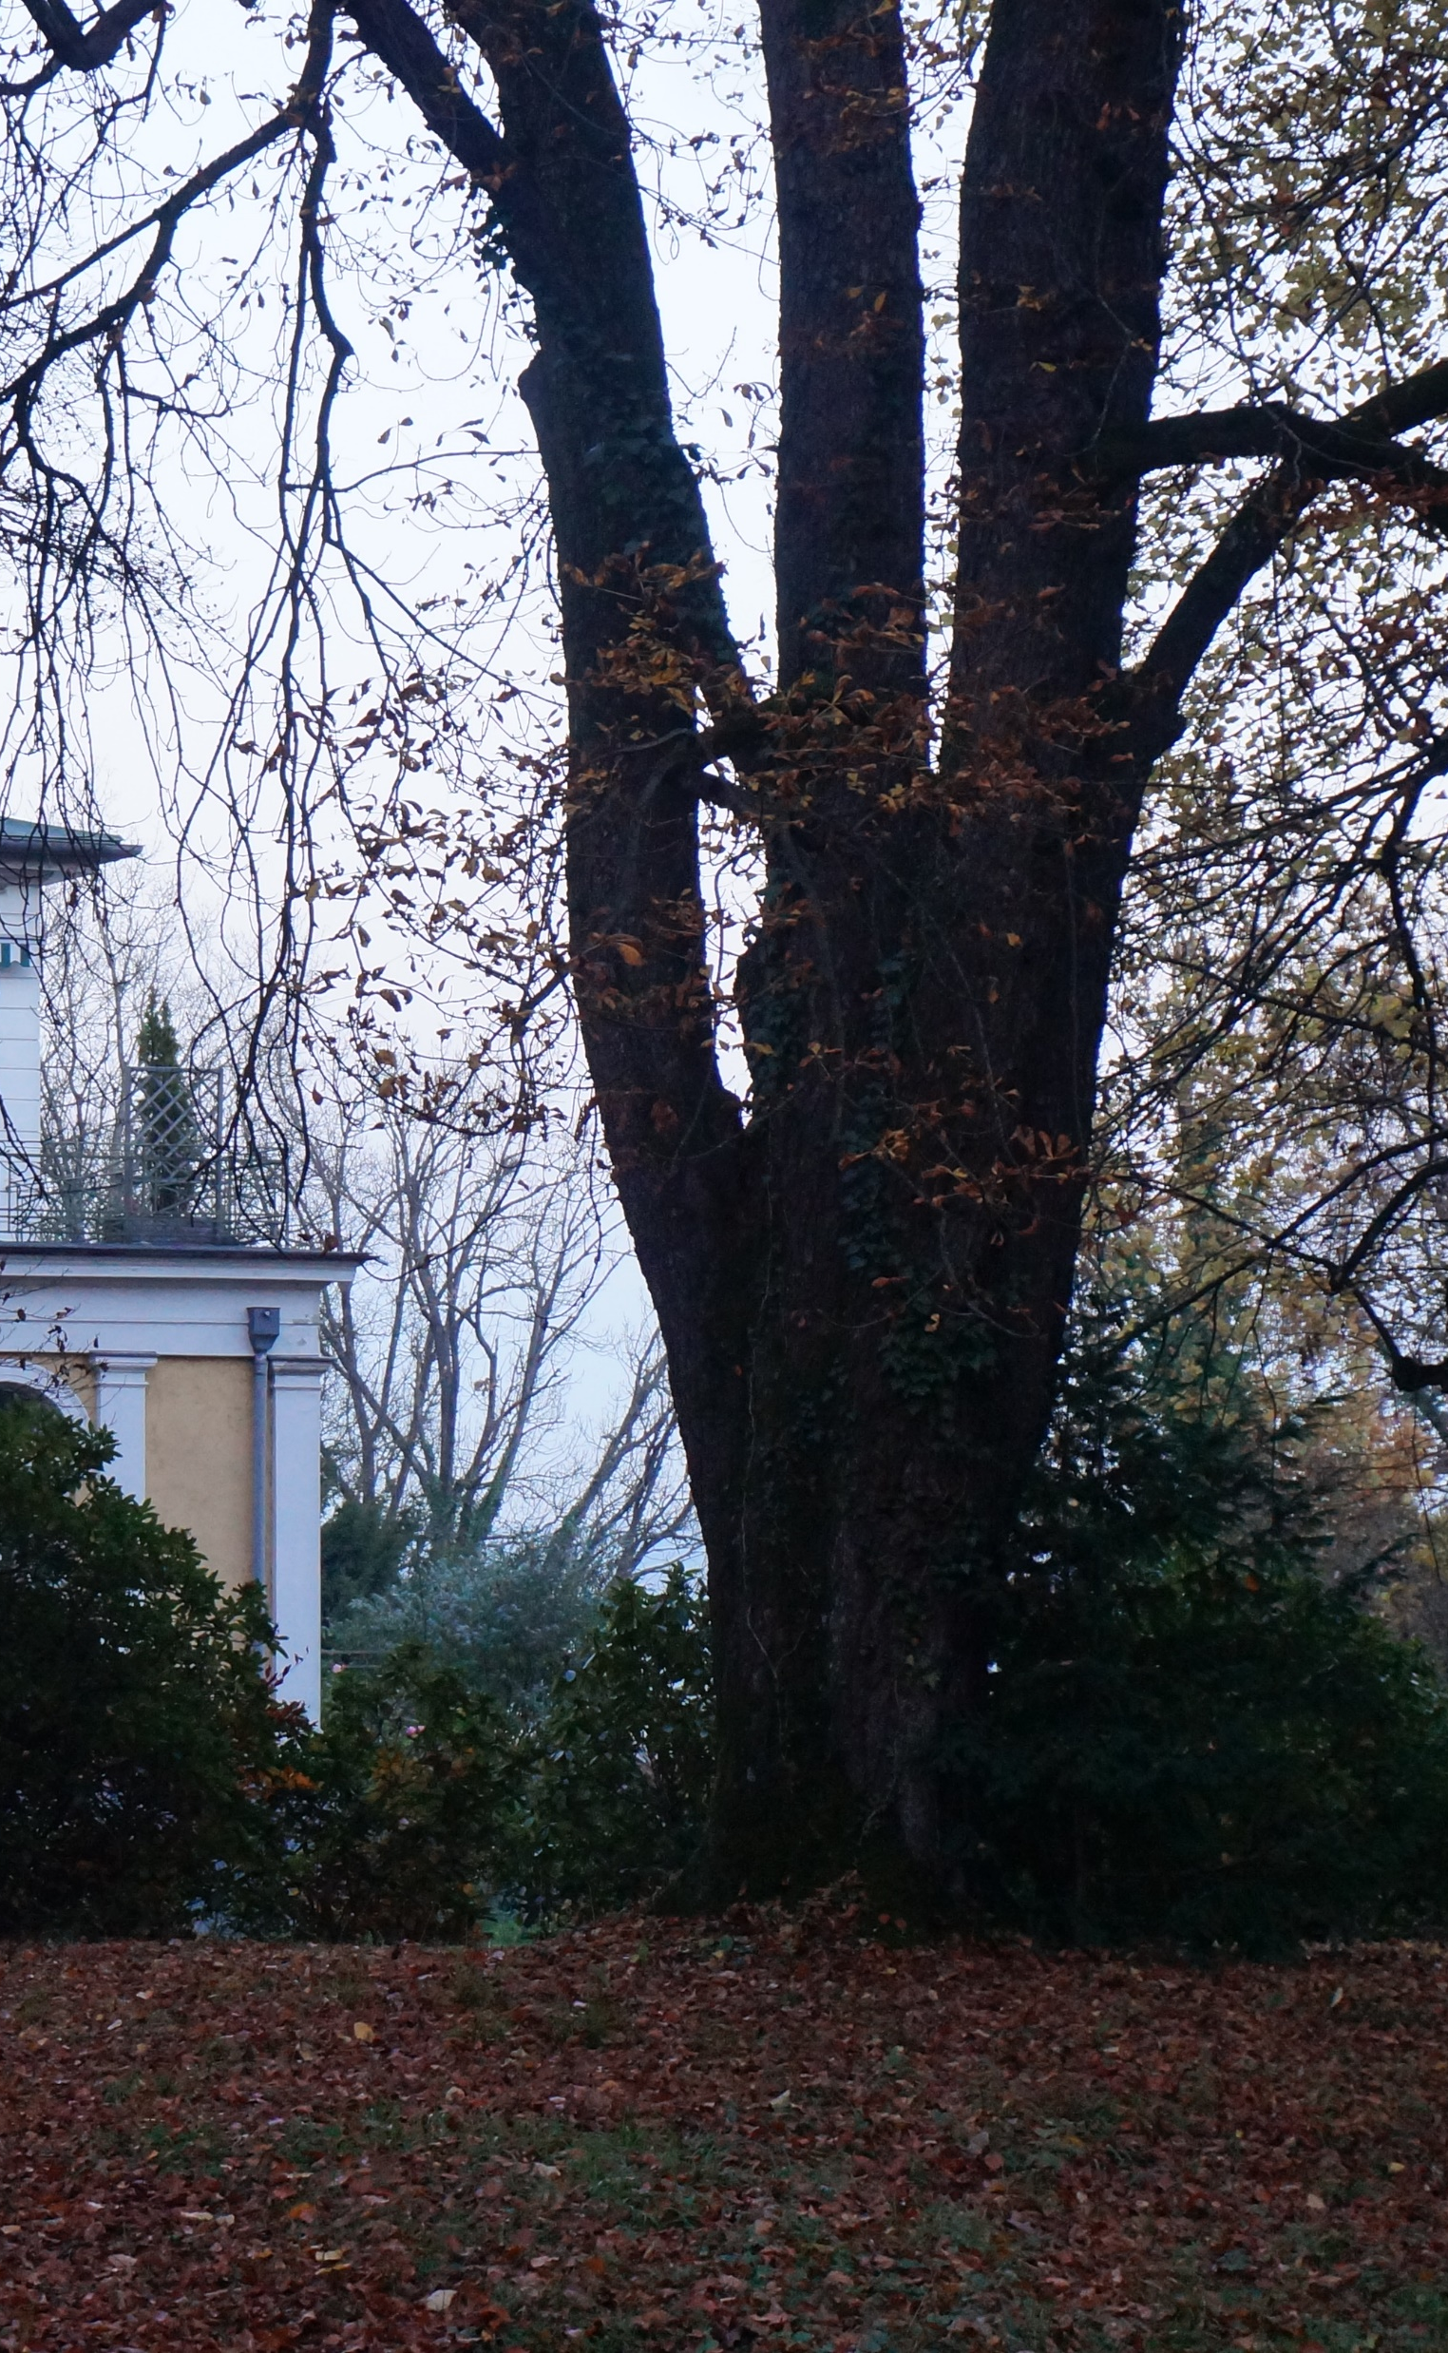
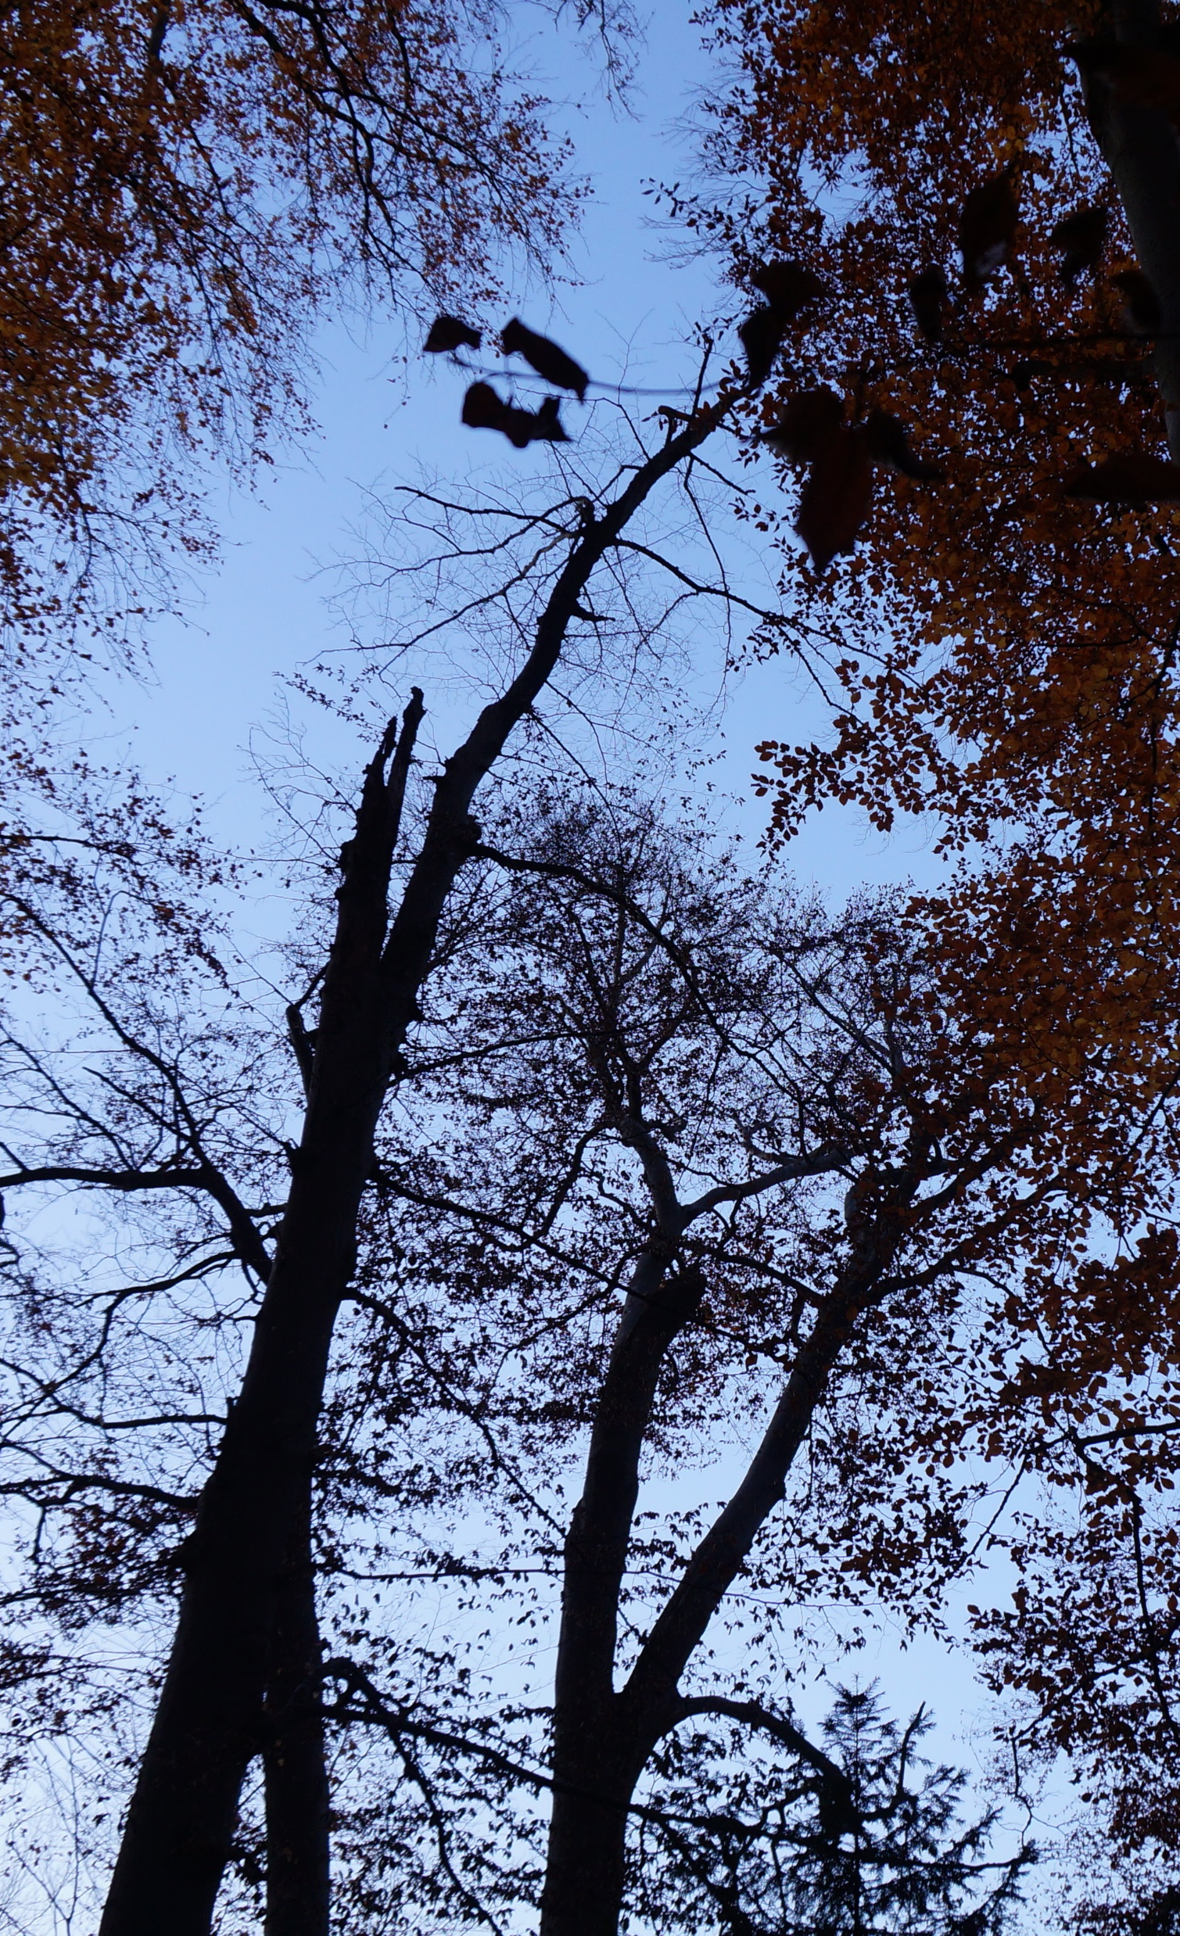
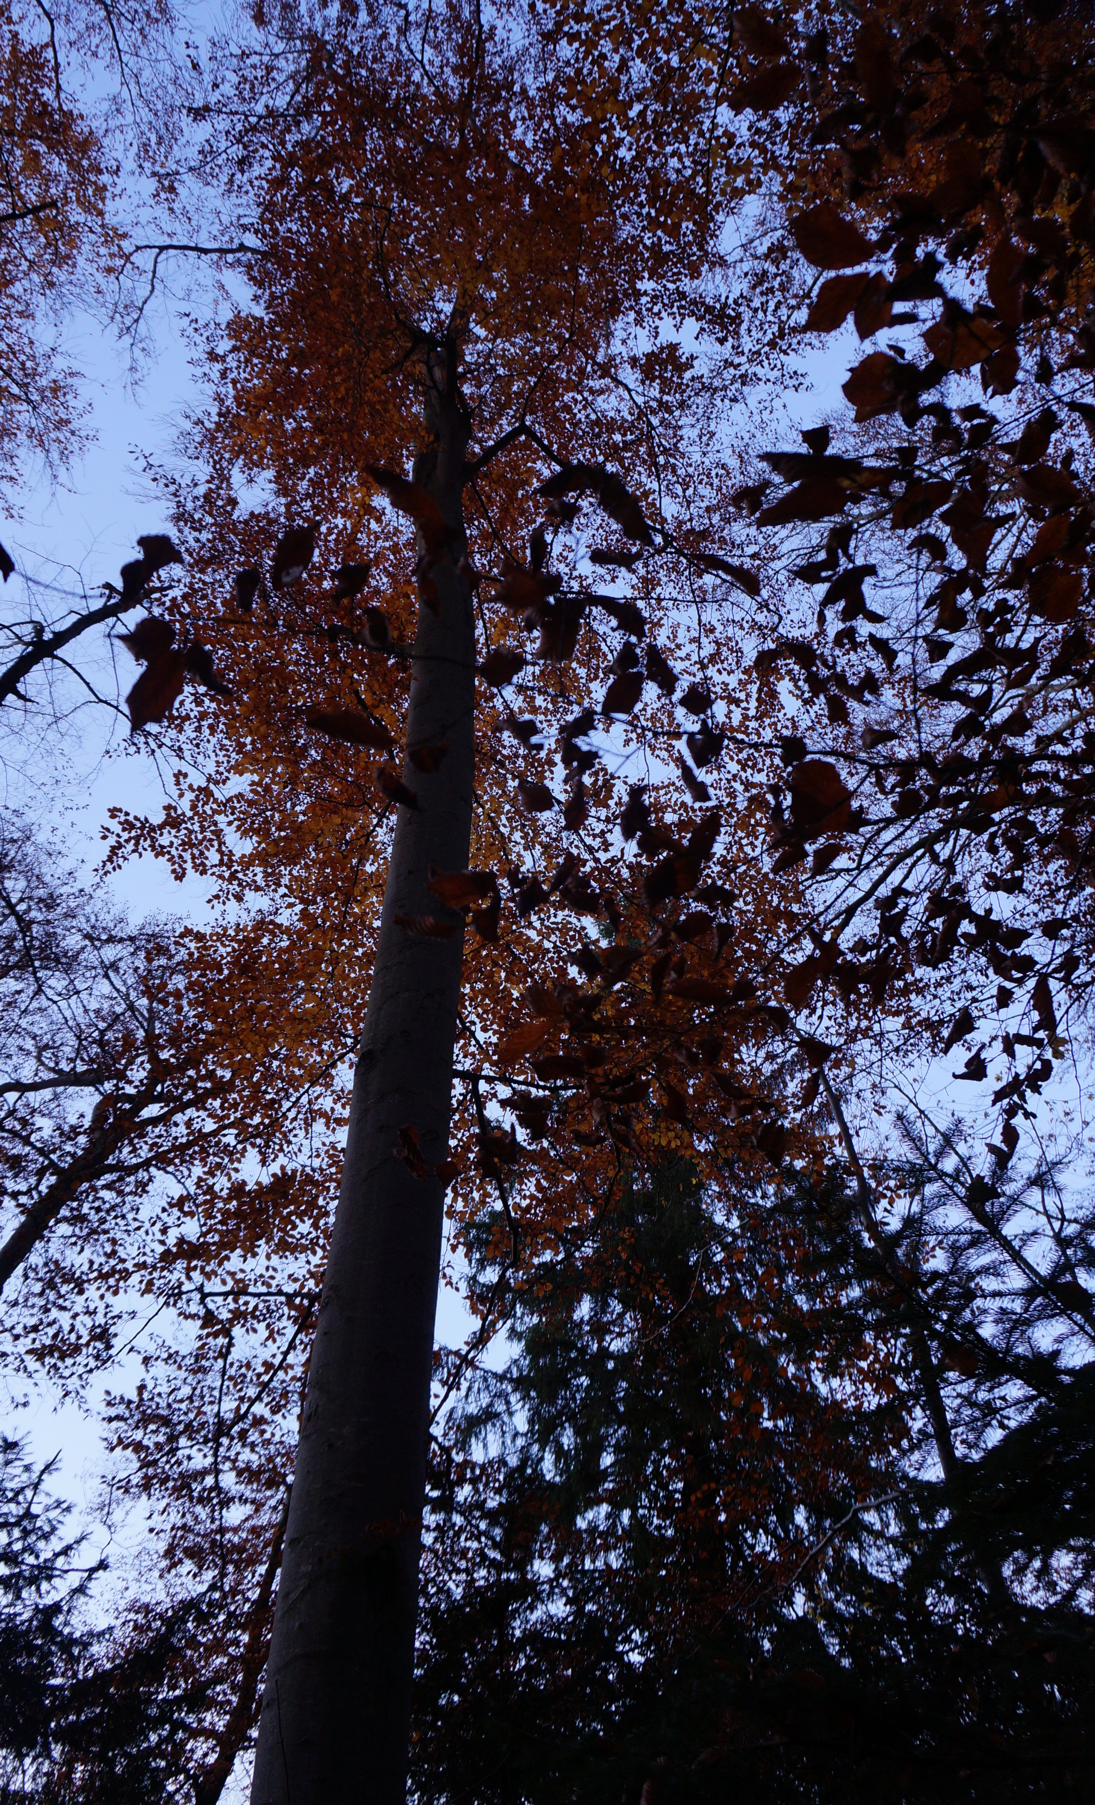

Slide 14
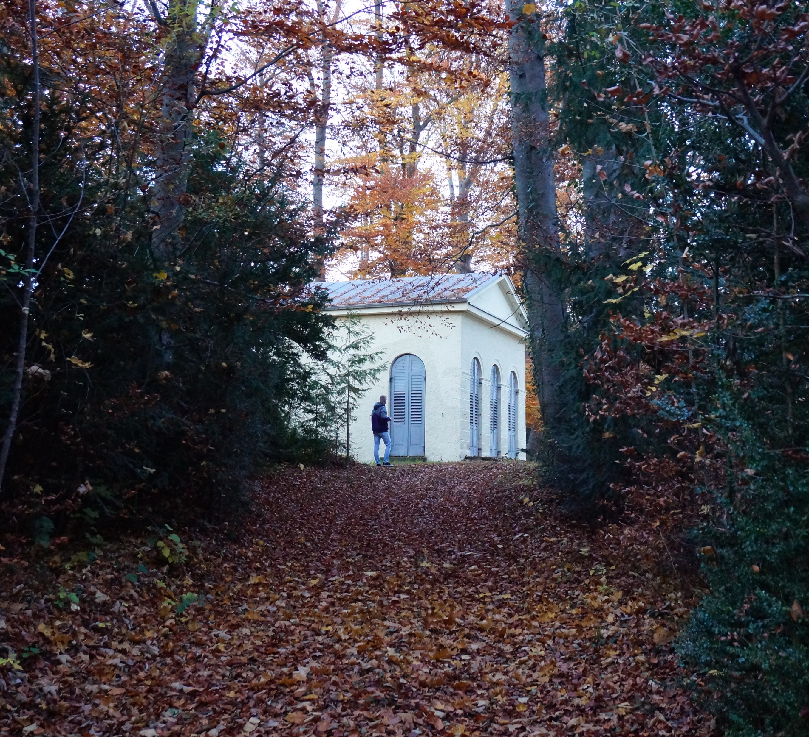
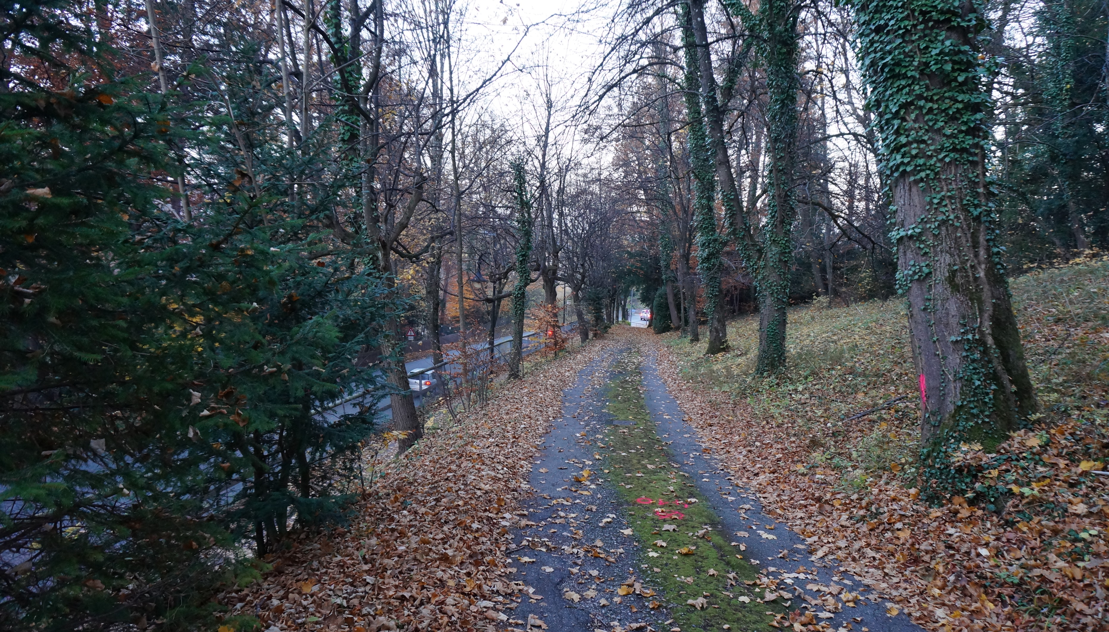
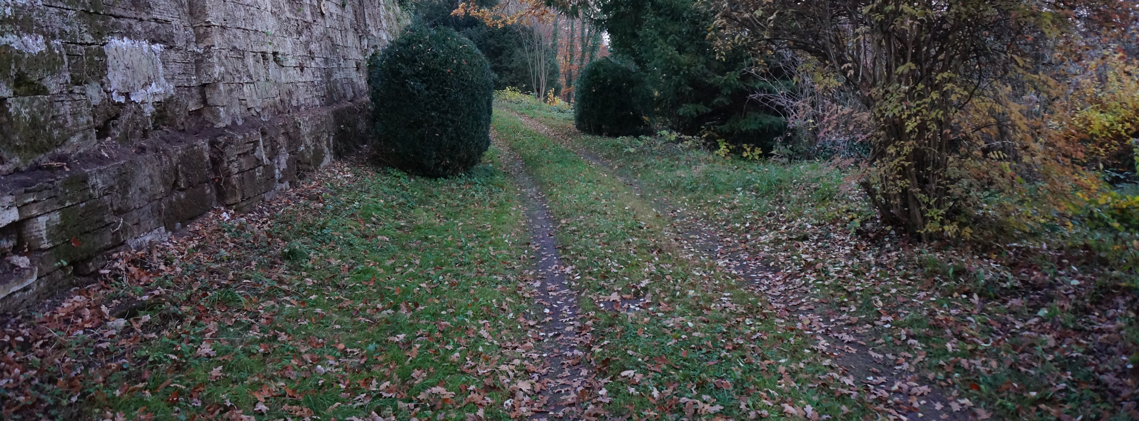

Slide 15
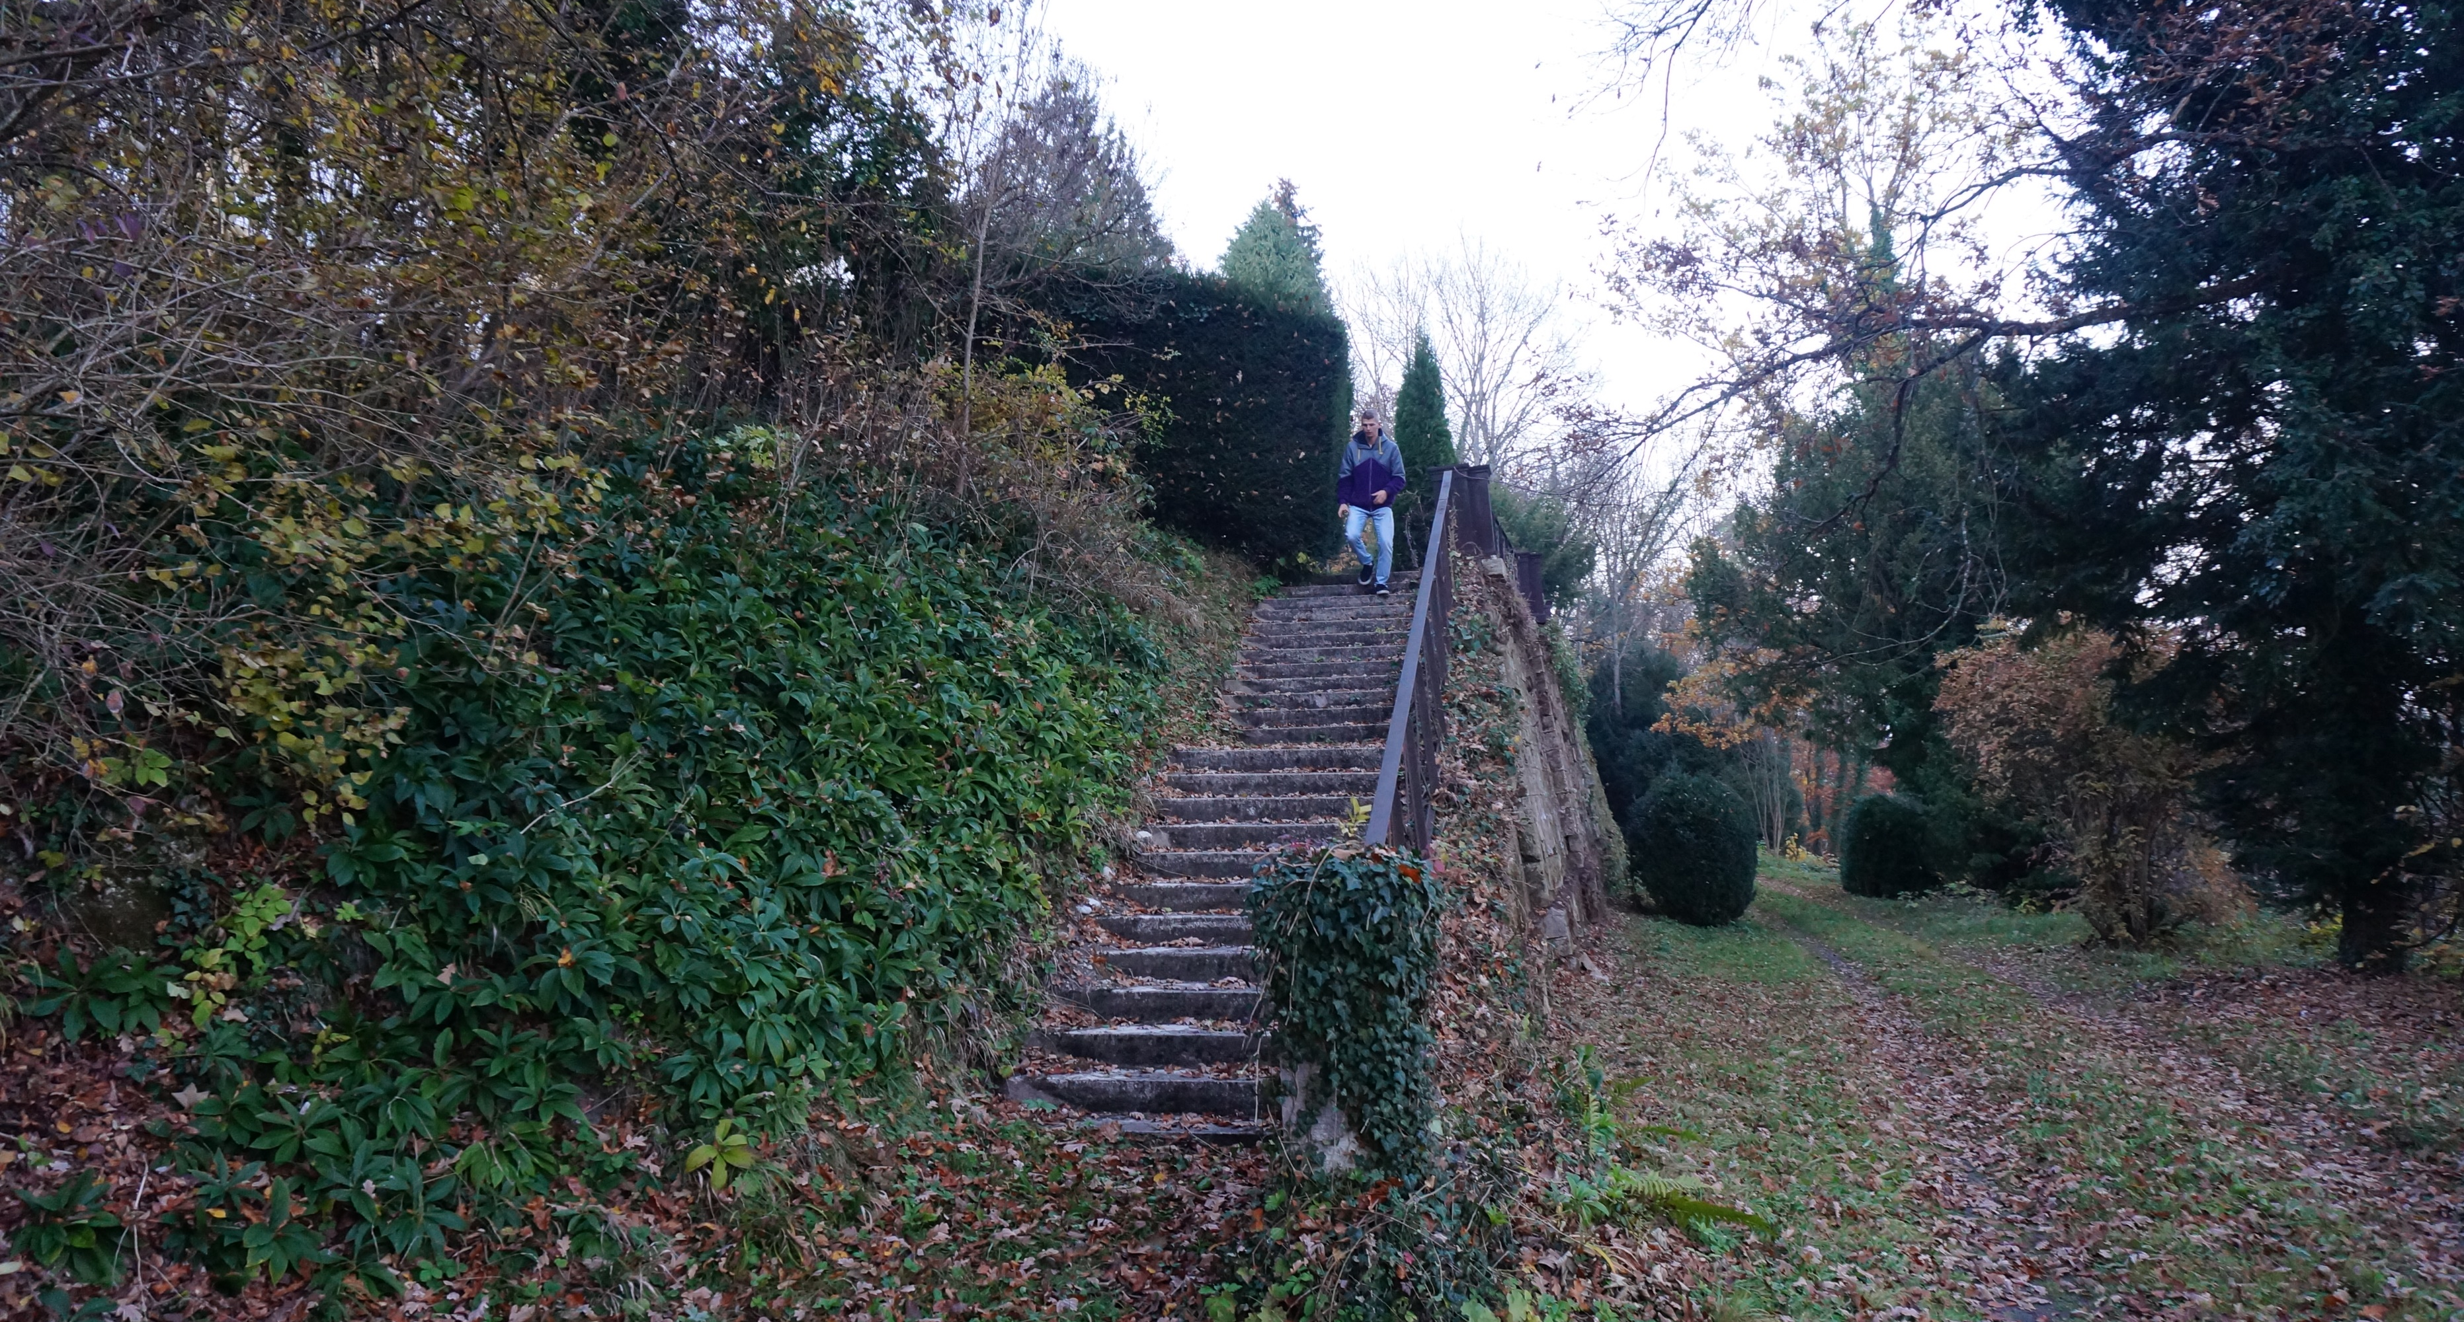
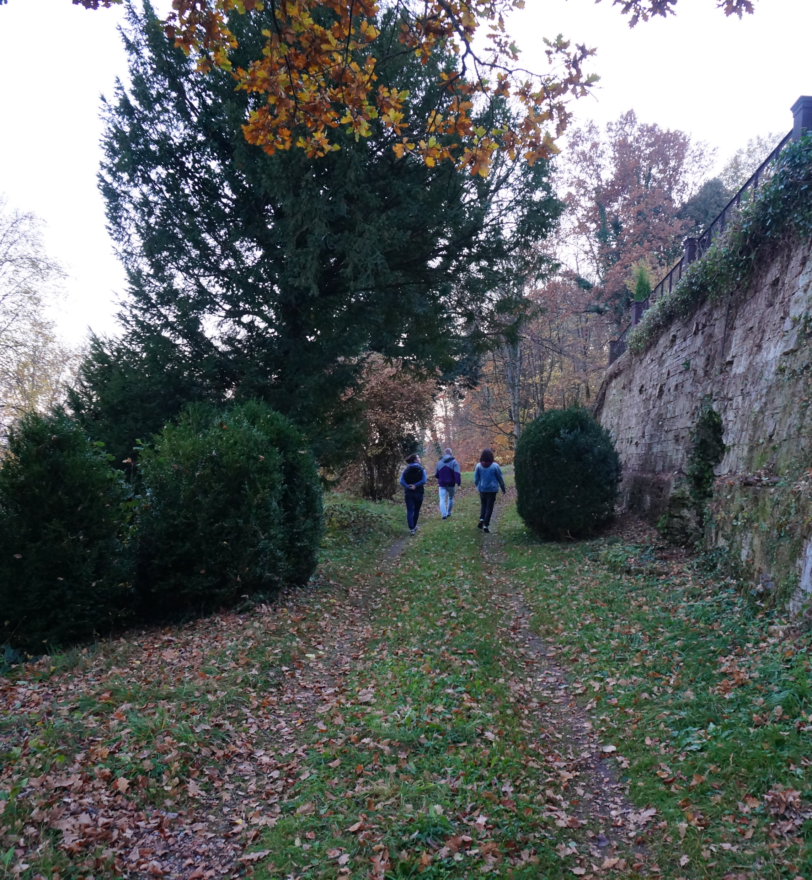

Slide 16

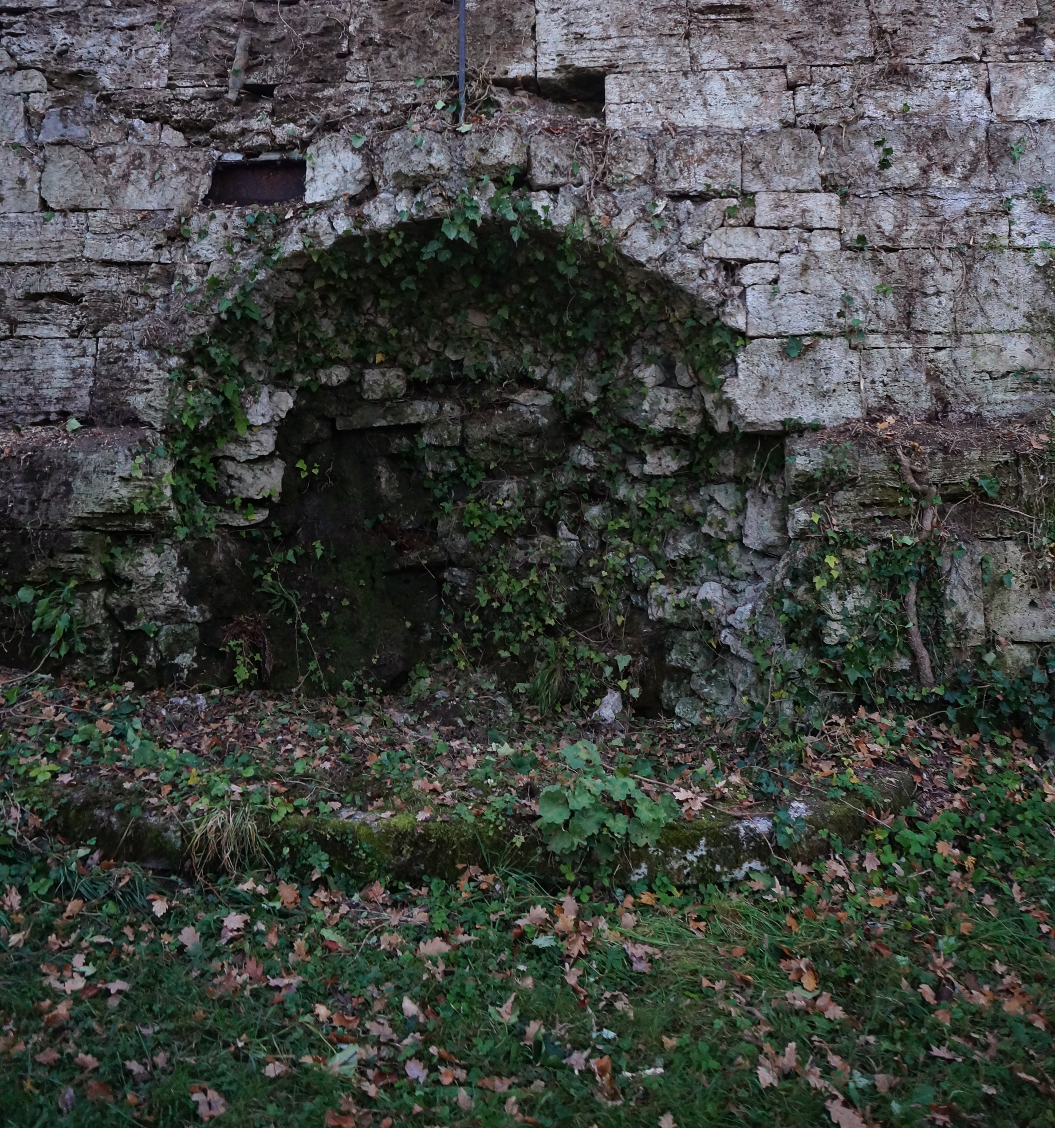
The old fountain

Slide 17
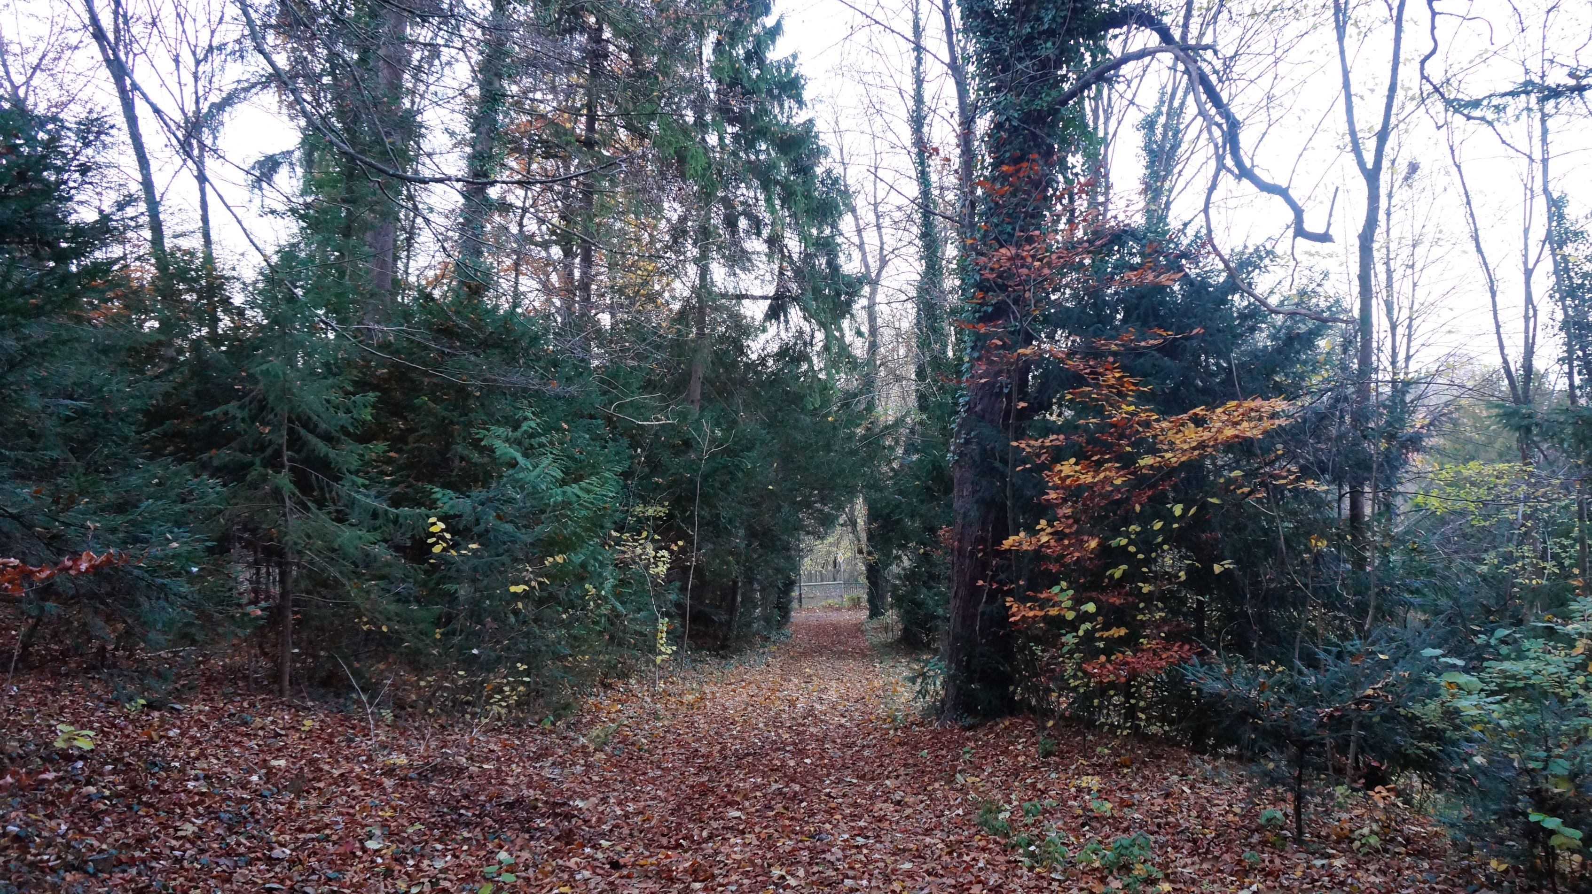
iII- Which idea of design with nature guides the design concept of this site ?

Slide 18
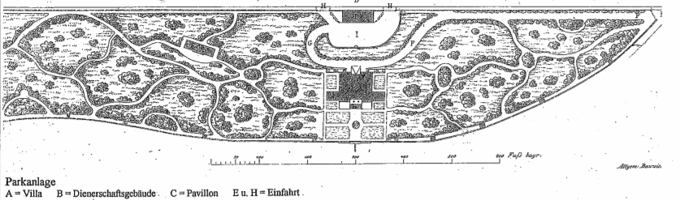
An english garden… that knows how to speak french

Slide 19

THANKS FOR YOUR ATTENTION !

