Slide 1


Final
Presentation of the AESOP4Food Sustainable Food Planning Seminar 2023
June 15, 2023
Bucharest Living Lab
Buruiană Community Garden
Living Lab Tutor: Ioana Elisabeta Enache,
PhD candidate, UAUIM Bucharest
Seminar Tutor: Roxana Triboi,
Coordinator AESOP4food ERASMUS+
Carlotta Tonveronachi

Slide 2
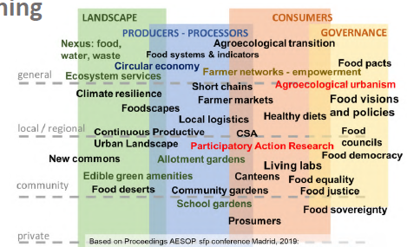
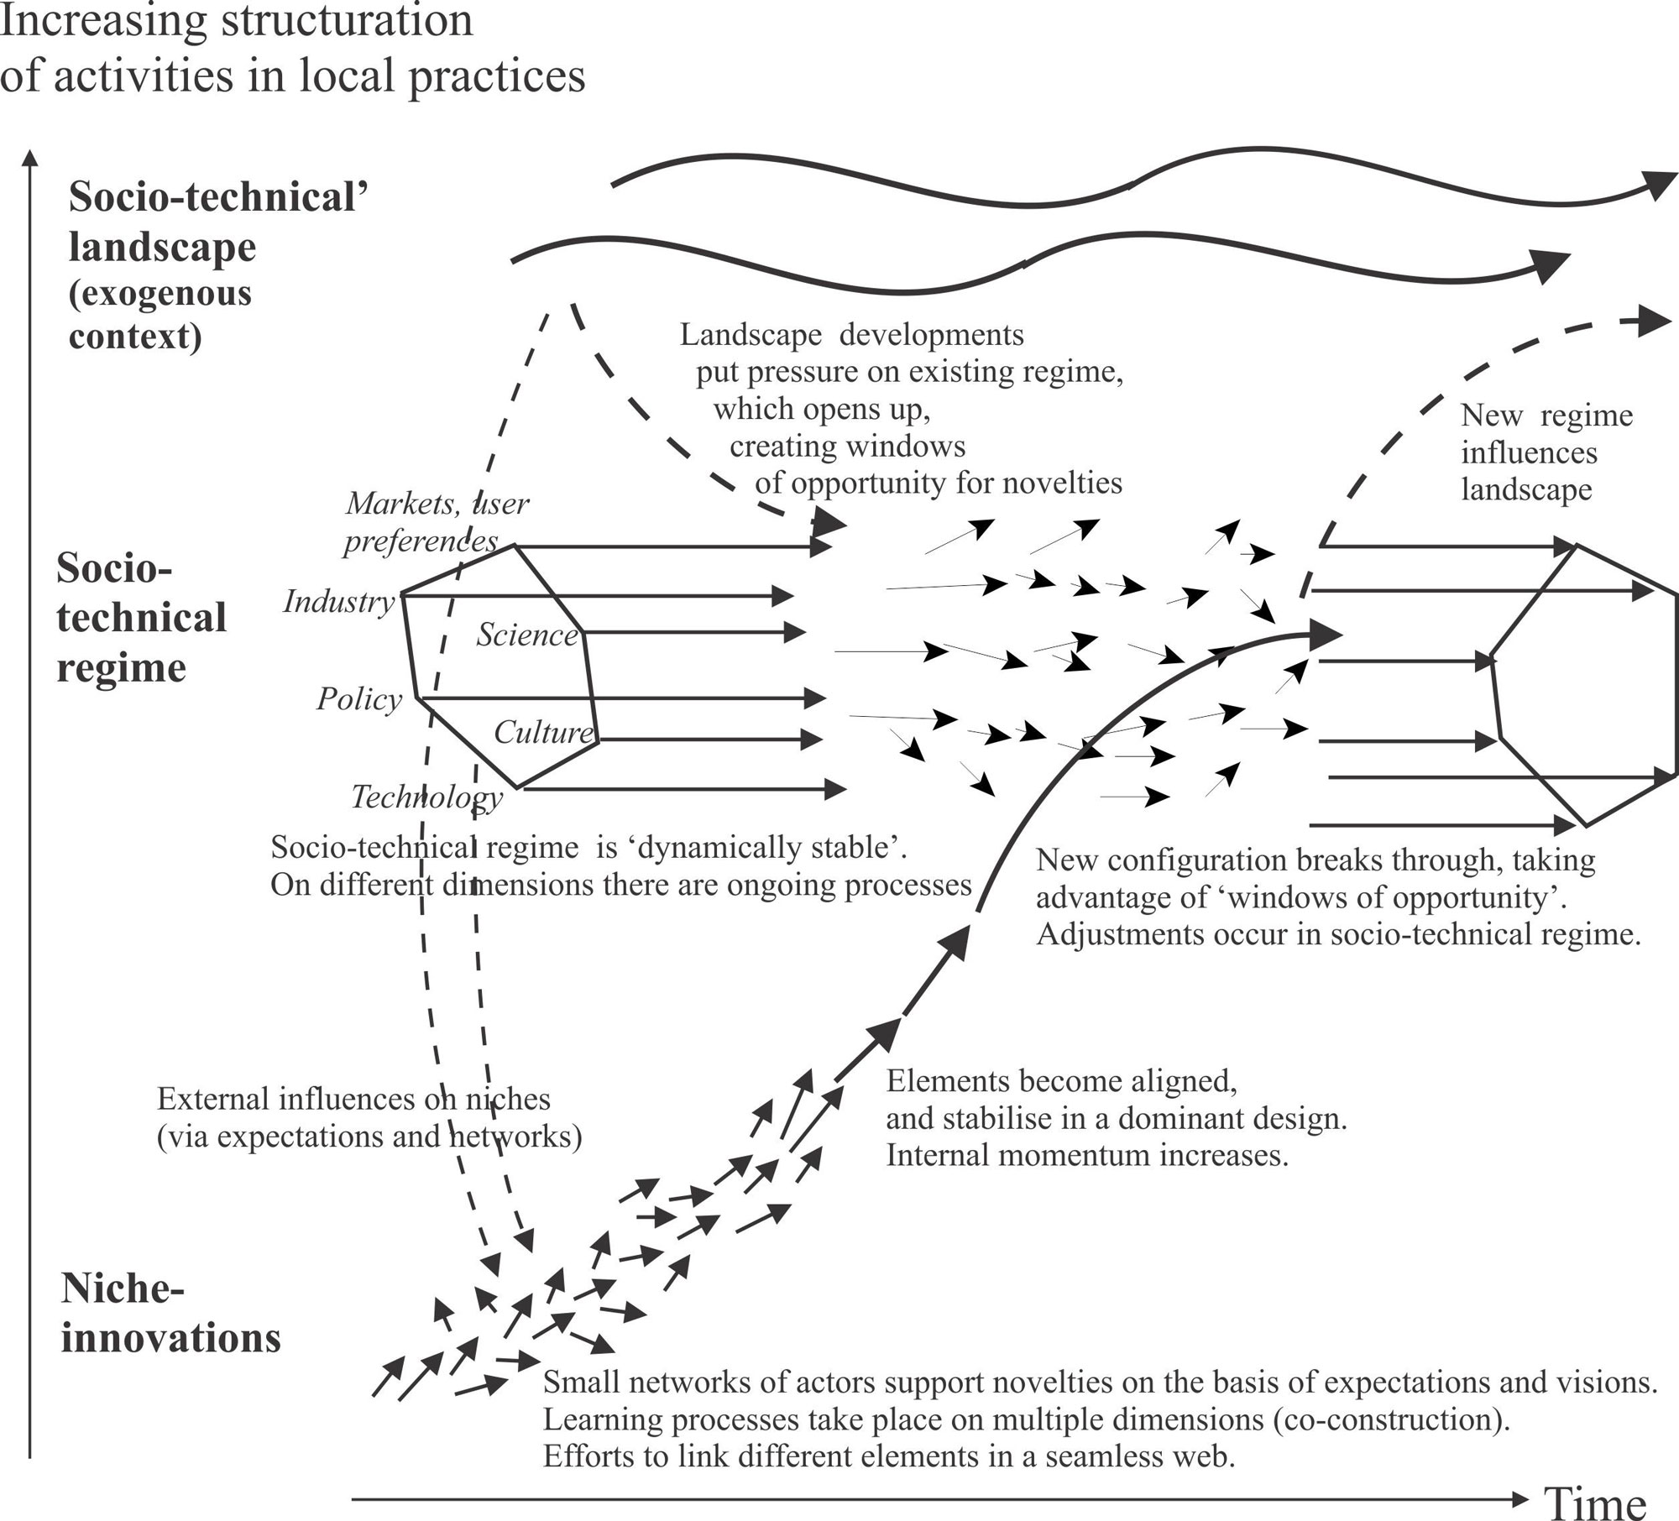
Research questions
1. How can a community garden/agriculture in the peri-urban area of a big city
(in the context of locals still practicing agriculture in an individual and specific traditional manner) look like?
  1.1 What are its elements, (power)relations and stakeholders?
  1.2 What challenges arise regarding long-term functionality and what are ways of dealing with them?
  1.3 What challenges arise regarding the peri-urban location and what are ways of dealing with them?
2. What are good case-study examples of events and activities to attract participants, new members and locals that are starting to learn about the existence and benefits of urban gardening/agriculture?

Slide 3
Methodology
02.03.2023
11.04.2023
17.05.2023
15.06.2023
First Lecture
First Presentation
Intermediary Presentation
Final Presentation
Group-Discovery-Phase
Coordinating Ideas and Needs
Finding collective research questions
Creating Procedure-Plan and Organizing first Interviews
First Phase of Data Generation and Analyse
Sharpening Research questions
Question Block 1: Conducting qualitative guided and problem centred Interviews with two members of Hortigas (Founder of the cooperative and radio-responsible and member of the commission “Difusión”), Friendship as a method, Co-Usage of Mural, GDPR and Ethics
First Data-Analysis and Results
Question Block 2: Preparing Literature review and case-study collection in Cologne Urban Gardening Network
Second Phase of Data Generation and Analyse & Finalization
Question Block 2: Conducting collective case-study brainstorm with Netzwerk der Kölner Gemeinschaftsgärten and the Food Council of Cologne by joining their assembly and through Mail-Contact
Synthesis: Bringing Data, Research questions and Living Lab-Context together

Slide 4
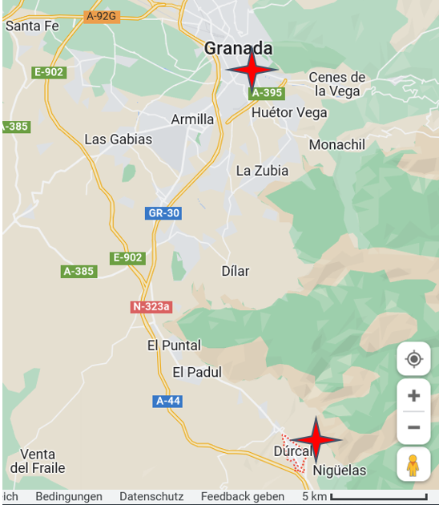

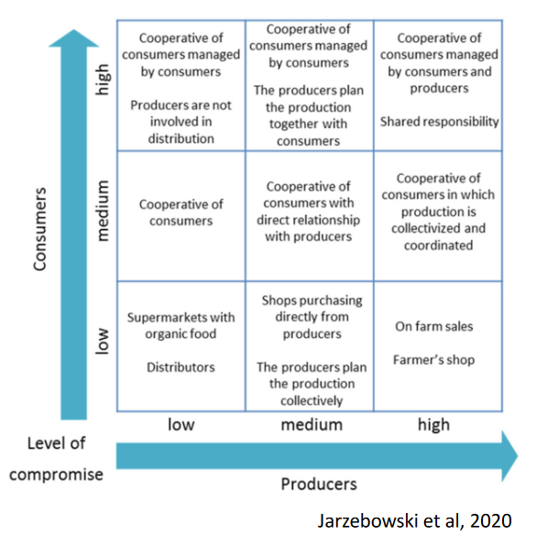
1. How can a community garden/agriculture in the peri-urban area of a big city (in the context of locals still practicing agriculture in an individual and specific traditional manner) look like?
Hortigas es una cooperativa agroecológica de producción, distribución y consumo, que nace en Granada en el año 2004. Es un proyecto comunitario donde conocer gente y pasarlo bien, buscando la autogestión de la alimentación mediante el cultivo de huertas, el trueque y apoyo mutuo con otros proyectos dedicados a la producción de alimentos y a la economía solidaria.

Slide 5
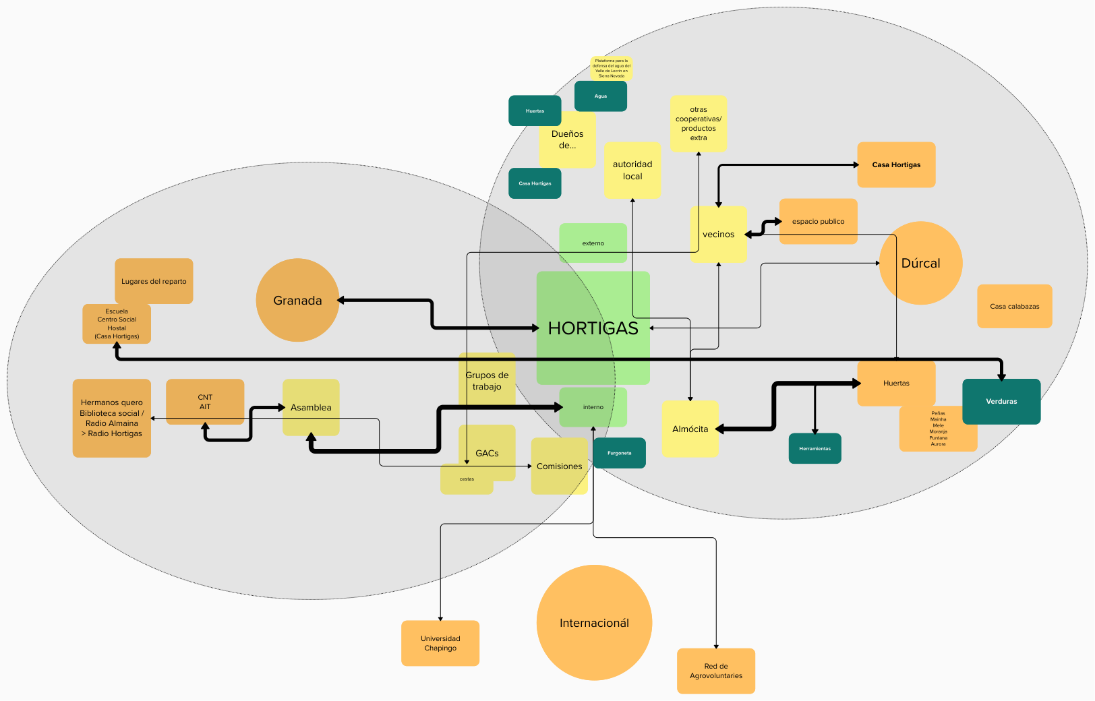
1.1 What are its elements, (power)relations and stakeholders?

Slide 6
Role and position of the stakeholders in terms of power and impact
 | (Local) authorities | Resource owners | Social Power Relations | Assembly
Power through… | Laws, definition of criteria for associations | Owning… Casa Hortigas Access to Water Fields | E.g. patriarchal mechanisms | Ability to make structural changes
Specific situation | Affects only 3 to 4 people working with employment contracts | No or low money-flows, ancient regulations based on values of Commoning | Awareness structurally implemented (“Comisión de Cuidados), Rotatory Systems | Consensus based
Impact

Slide 7
1.2 What challenges arise with regard to long-term functionality and what are ways of dealing with them?
1.3 What challenges arise regarding the peri-urban location and what are ways of dealing with them?
Internal Communication and Conflict-Management
Problem are not Conflicts itself but not knowing how to deal with them
→ Implementation of Conflict-Management
→ H.: „Comisión de Cuidados“
Inclusiveness
What’s your claim? Does the System you create work for everybody you want to address?
Financing
“We are not a company”
→situation-specific and flexible financial solutions and monitoring-strategies
→ H.: Finance-Commission “KAE”
Networking/ Agroecology as a political act
Peri-urban Area
Can’t live up to to claim of being transformative as one single project
→ Need of Network and Project-Model-Variety
→ “Hortigas no se encierra en su modelo”
Many vantages for urban and peri-urban area - but still not ideal
→ It takes more fields of play
→ H. e.g. inclusive to students and low-income-earners
same logic

Slide 8
Conclusion to Question Block 1
Inspirations and lessons-learned the Hortigas-Model can give respecting the similarities and differences between Hortigas and Buruiană:
internal and external organisation in the field of tension between the city and the surrounding area
way of making themselves as independent as possible from external influences and concentrating power into the consensus-based assembly
there should be a bypass strategy for each major challenge such as internal communication and conflict-management, Inclusiveness towards the people you want to reach and financing
For greater resilience and a broader common-good-movement it is important to act within a network and having different fields of play in the city and its region

Slide 9
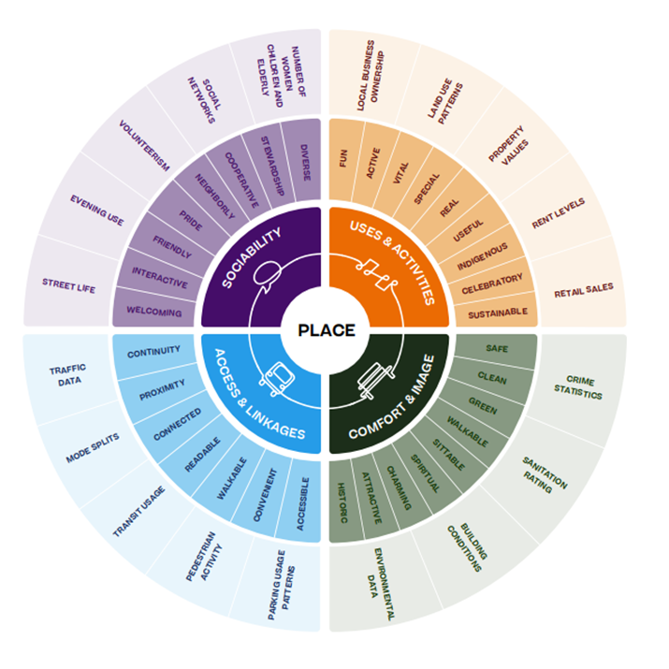
2. What are good case-study examples of events and activities to attract participants, new members and locals in the context of city inhabitants that are starting to learn about the existence and benefits of urban gardening/agriculture?
Theoretical reflections based on the concept of “sense of place”
subjective sense
Subjective meaning
Space
Place
(Project for Public Spaces 2022)

Slide 10
2. What are good case-study examples of events and activities to attract participants, new members and locals in the context of city inhabitants that are starting to learn about the existence and benefits of urban gardening/agriculture?
Internal Growth
External Growth
„GREAT PLACE“
VISIBILITY
Secondary benefit
Embedment into further topics and social contexts
→ Not only gardening – also attractive social space
Taking resistance serious
History of people is real and affects them
→ Showing a future that respects history while opening up new vision
Educational and Fun Activities
H.: Radio Hortigas, Presence in social library, Lectures/Workshops in Granada, Agri-Olympic-Games in Dúrcal, Partys
C.: Easter-treasure-hunt, Plant-swap-meetings, Urban gardening tours, cooking/fermentation/etc. -Events, Water-management-workshops, Concerts, Café, Intersectional activities
Makig use of bigger contexts/frames
Using existing platforms, Docking to larger events/guided tours
C.: Seedfestival, Eco-Hopping, Day of Music, „Rausgegangen“
Cooperations
With schools, unis, city, other gardens and initiatives, shops
H.: Agreement with University in Mexico, Visiting other Projects and Places/Spaces
C.: Lobbyism
Presence and Openness
Presence, Visibility, Being spotaneously accessible, Welcoming-Culture
H.: Volunteers, „estar con la mesa a fuera“, merchandise
C.: Visibility in the public space, Breakfast for Newcomers

Slide 11
Conclusion to question 2
Educational and Fun Activities with a secondary benefit can help to attract new participants
To also reach people who are starting to learn about the existence and benefits of urban gardening it is important to take their resistances serious and to show a future that respects their history while opening up a new vision
To keep participants involved and to let the project be a base of a successful collective empowerment there should be possibilities for everybody to representing themselves and to develop and shape the place
For more visibility and external growth, one should exude a welcoming openness and be present in situ
Further, it can be helpful to make use of bigger contexts and to dock to larger events or frames, as well as to create and work within cooperations with various actors
Reflection of aspects opened in Block 1 can…
    …also lead to internal and external growth
    …strengthen the base for starting the actions presented in Block 2, aiming for visibility and to becoming a “great place”

Slide 12
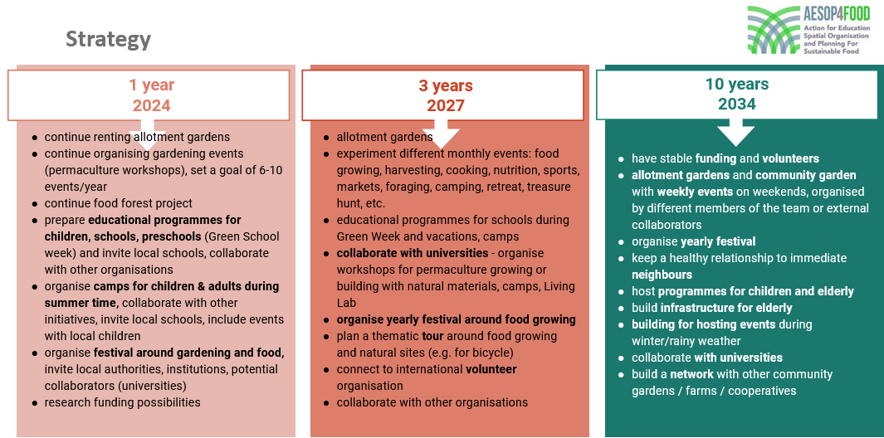
You are on a good way!

Slide 13
Sources
Bleasdale, T., Crouch, C., Harlan, S.L., 2011. Community gardening in disadvantaged neighborhoods in Phoenix, Arizona: Aligning programs with perceptions. Journal of Agriculture, Food Systems, and Community Development 1(3) (2011), 99-114.
Bogner, A., Littig, B., Menz, W., 2005. Das Experteninterview. Theorie, Methode, Anwendung. VS Verlag für Sozialwissenschaften, Wiesbaden.
Dias, N., Curvell, S., Bichard, E., 2014. The Current approach of Urban Design and its Implications for Sustainable Urban Development. Procedia Economics and Finance 18 (2014), 497 – 504.
Food and Agriculture Organization of the United Nations and RUAF Foundation, 2015. A vision for City Region Food Systems – Building sustainable and resilient city regions. https://www.fao.org/3/i4789e/i4789e.pdf, 07.06.2023.
Geels, F.W., 2006. Multi-Level perspective on System Innovation: Relevance for industrial transformation. In: Olsthoorn, X., Wieczorek, A.J. (Eds.), Understanding Industrial Transformation: Views from Different Disciplines. Springer, Dordrecht, 163–186.
Gläser, J., Laudel, G., 2010. Experteninterviews und qualitative Inhaltsanalyse. VS Verlag für Sozial-wissenschaften, Wiesbaden.
Markey, S., 2010. Primer on Place-Based Development. https://cdnregdev.files.wordpress.com/2011/10/primerplacebaseddevelopment-markey.pdf, 07.05.2023.
Owton, H., Allen-Collinson, J. 2014. Close But Not Too Close: Friendship as Method(ology) in Ethnographic Research Encounters. Journal of Contemporary Ethnography 43(3) (2014), 283-305.
Project for Public Spaces, 2022: Placemaking: What if we built our cities around places?. https://assets-global.website-files.com/581110f944272e4a11871c01/638a1fe260f36b92be75784f_2022%20placemaking%20booklet.pdf, 04.06.2023
Scannell, L., Gifford, R., 2009. Defining place attachment: A tripartite organizing framework. Journal of Environmental Psychology 30 (2010), 1–10.
Shamai, S., 1991. Sense of place: an Empirical Measurement. Geoforum 22 (1991), 347-358.
Strydom, W.J., 2014. Towards place-making in urban planning through participatory action research. Dissertation, North-West University, Südafrika.
Tillmann-Healy, L.M., 2003. Friendship as method. Qualitative Inquiry 9(5) (2003), 729-749.
Watson, J.R., Siska, P., Wolfel, R.L., 2013. Assessing Gains in Language Proficiency, Cross‐Cultural Competence, and Regional Awareness During Study Abroad: A Preliminary Study. Foreign Language Annals 46 (2013), 62-79.
Weedon, A., Ashley, T., 2020. Developing a Sense of Place: The Role of the Arts in Regenerating Communities. UCL Press, London.

Slide 14
Thank you for your attention!

