Slide 1



AESOP4Food
Sustainable Food
Planning Seminar
Bucharest Living Lab
Buruiană Community Garden
Ioana Elisabeta Enache, Romania, PhD candidate, UAUIM Bucharest
Adina Pasarel, Romania,
PhD candidate, USAMV Cluj
Tutor: Roxana Triboi
Final
presentation 2023
June 15, 2023

Slide 2
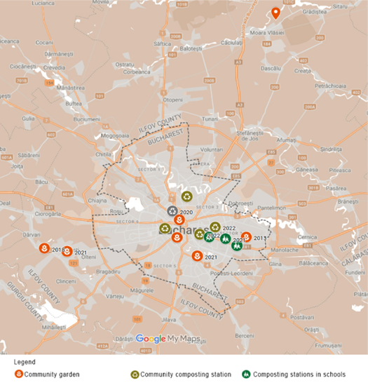
General introduction on the Llab - Bucharest
context
Context:
•Bucharest is subjected to suburban sprawl in the nearby regions, previously rural and agricultural regions.
•Most city inhabitants reject urban agriculture (UA) due to concerns on image, hygiene, odours from composting, health quality of produce due to pollution, as well as its association to poverty from communist times when urban agriculture was state mandated in order to provide the population with the necessary food supply.
•The growing interest of city inhabitants in sustainable practices and food growing in urban contexts can be observed in the presence of newly established community gardens and composting stations in and around the city area
•The Buruiană community garden is located in Domnești, 4 km away from the limit of Bucharest and the ring road surrounding the city.

Slide 3
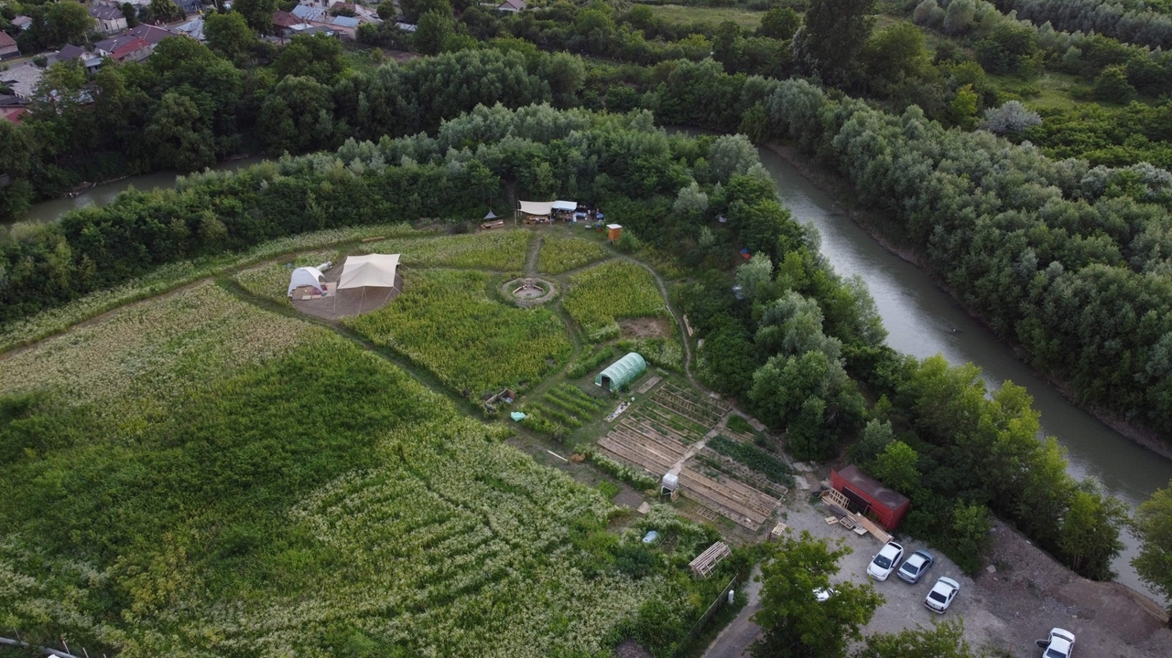
General introduction on the Llab - Buruiană Community Garden
•a bottom-up initiative of a group of young people who want to lead a sustainable lifestyle
•a space for growing food, education and socialisation following principles of regenerative agriculture and sustainable practices
•members have access to the community garden and/or allotment gardens inside the 9000 sqm plot, located next to a river and accessible by car
Challenges:
•involving new participants
•financial sustainability
•relationship with local authority
•time availability of organisers
Goals:
•developing a strategy for long-term functioning
•attracting members
•building collaborations
•financial sustainability.
Current strategy:
•applying for funding as an NGO
•existing food forest project that will be built gradually with participants in permaculture crash courses, workshops and other events
•the long-term plan is to also include a camping area, an open fireplace, toilets, parking spaces and a building for hosting events

Slide 4
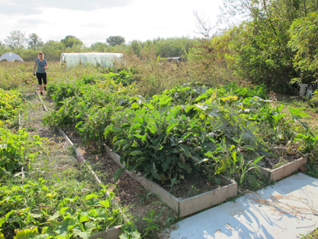

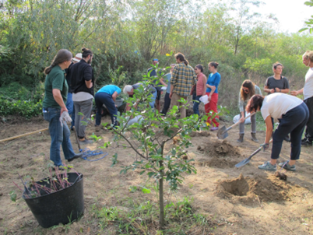
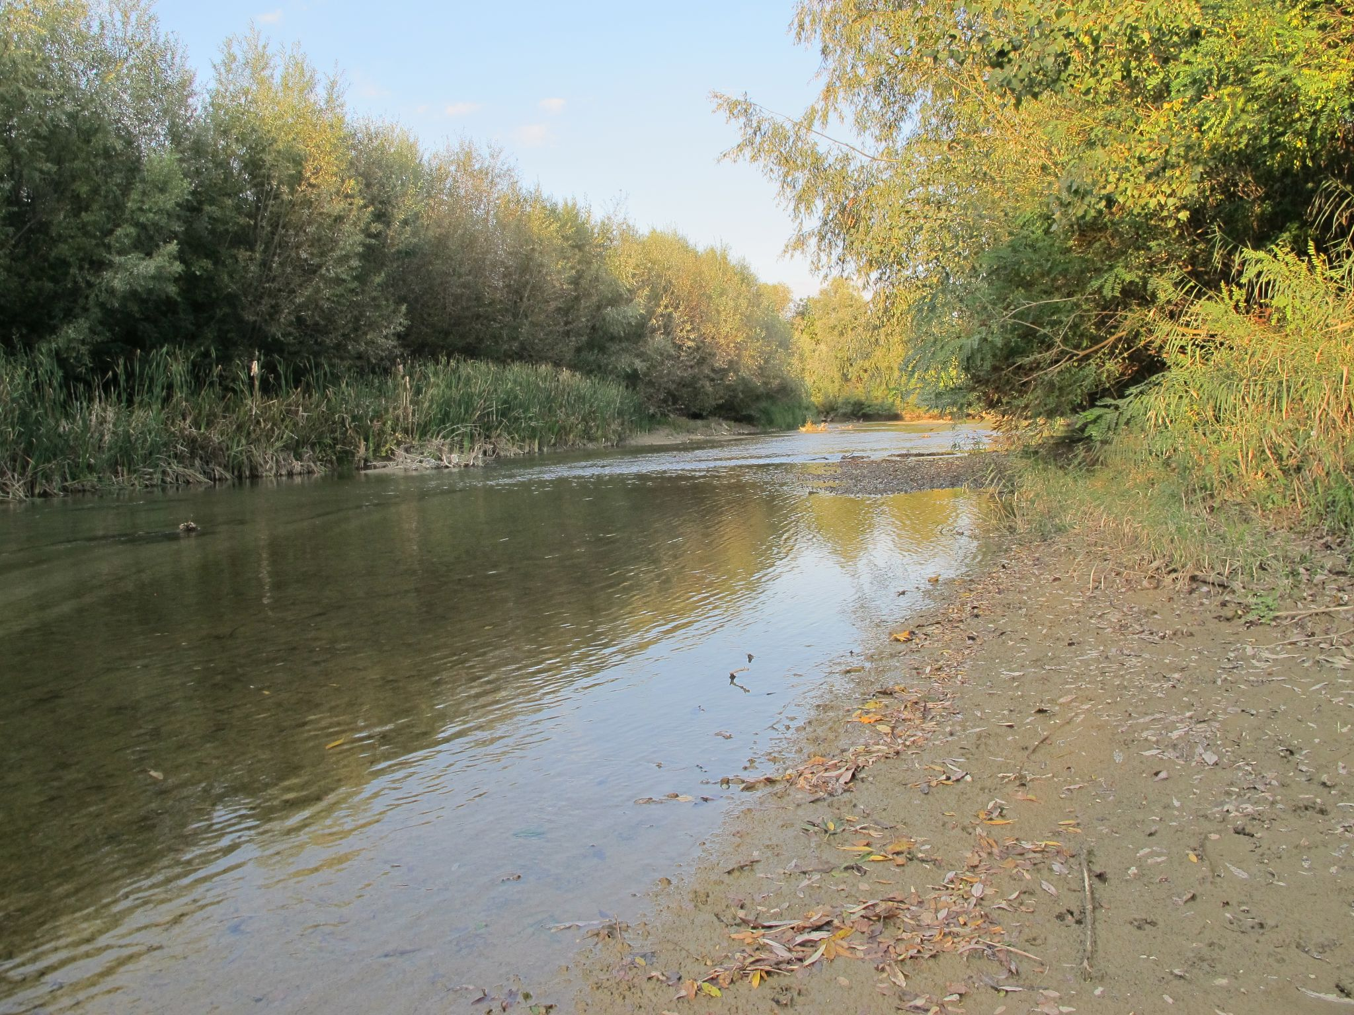
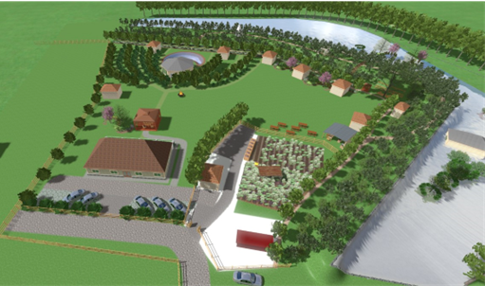
Buruină Community Garden SWOT Analysis
Lack of interest from authorities, city inhabitants
Physical distance to current target group - inner city inhabitants
Insufficient amenities, difficult accessibility for people with disabilities on site
Young busy team, growing community
Lack of funding
Natural landscape
Ownership of land
Agroecological ideals (care for nature and people,
inclusiveness, resilience, affordability)
Existing permaculture project
Strenghts
Weaknesses
Interest of city inhabitants for spending time in nature
Community with shared ideals
Suburbanisation (need of community spaces)
Strengthening local collaboration
Existing local agricultural practices
Education (Green Week)
Inclusion of vulnerable groups
European policies - environmental and food-related
Rejection from neighbours, locals, elderly (permaculture = “wilderness”)
Floodland, intervention from authorities
Lack of interest for members to join
Time required to manage such a project compared to time availability of organisers
Opportunities
Threats

Slide 5
Research aim and research questions
How to address the Eastern European and post-socialist context in an appropriate manner in order to support the development of UA in the form of community gardens?
What are good practice models for community gardens?
Case studies analysis by the remote students team
How to use the local resources for developing the sustainable food systems?
What can be done at local level to put in practice the EU public policies and initiatives like Urban Agenda in cities?
Ioana Enache - PhD thesis:
Urban Agriculture in the Periurban Area of Large Cities: Community Practices and Urban Planning
Adina Pasarel - PhD thesis:
Sustainable Development of Apuseni Mountains territory, based on the local resources

Slide 6
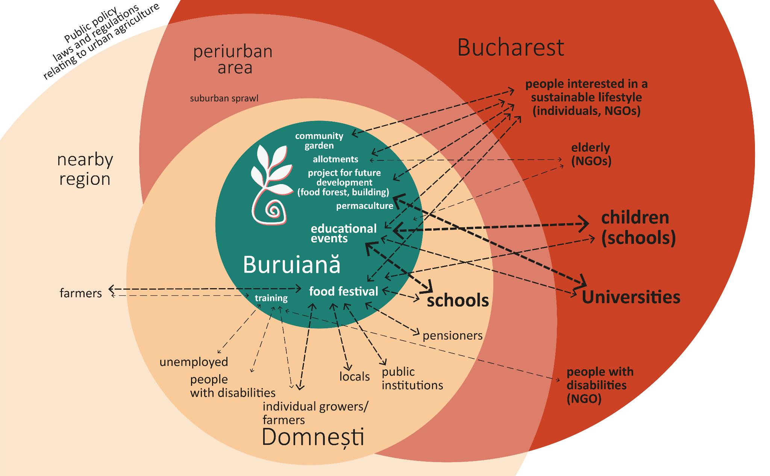
Stakeholders and potential partnerships map
Existing target group:
people interested in a sustainable lifestyle and gardening
Possible target groups and activities:
people with children, schools
interest in healthy food and outdoor activities, interest in proximity leisure possibilities
compulsory educational programmes in schools (Green School)
possibility to prepare educational programmes for children for the duration of a day / weekend / week
linking the community garden with local schools and residents
camping events for children
practical activities for university students

Slide 7
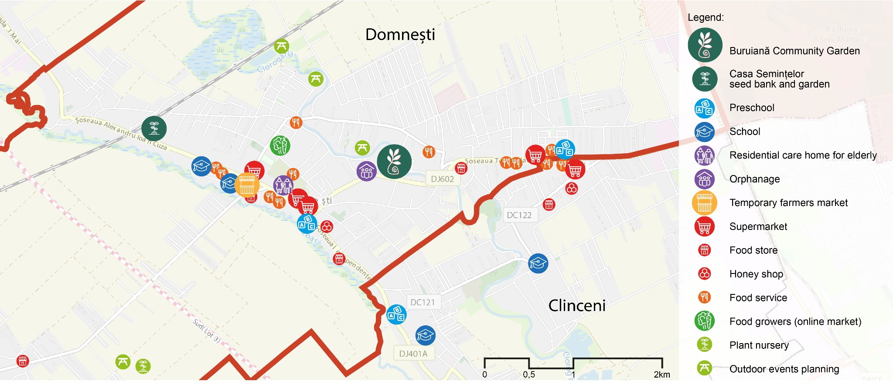
Local food system map
Sources: OpenStreetMap contributors; icons by Rudez Studio and hartadidesign from Noun Project (CCBY3.0)

Slide 8
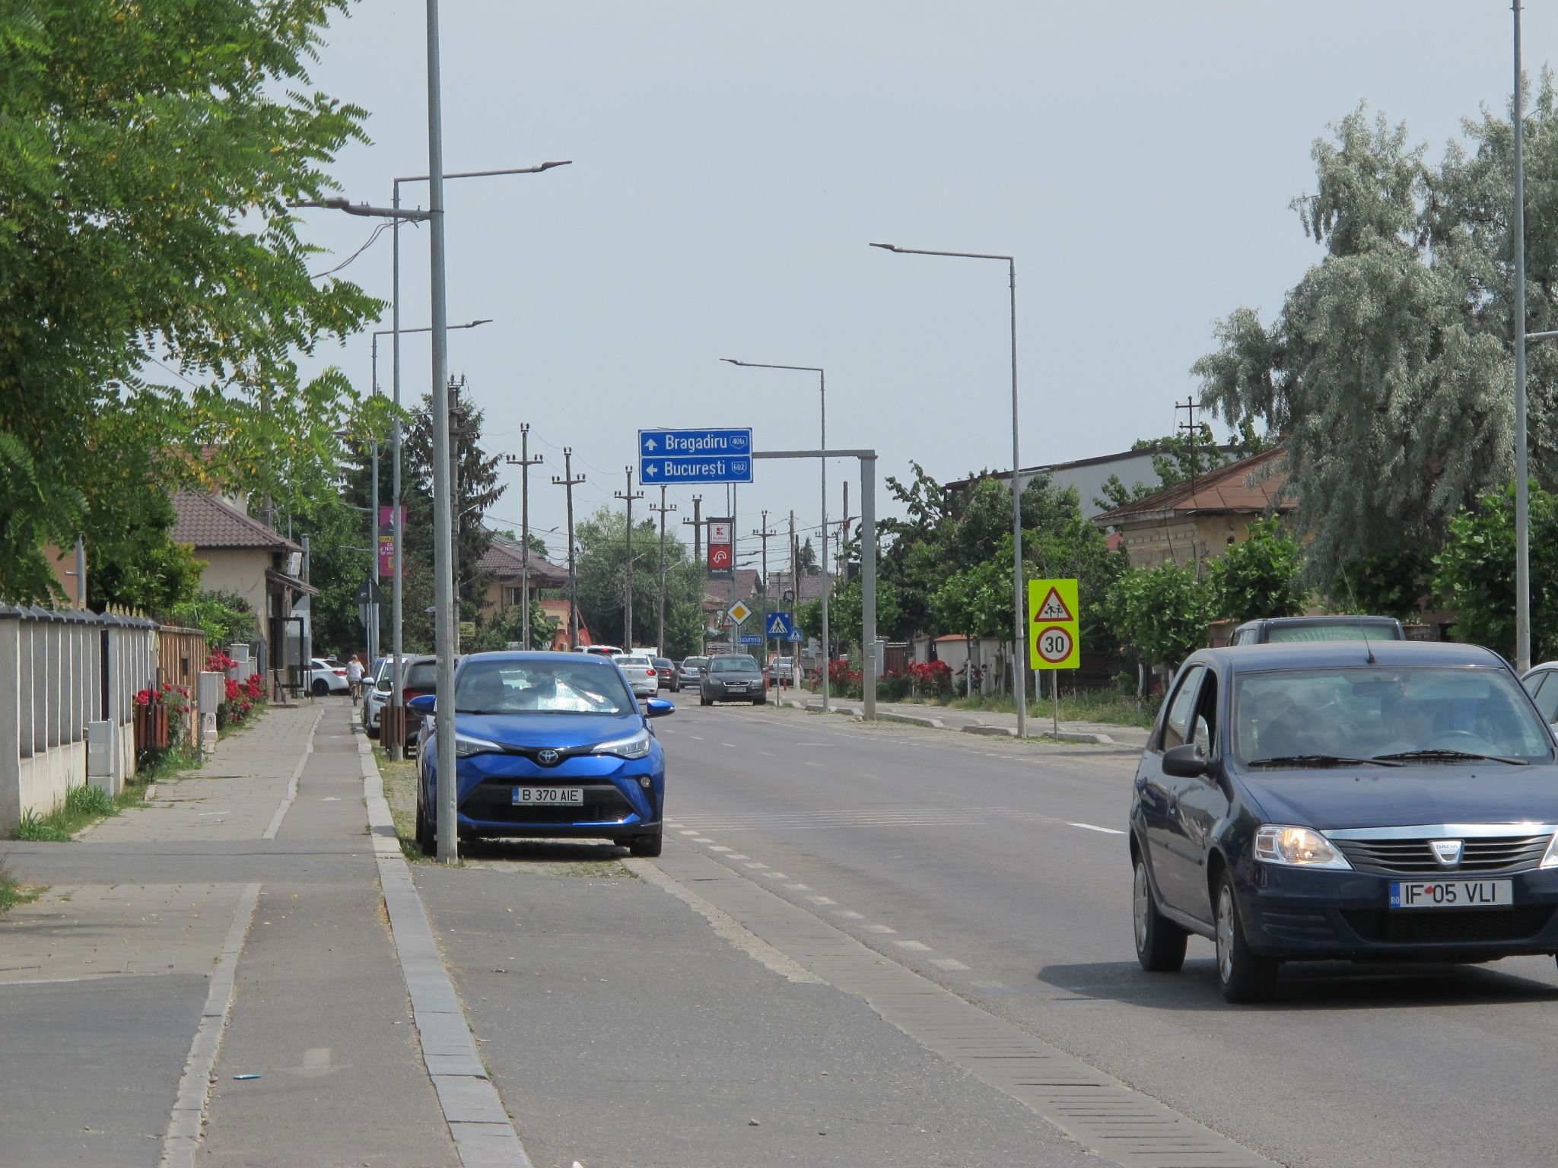
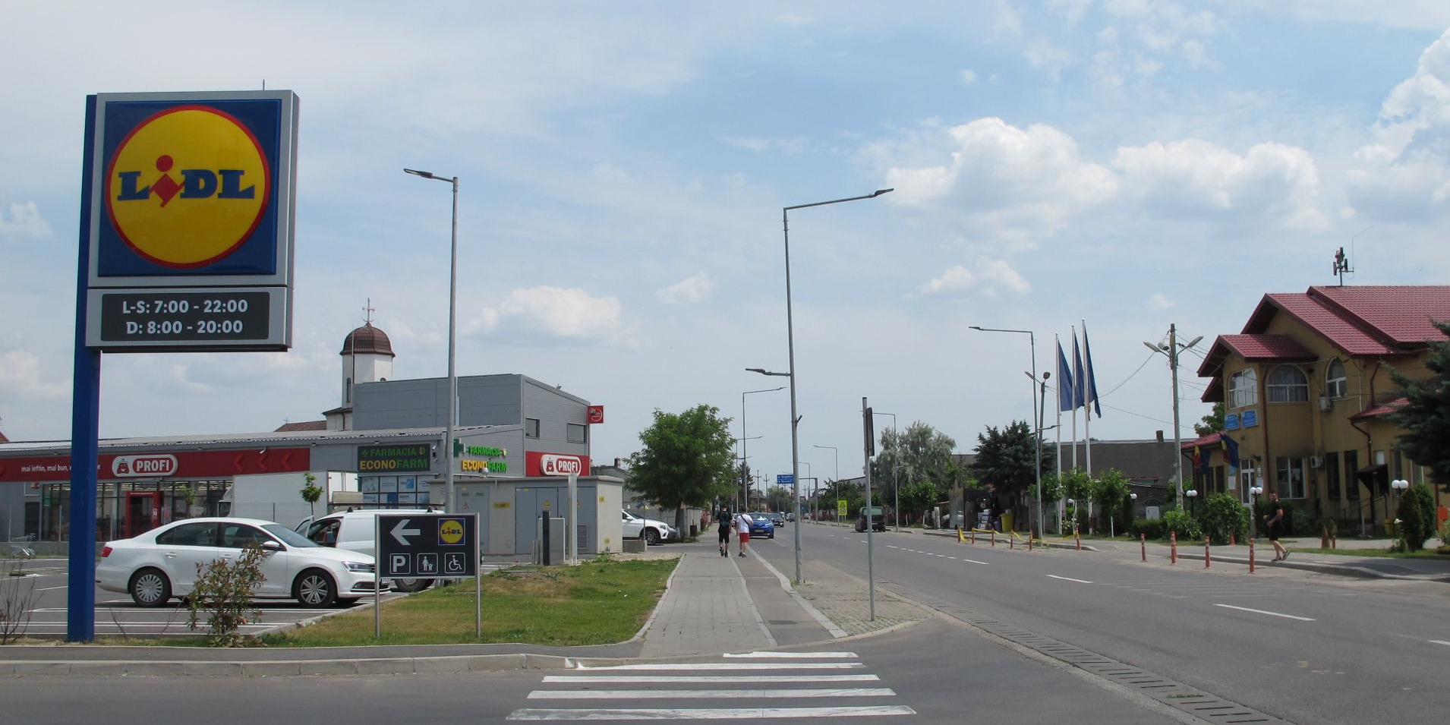
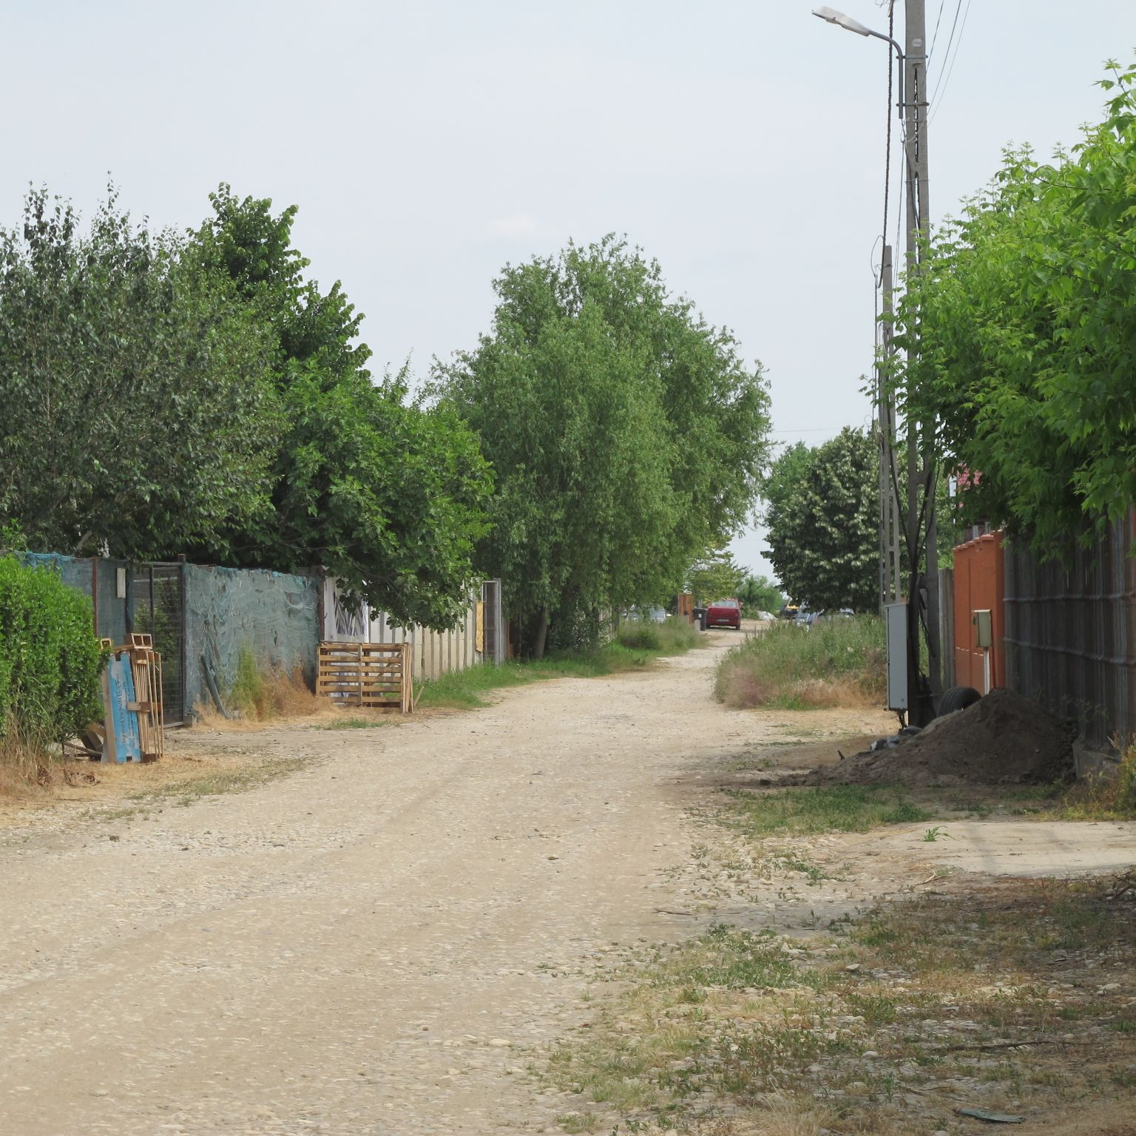
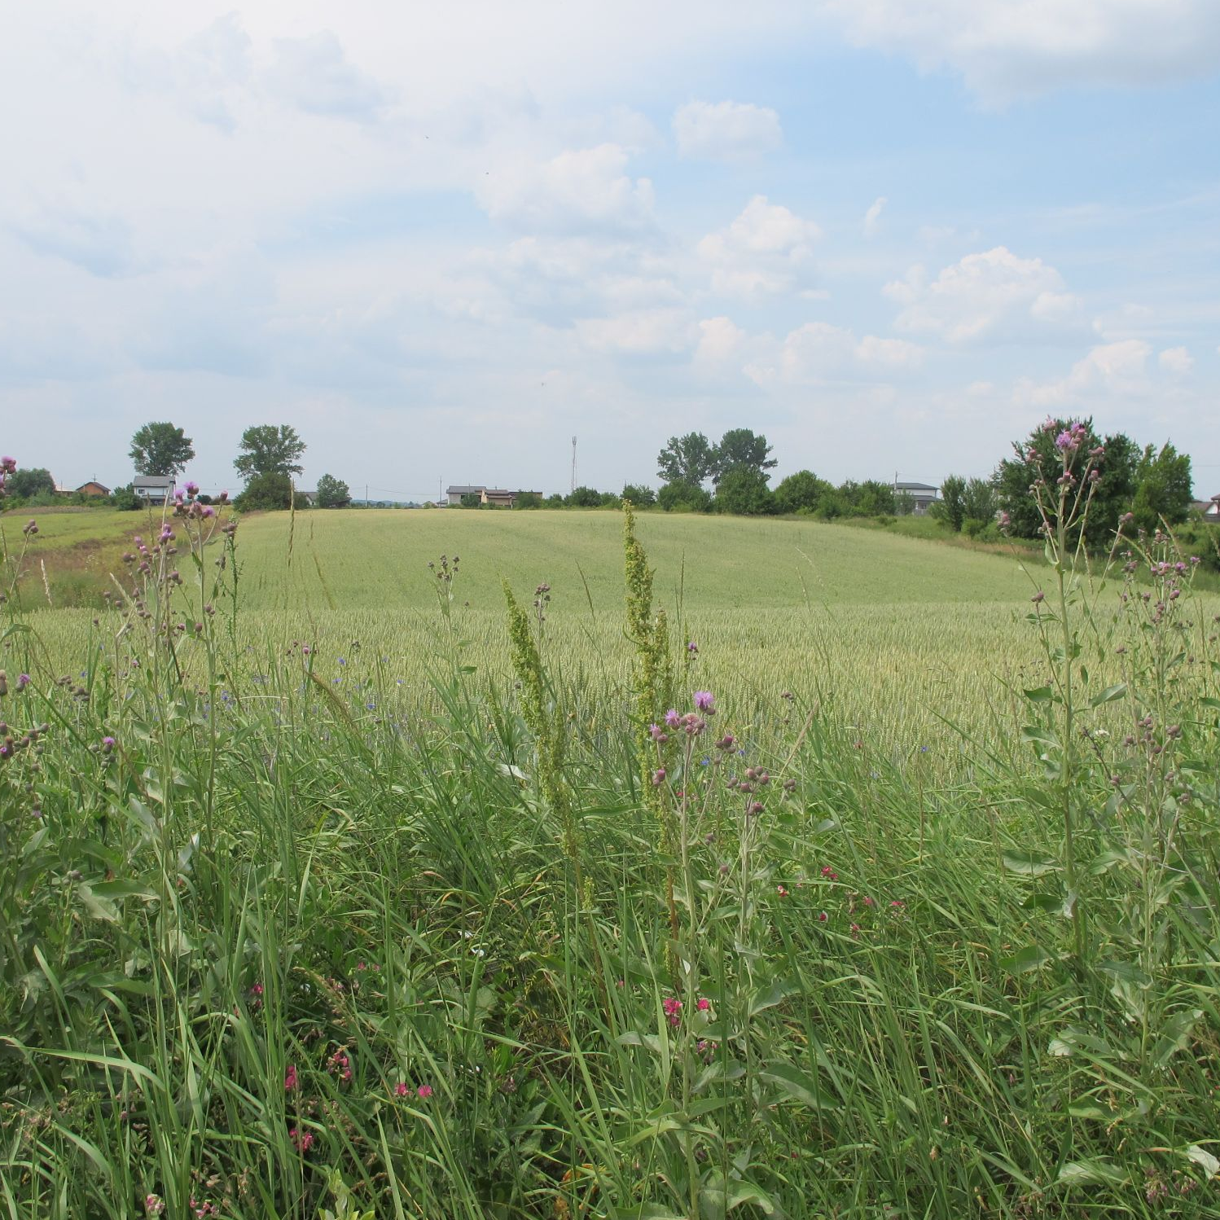
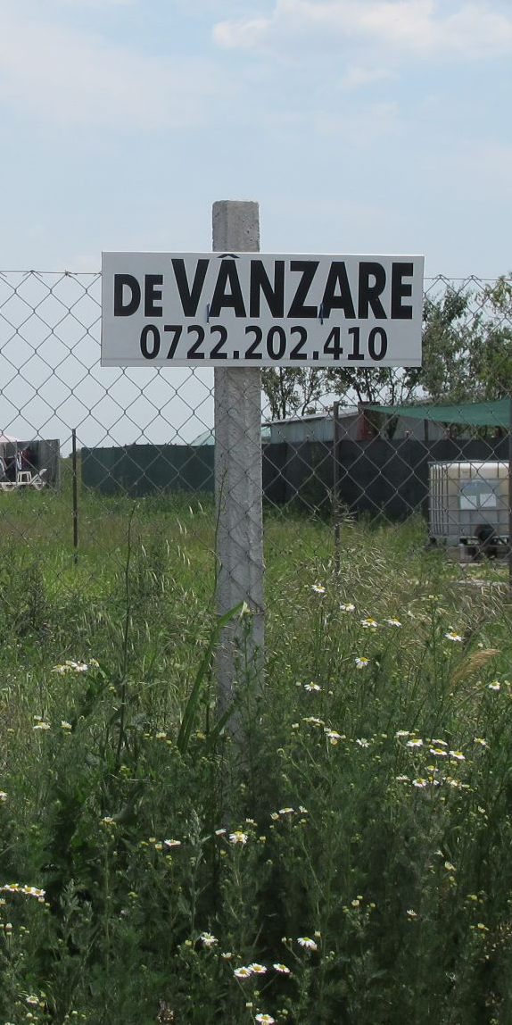
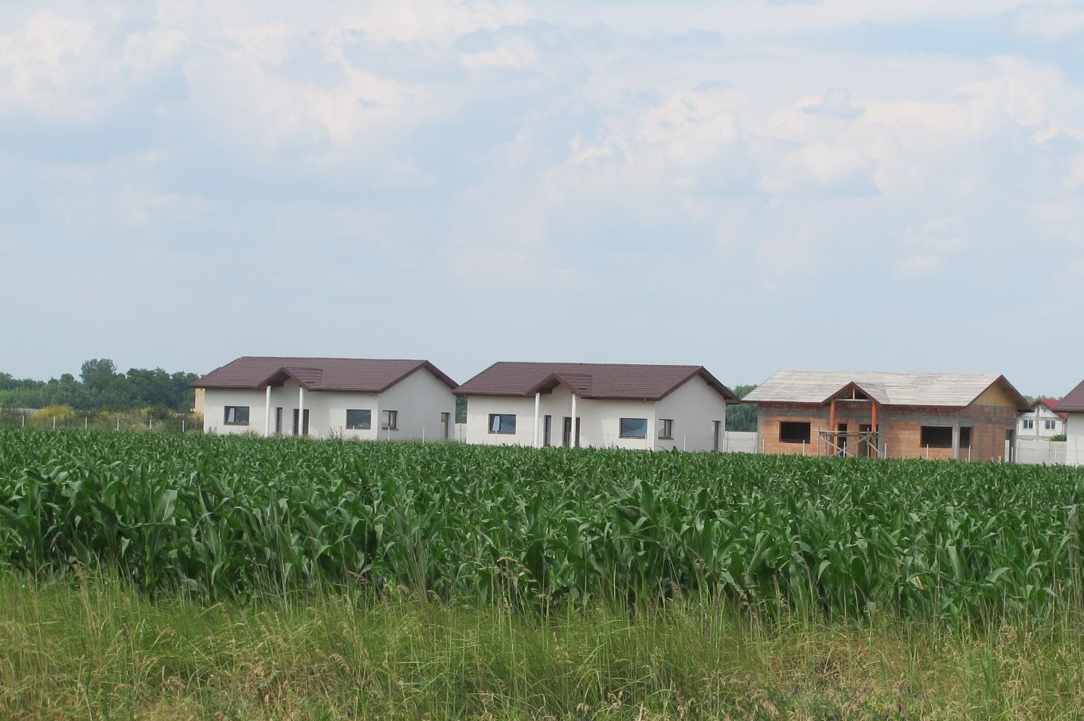
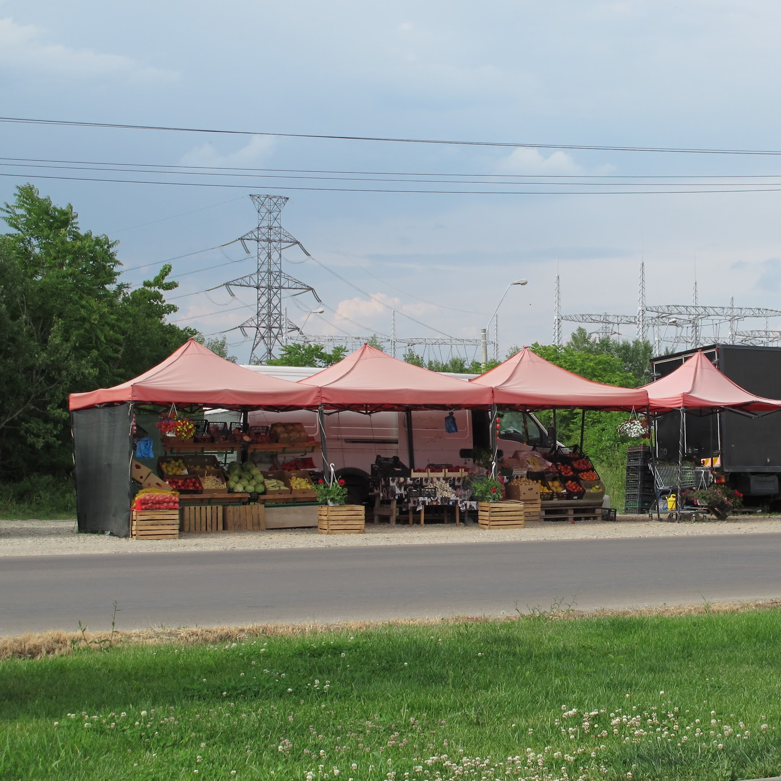
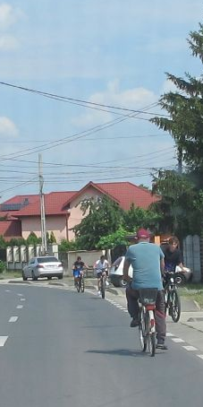
Landscape analysis and power map
Administration, laws and regulations, public policy
private investors (suburban development)
supermarkets
new residents
large-scale farmers
car, public transport
land for agriculture
informal markets
rural population
small-scale farmers
bicycle, train
Land use transformation

Slide 9
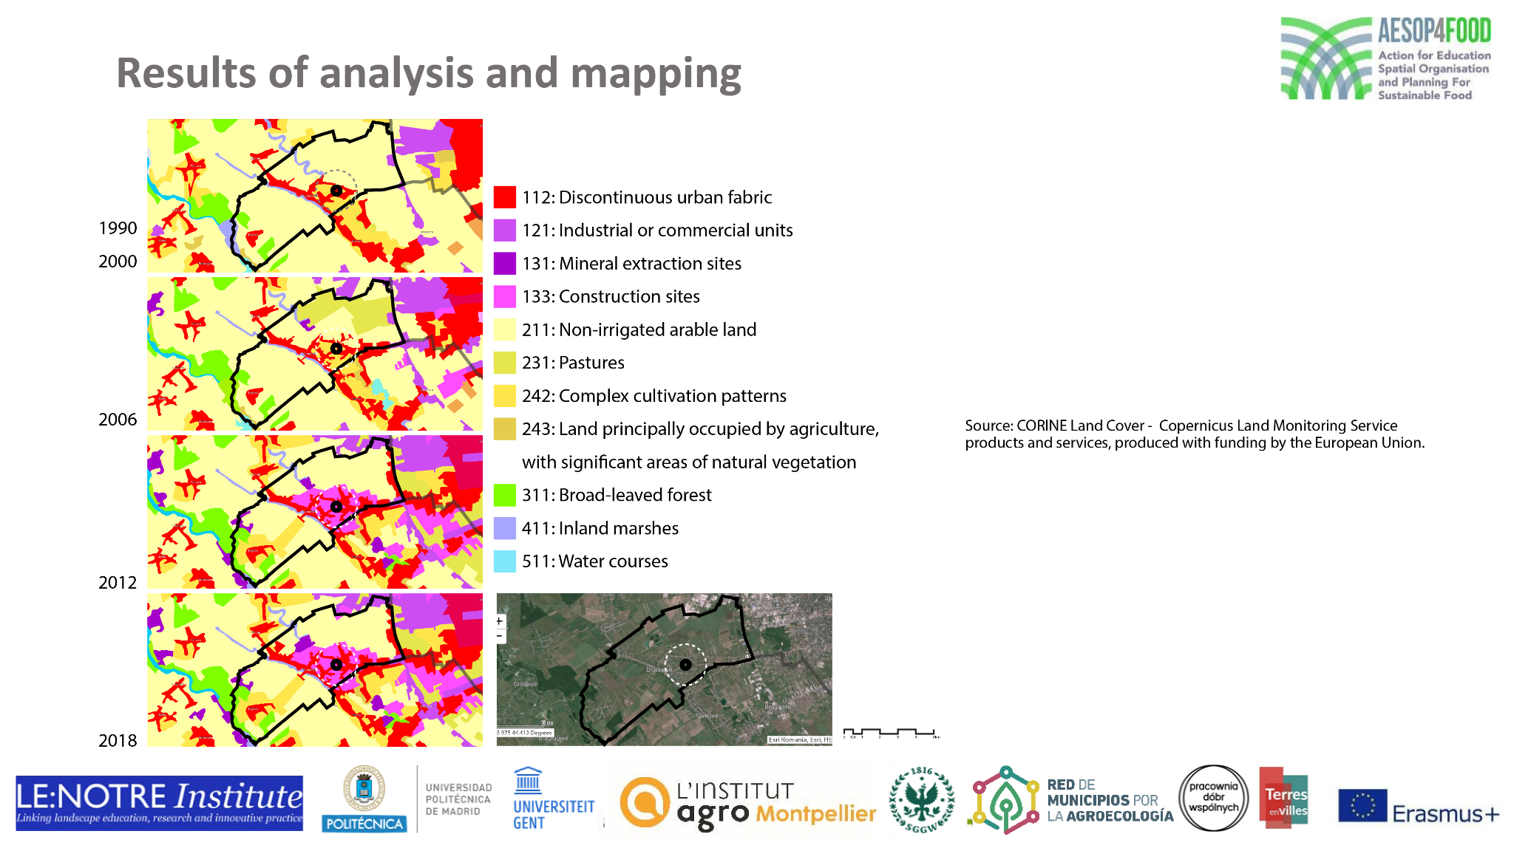
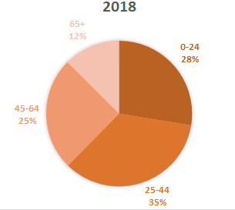
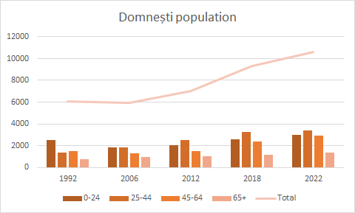
Land use transformation, statistical data analysis
Map legend:
Image source: CORINE Land Cover - Copernicus Land Monitoring Service products and services, produced with funding by the European Union.
Statistical data source: © 1998-2018 National Institute for Statistics - ROMANIA

Slide 10
Scientific literature review - situation in Romania
FoodPLand - Integrating food provision in urban policies in the context of land use transformation and displacement (Grădinaru, Iojă, 2022):
local authorities perceive the expansion of built environment as a factor for economic growth = urban planning is not designed to minimize the loss of agricultural land, abandonment of agricultural land in peri-urban areas affect short food chains | community gardens raise awareness on the importance of agricultural activities
family farms, traditional agricultural practices, local cultures, EU country with most small and subsistence farms | opportunity to learn from local traditional practice
lower financial return from agriculture, small farmers receive little support from state, import of cheap food, market competition (farmers markets, supermarkets), laws concerning food waste - voluntary activity of economic operators; | raise awareness on the struggles of local farmers, a place for connecting to customers
SmallGreen - Contribution of small urban green infrastructure in achieving environmental justice (Onose, 2022):
authorities do not understand ecological benefits provided by green spaces, aesthetic approach in planning; | education on importance of green spaces
in peripheral areas the green spaces belonging to single family homes are very small (because of the high price of land) and are being used for garages or pavilions; young families with children prefer single family homes in periurban areas; | create a community gathering space that encourages gardening at home
the mentality developed in communist times inhibits the civil society from being involved in decision making. | opportunity to encourage civic engagement
the study in neighborhoods in Bucharest with collective housing shows that the population is prepared and has an interest to be involved in urban planning, management and design of urban green spaces; | interest of city inhabitants for community gardens,
Grădinaru S. R., Iojă C. I., (2022) Integrarea preocupărilor privind furnizarea hranei în politicile urbane în contextul schimbărilor în utilizarea terenurilor și delocalizării producției alimentare, Raport final al proiectului PN-III-P1-1.1-PD-2019-0588. Centru de Cercetare a Mediului și Efectuarea Studiilor de Impact, Universitatea din București.
Onose D. A. (2022) Contribuția infrastructurii verzi de mici dimensiuni în asigurarea echității în mediile urbane, Raport final al proiectului PN-III-P1-1.1-TE-2019-1543. Centru de Cercetare a Mediului și Efectuarea Studiilor de Impact, Universitatea din București.
Notes:
to be rearranged

Slide 11
Collaborative goal setting and visioning
CHALLENGE:
Urban residents are not really engaged in community gardens,
these projects need some investment and participation to have a transformative role in the food system
VISION:
Peri-urban gardens are local initiatives and interaction accelerators and solicited by the urban residents that are really invested in process and participate regularly in the actions and events,
these kind of projects are flourishing on the outskirts of Bucharest, reinforcing local communities and ecosystems of actors and activities, improving life quality, and educating both city inhabitants of all ages and authorities
GOALS
Part of a network of institutions and organisations with similar values
Agenda of events and educational activities
Build collaboration with Universities for research and practical applications, Living Labs:
University of Agronomic Sciences and Veterinary Medicine of Bucharest
Create collaboration with other related organisations: cooking, camping, art, volunteers
Host educational programmes for schools and kindergartens (local and from the city) for day, weekend or week activities, class visits
Organise events (e. g. farmers market), moving towards local residents by inviting them to the festivity
Organise festival around food and agriculture

Slide 12
Strategy
1 year
2024
3 years
2027
10 years
2034
continue renting allotment gardens
continue organising gardening events (permaculture workshops), set a goal of 6-10 events/year
continue food forest project
prepare educational programmes for children, schools, preschools (Green School week) and invite local schools, collaborate with other organisations
organise camps for children & adults during summer time, collaborate with other initiatives, invite local schools, include events with local children
organise festival around gardening and food, invite local authorities, institutions, potential collaborators (universities)
research funding possibilities
allotment gardens
experiment different monthly events: food growing, harvesting, cooking, nutrition, sports, markets, foraging, camping, retreat, treasure hunt, etc.
educational programmes for schools during Green Week and vacations, camps
collaborate with universities - organise workshops for permaculture growing or building with natural materials, camps, Living Lab
organise yearly festival around food growing
plan a thematic tour around food growing and natural sites (e.g. for bicycle)
connect to international volunteer organisation
collaborate with other organisations
have stable funding and volunteers
allotment gardens and community garden with weekly events on weekends, organised by different members of the team or external collaborators
organise yearly festival
keep a healthy relationship to immediate neighbours
host programmes for children and elderly
build infrastructure for elderly
building for hosting events during winter/rainy weather
collaborate with universities
build a network with other community gardens / farms / cooperatives

Slide 13
ffunding possibilities / projects in partnerships
Education and Employment Program Romania
Open calls coming soon June /July 2023
Open calls for activities with students
Call 1 : Promoting the development of high-quality tertiary study programs, flexible and linked to the demands of the labor market - STUDENT INTERNSHIPS
Call 2 : Adaptation of educational services addressed to students and teaching staff in VET – Internships for students
Open call for activities with seniors
Keeping up", "Strengthening population participation in lifelong learning to facilitate transitions and mobility"
Open calls for Capacity Building
Call 1 : Strengthening social dialogue and partnerships for employment and training III - Civil society organizations
Call 2 Support for the establishment of social enterprises in the urban environment

Slide 14
Further action within the Living Lab
What is driving that change? How is it shaped? (cf. Scoones)
Citizen-led transformation
What is already in place? How are you building on this? What is missing? What is key (and cannot be left out)?
the garden, NGO
a growing community
set of values
growing the outreach
involving stakeholders building collaborations
financial sustainability
invested participants
What may follow? In 1 year, in 5, in 10? When will you consider this action to be successful?
What should it yield? How may it affect the food system?
financial sustainability
successful collaborations
agenda of events and activities
positive impact on the lifestyle of participants
changing mentalities and consumption patterns
pressuring decision makers

Slide 15
Collaborative monitoring and evaluation of the Living Lab groups
Adapt and use the results of the research to write projects for funding.
Reach out to potential partners
What have you learned as a group?
Collaboration is key
Next steps
One lesson learnt for each individual team member:
the importance of structure for the research and collaboration for the LL
Ioana
door to an international network /
Insights into the work of various actors
Carlotta
opportunity of understanding possible option of changing the food systems Adina
What is the personal reflection of each team member on the process and result?
very useful for my doctoral research, teamwork and managing skills; results are satisfactory, a larger local team would lead to a more in-depth approach - Ioana
inspiring content and perspectives, liberty in
research process, good communication/feedback
and support, assignment important for internalization, pleased with result - Carlotta
very useful for my PhD research on sustainable development
Adina

