Slide 1
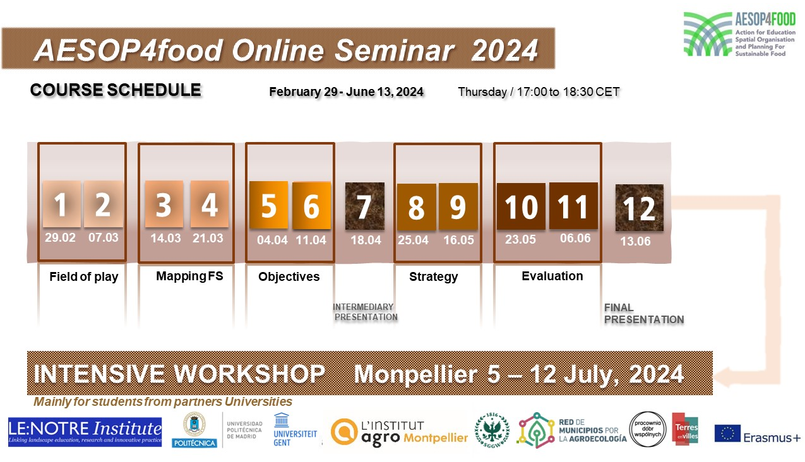

Slide 2
Phase V: Monitoring & Evaluation
Agenda:
17:00-17:10 Welcome
17:10-17:40 Theoretical and practical background of M & E methods
17:40-17:50 Survey
17:50-18:20 Exercise (padlet) in breakout rooms
18:20-18:30 Closing online lectures series

Slide 3
Phase V: Monitoring & Evaluation
Theoretical and practical background
Anna Podlasek, PhD. Eng.
Warsaw University of Life Sciences
06.06.2024

Slide 4
What is Monitoring & Evaluation?
Monitoring is a systematic process of keeping a close watch on a project’s progress, activities, and performance from start to finish.
Evaluation in its broadest sense refers to any systematic process to judge merit, worth or significance by combining evidence and values.
Monitoring and Evaluation (M&E) are complementary processes that work together to provide a comprehensive understanding of program performance and impact.

Slide 5
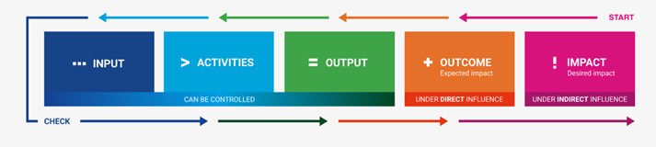
The result and chain concept
INPUTS
ACTIVITIES
OUTPUTS
OUTCOMES
IMPACTS
Each phase with feedback loops
What you put in? Values, tools, knowledge.
Input from the partners.
Resources needed to carry out activities
What you do?
Actions taken to transform inputs into outputs
Direct use of the intervention
The work accomplished by the project,
Usually a QUANTITY
Effects of activities for beneficiaries: Usually a CHANGE (behavioral change,
increased skills)
Higher order goals: social mission
Long-term consequences of the intervention
Image adapted from: Erasmus + Impact Tool

Slide 6
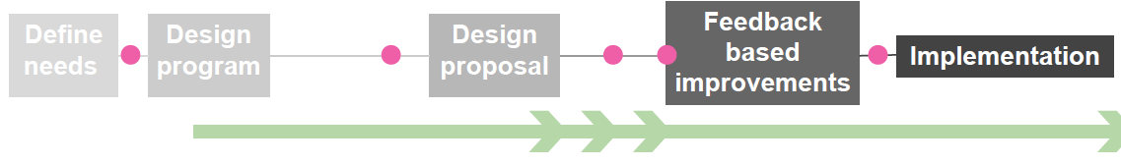


Monitoring & Evaluation
WHEN?
MONITORING
It keeps track of different parts of the process, with varying intensity
Continuous and systematic
Can continue after implementation
Is not a one-time activity but rather an ongoing process that runs parallel to program implementation. It provides real-time information and feedback to support effective management, decision-making, and adaptive programming throughout the life of a program.
EVALUATION
It happens in different parts of the process in order to evaluate what is being monitored
Systematic and punctual
It takes place at specific points during or after the completion of a program, project, or intervention

Slide 7
Monitoring & Evaluation
Element | Questions
Goals | What were the selected goals initially? Have the goals changed? Did the team add new goals throughout the process? What activities did you take to achieve these goals? What is the program’s current stage of implementing the goals? Were all goals achieved? If not, what were the obstacles? Were the selected indicators good enough to measure the success? What did we learn? What would you do differently next time?
Process | What is the program’s current stage of implementation? What were the milestones of the project? Were the different stages of the process coherent? Is the program being implemented the way it was intended? Did the process stay in its original direction or did the process change directions? Were the participants satisfied with the process? Was the process effective enough? Are the selected indicators good enough to measure success of the process? What did we learn? What would you do differently next time?
Output/Outcomes | What were the greatest outputs and outcomes of the project? Are they matching with the expected goals and objectives? Were the selected indicators effective in measuring the outcomes? Were the participants satisfied with the outputs and outcomes of the project? What did we learn? What would you do differently next time?
Tools and methods | Were the tool selected fitting to the targeted groups? Could the selected tools and methods engage all groups equally? Were the selected methods resulted in decent outcomes? Have the tools been efficient enough for the methodology selected? Were the selected indicators effective enough to measure the success of the tools and methods? What did we learn? What would you do differently next time?
Facilitation/Communication | Were the communication platforms equally distributed and involved in the process? Was everyone heard? Did everyone have an opportunity to share opinion? What is the level of satisfaction of various stakeholders? Did the communication used in the project affect the community outside the project? What impact would you expect in the community? Were the selected indicators effective enough? Did the project invent new communication platforms that was not intended? What did we learn? What would you do differently next time?

Slide 8
Monitoring & Evaluation
HOW?
Surveys
Interviews
Focus groups
Field observation
Feedbacks
Collecting data
Interactive games
Storytelling
Data analysis
Workshops

Slide 9
Evaluation for different purposes
formatively, to make improvements
summatively, to inform decisions about whether to start, continue, expand or stop an intervention
Type | Formative evaluation | Summative evaluation
Process evaluation | Focused on processes: intended to inform decisions about improving (primarily implementation) | Focused on processes: intended to inform decisions about stop/go
Impact evaluation | Focused on impact: intended to inform decisions about improving (primarily design characteristics) | Focused on impact: intended to inform decisions about stop/go
Notes:
Formative evaluation is not the same as process evaluation. Formative evaluation refers to the intended use of an evaluation (to make improvements); process evaluation refers to the focus of an evaluation (how it is being implemented).

Slide 10
Different types of evaluations
Done before, during and after implementation, including:
needs analysis —​ ​which analyses and prioritises needs to inform planning for an intervention​;
ex ante impact evaluation — which predicts the likely impacts of an intervention to inform resource allocation;
process evaluation —​ which examines the nature and quality of implementation of an intervention​;
outcome and impact evaluation —​ which examines the results of an intervention;​
sustained and emerging impacts evaluations —​ which examines the enduring impacts of an intervention some time after it has ended​;
value-for-money evaluations —​ which examines the relationship between the cost of an intervention and the value of its positive and negative impacts​;
syntheses of multiple evaluations —​ which combine evidence from multiple evaluations.

Slide 11
Conventional vs. Participatory evaluation
Conventional | Participatory
Conducted by external evaluators or experts with limited involvement from stakeholders. The evaluators design the evaluation, collect data, and interpret the findings. The evaluators have more control and authority over the evaluation process. Stakeholders are often seen as sources of information rather than active participants. The process is typically linear, with distinct phases such as planning, data collection, analysis, and reporting, often conducted by the evaluation team. Often focuses on accountability, assessing whether the project meets predefined objectives and outcomes. | Actively involves stakeholders, including beneficiaries, project staff, and community members, throughout the evaluation process. Aims to democratize the evaluation process by sharing power and decision-making authority with stakeholders, ensuring their perspectives and experiences are central to the evaluation. The process is more iterative and flexible, with ongoing feedback loops and continuous engagement with stakeholders. It adapts to the context and needs of the participants. Emphasizes learning and improvement, fostering a deeper understanding of the project's processes and effects from the stakeholders' perspectives. It often aims to build capacity and empower stakeholders through the evaluation process.

Slide 12
Benefits of Participatory evaluation
Make use of local knowledge;
Builds the capacity, promotes learning, increases understanding;
Can contribute to improved communications;
Builds mutual responsibility;
Empower people.

Slide 13
Participatory evaluation
Five key ways according to Campilan (2000):
Why evaluate? → learning for the program/project
How to evaluate? → as a common process, adaptive, semi-structured
Who evaluates? → representatives of the community, internal staff, external evaluators, a hybrid team
What to evaluate? → criteria discussed focusing on the goals, process and outcomes
For whom evaluation is being done? → for the community to learn, stakeholder groups
Source: https://www.betterevaluation.org/en/plan/approach/participatory_evaluation

Slide 14
Participatory evaluation
There are a number of ways to use participatory methods:
To collect qualitative and quantitative impact data
To investigate causality, for example through focus group discussions or interviews
To negotiate differences and to validate key findings
To score people’s appreciation of an intervention’s impact
To assess impacts in relation to wider developments in the intervention area

Slide 15
Indicators
1
To what extent our goals and targets are met?
2
What progress is made?
3
Is the change we are interested in hapenning?
Indicators
Quantitative
Qualitative
Number of: people involved, participants, meeting held, tools used, feedback received
Percentage of: groups/tools and methods/positive feedbacks received
Type or level of people involved/participants/meetings held/elements/tools used/satisfaction
Proportion or type of: groups/tools and methods/feedbacks received

Slide 16
SELF-EVALUATION
Valuable tool for assessing your progress, identifying areas for improvement, and your performance in a project
1. Reflection: Consider what went well, what challenges you faced, and what lessons you learned.
2. Goal Assessment: Determine if you achieved your objectives and if not, identify the reasons behind any shortcomings.
3. SWOT Analysis: Conduct a SWOT (Strengths, Weaknesses, Opportunities, Threats) in terms of skills, knowledge, and resources.
4. Feedback Analysis: Seek feedback from colleagues, team members, or supervisors who were involved in the project. Request constructive criticism about your performance, communication, teamwork, and overall contribution.
5. Documentation Review: Analyze the project documentation, such as project plans, reports, and milestones. Assess how well you adhered to the established plans and timelines. Evaluate the quality and accuracy of your work and identify any areas where you could have improved.
6. Self-Assessment Questionnaires: Use self-assessment questionnaires or checklists tailored to project management or specific project roles.
7. Peer Evaluation: Collaborate with your project team members to conduct peer evaluations. Allow them to provide feedback on your performance and contributions. This process can give you a different perspective and highlight areas for improvement that you might not have considered.
8. Metrics and Key Performance Indicators (KPIs): Evaluate your performance based on these quantifiable measures. Analyze trends, variances, and any gaps between the actual results and the desired targets.
9. Self-Reflection Journal: Maintain a journal throughout the project, documenting your thoughts, challenges, successes, and failures. Regularly review your journal to identify patterns, track your progress, and gain insights into your personal growth.
10. Continuous Learning and Development: Embrace a growth mindset and actively seek opportunities for continuous learning and development. Engage in training, workshops, or online courses relevant to your project or area of expertise. Regularly update your knowledge and skills to improve future project performance.

Slide 17

Exercise for self-evaluation
Traffic Light Reflection: Use the traffic light colors (red, yellow, green) as a framework for self-evaluation.
  Red Light (Stop): Identify one aspect of your performance or work that you feel needs improvement or didn't meet your expectations. It could be a challenge you faced, a concept you struggled with, or an area where you feel unsure.
  Yellow Light (Caution): Identify one aspect of your performance or work that you feel was average or could be improved. This could be an area where you have made progress but still have room to grow.
  Green Light (Go): Identify one aspect of your performance or work that you feel was a strength or a significant achievement. This could be a skill you demonstrated effectively, or a positive outcome you achieved.
Reflection and Action: Reflect on your red, yellow, and green light areas. Suggest specific actions or strategies you can take to address the red and yellow light areas and continue building on their green light areas.
Sharing and Discussion: Share your reflections and actions. Discuss common challenges, offer suggestions, and support each other in their growth areas.

Slide 18
Nominal Group Technique (NGT)
Structured group discussion method used to generate and prioritize ideas or make decisions. NGT provides a structured and inclusive approach to group decision making, idea generation, and problem-solving, allowing for a balance between individual input and group consensus.
Brainstorming and Idea Generation
Ranking or Prioritizing Options
Decision Making
Problem Solving
Needs Assessment

Slide 19
Tools for participatory research
Card visualization
Smiley-face scale
Testominials/stories
Impact drawings
Historical timeline
Social mapping
Trend analysis
Force-field analysis
Ideal for encouraging participation, discussion, interaction, group and individual discovery, and learning.
Especially appropriate for empowering people to formulate and share views and experience.

Slide 20
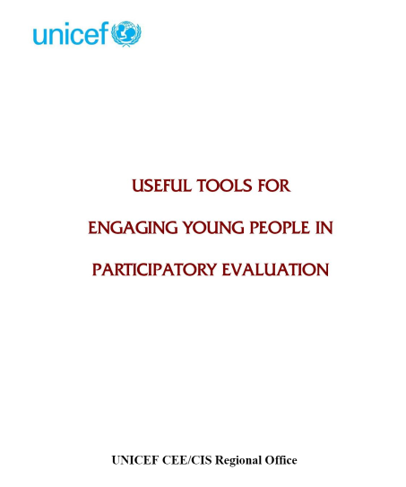
Compulsory reading:
UNICEF (2005) Useful Tools for Engaging Young People in Participatory Evaluation. UNICEF CEE/CIS Regional Office. Retrieved from http://issuu.com/learneasy/docs/tools-for-participatory-evaluation

Slide 21
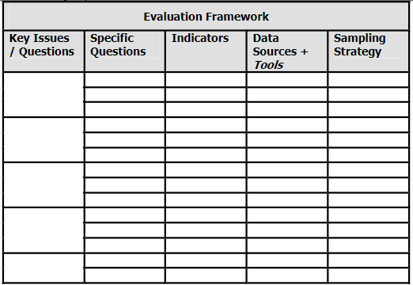
Classical evaluation tools
#1 Evaluation framework
Purpose is to determine key research questions and to develop a data collection strategy to answer them.
It is useful to prepare an evaluation framework with specific research questions, together with indicator, the sources of data for each question and the evaluation tools to be used for each data source
Sample questions: Typically the key issues covered are: relevance, effectiveness, impact and sustainability
  Do stakeholders care about the project and believe it make sense? (relevance)
  Is the project achieving the intended results? (effectiveness)
  What effects has the project had on the broader context, e.g. stakeholder groups, communities ? (impact)
  What evidence is there that the results or activities of the project will continue beyond the project lifetime ? (sustainability)

Slide 22

Classical evaluation tools
#2 Questionnaires
Purpose is to collect quantitative and sometimes qualitative information on specific questions from a large number of respondents.
A questionnaire is a structured group of questions to gather information in a consistent way with each respondent.
Questions are either fixed-response questions where the respondent is asked to choose one or more answers from those provided or they are open-ended, free response questions where the respondents answer in their own words.
Four point scale: strongly agree, agree, disagree, strongly disagree oblige respondent to take a side. Resuts can be analyzed quantitatively.
Five point scale adds neutral in between agree and disagree. Resuts can be analyzed quantitatively.
It is important to add „Don’t know option” to avoid forcing a respondent to give an opinion they don’t really have.

Slide 23
Classical evaluation tools
#2 Questionnaires
The questionnaire should be deigned to be quick and painless as possible for the respondent.
How your questionnaire are formulated will be absolutely critical to the quality of the data collected.
Tips:
  Check every question to make sure it is not a double or multiple question
  Check clarity of questions – word them as simply as possible
  Make sure that questions cannot have more than one meaning
  Arrange questions in a logical sequence, to the extent posssible with the easier ones first
  Check how long it takes to complete
  Make the questionnaire visually attractive

Slide 24
Classical evaluation tools
#3 Key Informant Interviews
Are designed to obtain information on specific research questions.
„Key informants” are people who have extensive experience and knowledge on one or more topics of interest of evaluation.
It is often useful to prepare a data collection instrument or a brief interview guide beforehand, to ensure that all key points are covered. This can be shared with the respondent ahead of time to give the opportunity to organize thoughts before the interview.
Any questions that may be difficult or sensitive should be left until the end of the interview.
15-60 minutes for the interview depending on the age, knowledge and the availability of the respondent.
Avoid closed questions (they limit discussion), double-barelled or multiple questions (confusing) and be careful to avoid leading questions that suggest the answer.

Slide 25
Classical evaluation tools
#3 Key Informant Interviews
If well conducted can also lead to an interesting exchange of ideas, benefitting both parties. Can also built suport for the project by opening up avenues of discussion and awareness.
Provides an opportunity to test theories inherent in the project or in the evaluation or that have come up in the course of evaluation, as well as opportunities to triangulate and verify othe point of view.
Good interviewers use:
Open questions, e.g. „Tell me about your feeling about the AESOP course”.
Probing questions, e.g. „Why do you say the AESOP course was effective?”

Slide 26
Classical evaluation tools
#3 Key Informant Interviews
Related tools:
  Group interview: similar to the individual interview but with a group sharing similar characteristics and experiences. This has the advantage of promoting discussion of various opinions and attitudes. Ideally the numer of persons in a group interview should be limited to 10-12.
  Field observation: An observation guide can help the observer record their observations of community process and other aspects of the project that are of interest to the evaluation.

Slide 27
Classical evaluation tools
#4 Focus group
Designed to collect data in a social context where people can consider their own views in the context of the view of other.
Focus groups allow specific topics to be explored in depth with a group of selected individuals.
Focus group are useful for:
  Determining stakeholders’ preferences
  Understanding programme implementation problems
  Developing recommendations and suggestions exploring a range of views on a particular subject

Slide 28
Classical evaluation tools
#4 Focus group
Questions are always open ended. They are best because they allow participants to tell the story in their own words.
Avoid quantifiers such as „How much” as they tend to restrict answers.
Avoid questions with a „yes” or „no” answers.
„Why” questions are not common because are often too directive and they tend to put people on the defensive.
The session should be an overall discussion (participants should not have the impression that they finished one question an are asked to another, the sequence of questions should flow naturally from one to another).

Slide 29
Classical evaluation tools
#4 Focus group
Sample questions: „What did you think about the AESOP course?”, „What did you like best about this course?”
A facilitator is required who can direct the process, controlling who dominates the conversation, and drawing out the shy ones.
Well-conducted focus groups are enjoyable for the participants.
Cost-effective: in one hour you can get data from 6-10 people instead of one.
Important tools in collaborative and empowerement evaluation.

Slide 30
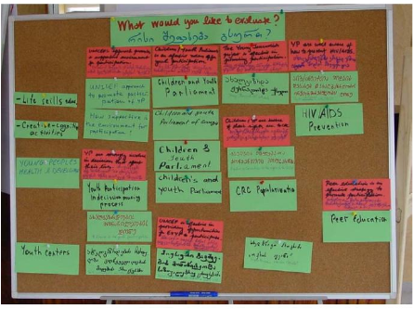
Tools for participatory research
#5 Card visualization
Brainstorming individual ideas and converting these into several overall ideas that represent a group consensus.
What is needed? Pin board of flipchart, coloured cards, marker.
Different coloured cards for different questions.
Sample questions: „What aspect of this course you like the most?”, „What does participation mean to you?”
Visualizes the discussion for everyone, and ensure transparency.
Leaves a written trace – easy to document.
Excellent method for synthesizing group ideas.
Source: UNICEF (2005) Useful Tools for Engaging Young People in Participatory Evaluation

Slide 31
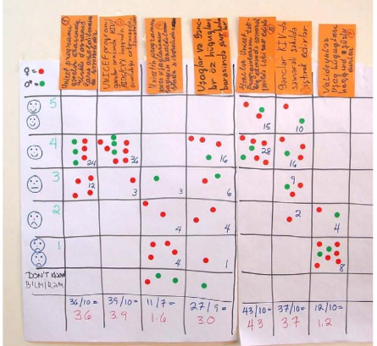
Tools for participatory research
#6 Smiley-face scale
Quantitative group evaluation of specific research questions.
The research questions must be formulated as positive statements of opinion that can be evaluated by stakeholders according to whether they „strongly agree = 5”, „agree = 4” „are neutral = 3” „disagree” = 2, „strongly disagree” = 1 or „don’t know” = 0
Sample statement: „AESOP course is effective”.
One voting per one statement to be evaluated.
The participants can be devided into groups.
Easy to analyse and interpret.
Provides immediate results.
Source: UNICEF (2005) Useful Tools for Engaging Young People in Participatory Evaluation

Slide 32
Tools for participatory research
#7 Testimonials/stories
Purpose is to gather targeted life stories with critical key points – in depth stories, and give meaning to salient issues behind the general qualitative and quantitative data.
Bring personal, human angle perspective to evaluations.
Inherently subjective and are not generally used as a sole source of information.
Can corroborate other sources of data and provide more in-depth insights.
Testomonials are presented in the first person, narrative style.
Sample question: „I’d like to invite you to talk about how you became involved in the project and what difference it has made to you”.
Testimonials add a personal and human element to the evaluation process by capturing real-life stories and experiences. They provide valuable qualitative data that complements quantitative measures and helps paint a more comprehensive picture of the project's effectiveness and impact. Testimonials can be powerful tools for advocacy, fundraising, and decision-making, as they showcase the tangible benefits and outcomes of the educational project.

Slide 33
Tools for participatory research
#8 Taking stock
Comprehensive and systematic assessment of an educational project or program. It involves examining various aspects, such as goals, activities, outcomes, and impacts, by analyzing data, conducting interviews, and reviewing documentation. It takes a broader perspective to understand the overall performance and effectiveness of the project.
Involve collecting data from multiple sources, such as project documents, reports, financial records, interviews, surveys, and other relevant data. This data is analyzed to identify patterns, trends, and key findings that contribute to a comprehensive assessment of the project.

Slide 34
Tools for participatory research
#9 Impact drawings
Tool to boost reflection and creativity.
Can be used to describe past, present or future situations.
10 minutes for the drawings, 1-2 minutes for the succinct presentations.
Sample question: „Draw how participation in the project has changed you”.
Great opportunity for creativity and sharing on a very personal level.
The time for reflection and drawing really opens people up, with the result that the stories that are shared are far more personal.
Not appropriate for more reserved stakeholders, who may feel inhibited or may take themselves bit seriously (e.g. government officials).

Slide 35
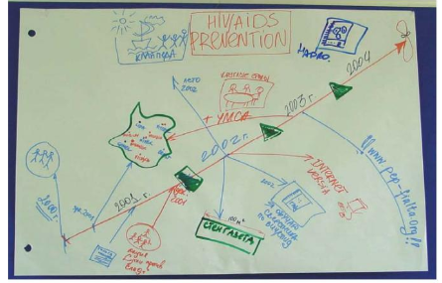
Tools for participatory research
#10 Historical timeline
To understand the evolution of a project and record important events over time from a perspective of the stakeholders.
Sample questions: „Describe the evolution of your project by drawing a historical timeline, recording the most important development, and key milestones and dates”. „Describe the evolution of your LL”.
Interactive process encourages reflection, generates ideas, and stimulate discussion.
Helps teams to organize their thoughts and history.
Related tools:
  Impact timeline: a combination of historical timelines and impact drawings, where participants individually draw how they have evolved over time.
Source: UNICEF (2005) Useful Tools for Engaging Young People in Participatory Evaluation

Slide 36
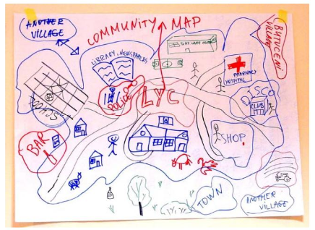
Tools for participatory research
#11 Social mapping/ community mapping
To understand the context in which a project operates, as well as people’s perception of their environment and resources for dealing with them.
Not analytical tool (only descriptive).
Involves stakeholders in drawing maps of community structures, institutions, associations, kinship groupings, boundaries and resources.
Sample question: „Draw a map describing all the important elements of the context in which your LL is operating”.
Venn diagram: circles of various sizes are cut out of coloured paper and given to the group of stakeholders who are asked to allocate them according to different institutions, community structures and resources, with the most important elements represented by larger circles. The overlap between the circles shows the degree of contact between the groups.
Tool for assessing stakeholders’ perceptions of relationships with a community.
Source: UNICEF (2005) Useful Tools for Engaging Young People in Participatory Evaluation

Slide 37
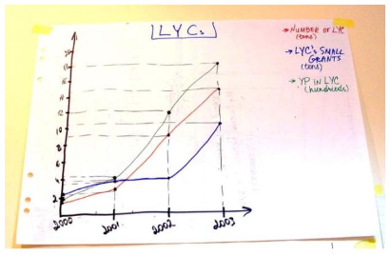
Tools for participatory research
#12 Trend analysis
To track changes in one or more project parameters over time.
Can track multiple indicators along the same time scale.
Sample question: „Make a graph of the key parameters illustrating the evolution of your LL since they began”.
Adds a quantitative aspect to the description of how project has evolved and changed over time.
Excellent tool for encouraging project teams to monitor their progress.
Source: UNICEF (2005) Useful Tools for Engaging Young People in Participatory Evaluation

Slide 38
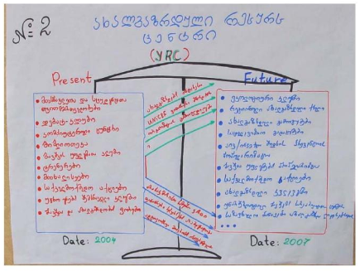
Tools for participatory research
#13 Force-field analysis
To analyse why a project has evolved as it has (evaluation function) or to plan the future of the project (planning function).
Analytical tool that promotes understanding for a given project not only that the changes from the past to the present but also why – what have been the positive factors, and what obstacles have had to be overcome.
To analyse:
  The past i.e. the situation at the beginning of the project
  The present state of the project
  Forces i.e. resources that helped create the present state and the constraints that influences this evolution
Sample questions:
  Evaluation: „How has the participation changed the participants you worked with?”
  Planning: „How could you increase the people’s interest to your LL?”
Source: UNICEF (2005) Useful Tools for Engaging Young People in Participatory Evaluation

Slide 39
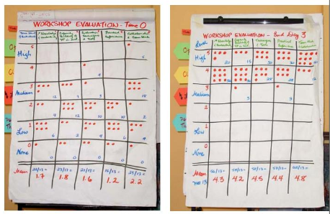
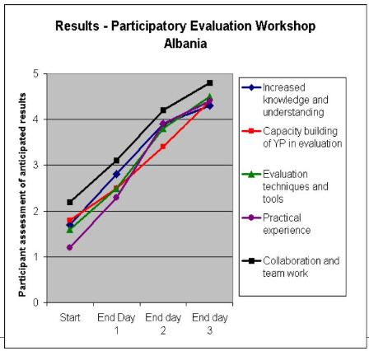
Tools for participatory research
#14 Quantitative evaluation
To track the participants’ assessment of the results defined for the workshop from the beginning to the end, and including mid-points as well.
Each person rates their own level of understanding at this moment with each respect to each of expected results.
Ratings should be done at time zero and at the end of the workshop (and also at mid-points e.g. after each day of the workshop).
Quick, quantitative, easy to analyse.
Subjective (self-evaluation).
Source: UNICEF (2005) Useful Tools for Engaging Young People in Participatory Evaluation

Slide 40
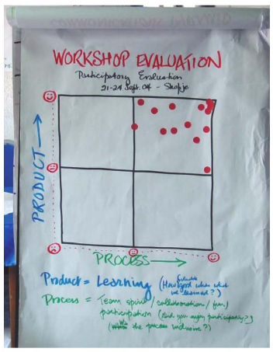
Tools for participatory research
#15 Process/ Product Evaluation
To provide a quick, visual assessment by the participants of the overall quality of a workshop/ course in terms of a product (learning) and process (team spirit, inclusiveness, transparency, fun, etc.).
Product = „How useful/valuable was what you learned?”
Process = „Did you enjoy the workshop? Was it inclusive?, Did it bulid team spirit?”
Fast and highly visual. The results provides a good synthesis on the group’s assessment of the workshop/course.
Source: UNICEF (2005) Useful Tools for Engaging Young People in Participatory Evaluation

Slide 41
Phase V: Monitoring & Evaluation
Survey
10 minutes

Slide 42
Phase V: Monitoring & Evaluation
Exercise in breakout rooms
30 minutes

Slide 43
Phase V: Monitoring & Evaluation
Exercise in breakout rooms
The breakout rooms will be for summarizing general feelings regarding the entire AESOP4FOOD course and preparing the ideas on the final presentation (each student team are asked to give an overview of the main elements of each phase and conclude with a reflection).
We will use a padlet for the discussion.

Slide 44
Phase V: Monitoring & Evaluation
Exercise in breakout rooms
I – The students address the folowing questions: (you can select 3 or 4 and share reflections)
  What did you like most about the AESOP4FOOD course?
  What did you like least about the AESOP4FOOD course?
  What will you take home?
  How do you think this course could have been improved?
  Did the teaching and learning method work for you?
  Did the content/course phases come together coherently throughout the seminar?
  Did the assignments serve the Living Lab activities well?
  What have you learned as a group in terms of addressing a sustainable food planning challenge?
  Mention one lesson learnt for each individual team member.
  What might be the most important next step or action for your Living Lab?
II – The tutor and students are filling the padlet
III – Open discussion
Time for the exercise: around 30 minutes

Slide 45
Padlet
1. Montpellier: https://padlet.com/anpodlasek/montpellier-2024-now-it-is-time-to-reflect-on-your-process-a-s6ocdko6b6nzfi78
2. Warsaw: https://padlet.com/anpodlasek/warsaw-2024-now-it-is-time-to-reflect-on-your-process-and-re-qu90g0yf4xhijm9h
3. Ghent: https://padlet.com/anpodlasek/ghent-2024-now-it-is-time-to-reflect-on-your-process-and-res-gyv71e5fhywvtwro
4. Madrid: https://padlet.com/anpodlasek/madrid-2024-now-it-is-time-to-reflect-on-your-process-and-re-1c2u82l6tc6hoi73
5. Bucharest: https://padlet.com/anpodlasek/bucharest-2024-now-it-is-time-to-reflect-on-your-process-and-jf4tkaye38o6vpkm
6. Tartu: https://padlet.com/anpodlasek/tartu-2024-now-it-is-time-to-reflect-on-your-process-and-res-l17giyn2sqr5cijt

Slide 46
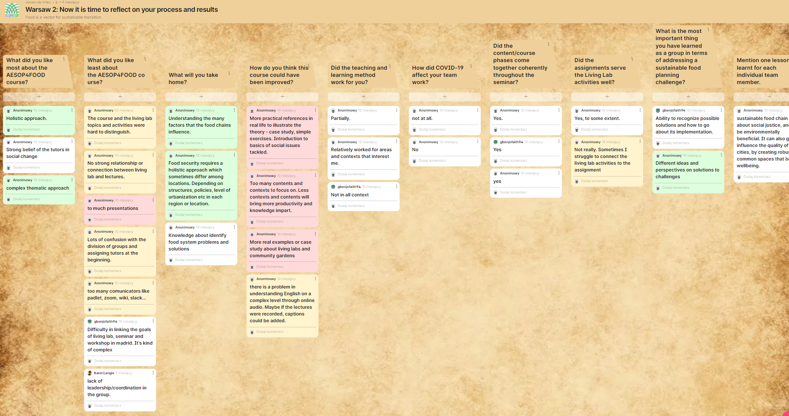
Phase V: Monitoring & Evaluation
Exercise in breakout rooms

Slide 47
Assignment: Monitoring & Evaluation
The final presentation should include:
evaluation and statements about the seminar, your Living Lab / case study, your team, yourself, and your future agenda,
reference to the questions addressed during the excercise in breakout rooms,
introduction of one lesson learnt for each individual team member.

